Slide 1

Software Safety
Type Airworthiness Desk Officers’ Foundation Course (TADOF)

Slide 2
Software Safety
Learning Outcome
To provide an understanding of:
The role of software in system safety
Software safety assessment, random and systematic failures
Developing safe software
The concepts of Safety Integrity Levels (SILs) and Design Assurance Levels (DALs)
The risks of using Commercial Off The Shelf (COTS) system software and Software of Unknown Pedigree (SOUP)
Cyber Security for Airworthiness

Slide 3
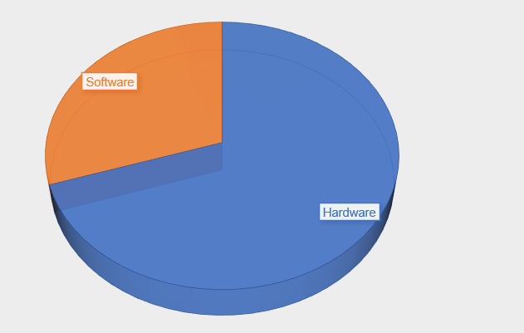
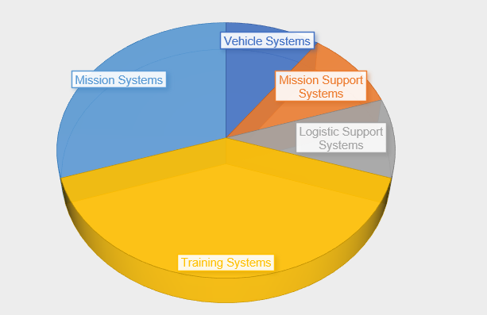
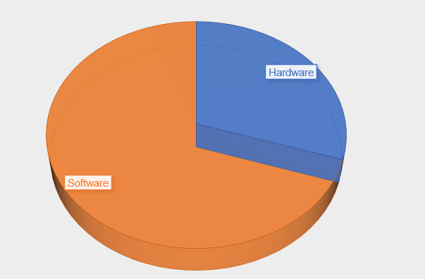
What is Software?
1970
“Intellectual creation comprising the programs, procedures, data, rules and any associated documentation pertaining to the operation of a data processing system.”
IEC 61508: 2010
“Programmable Element (PE): “Products, Services & Systems (PSS) that is implemented in software or programmable hardware, which includes any device that can be customised”
Def Stan 00-056 Issue 7
“Instructions given to hardware.”
Kev
2020
Notes:
Walk through definitions:
IEC 61508 has a very wide definition including documentation
DS 00-056 does not define software but rather uses the term “Programmable Element”. Customisation is important – it means that software is a very specialised, customisable component
Kev’s definition brings out the fact that software must work within a system – software itself is useless without the hardware.
Exemplify difficulty of software task by asking audience to direct you to Reception to highlight:
Need to understand the vocabulary used in the instruction – “walk”, “step”, “turn”, “left” etc
Need specific number of steps
Need a starting point - initialisation

Slide 4
Software Safety
Def Stan
00-970
A combination of associated computer instructions and computer data definitions required to enable the computer hardware to perform computational or control functions.
The White Book
Random/Pseudo-random Failures:
  Causes: Wear-out, corrosion.
  Time to failure: Unpredictable.
  Prediction: Failure statistics can predict occurrence rates across large populations.
Systematic Failures:
  Causes: Errors in specification, design.
  Dependence: Input conditions, transient operating conditions.
  Occurrence: Happen under the same conditions.
Software Failures:
  Nature: Not subject to random failures.
  Causes: Mistakes in specification, design, implementation, change control.
  Guarantee: No affordable system is completely free from systematic errors.
  Mitigation: Methods like auto-coding, semi-automated formal methods proving.
Notes:
Read off slide

Slide 5
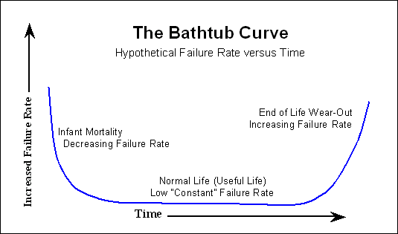
Random Failures
Notes:
Equipment used in systems by and large exhibit failures randomly. The Equipment manufacturers (if they are good) have robust in service reliability data which builds a prediction of how frequently a piece of equipment failures and understand of the items of components that make up that equipment, which of those components fail driving the overall equipment failure. The picture that is developed is one where the failures are random, they are based on use, environment, and the bigger the fleet of equipment operating the more accurate the prediction will be, but it is a prediction. A piece of equipment entering service could fail in the 1st hr or the 10,000 hr of its use. The prediction is based on the sample size and is calculated accordingly. Manufacturers minimise infant mortality by batch testing equipment coming off the production line and then from the in service data analysis will determine when a piece of equipment is into its wear out phase as the equipment will be seen to be failing more often.
You then have systematic failures

Slide 6






Systematic Failures
NOT RANDOM
Notes:
Systematic failures will happen every time the same set of inputs are present. It is therefore not random. If you have a set combination of events the outcome will always be the same. As such it can be said that the failure has been designed in.
Nothing needs to have failed necessarily but if in testing the behavior of the system has not been sufficiently explored it is possible that the way the system has been designed will in itself result in a feared event. This is why software itself is a good example of something that can result in a systematic failure.

Slide 7
Software Safety
Def Stan
00-970
There is not a single authoritative standard for Software Acquisition Management, and this is acknowledged in Def Stan 00-055 for Software Safety, which directs the use of existing open standards.
For Air Domain, typically:
RTCA DO178C Guidelines for Development of Civil Aircraft and Systems | RTCA DO254 Design Assurance Guidance for Airborne Electronic Hardware | ARP4754 Guidelines for Development of Civil Aircraft and Systems | ARP4761 Guidelines for Conducting Safety Assessment on Civil Airborne Systems
The White Book
SILs and DALs can give guidance on the degree of rigour required in design, development and testing – but they are not a ‘cure-all’ for systematic errors
IEC 61508
The probability of a safety-related system satisfactorily performing the required safety functions under all the stated conditions within a stated period of time.
DO 178
The Software Level, also known as the Design Assurance Level (DAL) or also Item Development Assurance Level (IDAL) is determined from the safety assessment process and hazard analysis by examining the effects of a failure condition in the system. The failure conditions are categorized by their effects on the aircraft, crew, and passengers.
Notes:
A combination of associated computer instructions and computer data definitions required to enable the computer hardware to perform computational or control functions.
Why is Software Different?
Systems can be affected by failures due to random or pseudo-random causes (such as wear-out or corrosion). Although the time to each such failure is not predictable, failure statistics can be used to predict the rate of occurrence across large populations of similar items. Systems can also be affected by systematic causes such as errors in specification or design. Such failures depend on input conditions to the system and on transient conditions in the operating domain and would occur whenever the same conditions apply. Software is not subject to random failure, but systematic failures can arise due to mistakes in specification, design implementation, change control etc. There can be no guarantees that any (affordable) system is completely free from systematic errors, although methods progress towards this goal (e.g. for software, auto-coding and semi-automated formal methods proving). As complexity of systems increases, we can expect to encounter more systematic errors.
Accordingly assessment needs to be made of system functionality and how software is going to then be able to have an impact on those functions and therefore we can through the assessment determine the level of development needed for the software development in order to assure the software to the appropriate levels of safety criticality where it is used.

Slide 8

Integrity/Assurance Levels
Catastrophic
Hazardous
Major
Minor
No Effect
Notes:
In assessing the safety criticality of a system and or its deployed functions Safety Integrity Levels or Development Assurance Levels can be assigned accordingly. The higher the risk involved the more software assurance activity is going to be needed.

Slide 9
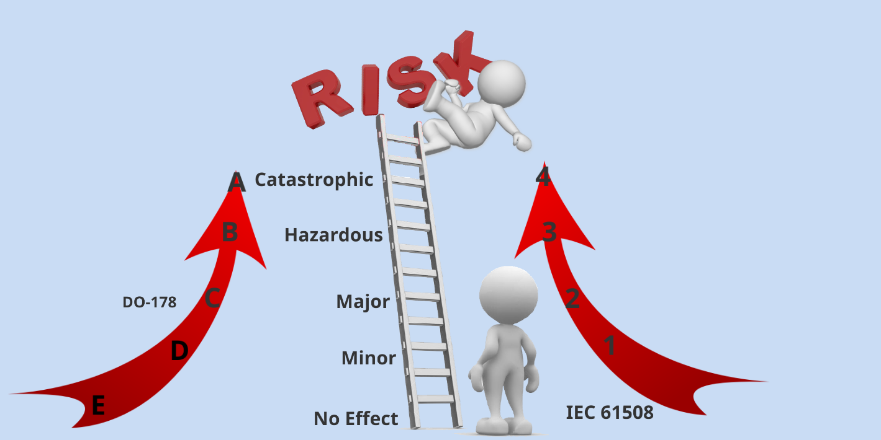
Integrity/Assurance Levels
Notes:
Similarly for SILs a 4 is assigned by IEC 61508 for the most critical case and 1 for the lowest critical case

Slide 10
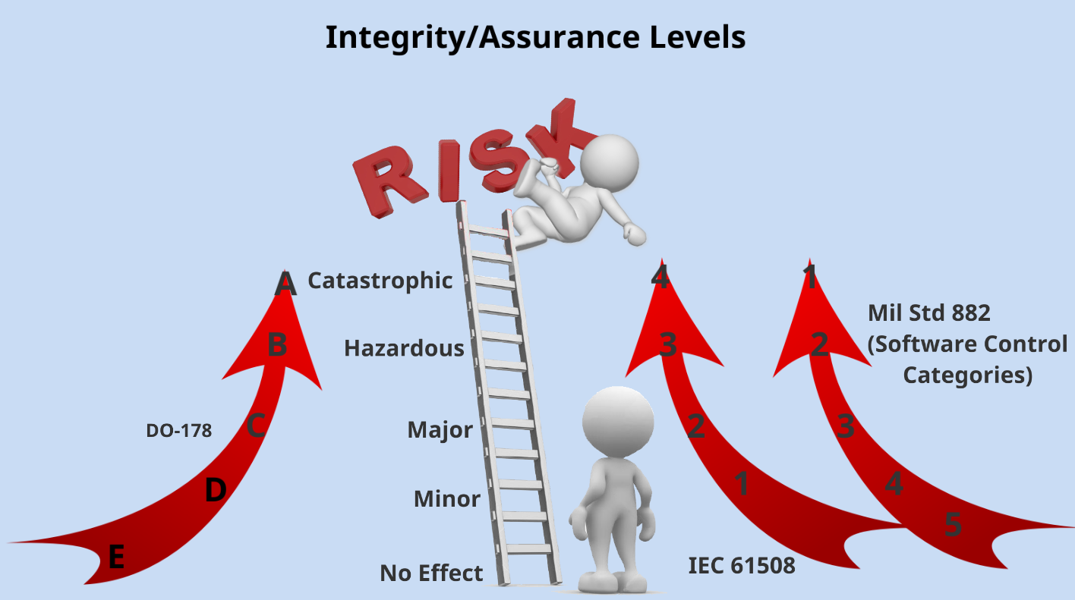
Integrity/Assurance Levels
Notes:
You then have MIL STD 882 that has a 1 to 5 structure, 1 being the most stringent assurance activity so aligned with the CAT case and 5 for the NSE.

Slide 11
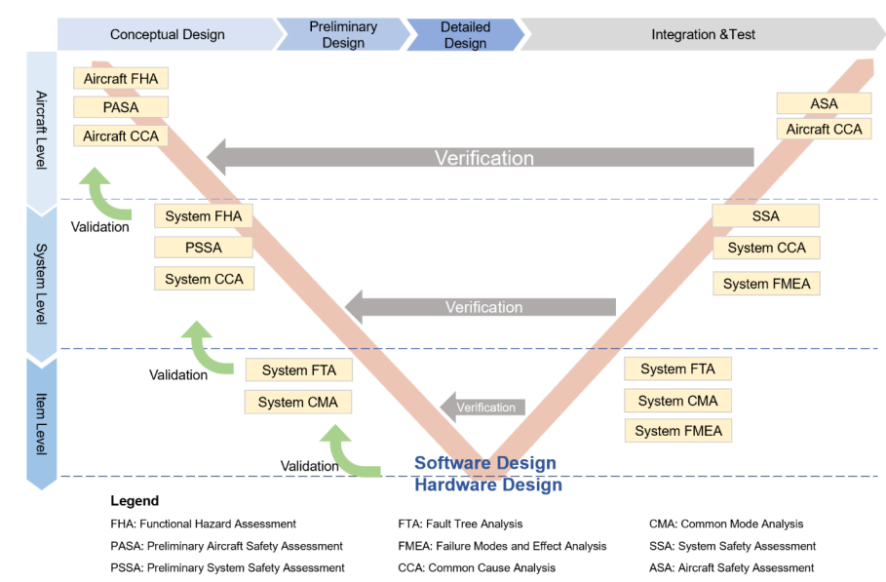
Developing Safe Software
Notes:
Presented here is the typical V and V cycle provided by ARP4754 and 4761. Following this process will permit the designer and or safety assessor to determine at aircraft and then at system level the functions and their safety effect. In understanding the safety effect of the functions not being provided or provided in an unusual way will allow a SIL or DAL etc to be identified against that function which will in turn then permit the associated assurance activities for the software to be used to perform the function to be identified and development started in creating the software. As such starting this activity early in the CADMID phase is going to give you the most time to determine effects, develop and test the software before its use in service.
Preliminary Hazard Analysis (PHA). PHA is an initial risk study in the early stage of a project. The PHA identifies top-level accident events, and gives rough estimates of severity.
Functional Hazard Analysis (FHA). The purpose of the FHA is to identify and classify the system functions and safety hazards and consequences associated with functional failure. The FHA identifies the relationships between functions and hazards, identifying the safety-significant functions of the system as well as the hazards associated with that functionality.
Software re-use via standards-based architectures are increasingly used as a cost-effective method of delivering capability. However, the benefits and risks of use/re-use (directly or modified) of existing software from any source (Commercial Off-The-Shelf COTS)) needs to be assessed as opposed to a bespoke development

Slide 12


Commercial Off The Shelf & Software of Unknown Pedigree
SOFTWARE OF UNKNOWN PEDIGREE
Notes:
Without the activities of software assurance being performed at all or to a defined standard will result in SOUP or software of unknown provenance. In this case the risk owner will have no idea to what capacity the software will have in being able to carry out its functions reliably and without systematic issues.

Slide 13
Cyber Security for Airworthiness
Regulation 1202(1)
Aviation Duty Holders (ADH) / Accountable Managers (Military Flying) (AM(MF)) and Senior Responsible Owners (SRO) shall ensure that cyber security threats to Air Safety and Airworthiness are identified, suitably mitigated, and managed through life, appropriate to the level required by the intended use of the Programmable Elements (PE).
Regulation 5890(1)
Type Airworthiness Authorities (TAA) shall ensure Air System Type Design and Changes / Repairs to Type Design are assessed for cyber threats, which once identified are suitably mitigated to combat the potential negative impact on CSA and Air Safety; this applies to all Air Systems on, or destined for, the UK Military Aircraft Register (MAR).
General
DATIN 69
Acceptable Means of Compliance for Cyber Security:
RTCA DO-326 (Airworthiness Process Security Specification).
RTCA DO-355 (Information Security Guidance for Continuing Airworthiness).
RTCA DO-356 (Airworthiness Security Methods & Considerations).
JSP 440 (Defence Manual of Security & Resilience).
AET SP4 - Air System Software Complex Hardware & Cyber Security
Notes:
CSA is the application of Cyber Security principles onto systems that have a direct or indirect interface to Safety Related Systems
Security measures are provided in DO 326 that talks about security, development and assurance requirements.
DO 356 provides guidance on how to apply security measures and DO 355 focuses on the information security of the aircraft and its interfaces during operation.
AET SP4 provides templates and guidance in developing plans for security aspects of Certification and security risk assessments
DATIN 69 acknowledges that all Air Systems on the Military Register are required to carry out a Cyber Security for Airworthiness. DATIN 69 identifies Secure by Design launched in 2023 which applies immediately to new platforms and then varies for platforms at different stages of CADMID

Slide 14
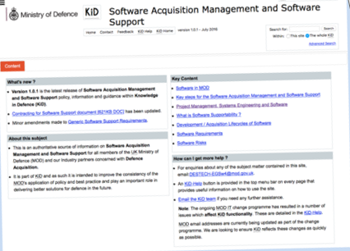
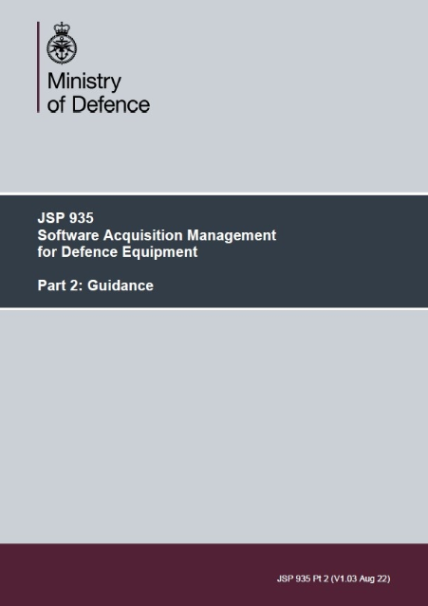

Help and Support
HEA Air

Slide 15
Any Questions?

