Slide 1

Safety and Environmental Management
Type Airworthiness Desk Officers’ Foundation Course

Slide 2
Safety and Environmental Management
What this will do for you
To provide an understanding of:
What Safety is
The Equipment Contribution
The source of S&E policy in the MOD
What an SMS is
The Safety Case & Safety Assessment
Hazard Logs
The Safety Managers Toolkit

Slide 3
So….What is Safety?

Slide 4
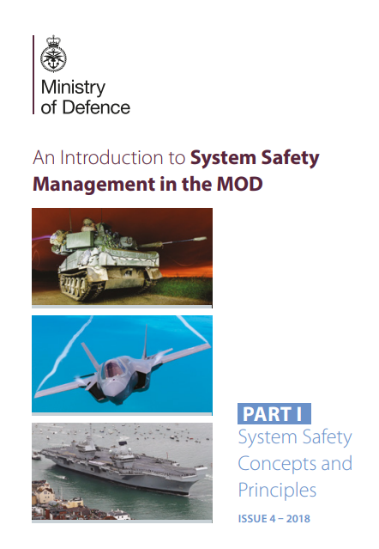
What is Safety?
MAA-02
The freedom from unacceptable risk of personal harm.
Perfect safety is rare, so risks must be recognised, understood & controlled
The White Book Key Messages
Everyone has a part to play in safety management
People should be only exposed to safety risks if a benefit is expected and risks are adequately controlled
Safety Management allows you to do safely what you want to do; it is not about avoiding something just in case its harmful
Notes:
Some statements about safety

Slide 5
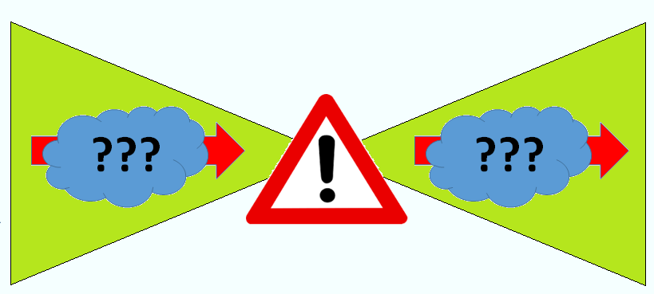


What are the elements of Safety?
The combination of the severity of the accident and the likelihood of the accident occurring​
Risk
Accidents
Hazards
Causes
???
???
The point in time when a person has sustained an injury
Cause
Accident Sequence
The Potential to cause harm
A risk can not be assessed or managed without a Credible Accident Sequence from the initiating event (the cause) through to the eventual safe or unsafe outcome (the accident)​
Initiating events that could lead to a hazard occurring
Notes:
The elements of safety – Talk through the slide

Slide 6
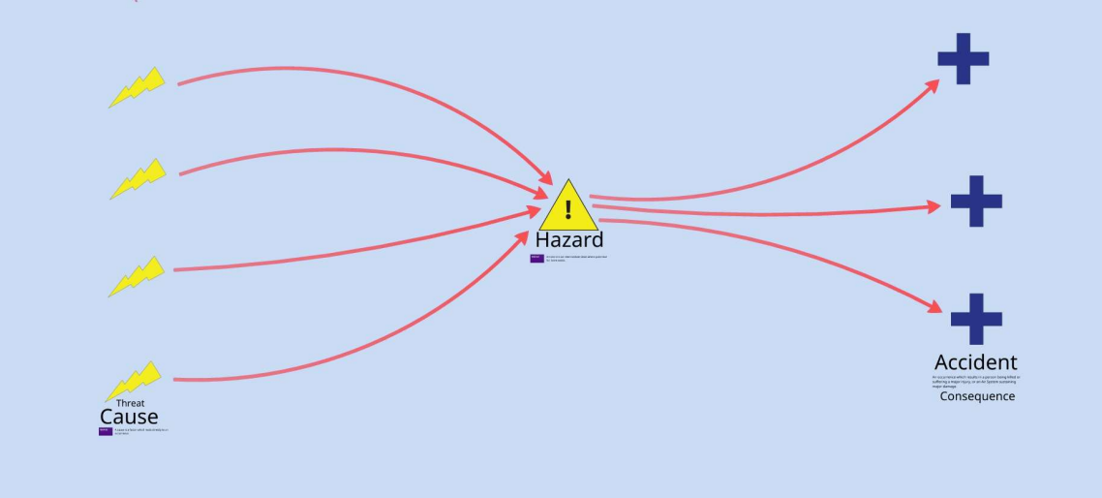
The Accident Sequence
Notes:
Talk through the slide

Slide 7
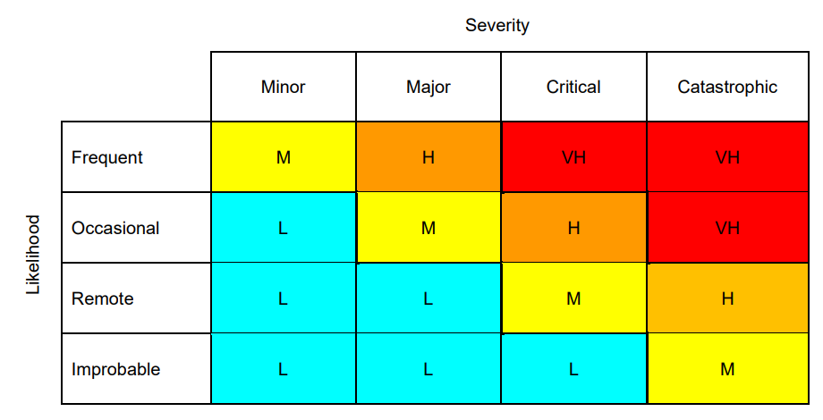
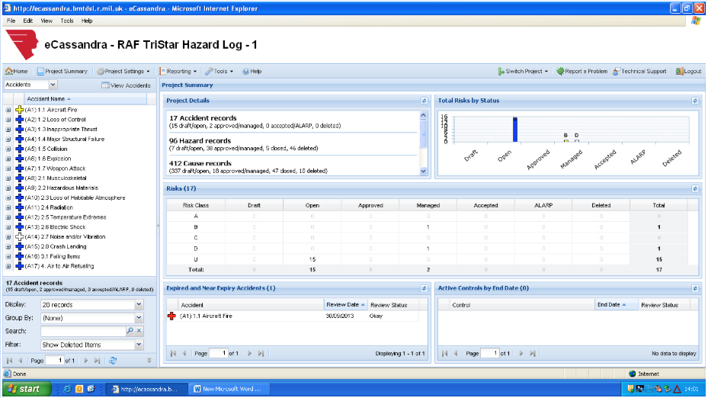
The General Hazard and Risk Assessment Process
Identify the Hazard
Identify Causes
Hazard Log
Assess available controls
Assess Credible Accident
Update Risk – Freq x Severity
Consider further Mitigation / Controls to improve Frequency and / Severity
Notes:
Talk through the slide

Slide 8
Why do Risk Assessment?
By measuring Risk by its severity and likelihood, Risk can be classified
Unacceptable, tolerable, acceptable
Suggest if a change is to be made
Suggest if further study is required
Allows risks to be compared with each other
This “Risk Classification” can then be ranked in order to prioritise where most effort (e.g. resources, funding) should be used to reduce the identified risks.
Unacceptable / Intolerable
Risk Tolerability
Tolerable
Risk is undertaken only if the benefit is desirable
Broadly Acceptable Region
Notes:
Ask the title question to students. Answers as per slide.

Slide 9
Risk Continuum
UNACCEPTABLE
Probability
Increasing Risk
Broadly Acceptable
May be Tolerable if ALARP
Harm
Notes:
Discuss the slide

Slide 10
OK for Commodity DTs but what about Airworthiness?
Regulatory Article 1210
Annex A
Who Owns the Risk?
Notes:
So this is the Defence Aviation HRM captured in RA1210 Annex A and enables Risk Classification according to each Single Risks assessed severity and likelihood. It is designed to assist with assessing the hazards and to determine appropriate levels of ADH risk ownership. At ECtRtL level it is used to assess and inform the probability of Equipment Threats and in so doing the impact of these on the Equipment Functional Threats in a way that is shared between the DT and the ADH.

Slide 11
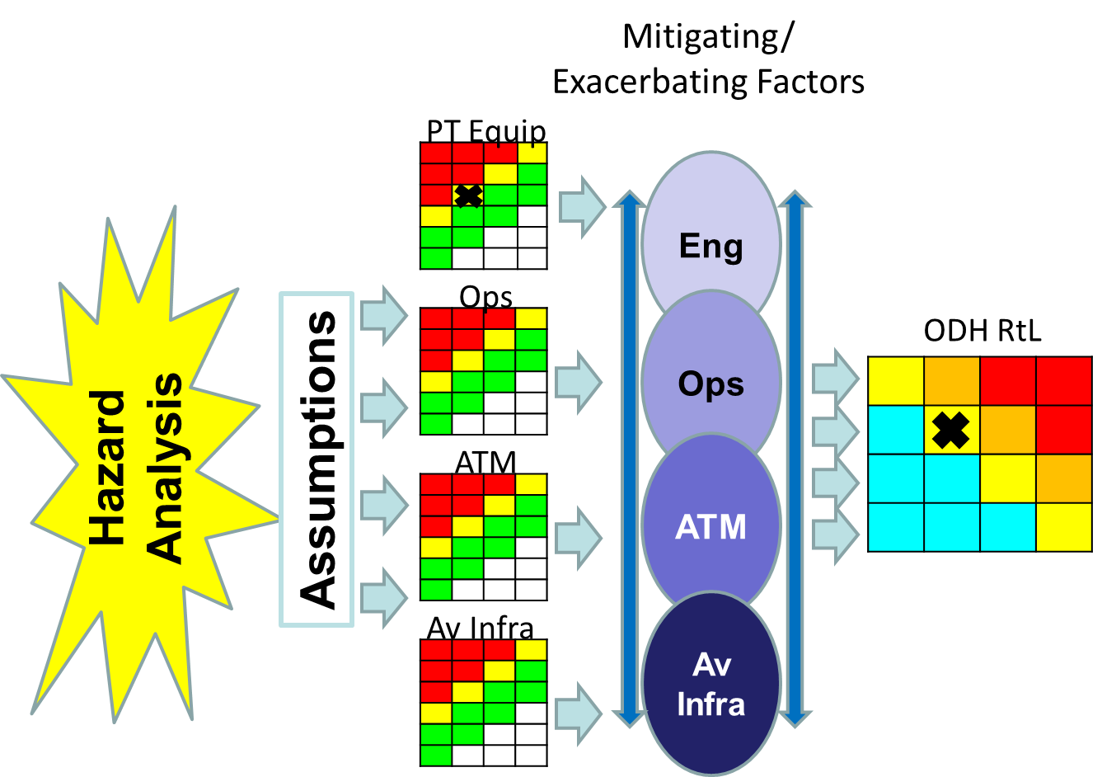
Who Owns and Conducts the Risk Assessment?
ADH owns the RtL
Therefore, it is incumbent on the ADH to assess and classify the Risk
DT Equip
Notes:
So as stated the ADH owns the RTL but the assessment of that Risk is informed by assessments done by the contributing elements to the Air System Safety Case.

Slide 12
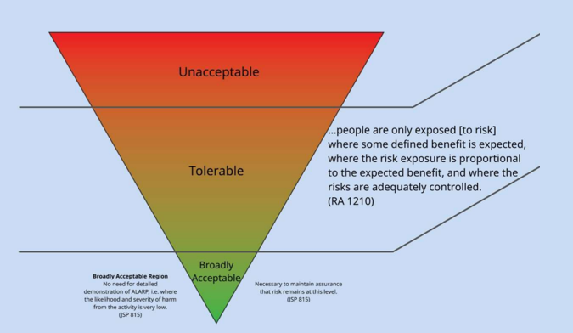
ALARP & Tolerable
Regulation 1210(2)
ADHs / AM(MF)s shall ensure that RtL that they hold are both ALARP and Tolerable.
A Risk can be said to be reduced to a level that is ALARP when the sacrifice is “grossly disproportionate” to the decrease in Risk that would be achieved.
Notes:
Do we understand the difference between tolerability and acceptability terms that have been used in previous sessions.
Quote the definitions and safety context.
Def Stan 00-056 states that Tolerable in the context of risk is “A level of risk between broadly acceptable and unacceptable that may be tolerated when it has been demonstrated to be ALARP. Unacceptable A level of risk that is tolerated only under exceptional circumstances”
Def Stan 00-056 states Broadly Acceptable as “A level of risk that is sufficiently low that it may be tolerated without the need to demonstrate that the risk is ALARP”
With the assessment of contributions to their Risk picture the ADH will need to assess whether the risk as has been reduced to a level that can be argued to be Tolerable and ALARP. The TAA will need to inform this assessment through provision of the Equipment Contribution Log and Equipment Contribution Interface Documents which present the equipment threat picture to the ADH.

Slide 13
How do Aviation DTs fit in?
ADH owns the Rtl and assesses the Risk
TAA supports this by defining and quantifying the Equipment Contribution to the RtL
ASPIRE Process 17 developed to assist this approach.
ID FT from HAZID/FHA
ID Equipment Threats
Illustrate impact on ADH Bowtie
ID Barriers & Escalation Factors
Tell ADH
Notes:
Contributing to the ECL and ECID are the assessments that the TAA has performed that supports the ADH Risk Assessment. These assessments define and quantify the Equipment Contribution to the RtL
Identify Functional Threats from the Equipment (HAZID – FHA)
Identify Equipment Threats that impact the Functional Threats
Illustrate how the equipment impacts ADH risks (BowTie)
Identify Barriers associated with the Equipment
Identify escalation factors that could affect the barriers (HAZID – ZHA)
Assess effectiveness of the Barriers
Communicate Equipment Contribution analysis to the ADH

Slide 14
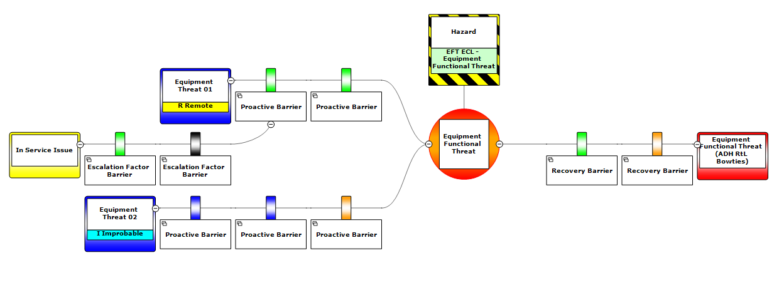
Two Approaches
For Type Airworthiness Assessment and management of Safety Risk the Equipment Contribution Log which utilises Bow Tie methodology
For the purposes of assessing and managing commodity equipment the risk is identified and managed through a Hazard Log approach where tools like eCassandra are used
Notes:
For Airworthiness Assessment the approach is to perform an Equipment Contribution to Risk to Life and in so doing an Equipment Contribution Log is developed or ECL seen here on the Left Hand Side using BowTie XP which is available to DTs and the ADH on MODNet.
For Commodities the development and maintenance of a Hazard Log is still pursued using tools such as eCassandra or EXCEL .

Slide 15
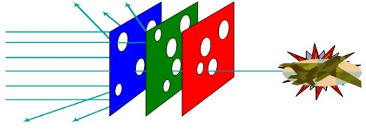
Assessment of the Equipment Contribution
Barrier
Barrier
Notes:
DTs as part of the ECtRtL activity identify and assess the strength of barriers that work to mitigate the cause from resulting in a Hazard or to mitigate the hazard from becoming an Accident or Consequence.
By assessing the strength of the barriers the DT can determine the ECtRtL which contributes to the ADH’s determination of their overall risk to life and whether sufficient barriers exist. In so doing the risk can be managed accordingly through changes to the equipment contribution within the DTs area of influence working with the DO and OEM and changes in the way the air system is operated and maintained until a ALARP and Tolerable position is considered achieved by the ADH.
DTs as part of the ECtRtL activity identify and assess the strength of barriers that work to mitigate the cause from resulting in a Hazard or to mitigate the hazard from becoming an Accident or Consequence.
By assessing the strength of the barriers the DT can determine the ECtRtL which contributes to the ADH’s determination of their overall risk to life and whether sufficient barriers exist. In so doing the risk can be managed accordingly through changes to the equipment contribution within the DTs area of influence working with the DO and OEM and changes in the way the air system is operated and maintained until a ALARP and Tolerable position is considered achieved by the ADH.

Slide 16
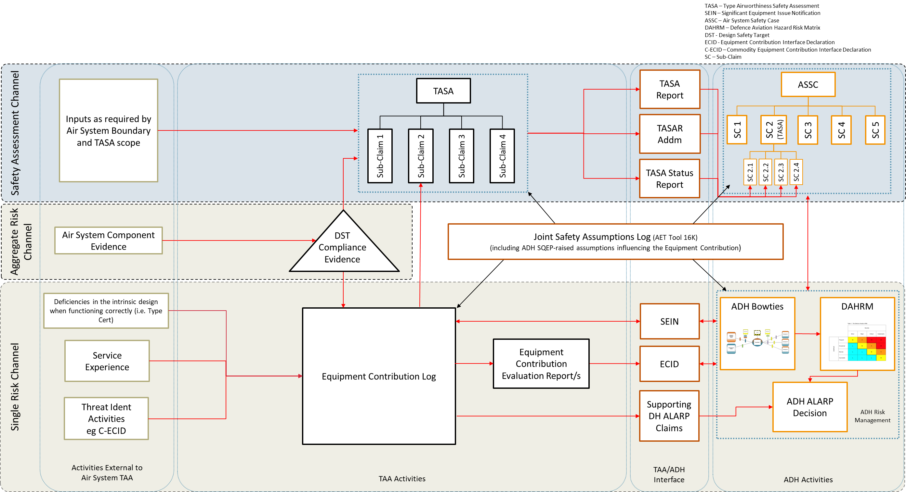
ASPIRE – Joint Operating Model for the Equipment Contribution to Air System Safety
AET Tool 16.E
Notes:
Referring to the ASPIRE Joint Operating model you can see here the Equipment Contribution Log driving the Equipment Contribution Evaluation Reports or ECER and then this feeding the ECID. The ECID feeds the ADH Bowties and ADH Alarp Decisions ultimately.

Slide 17
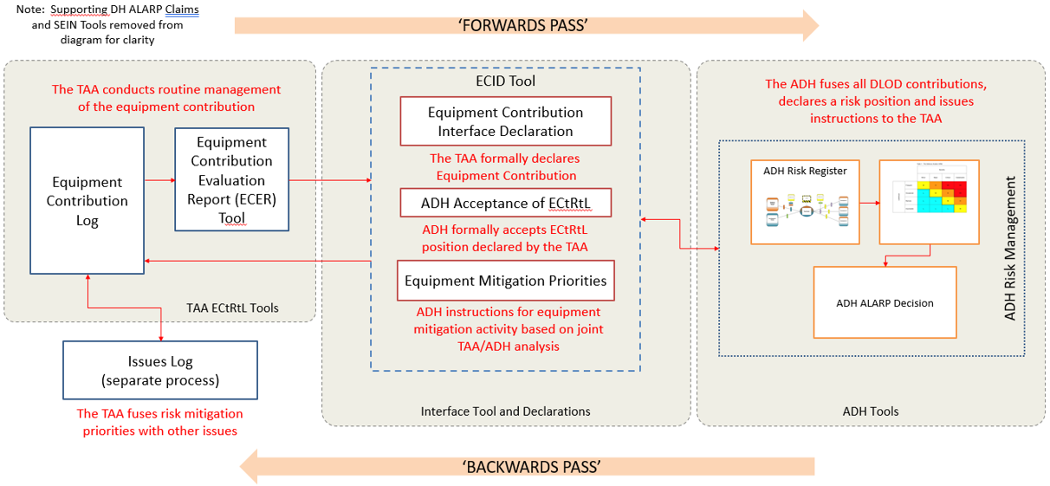
Reporting of ECtRtL
AET Tool 17.B
Notes:
This is a bit more of a zoom on the process of ECtRtL (Take people through the slide) including the backwards pass acceptance or other wise of the assessment by the ADH

Slide 18
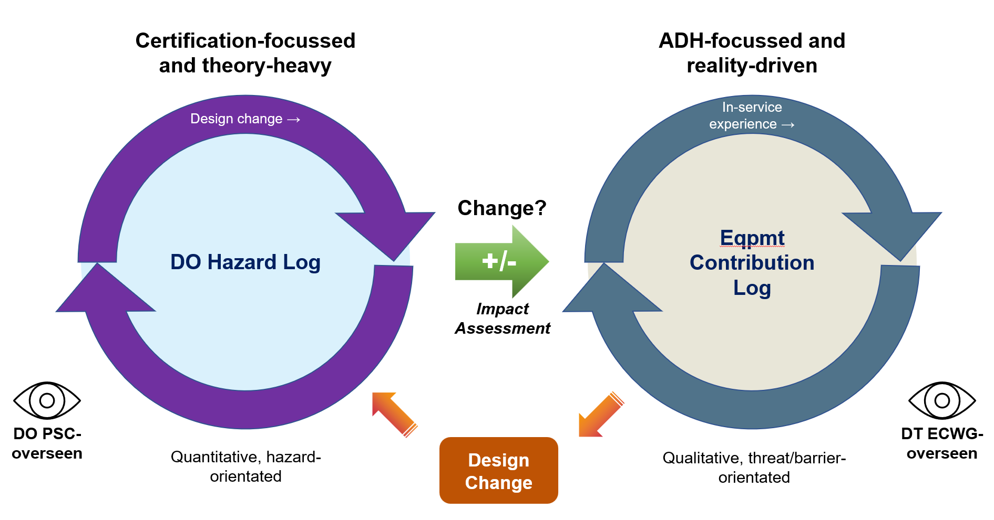
Acceptance of DO/TCH Responsibilities
AET Tool 17.B
Notes:
As part of the ECtRtL assessment activity needed to be performed through life, the DT need to work with the Design Organization / Coordinating Design Organization or OEM to initially establish the ECtRtL and then manage it through life in view of design changes either identified as required by the DO or requested by the DH or TAA.
The DO activity is certification focussed, will utilise assessments such as Functional Hazard Analysis and System Safety Analyses (including Fault Tree Analyses) to allow them to meet regulatory compliance to EASA and or FAA requirements. The data developed is assessed and translated into the Equipment Contribution which is an ADH Focussed, more qualitative, threat/barrier orientated approach all be it built on the more quantitative DO assessment.

Slide 19
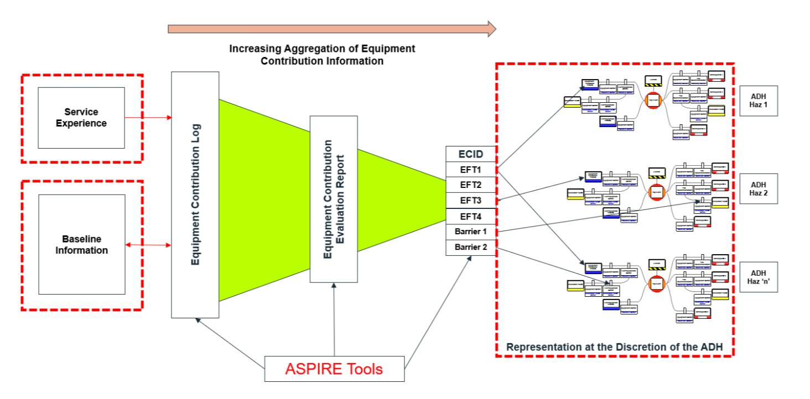
ECtRtL
AET Tool 17.B
Notes:
We can see on this diagram the Duty Holder BowTies on the right hand side interfacing in the middle with the DTs ECID which will within it identify the different Equipment Functional Threats. The EFT assessments are presented to the left of this centre point, captured in the Equipment Contribution Log with each one articulated in an ECER although these are not mandated as the ECL itself can hold all the information that can also be captured in the ECER. The AET 0E can be used to mitigate the ECER need.
To the far left is the baseline information coming in from DO/CDO/OEM and in service experience (DASORS etc)

Slide 20
ASPIRE – Joint Operating Model for the Equipment Contribution to Air System Safety
AET Tool 16.E
Notes:
Here we can see these inputs in the Joint Operating Model

Slide 21
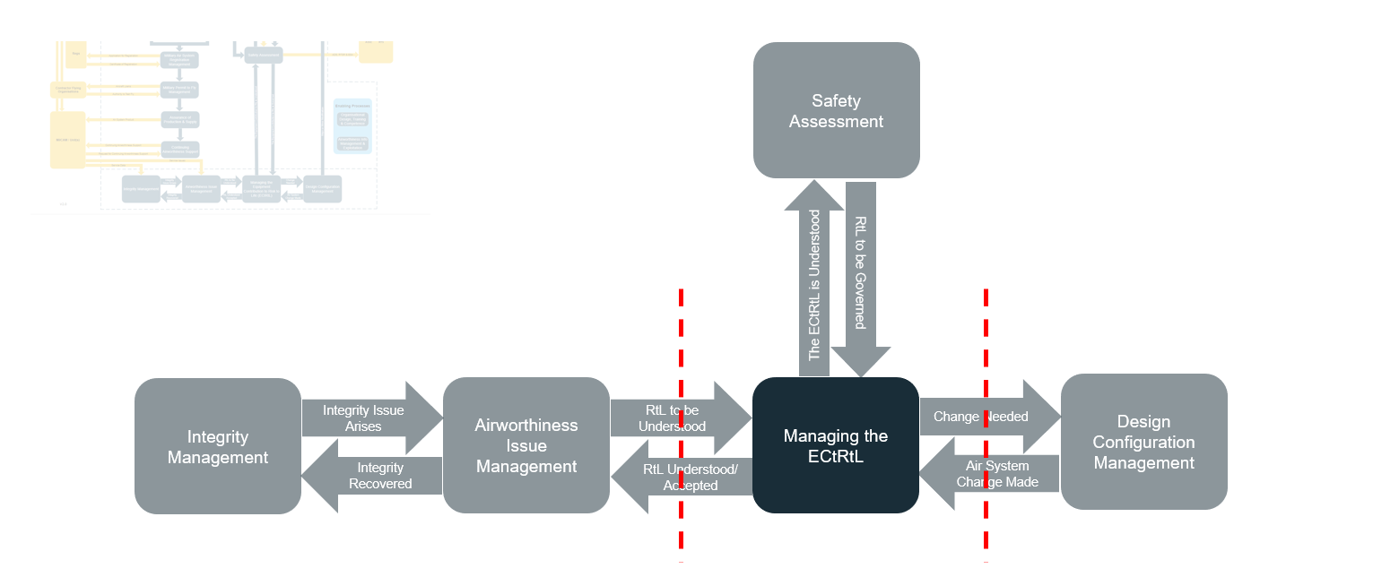
AET Process 17 – Level 0
Notes:
This shows the exciters to the ECtRtL management activity with
a requirement for the RtL to be governed coming from the TASA,
Feedback from the RtL process that the ECtRtL is being managed and understood
Issues from in service being fed in from Integrity Management and Airworthiness issued management activities
The management of design configuration driven from TAA, DH or the DO

Slide 22
Defining ECtRtL
This model focusses on an accident sequence with the centre of the Bow Tie representing an ADH managed hazard.
Escalation Factor
Escalation Factor
Hazard
Consequence 1
Equipment Functional Threats
Top Event
Consequence 2
Non-Equipment Threats
Consequence 3
EQUIPMENT
CONTRIBUTION
TO ADH RtL
MODEL
Equipment Functional Threats (LHS of bow tie only) | Non-Equipment Functional Threats (ADH bow tie only) | Proactive Equipment Barrier | Proactive Non-Equipment Barrier (TAA Advice) | Equipment Recovery Barrier | Non-Equipment Recovery Barrier (TAA Advice)
Notes:
Talk through the slide build up
So we have the Hazard and its partnered Top Event
Left of ark we then need to consider what Equipment Functional Threats can contribute to the Top Event this could be something like A Loss of Flying Controls
The Duty Hoder then needs to have to think of any Non Equipment Threats which could be an Environmental Condition perhaps such as Ice Build or some human element
On the Right had side then then have the Duty Holders assessed Consequences which could be CFIT or UFIT etc
We can then consider barriers that we know to exist that are going to have the ability to prevent or disrupt the EFT in resulting in the Top Event. These equipment barriers have the ability to mitigate both EFT and NETs depending on what they are. Similarly NET barriers can mitigate EFTs also.
We then have equipment recovery barriers that mitigate Top Event from realising consequences as well as non equipment recovery barriers also.
For any barrier there can be escalation factors which could be in response to an in service issue where by the barrier identified has been undermined by failures, or an incident that has shown it to be less effective than previously assessed.
Equipment Barrier – Could Be Radalt,
NET Barrier - Damage Tolerance is a NET Barrier, bonding
Equipment Recovery – Air Crew emergency operating procedures, Ejection System
NE Recovery Barriers Notams, ATC

Slide 23
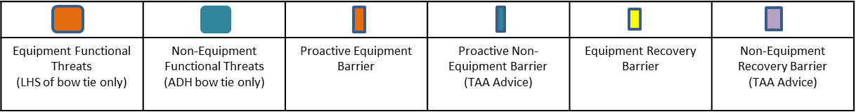
ASPIRE – DT Focus
Loss Model
This model focusses on an accident sequence with the centre of the Bow Tie representing an ADH managed hazard.
Escalation Factor
Escalation Factor
Equipment Threats
Hazard
Consequence 1
DO SSA
Equipment Functional Threats
Equipment Threats
Top Event
Consequence 2
In-Service Experience
Non-Equipment Threats
Consequence 3
EQUIPMENT
CONTRIBUTION
TO ADH RtL
MODEL
Notes:
The DT is going to be involved in supporting the DH manage this risk picture for the equipment contribution elements. The main focus though is the integration of Loss Modelling, DO SSA and IN Service experience that informs the Equipment Functional Threats

Slide 24
ASPIRE – Barrier Theory
Notes:
Here is an example of an ECL with the functional Threat identified in the middle along with the Hazard sat above. The ADH bowtie is to the right with the TAA focus on the left where Equipment Threats are identified for their contribution to realising the Equipment Functional Threat. For each Equipment Threat we can see that a variety of proactive or preventative barriers are identified along with an indication of their assessed strength. Also shown here is an in service issue or escalation factor feeding into one of the barriers and identified barriers that are considered able to mitigate the escalation factor, hopefully to its removal once the barriers have been realised.
Can illustrate who has responsibility for mitigation measures.

Slide 25
ASPIRE – Assurance Barrier Taxonomy
Provides analysis of assurance of key factors that support the type airworthiness.
Design
Process, Materials, Architecture, Installation, Performance, Alerts
Maintenance Schedule
Inspections, Checks, Lifing, Line Maintenance
Limitations
RTS
Aircrew Publication Information
Aircrew Manual, FRCs, ODM
Technical Information
Maintenance Manual, Mod Instructions, Orders, IPC, SOIU
Operating Procedure Recommendations
Training Recommendations
Notes:
There are two types of barriers in Process 17
Barriers providing assurance against Equipment Threats
Equipment Barriers that prevent/mitigate progression along the threat line
The examples in this slide are Equipment barriers
Any measure taken that acts against a Threat or Top Event becoming a consequence
Typically applied to the ADH BowTie but recorded in the TAA EC Log as they are provided as part of the equipment.
Examples include:
RadAlt
Ice Protection
Collision Warning System
Ejection Systems
Wirecutters (Helicopters)

Slide 26
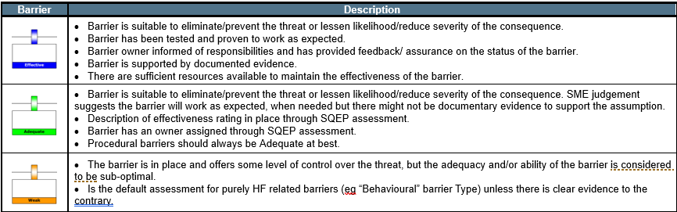
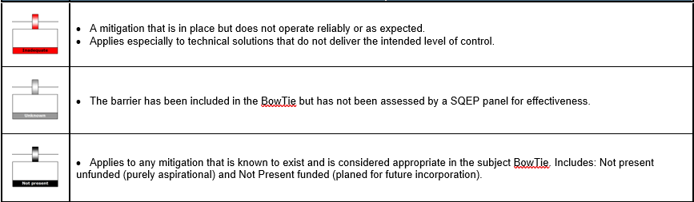
ASPIRE – Barrier Effectiveness Taxonomy
ASPIRE Tool 17.C
Notes:
For each barrier identified there is then a set of assessment criteria that permit the strength of the barrier to be assessed and set by the assessor and subsequent SQEP reviewers.

Slide 27
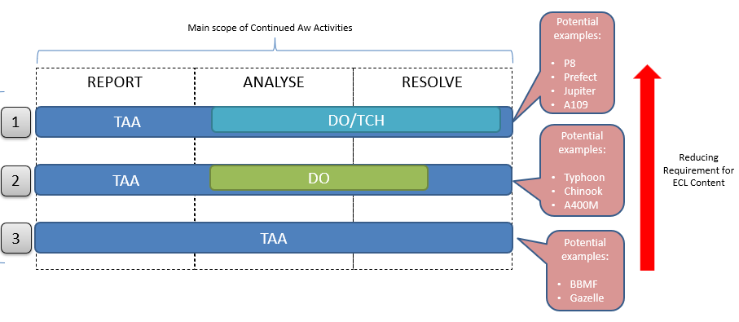
Scope of Equipment Contribution Log
AET Tool 17.B
Notes:
As the ECL has become increasingly established it has become clear that for some platforms more input has been required to be included. These platforms are those older platforms where the original certification evidence is available or less able to provide a foundation on which the ECL can rely. The table above provides a view on some platforms and how this translates to the activity of the TAA, DO/TCH to manage activities through life.
The older the platforms the more data is going to have to be included in the ECL essentially

Slide 28
Safety ….To what Policy ?

Slide 29
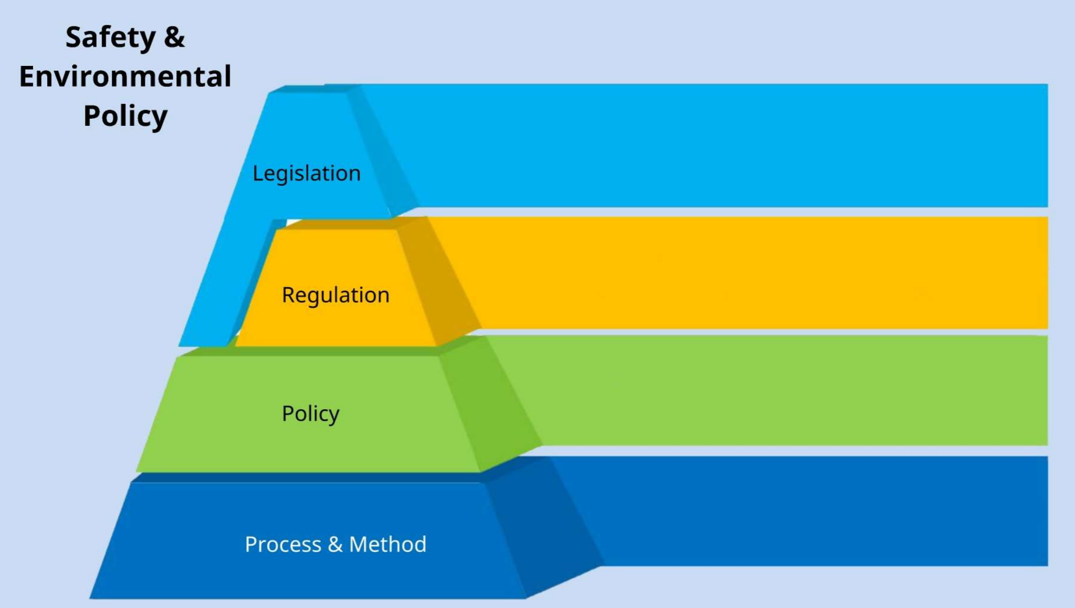



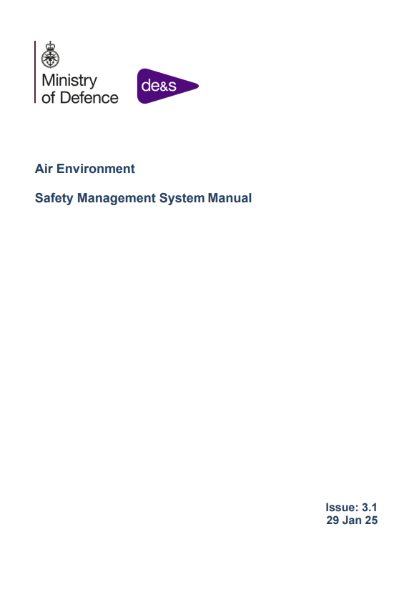

AE SMS
Notes:
Talk through the slide as it develops

Slide 30
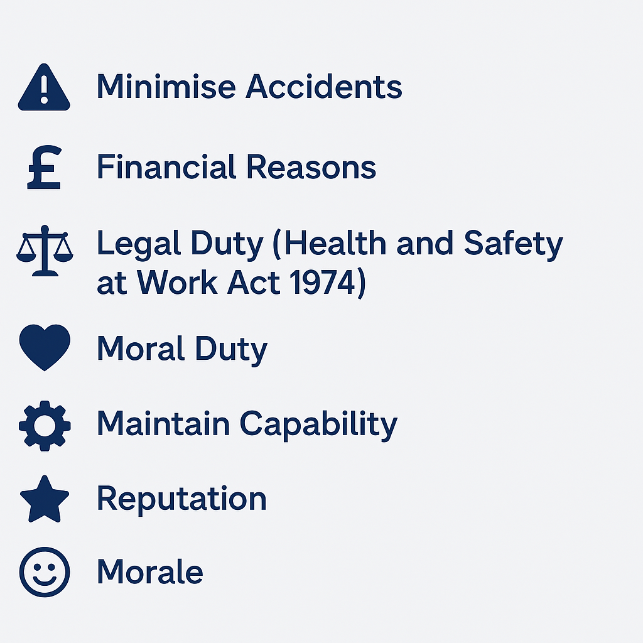
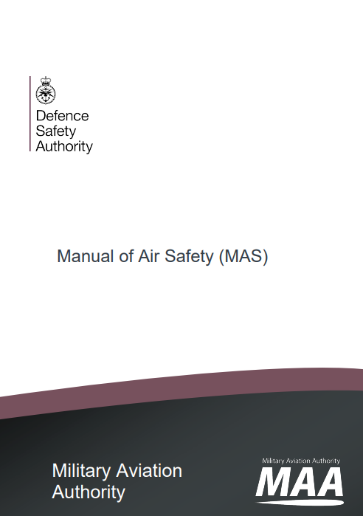
Why Manage Safety?
Notes:
To minimise accidents
Financial Reasons
Legal Duty – The Health and Safety at Work Act 1974 requires employers to ensure, so far as is reasonably practicable, the health safety and welfare of employees working on their behalf.
Moral Duty – What employer would want to see an employee injured or becoming ill because of the work they were undertaking on the employer’s behalf?
Maintain capability
Reputation
Morale

Slide 31
Who is Responsible for Safety?
Everyone (HSWA)
Not just the Safety Manager, Team Leader, Duty Holder
But certain Organizations act as Safety Focal Points:
Health and Safety Executive (HSE), European Aviation Safety Agency (EASA)
Legal and Regulatory Requirements
Defence Safety Authority (DSA)
Military Aviation Authority (MAA)
Safety Policy and Regulations
Head Engineering Authority (Air) – HEA (Air)
Quality, Safety, Environmental & Engineering
Notes:
Read off the slide

Slide 32
When Do We Manage Safety?
Concept
Assessment
Demonstration
Manufacture
In-Service
Disposal
Safety Requirements
Design in redundancy/protective features
Periodic Review
Remember Handling during Disposal
Modification
Notes:
Talk through the slide

Slide 33
What is a Safety Management System?
Master Glossary
MAA 02
The organizational Structure, processes, procedures and methodologies that enable the direction and control of the activities necessary to meet Safety requirements and Safety policy objectives. (Sourced from: Defence Standard 00-056)
Rationale
RA1200
An effective Air Safety Management System (ASMS), in conjunction with an Air System Safety Case (ASSC), will ensure that RtL is mitigated to As Low As Reasonably Practicable (ALARP) and Tolerable. The ASMS comprises the entirety of all documented and undocumented processes, procedures, tools and methodologies that exist to manage Air Safety. It is underpinned by Leadership, Assurance, and an Engaged Air Safety Culture.
Rational
RA5011
Type Airworthiness (TAw) organizations have specific Safety Management System (SMS) requirements which must interface effectively with other adjoining ASMS.
An ineffective TAw SMS is likely to compromise TAw
Notes:
Read off the slide
An ineffective Taw SMS is likely to compromise TAw….ask why…looking for issues around activities being reactive, non systematic, difficult to audit, derive robust requirements and show how the different SMSs are interacting and therefore difficult to have confidence that the activities performed will have achieved the required levels of safety, or prove that these have been achieved.
Post discussion you can state RA 5011 Rational - A comprehensive Air Safety Management System (ASMS) is necessary to deliver a systematic, pro-active and auditable approach to Air Safety and enable the delivery of effective operational capability. Type Airworthiness (TAw) organizations have specific Safety Management System (SMS) requirements which must interface effectively with other adjoining ASMS. An ineffective TAw SMS is likely to compromise TAw. This RA sets out the specific requirements for a TAw SMS to include all activity and decision making key to managing TAw and Hazards in support of the Air System Safety Case (ASSC).

Slide 34
Interfacing SMS’s in Air
All ADHs, AM(MF), HoEs and ADH Facing Organizations directly or indirectly involved in Defence Aviation shall establish, maintain an effective ASMS. TAw SMS has focus on TAw. [RA1200-RA5011]
ASMS
Air Safety Management System (ASMS):
“An SMS specific to aviation, including activities such as the operation, control and Maintenance of Aircraft, Air Systems and pan-DLoD and address a combination of the physical components, procedures, controls and human resources organized to deliver safety within an organization”. [MAS]
TAw SMS
Commodity DT SMS
Type Airworthiness SMS (TAw SMS):
“The TAA and / or TAM should develop, own and manage an SMS, which is described in a Safety Management Plan (SMP) detailing how the TAw Strategy is enacted.” [RA 5011]
Commodity DT SMS:
“The organization providing the equipment is required to operate a SMS which specifically supports the TASA and/or ASSC and which interfaces with adjoining ASMS.” [RA5013]
Notes:
There are 3 levels of SMS operating in Air
The ASMS established by the DH, the Taw SMS established by the TAA and or TAM and then you have the SMS Commodity SMS which support the TAA and or ASSC

Slide 35
The 4 Key Pillars of ASMS
Acceptable Means of Compliance 1200(1)
ASMS
Safety Policy & Objectives
Safety Risk Management
Safety Assurance
Safety Promotion
Engaged Air Safety Culture
Notes:
An ASMS should be proportional to the size, complexity and activities of the organization and consider the Hazards and associated Risks. It should comprise the 4 key pillars:
a. Safety Policy and Objectives.
b. Safety Risk Management.
c. Safety Assurance.
d. Safety Promotion.

Slide 36
Structure of ASMS
Safety Policy & Objectives
Act
Plan
Continuous
Improvement
Loop
Safety Promotion
Safety Risk Management
Study
Do
Safety Assurance
Notes:
STRUCTURE OF THE ASMS
The fundamentals of the SMS are largely consistent regardless of which activity, industry or organization they are applied to.
RA 1200 has adopted the 4 top-level ICAO SMS Framework components with some additional facets, appropriate to and required of Defence Aviation added at the sub-component ‘element’ level.
Thus, the RA 1200 requirement can now be matched directly to the ‘Deming Cycle’ Continuous Improvement Loop.
The MAA expand on this model by introducing the 16 Auditable Facets that break the four pillars into smaller component parts to enable performance measurement and SMS evaluation.

Slide 37
Safety …. How is it managed?

Slide 38
Plan

Slide 39
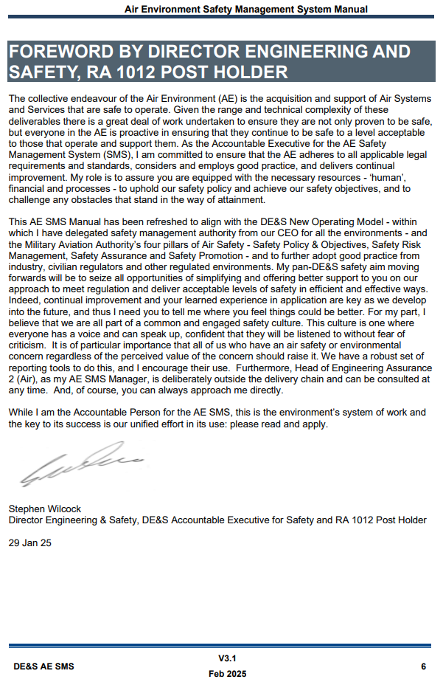
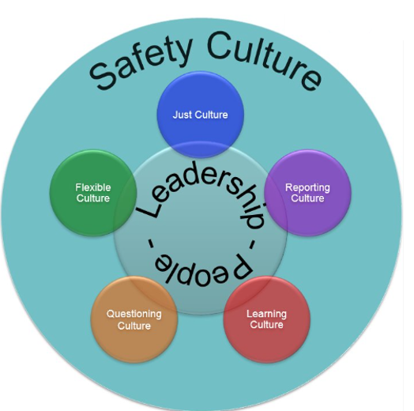

Safety Policy & Objectives
A1 – Leadership Commitment & Responsibilities
A2 – Engaged Air Safety Culture
A3 – Air Safety Priority, Objectives & Targets
A4 – Organization, Key Personnel & Air Safety Competencies
Trained
Experienced
Professional Registration
SQEP
=
Notes:
A1 - Leadership Commitment, Accountabilities and Responsibilities
Concise and unambiguous statements are required to highlight the leadership commitment, Accountability and Responsibility for Air Safety, including the importance and significance of the role the ASMS can play in maintaining and enhancing output or operational capability. ADH, AM(MF), Accountable Managers (AM) 7 or Heads of ADH-Facing Organizations can demonstrate endorsement of their Safety Policy by means of prominent and current Safety statements that highlight the importance of Air Safety and the priority it is to be afforded. A clear commitment to promoting and developing an Engaged Air Safety Culture is a crucial element, whilst the undertaking to adequately resource Air Safety, including the appropriate training and empowerment of personnel with Air Safety roles and responsibilities, will provide a demonstratable measure of a high level of Air Safety commitment
A2 - Engaged Air Safety Culture
An Engaged Air Safety Culture is an essential, enabling characteristic of an ASMS. Detailed Air Safety Culture Guidance Material is provided at Chapter 3.
A3 - Air Safety Priority, Objectives and Targets
Safety Priority - The priority afforded to Air Safety by the ADH, AM(MF), AM or Heads of ADH-Facing Organizations needs to be explicitly articulated, and effectively communicated, such that it is understood at all levels throughout the organization. Given the nature of the role of Defence, it may not always be appropriate to categorize Air Safety as the highest priority. By facilitating the successful management of Risk, thus enabling the reduction of Safety Occurrences and the increased availability of Air Systems, an appropriate ASMS has the potential to support the generation of an enhanced operational capability that is balanced against Air Safety. Defence Aviation organizations need to be prepared to justify the balance attained under the ALARP and Tolerable principles, as detailed in RA 1210.
Air Safety Objectives - are the means by which the organization expresses, in subjective, quantitative and qualitative terms, what the ASMS has been established to achieve; they ought therefore to relate directly to the Air Safety Priority. They additionally provide the high-level measure against which the performance of the ASMS can be assessed. The most appropriate targets will depend entirely upon the organization and will vary widely, particularly between ADH / AM organizations and those DH-Facing and other supporting organizations. Where the ASMS directly contributes to an ASSC, it is expected that there will be flow down of objectives to subordinate ASMS. In seeking to compose suitable Air Safety Objectives the key questions to address are:
a. What is the aim of the ASMS?
b. How do we determine whether that aim is being achieved?
c. How do we determine how well that aim is being achieved?
Air Safety Targets - need to be derived from, and provide a measure of, the Air Safety Objectives. The inclusion of focused Safety Performance Indicators (SPIs) which allow potentially broad Objectives to be disassembled into directly measurable components will often prove useful. Targets may be expressed in several different ways, but whichever approach is chosen needs to reflect the legal and societal constraints within which the ASMS operates and consider all interfaces i.e. Continuing Airworthiness Management Organizations (CAMO), Military Maintenance Organizations, Airfield Operator / Air Traffic Control (ATC) etc. in compiling the objectives. Further guidance on SMART8 , Absolute and Relative targets, and Safety Performance Indicators, is provided at Annex A to this chapter.
A4 – Organization, Key Personnel and Air Safety Competencies

Slide 40
DT Personnel Requirements
All Air Environment Directors and DTs shall have a system in place to:
Identify all posts with responsibility for airworthiness activities
Identify the safety assignment taxonomy relevant to all posts
Assess and record the competency requirements for posts
Delegating airworthiness authority and providing notifications of air safety responsibilities to competent individuals
Review all LoAAs, LoANs and/or LoAs they have issued on at least an annual basis
Directors should personally authorize any LoAA holders who do not meet the minimum Professional Registration criteria for their role
Notes:
So this was from the until recently provided AE SEMS and although the list does not appear in the new AE SMS Manual, the content of this list remains pertinent.

Slide 41
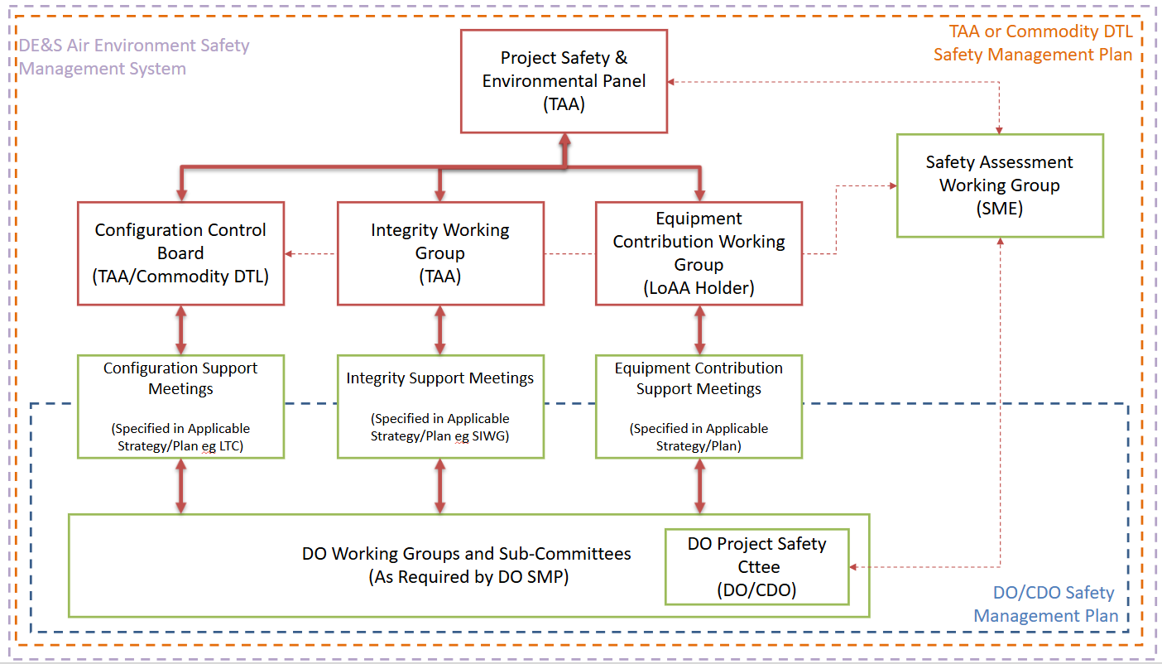
AE SMS – DT Safety Governance Meetings
[Source AET Tool 5B]
Notes:
For help with format, content, conduct and invitees there are a number of AET Tools available

Slide 42
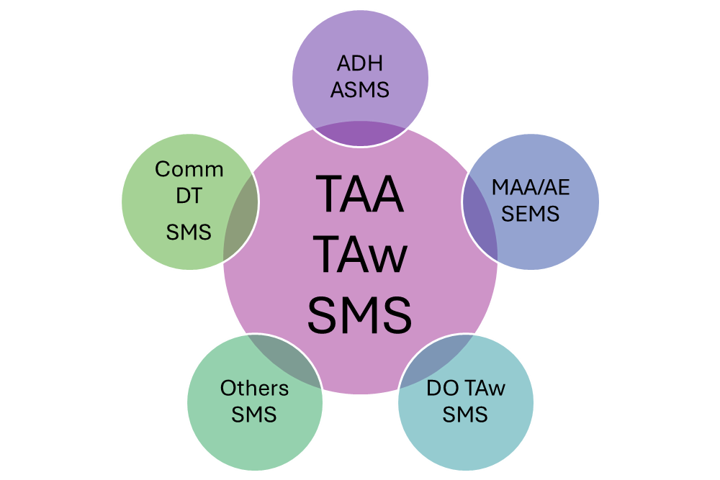
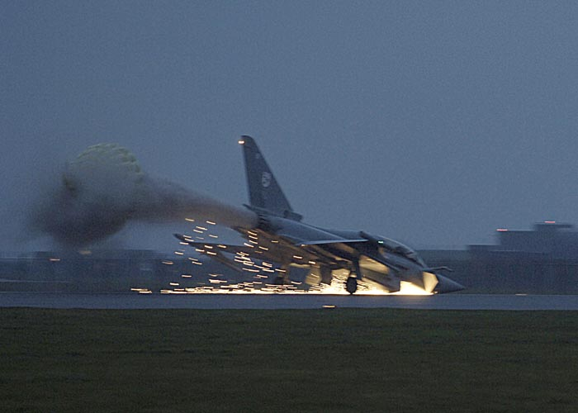
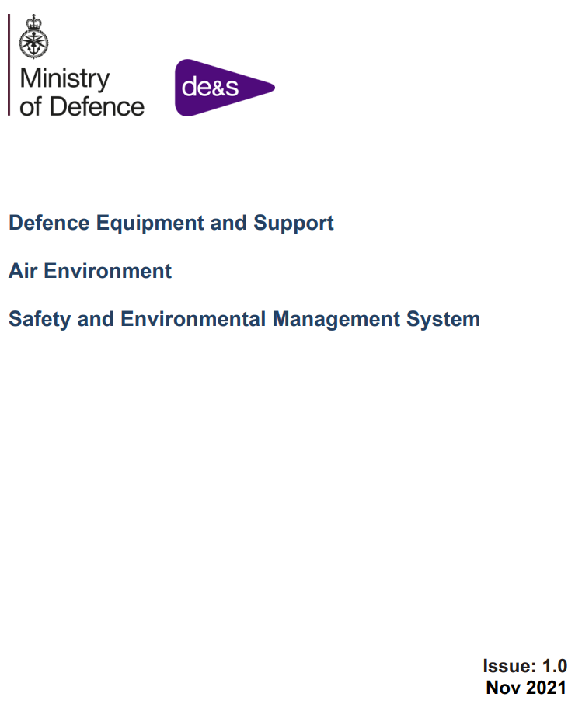
Taw SMS – Safety Policy & Objectives
A5 – Defined Interfaces with Adjacent ASMS
A6 – Emergency Response Planning
A7 – ASMS Documentation
Notes:
A5 – Defined Interfaces with Adjacent SMS
An ASMS that exists in isolation from all others will not be effective.
All organizations within Defence Aviation either rely on, or support, others; in many cases they do both. It is important that all relevant interfaces with adjacent SMS are identified, established, managed and documented.
Arrangements need to be put in place to formalise the exchange of relevant and useful information (particularly with regard to risks and hazards), good practices and the personnel interfaces required at Air Safety meetings, for example.
Adjacent organizations will include, for example, superior, peer and subordinate Aviation DH organizations as well as DH-facing and other supporting and supplier organizations within the MOD and Industry. In many cases there will also be the requirement to interface with foreign military organizations, as well as suppliers and contractors that are out with the MOD but very much within Defence Aviation.
A6 – Emergency Response Planning
Effective emergency response planning enables contingency plans to be developed that clearly document the actions to be taken following aviation-related emergencies.
The aim of these plans is to control the situation, limit the initial impact and enable return to normality at the earliest practicable opportunity.
The type, scale and method of documenting such plans will depend on the size and role of the organization and this is not an undertaking that is limited to those organizations directly involved in operating aircraft.
Organizations operating aircraft will need to establish and maintain plans that address the approach to accidents, incidents, disasters, Aircraft Post Crash Management (APCM) and business continuity, etc. This includes DE&S PTs particularly business continuity, call out lists etc…
We discuss this in more detail in the Emergency Arrangements module on Thursday.
A7 – SMS Documentation
An ASMS is the entirety of all documented and undocumented structures, processes, procedures, tools and methodologies, enabled and underpinned by the prevailing Air Safety Culture, that exist to manage Air Safety.
The ASMS may exist as a distinct entity or it may be embedded within a higher level management system that encapsulates safety across a wider remit. The most appropriate manner by which to document the ASMS is therefore dependent on the organization’s safety management structure.
Not dictated by RA1200. Organizations routinely opt for a top-level ASMS description document, or plan, supplemented by additional lower-level documentation as required.
Clear documentation that describes how an organization meets the ASMS regulatory requirement is essential if all personnel and external agencies are to understand the ASMS, their role within it and interfaces to it.
What is most important is that the documentation is bespoke, entirely relevant and that it reflects the organization’s Air Safety focus and activities accurately.
If ASMP is very large consider producing a concise précis that contains the key Air Safety priorities, messages and themes.

Slide 43
Plan

Slide 44
Structure of ASMS
Safety Policy & Objectives
Act
Plan
Continuous
Improvement
Loop
Safety Promotion
Safety Risk Management
Study
Do
Safety Assurance
Notes:
STRUCTURE OF THE ASMS
The fundamentals of the SMS are largely consistent regardless of which activity, industry or organization they are applied to.
RA 1200 has adopted the 4 top-level ICAO SMS Framework components with some additional facets, appropriate to and required of Defence Aviation added at the sub-component ‘element’ level.
Thus, the RA 1200 requirement can now be matched directly to the ‘Deming Cycle’ Continuous Improvement Loop.
The MAA expand on this model by introducing the 16 Auditable Facets that break the four pillars into smaller component parts to enable performance measurement and SMS evaluation.

Slide 45
Do

Slide 46
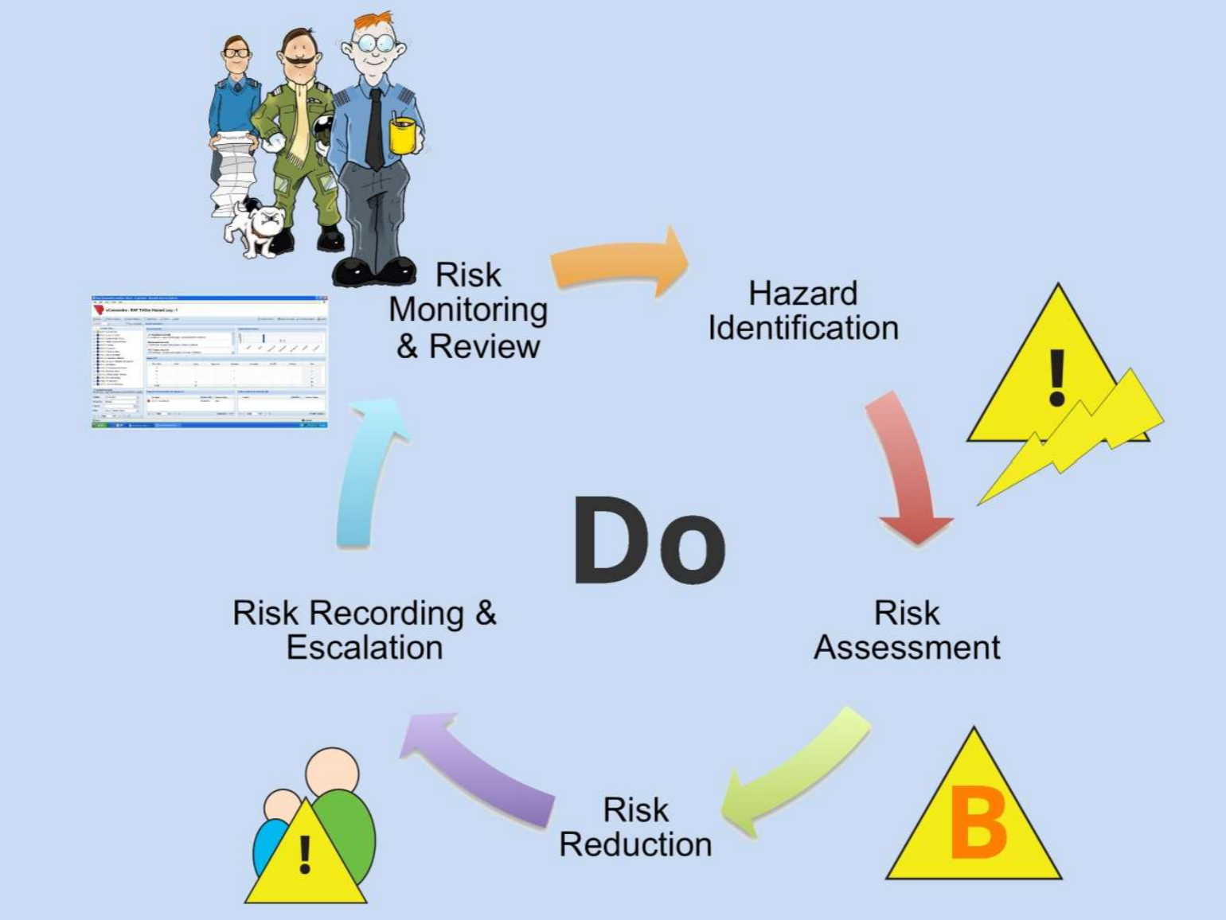
For Commodities
Notes:
Still very much a Hazard Identification, Risk Assessment, Reduction, management and monitoring activity using something like eCassandra at its heart.

Slide 47
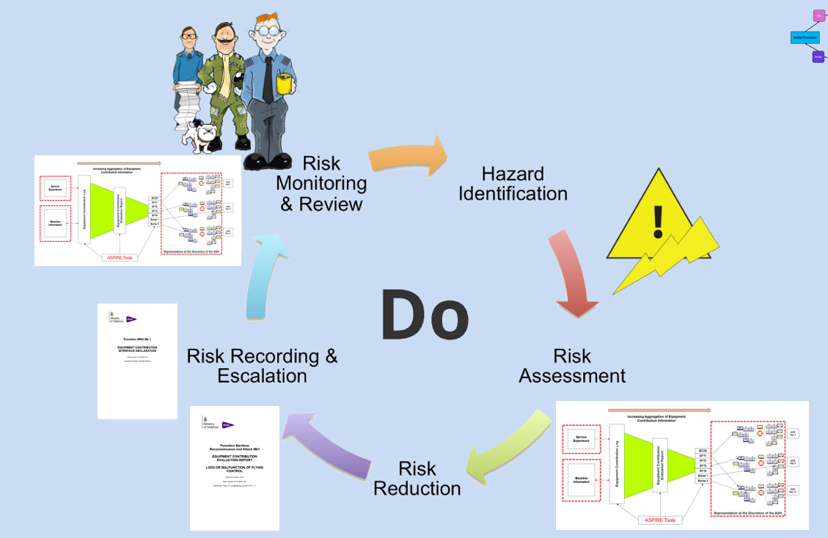
For Airworthiness
DO / OEM Safety Data Review
ECtRtL Recording & Escalation
ECtRtL Assessment
ECtRtL Reduction
Notes:
For Airworthiness we have the approach around managing Equipment Contribution Risk to Life where there is an ECL established and assessed with risk reduction considered and a position reached on the arrived at levels that are then presented to the ADH for review and acceptance. The ECtRtL is monitored continuously through life of the product and responds to in service issues and changes.

Slide 48

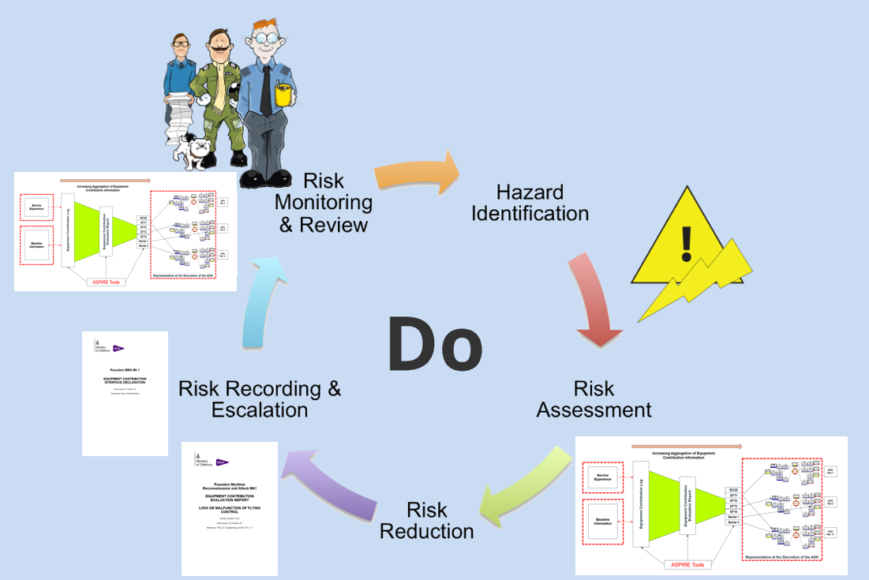
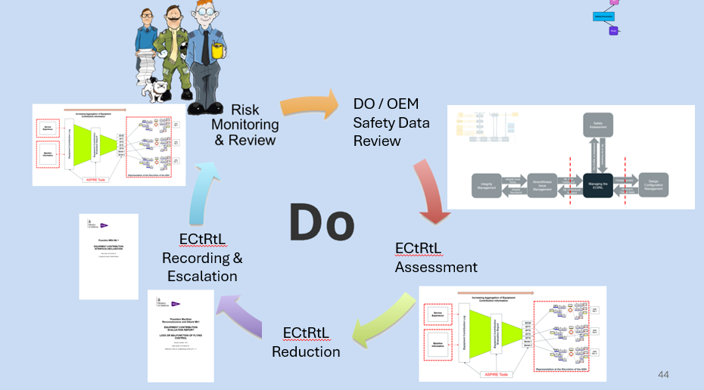

Type Airworthiness Safety Panel (TAwSP) or Platform Safety Panel (PSP)
Local Equipment Contribution Workshop
Equipment Contribution Working Group
Air System Safety Working Group
Assessment of Equipment Contributions from OEM or DO Data
Creation or update of Equipment Contribution Log
Equipment Contribution Evaluation Report
Equipment Contribution Interface Declaration
Notes:
The process of managing the ECtRtL is generally as shown here
Process 17 across the bottom
DT Assurance at the top

Slide 49
Do
Notes:
STRUCTURE OF THE ASMS
The fundamentals of the SMS are largely consistent regardless of which activity, industry or organization they are applied to.
RA 1200 has adopted the 4 top-level ICAO SMS Framework components with some additional facets, appropriate to and required of Defence Aviation added at the sub-component ‘element’ level.
Thus, the RA 1200 requirement can now be matched directly to the ‘Deming Cycle’ Continuous Improvement Loop.
The MAA expand on this model by introducing the 16 Auditable Facets that break the four pillars into smaller component parts to enable performance measurement and SMS evaluation.

Slide 50
Structure of ASMS
Safety Policy & Objectives
Act
Plan
Continuous
Improvement
Loop
Safety Promotion
Safety Risk Management
Study
Do
Safety Assurance

Slide 51
Study

Slide 52




Safety Assurance
C1 – Compliance Monitoring and Safety Performance Measurement
C2 – Management of Change
C3 – Continuous Improvement of the SMS
C4 – Retention, Evaluation & Feedback of Information
Notes:
C1 – The ASMS needs to be shown to operate a comprehensive and documented safety assurance programme. The programme needs to be routinely reviewed to ensure an appropriate focus is maintained. Assurance can be provided at 3 levels
1st Party Audit (PA) done internally – are we doing what we said we would iaw Safety Performance (SPI), Objectives, Targets?
Or 2PA done by ISA/HEA 2/QSEP – keeping us on track
Or 3PA done by MAA also 3rd party sometimes identified to be performed by an ISA rather than at 2PA level.
Other aspects of assurance include the management of change whereby change is not performed for change sake but assessed for its impact before any change is made.
Continuous improvement of the SMS which include processes to monitor and evaluate the effectiveness of the SMS and act upon findings
You then have retention, evaluation and feedback of information which is your sharepoint, records etc where all the data is stored and can be readily found and audited that supports the risk management and decision making processes.

Slide 53
Study

Slide 54
Structure of ASMS
Safety Policy & Objectives
Act
Plan
Continuous
Improvement
Loop
Safety Promotion
Safety Risk Management
Study
Do
Safety Assurance
Notes:
STRUCTURE OF THE ASMS
The fundamentals of the SMS are largely consistent regardless of which activity, industry or organization they are applied to.
RA 1200 has adopted the 4 top-level ICAO SMS Framework components with some additional facets, appropriate to and required of Defence Aviation added at the sub-component ‘element’ level.
Thus, the RA 1200 requirement can now be matched directly to the ‘Deming Cycle’ Continuous Improvement Loop.
The MAA expand on this model by introducing the 16 Auditable Facets that break the four pillars into smaller component parts to enable performance measurement and SMS evaluation.

Slide 55
Act

Slide 56



TAw SMS - Promotion
D1 – Training & Education
D2 – Safety Communication
Notes:
Covers Training, Education and Communication where processes needs to be in place that identify how the Organization goes about training and educations, implementation of training matrices that track personnel competency needs and achievement especially in regard to LoAAs etc.
For Commumications this is about what is being done to promote safety in the team, across the team. Anyone got any example of safety promotion?

Slide 57
Act

Slide 58
Structure of ASMS
Safety Policy & Objectives
Act
Plan
Continuous
Improvement
Loop
Safety Promotion
Safety Risk Management
Study
Do
Safety Assurance

Slide 59

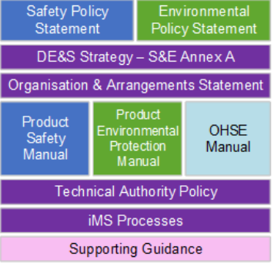
Change is Coming Though….
DE&S Unified Safety and Environmental Management System
What is it? – The Unified SEMS will comprise the CEOs policies, procedures, processes and guidance on Product Safety, Product Environmental Protection and Occupational Health, Safety and Environment (OHSE).
.
Unified SEMS designed to Align with DE&S Operating Model
The SEMS is to take precedence over all previously issued material from DE&S former domains and Operating Centres unless where legacy policies, processes, procedures and guidance may yet address topics or requirements that have not yet been incorporated.
Such material will be replaced by new common material as it is released
Available already –
To come – Those items not ticked plus an Air Annex to the PSM, and ASEMS
Unified SEMS
Notes:
So the DE&S Unified SEMS is in the process of being brought into service with its intent being to replace separate management systems used in different domains of the previous DE&S Operating Model. This is being done to align with the new DE&S Operating Model and create common material in these areas across DE&S.
It’s championed by Stephen Wilcox who is the Director Engineering and Safety in DE&S who states his ambition being to draw together good practices from across the different environments, technologies, regulators and industry partners into a single, streamlined system to support the new operating model.
It is hoped that its effect will be to improve effectivity and efficiency in DE&S activities required to preserve and protect health, well being and the environment.
Available now are the Policy Statements for safety and the Environment. There is also the DE&S Strategy Annex and the Product Safety Manual.

Slide 60
Safety ….What’s in the case?

Slide 61
The Air System Safety Case (ASSC)
Manual of Air System Safety Cases (MASSC)
Air System Safety Case. A structured argument, supported by a body of evidence that provides a compelling, comprehensible and valid case that an Air System is safe for a given application in a given environment. It is through-life, pan-DLoD, and addresses a combination of the physical components, procedures and human resources organized to deliver the capability
RA1205
Rationale
Military Air Systems are complex and often have unique and emerging capabilities that present complicated developmental challenges; moreover, the operation of Military Air Systems presents a foreseeable and credible Risk to Life (RtL). A simple Risk assessment will not be sufficient to assess the potential impact of these RtL, whereas the use of a Safety Case provides the ability to understand the cumulative and / or interrelated Risks from the use of the complex system.
Regulation
RA1205(1)
An ASSC shall be produced for Air Systems on, or destined for, the UK MAR. The ASSC shall be articulated via an ASSC Report.
Acceptable Means of Compliance RA1205(1)
The ASSC should consist of a claim (or number of claims), a structured and explicit argument, and a supporting body of evidence, that together provide a compelling, comprehensible and valid case that an Air System is safe to operate and being operated safely within a clearly defined context .
Notes:
So what is a Safety Case? Anyone heard of a safety case? What types are you aware of?
Read off the slide
At platform level the ASSC is to consist of claims, a structured and explicit argument and a supporting body of evidence that provide a compelling, comprehensive and valid case that an air system is safety to operate and being operated safely within a clearly defined context.

Slide 62
The Air System Safety Case (ASSC)
ADH ASSC
Other DHFO Safety Assessment
Air Traffic Management Safety Assessment
TAA Type Airworthiness SA (TASA)
Infrastructure SA
Notes:
So we have the overarching Air System Safety Case owned by the Duty Holder. This is contributed to by other safety assessments as shown in this diagram

Slide 63
The Type Airworthiness Safety Assessment
RA5012
Rationale
Type Airworthiness (TAw) is a key element of an Air System Safety Case (ASSC) . A Type Airworthiness Safety Assessment (TASA) will provide a reasoned and evidenced argument that the Air System is safe to operate in a clearly defined context.
Regulation
RA5012(1)
The TAw Authority (TAA) or TAw Manager (TAM) shall own and manage a TASA
Acceptable Means of Compliance RA5012(1)
The TASA should consist of a claim (or number of claims), a structured and explicit argument, and supporting body of evidence, that together provide a compelling, comprehensible and valid case in support of the ASSC that the Air System is safe to operate within defined limits.
The TASA should be summarized in a Type Airworthiness Safety Assessment Report (TASAR).
The TASAR should be produced to support the ASSC as part of the Military Aircraft Registration activation request.
Notes:
At the DT level the TAA needs to produce a Type Airworthiness Safety Assessment.
This states here that it is going to provide a reasoned and evidence argument that the Air System is safe to operate which directly contributes to the ASSC that adds operated safely to it. It is though again to be provided through a claim, argument and evidence approach the same as the ASSC.

Slide 64
What is a Safety Case?
Definition MASSC
Safety Case. A structured argument, supported by a body of evidence that provides a compelling, comprehensible and valid case that a system is safe for a given application in a given operating environment .
Safety Case Argument. A demonstration of how a system can be deemed acceptably safe from the evidence available
Assumptions
Actions
Claims / Requirements / Objectives
What you want to achieve from the Safety Case is established
How you consider being able to instantiate the Claims developed through arguments
Argument
Context
Based on your argument strategy you go find evidence / have evidence produced that will satisfy your argument and therefore your claim
Safety Evidence
Notes:
As stated here the safety case is a structured argument supported by a body of evidence that provides a compelling, comprehensive and valid case that a system is safe
Argument is a demonstration of how a system can be deemed acceptably safety from the evidence available.
So we have as follows – reading off the slide as it develop

Slide 65
The White Book
Techniques such as Goal Structuring Notation (GSN) and Claims, Argument, Evidence (CAE) have been developed to provide rigour and clarity in the presentation of safety cases and similar types of reasoned argument.
GOAL
CLAIM
Strategy
Argument
Sub Claim
Sub Claim
Sub Goal
Sub Goal
Argument
Argument
Argument
Solution
Solution
Solution
Solution
Solution
Evidence
Evidence
Evidence
Evidence
Evidence
Notes:
I terms of claims and structured arguments the White Books identify GSN and CAE with the now HEA (Air) mandating a CAE approach.
Explain the slide

Slide 66
The Type Airworthiness Safety Assessment
Air Engineers Tool Kit Tool 16 identifies the following:
TASA Principal Claim
The Air System is Acceptably Safe to Operate in Service to Defined Limits within its support Framework
To be argued through evidence of the following claims being true or met
The Type Design is Safe
The ECtRtL is known, assessed & agreed ALARP
The Air System can be operated and maintained safety in service
The Safety Management System Ensures Safe Practices
Notes:
So with the CAE approach Tool 16 provides a principal claim aet of level 1 and 2 subclaims with the level 1 claims shown here

Slide 67
The Type Airworthiness Safety Assessment - Evidence
The Type Design is Safe
The ECtRtL is known, assessed & agreed ALARP
The Air System can be operated and maintained safety in service
The Safety Management System Ensures Safe Practices
Endorsed ENBAS
RESOLVE
Disposal
DO Safety Case
SEMP
RTSR/RTS
Airworthiness Strat
SEIN
CMP
TAwSP MOM
TCB
Haz Materials
HRM/ HRB
SOIU & Updates
ADS / ADS MP
SEMP
DST Compliance
TAwSP
ISA & ITE Reports
QAR
TCE
ECL
SPS
Maint Sched
QMS
MTC
ASSWG
Training / Competency
CAME / CASP
C of D
CMP
Config Man
ECID
QMS
Integrity WG / Plan
Business Process
Loss Model
Notes:
The kinds of evidence needed to be provided under each sub claim as a minimum is seen here
Work the slide

Slide 68
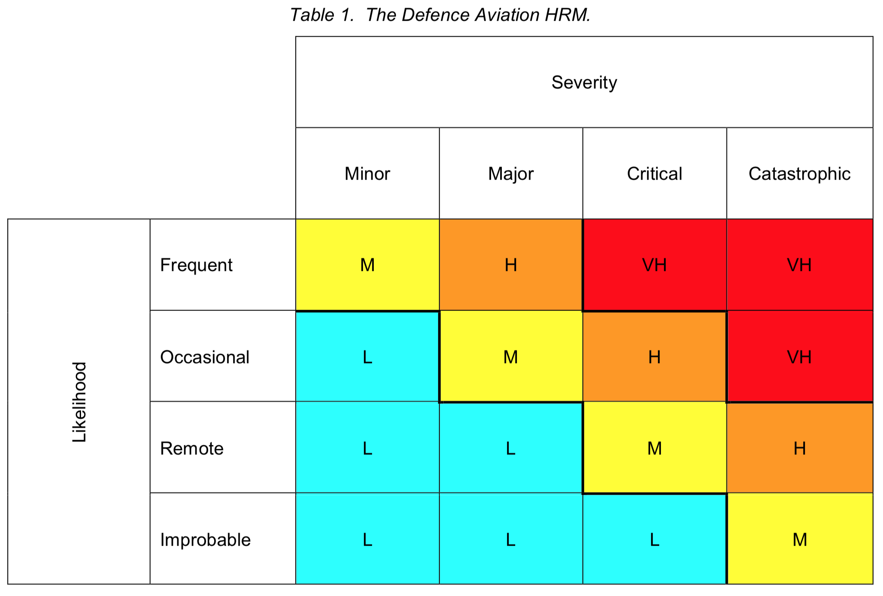
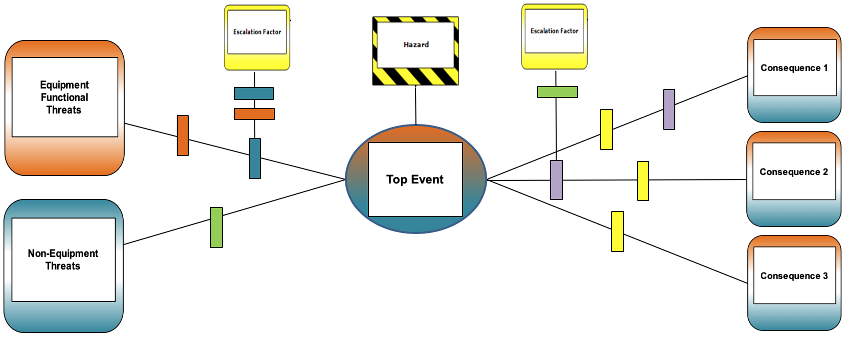
ASPIRE – Joint Operating Model for TASAs
TASA – Type Airworthiness Safety Assessment
SEIN – Significant Equipment Issue Notification
ASSC – Air System Safety Case
DAHRM – Defence Aviation Hazard Risk Matrix
DST - Design Safety Target
ECID - Equipment Contribution Interface Declaration
C-ECID – Commodity Equipment Contribution Interface Declaration
SC – Sub-Claim
TASA – Type Airworthiness Safety Assessment
SEIN – Significant Equipment Issue Notification
ASSC – Air System Safety Case
DAHRM – Defence Aviation Hazard Risk Matrix
DST - Design Safety Target
ECID - Equipment Contribution Interface Declaration
C-ECID – Commodity Equipment Contribution Interface Declaration
SC – Sub-Claim
ASSC
ASSC
Activities External to
Air System TAA
TAA Activities
TAA/ADH Interface
ADH Activities
Activities External to
Air System TAA
TAA Activities
TAA/ADH Interface
ADH Activities
TASA
TASA
Safety Assessment Channel
Safety Assessment Channel
TASA
Report
Inputs as required by Air System Boundary and TASA scope
TASA
Report
Inputs as required by Air System Boundary and TASA scope
TASAR Addm
TASAR Addm
SC 1
SC 2 (TASA)
SC 1
SC 2 (TASA)
SC 5
SC 3
SC 4
SC 5
Sub-Claim 1
Sub-Claim 2
Sub-Claim 3
Sub-Claim 4
SC 3
SC 4
Sub-Claim 1
Sub-Claim 2
Sub-Claim 3
Sub-Claim 4
SC 2.1
SC 2.2
SC 2.3
SC 2.1
SC 2.2
SC 2.3
SC 2.4
TASA Status Report
SC 2.4
TASA Status Report
Aggregate Risk Channel
Aggregate Risk Channel
Joint Safety Assumptions Log (AET Tool 16K)
(including ADH SQEP-raised assumptions influencing the Equipment Contribution)
Air System Component Evidence
Joint Safety Assumptions Log (AET Tool 16K)
(including ADH SQEP-raised assumptions influencing the Equipment Contribution)
Air System Component Evidence
DST Compliance Evidence
DST Compliance Evidence
Single Risk Channel
Single Risk Channel
Deficiencies in the intrinsic design when functioning correctly (i.e. Type Cert)
Deficiencies in the intrinsic design when functioning correctly (i.e. Type Cert)
ADH Bowties
DAHRM
SEIN
ADH Bowties
DAHRM
Equipment Contribution Log
SEIN
Equipment Contribution Log
Equipment Contribution Evaluation Report/s
Service Experience
Equipment Contribution Evaluation Report/s
Service Experience
ECID
ECID
ADH ALARP Decision
Supporting DH ALARP Claims
ADH ALARP Decision
Threat Ident Activities
eg C-ECID
Supporting DH ALARP Claims
Threat Ident Activities
eg C-ECID
ADH Risk Management
ADH Risk Management
Notes:
In terms of the Joint Operating Model the TASA sits here with its 4 level 1 sub claim reporting to the ASSC through TASA Reports, Status Reports and Addendums

Slide 69
Safety ….What about the Hazard Log?

Slide 70
Hazard Log
Def Stan 00-056
The continually updated record of the Hazards, accident sequences and accidents associated with a system. It includes information documenting risk management for each Hazard and Accident.
In some areas such as commodities DT risk assessment is typically recorded in a Hazard Log rather than in the ECtRtL Log in a way that captures and retells the accident sequence:
Ref | Hazard | Causes | Mitigation | Outcome | Severity | Likelihood | Risk
Describes the accident sequence
Categorises the risk
Provides the evidence to justify the risk likelihood
Notes:
So Hazard Logs are still used and mandated in air for the safety management of commodities.
Read off the slide and explain the hazard log itself

Slide 71




Hazard Log
Purpose
Live document through CADMID/T lifecycle
Records safety assessments & risk mitigations
Provides traceable, auditable decisions
Content
System scope & safety requirements
Tracks:
Hazards & risks
ALARP justifications
Status & actions
Design
Choose format (paper/electronic)
Assign Hazard Log Administrator
Define risk classes & hazard categories
Operation
Initiated with hazard identification
Maintains configuration control
Hazards are closed, not deleted
Regularly reviewed & updated
Purpose
Content
Design
Operation

Slide 72
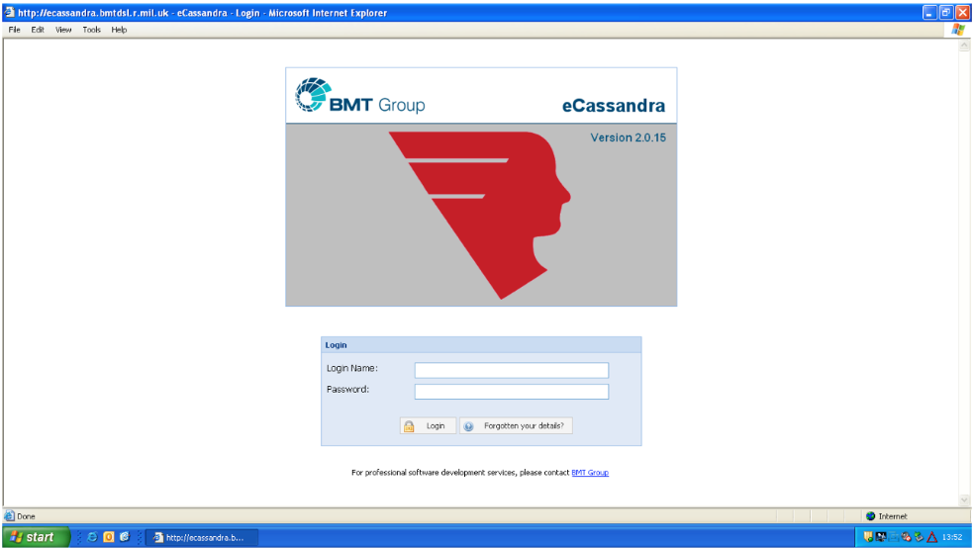
Hazard Log
Notes:
eCassandra is the hazard log too of choi and is maintained by BMT

Slide 73
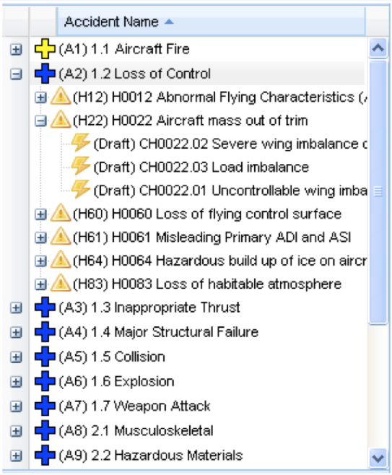
Notes:
The tool is a relationship based data base that allows for the identification of Hazards, causes, consequences, controls and associated documents that support the assessments made.

Slide 74
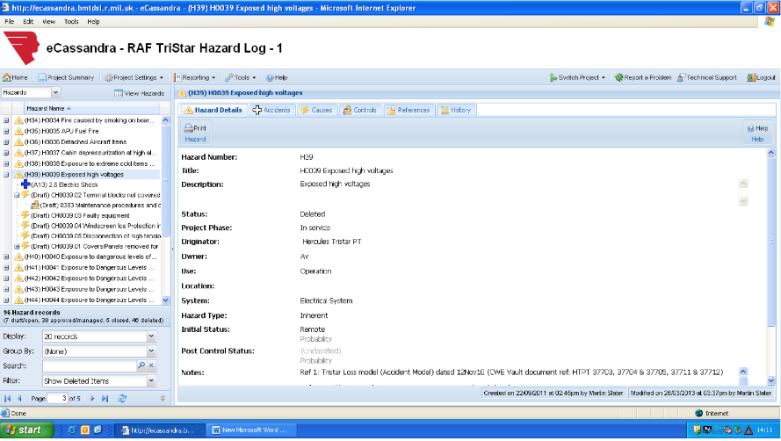

Slide 75
Safety ….What Tools?

Slide 76
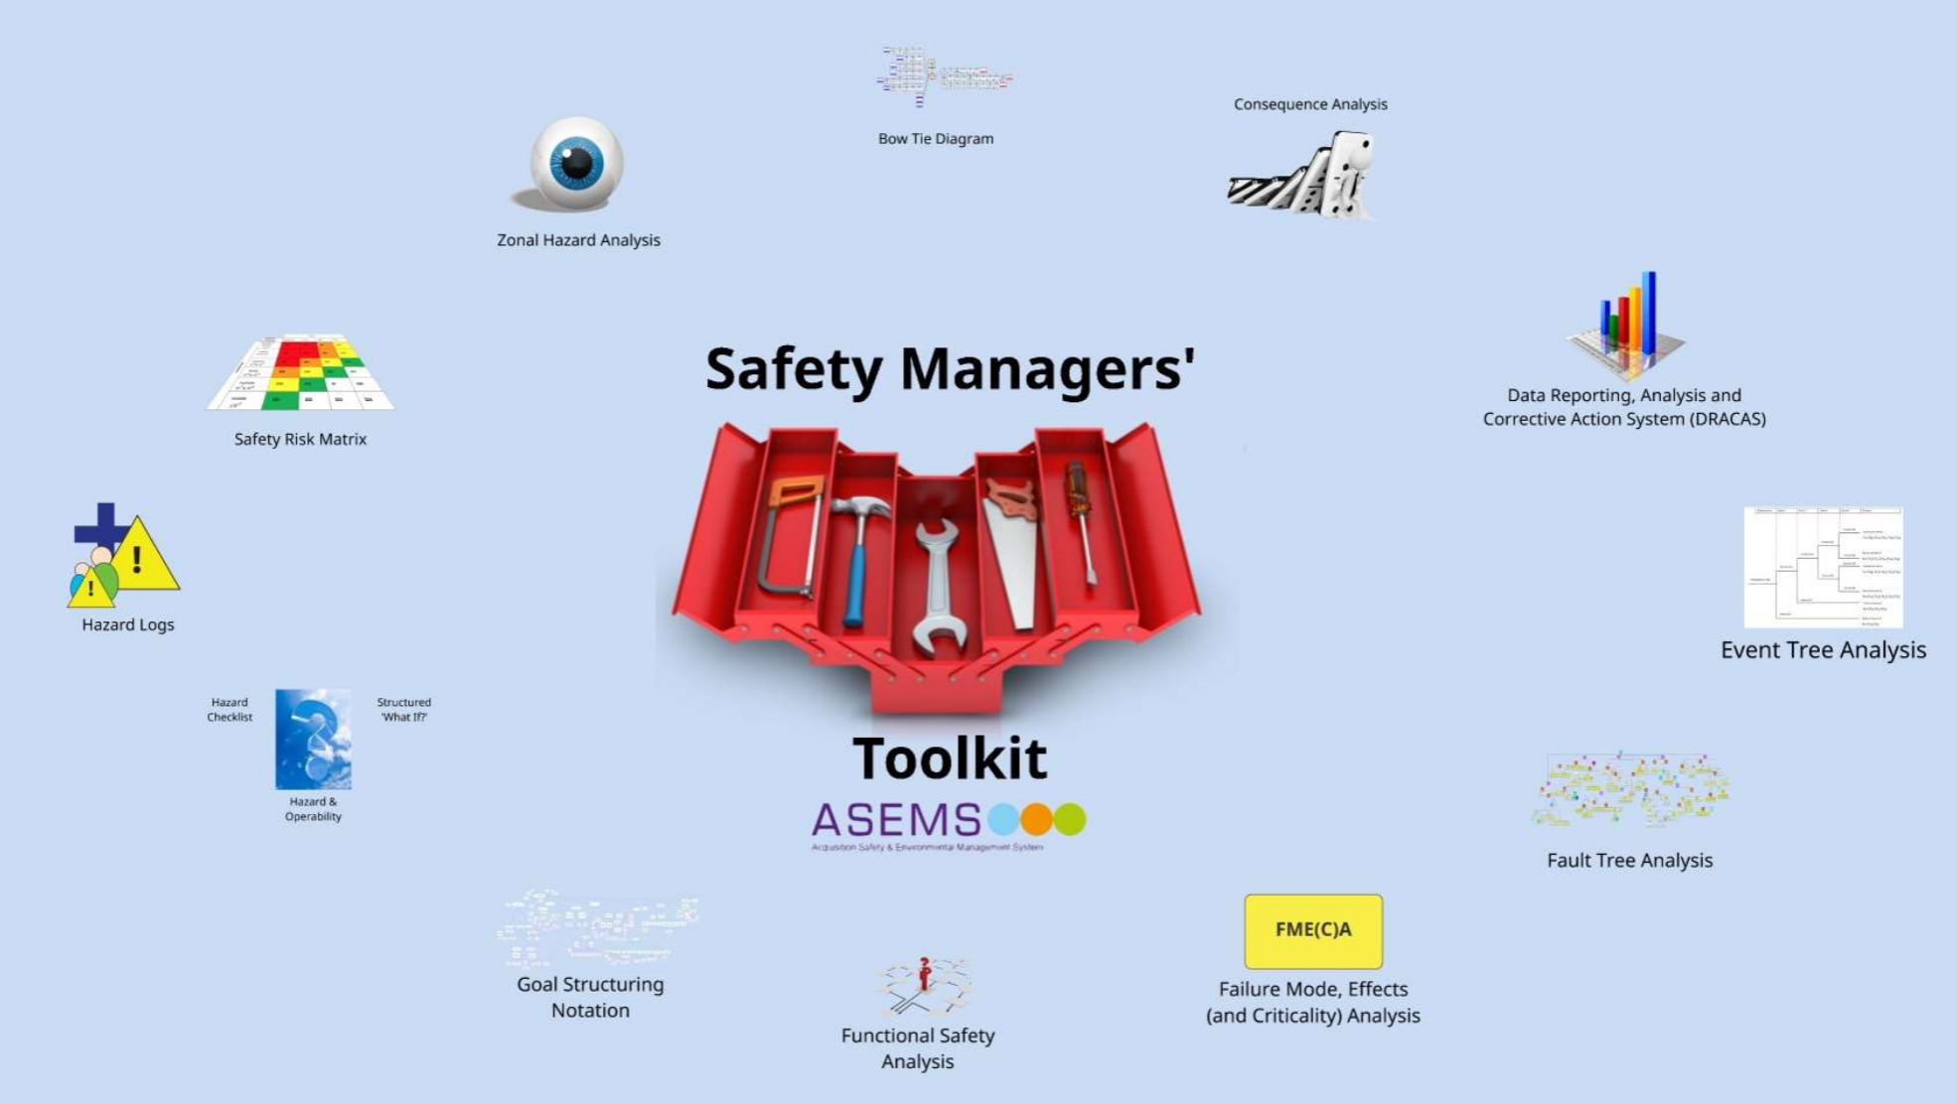
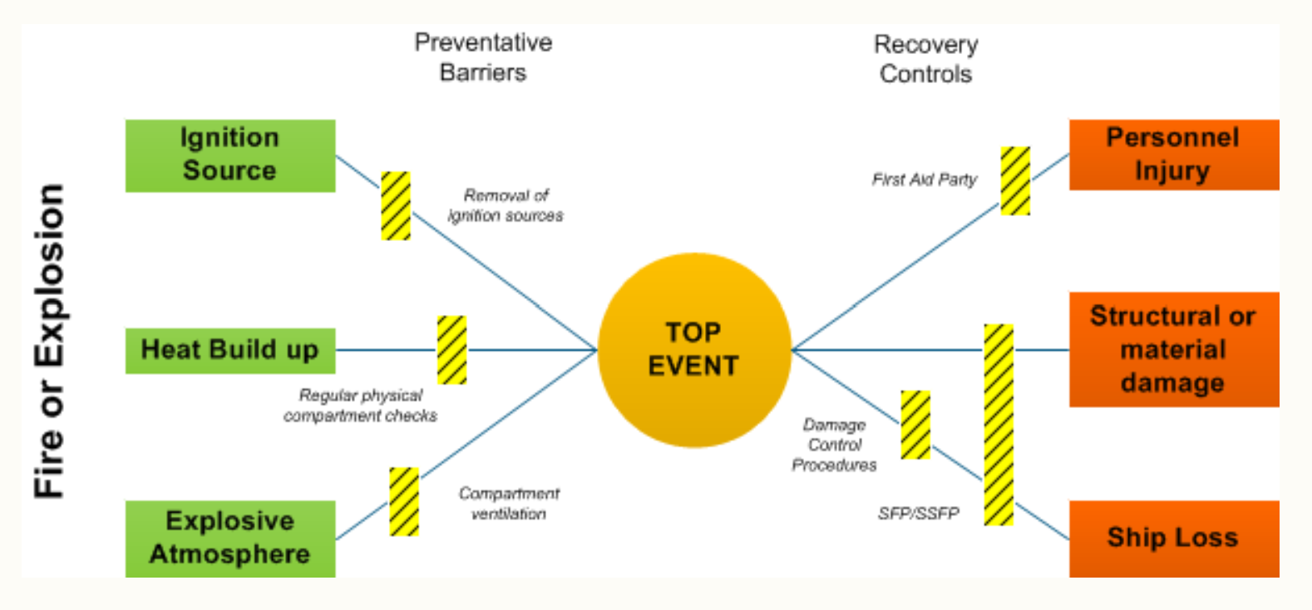
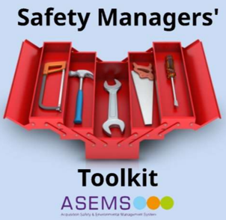
Bowtie Methodology
Notes:
Final slide here pointing to the various tools that exist to support the assessment of safety available for use across DE&S

Slide 77
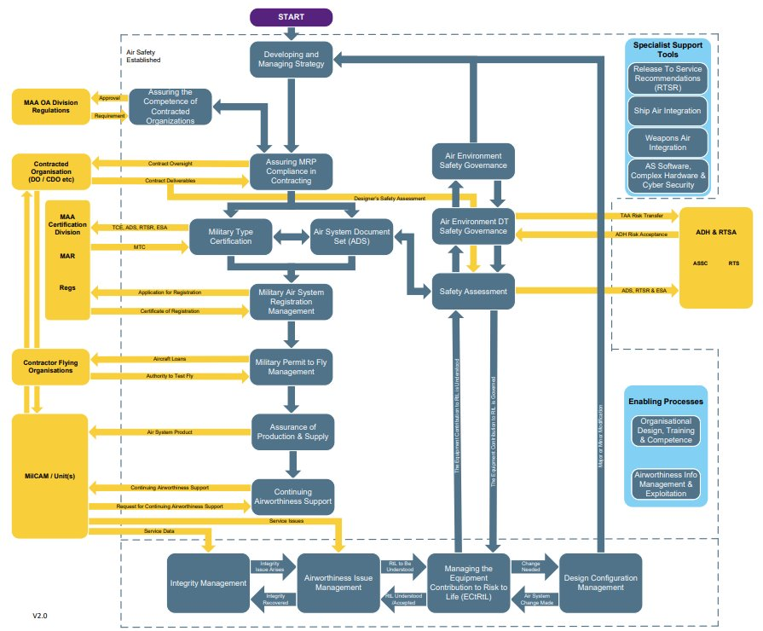
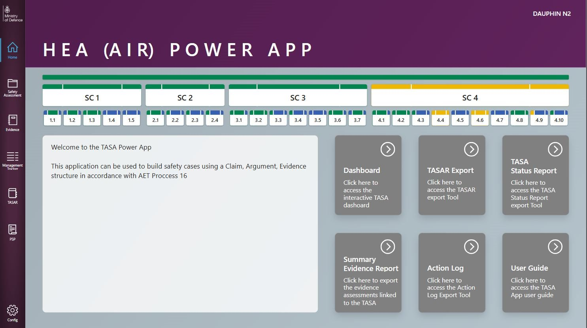
Air Engineers Toolkit - Safety
AET Process 16 Safety Assessment
Safety Assessment
AET Process 16
AET Process 17
Managing the ECtRtL
AET Process 17
Notes:
Final slide here pointing to the various tools that exist to support the assessment of safety available for use across DE&S

Slide 78
Any Questions?

