Slide 1
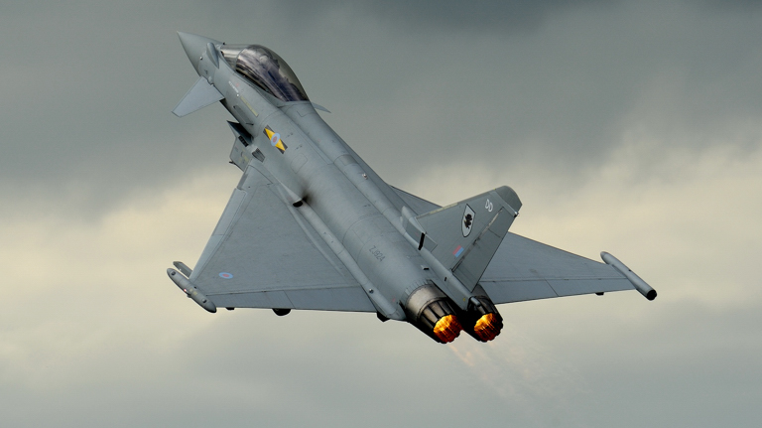
Overview
Type Airworthiness Desk Officers’ Foundation Course

Slide 2
TADOF - Overview
Learning Outcome
To provide an understanding of:
Important Definitions for a Type Airworthiness desk officer.
How the airworthiness organization works.
What the Military Aviation Authority (MAA), Type Airworthiness Authority (TAA), and Duty Holders do.
The Defence Air Environment Framework.
Provide an overview of the Air Engineers Toolkit (AET) and the standardized processes the AET provides.
Notes:
READ OFF THE SLIDE

Slide 3
Definitions
Definitions
MAA-02
Airworthiness: The ability of an Air System or other Airborne Equipment or system to be operated in flight and on the ground without significant Hazard to Aircrew, groundcrew, Passengers or 3rd parties. It is a technical attribute of materiel throughout its lifecycle.
Flight Safety: A collective endeavour to operate in the Air Environment safely, it embraces any activity that contributes to the safe operation of military airworthy systems in flight or on the ground.
Air Safety: Is the state of freedom from unacceptable Risk of Injury to persons, or damage, throughout the life cycle of military Air Systems. Its purview extends across all Defence Lines of Development and includes Airworthiness, Flight Safety, Policy, Regulation and the apportionment of Resources. It does not address survivability in a hostile environment.
Air System: Is the Aircraft (whether Crewed or Uncrewed) and associated components vital to their safe operation. This may include components not on the Aircraft itself (for example, for RPAS, the Remote Pilot Station and datalinks essential for control of the Aircraft).
Notes:
THE MAA-02 provides a single reference source for the definition of Air Safety terms as defined by the MAA. Note for Environmental Protection there is the JSP418 Mater Glossary and JSP 816 Defence Environment Management System
For concerns the Type Airworthiness Desk Office 'CLICK'
So we have.....
Ask them what is meant by
Airworthiness
Flight Safety
Air Safety
Air System
SEPARATE THE HEADINGS FROM THE TEXT

Slide 4
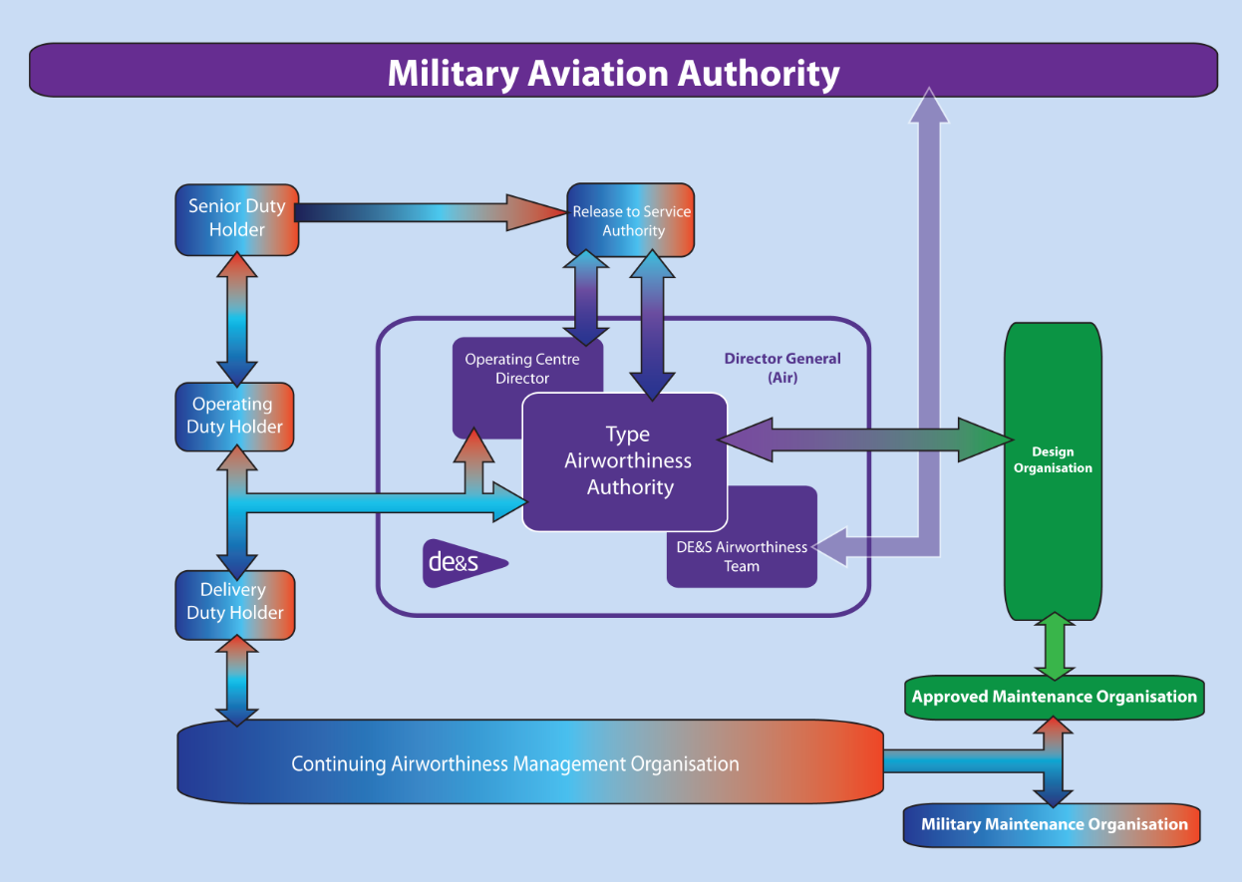
Dir Fixed Wing
Dir Rotary Wing & UAS (RA1013)
Director Engineering
and Safety (RA 1012 Responsibilities
(RA1015 Responsibilities)
Head of Eng Authority (Air)
Notes:
So how does the organisation work?
At the top we have the Military Aviation Authority or MAA
Overall view – TAA interaction with other orgainisaton
Massivemy simplified dia
Provisdes srructure for week – training / docturin
We'll go through each iof these this week
TAA provided auth by dieactors, supported by HEA, in order to meet reg needs of MAA and support DH chain in man of risk
Relationship with DO, AMO and CAMO
Intro into each section

Slide 5
Military Aviation Authority
Established as the single regulatory authority responsible for regulating all aspects of Airworthiness across the three services and DE&S, the purpose of the MAA is to enhance operational capability by delivering effective Air Safety Regulation and facilitating safe innovation; fostering good practice and appropriate culture across the Defence Air Environment.
The MAA is part of 7 Defence Regulators with the Defence Safety Authority governed at strategic level by a Director MAA reporting to the DG DSA who in turn assures the Secretary of State for Defence.
Notes:
THE NEED FOR MAA WAS IDENTIFIED BY HADDON CAVE IN RECOMMENDATION 21.A.1 ASKING FOR A MAA TO BE ESTABLISHED AS SOON AS PRACTICABLE AND IN RECOMMENDATION 21.A.6 TO HAVE A STATUS COMPARABLE TO THAT AFFORDED BY THE CAA
THE MAA IS PART OF THE DEFENCE SAFETY AUTHORITY AS ONE OF 7 REGULATORS. THE MAA REPORTS TO THE DG DSA WHO IN TURN REPORTS TO THE SOfS FOR DEFENCE
Pre Nimrod – MAA did not exist
The UK Ministry of Defence (MOD) Military Aviation Authority (MAA) plays a critical role in ensuring the safety and effectiveness of military aviation.
The MAA was established in 2010 following the Nimrod Review by Mr Justice Haddon-Cave, which called for a radical overhaul of military airworthiness regulation.wikipedia
It operates under the Defence Safety Authority (DSA) and is empowered by a Charter signed by the Secretary of State for Defence.
It maintains full oversight of all defence aviation activity and is headquartered at MOD Abbey Wood, Bristol.gov
Its core purpose is: To enhance operational capability by delivering effective Air Safety regulation while fostering good practice and appropriate culture across the Defence Air Environment (DAE).gov
The MAA is responsible for:
Regulation: Setting and enforcing air safety regulations across all UK defence aviation activities.
Assurance: Providing independent audit and continuous surveillance to ensure compliance with safety standards.
Enforcement: Taking corrective actions when safety standards are not met, including issuing enforcement notices when necessary.
Certification: Overseeing the technical certification of new air systems and major changes to ensure compliance with baseline design requirements.
Environmental Protection: Developing and assuring aviation-related environmental protection regulations.service
The MAA is led by a 2-star Director (D MAA) and a 2-star Technical Director, supported by a Chief of Staff. - MP to Confirm
Comprises groups focused on Regulations & Certification, Operating Assurance, and Enabling Functions (e.g., training, legal, finance).

Slide 6
Dir Fixed Wing
Dir Rotary Wing & UAS (RA1013)
Director Engineering
and Safety (RA 1012 Responsibilities
(RA1015 Responsibilities)
Head of Eng Authority (Air)

Slide 7
Duty Holder Chain
AVIATION DUTY HOLDERS
SDH: Are personally legally responsible and accountable for ensuring that an effective end to end ASMS is resourced, implemented, appropriately managed by their area of responsibility; and that those personnel under their command who are engaged directly in Defence Aviation are suitably qualified, trained, experienced and equipped.
The SDH appoints by name the ODHs and DDHs.
ODH: Are 2* operators who are personally legally responsible and accountable for the safe operation, Continuing Airworthiness and Maintenance of the Air System in their defined Are of Responsibility. ODH are accountable to the SDH for Air Safety
DDH: Are personally legally responsible and accountable for the safe operation, Continuing Airworthiness and maintenance of the Air System in their Area of Responsibility. They are accountable to their ODH.
Notes:
Aviation Duty Holders (ADHs) are responsible for Air Safety and ensuring that associated Risk to Life (RtL) is As Low As Reasonably Practicable (ALARP) and Tolerable for the aviation activities within their Area of Responsibility (AoR).
A compromised level of Accountability for operations may result from not having ADHs in place.
Clearly defined roles and responsibilities are required so that legally accountable individuals can effectively carry out their duties in mitigating and making judgements on Air Safety Risk.
3 levels of ADH are identified to actively mange Air Safety for each Air System within their Area of Responsibility via an Air System Safety Case with is managed by the Air Safety Management System (ASMS) to ensure that the RtL is ALARP and Tolerable
Intro'd due to HC Rec
Pre HC – DH would not accept responsibility for safety
Post HC – DH now own risk – big change – in fact the ADHs are now legally accountable under UK law, including the Health and Safety at Work Act (1974).
SDH – Top Level
ODH – Oerating Level
DDH – Unit Level
In a civilian construct the DH are in fact the Accountable Manager (Military Flying) or AM(MF)
Regulatory Basis
The framework is defined in:
Regulatory Article (RA) 1020 – Roles and responsibilities of ADHs.
RA 1032 – Responsibilities of ADH-facing organizations and Accountable Managers (Military Flying).

Slide 8
Dir Fixed Wing
Dir Rotary Wing & UAS (RA1013)
Director Engineering
and Safety (RA 1012 Responsibilities
(RA1015 Responsibilities)
Head of Eng Authority (Air)

Slide 9
Type Airworthiness Authority
Dir Fixed Wing
Dir Rotary Wing & UAS (RA1013)
Director Engineering
and Safety (RA 1012 Responsibilities
(RA1015 Responsibilities)
HEA
Notes:
Within DE&S each Air System Delivery Team should have a senior Project Engineer who is nominated as the TAA for each Air System type or group of Air System types.
The TAA is responsible for the Type Airworthiness (TAw) of a specific air system throughout its lifecycle—from development to disposal.
Responsibilities:
Maintain control of the Type Design to ensure continued airworthiness.
Hold a Letter of Airworthiness Authority (LoAA) from the Operating Centre Director.
Support the ADH and AM(MF) by managing airworthiness risks and informing them of any changes.
Develop and maintain:
An Airworthiness Strategy
A Safety Management System (SMS)
A Type Airworthiness Safety Assessment (TASA)
Approve changes to the Type Design and ensure compliance with certification specifications.
Conduct assurance of contracted organizations involved in design, production, and maintenance.
Ensure configuration control and integrity management of the air system.
The TAA role is governed by Regulatory Article (RA) 1015.
The HEA is the principal point of contact within DE&S on all matters related to Air Safety. It provides Airworthiness Policy, Rules and Guidance, Airworthiness Technical Support to Delivery Teams in the Air Environment

Slide 10
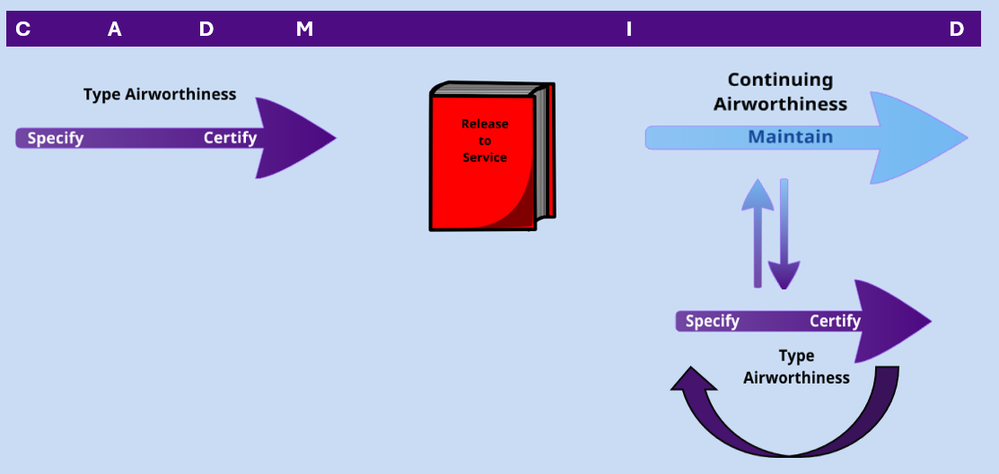
Type Airworthiness Authority
Definitions
MAA-02
Type Airworthiness:
All the actions associated with the upkeep of a type design and the associated approved data through life. Type Airworthiness Authorities are responsible for all aspects of Type Airworthiness.
Notes:
This slide shows the involvement of the TAA in the establishment of type airworthiness on the left hand side, working with OEMs/DOs etc to bring a platform in to service, supporting the achievement of a Military Type Certificate and providing recommendations for a release to service.
Type Airworthiness (TAw) in the UK MOD context refers to the ongoing assurance that a military air system remains safe and airworthy throughout its lifecycle, from development to disposal. It is a cornerstone of military aviation safety governance and is managed primarily by the Type Airworthiness Authority (TAA).
Type Airworthiness is the state of an air system's design being compliant with applicable airworthiness requirements and safe for its intended military use. It encompasses:
Initial certification of the air system's design.
Management of design changes and modifications.
Sustainment of safety and integrity through life.
Configuration control and documentation.
Ongoing risk and hazard management.
Once in service the TAA in involved in the activity to maintain the type certificate through continual assessment of the Equipment Contribution and Risk to Life, Maintenance Scheduling and development of modifications driven through in service issues or through capability development.

Slide 11
Type Airworthiness Authority
Definitions
MAA-02
Continuing Airworthiness:
All of the processes ensuring that, at any time in its operating life, an Air System complies with the airworthiness requirements in force and is in a condition for safe operation.
Notes:
Continuing Airworthiness (CAw) in the UK MOD context refers to the ongoing management and assurance that a military air system remains airworthy and safe to operate throughout its service life. It is a critical component of the Defence Air Environment's safety framework and is governed by Regulatory Article (RA) 1016.
Continuing Airworthiness involves:
Maintaining the airworthiness of military registered air systems.
Ensuring systems are operated with a valid Military Airworthiness Review Certificate (MARC).
Managing all CAw tasks through an approved Military Continuing Airworthiness Management Organization (Mil CAMO).
Supporting the Air System Safety Case (ASSC) by ensuring that Risk to Life (RtL) assessments remain valid.

Slide 12
Dir Fixed Wing
Dir Rotary Wing & UAS (RA1013)
Director Engineering
and Safety (RA 1012 Responsibilities
(RA1015 Responsibilities)
Head of Eng Authority (Air)

Slide 13
Continuing Airworthiness Management Organisation
The UK MoD established CAMO to align military aircraft airworthiness with civil aviation standards, following incidents like Nimrod XV230. Governed by MAA regulations (RA 4900–4999), it ensures ongoing airworthiness through formal, accountable processes and supports both MoD and industry-managed fleets to enhance safety oversight.
Notes:
Another recommendation (21.I.3) from Haddon Cave, was for the establishment of a Continuing Airworthiness Management Organisation to mirror and align with civil arrangements for the same activity that would work to maintain the continued airworthiness of the aircraft.
The UK MOD Military Continuing Airworthiness Management Organization (Mil CAMO) is a critical entity responsible for ensuring that military air systems remain airworthy and safe to operate throughout their service life.
A Mil CAMO is an organization approved by the Military Aviation Authority (MAA) to manage all Continuing Airworthiness (CAw) tasks for military registered air systems. Its responsibilities are defined in Regulatory Articles RA 1016 and RA 4947.

Slide 14
Dir Fixed Wing
Dir Rotary Wing & UAS (RA1013)
Director Engineering
and Safety (RA 1012 Responsibilities
(RA1015 Responsibilities)
Head of Eng Authority (Air)

Slide 15
Notes:
Design Organisations are responsible for the through life configuration management of the design of each Product, Part, Appliance, item of Airborne Equipment, Air Launched Weapons, Aircrew Equipment Assemblies and Survival Equipment installed in or on an Air System.
The DO must be competent and should be approved through the Design Approved Organisation Scheme (DAOS). An organising seeking DAOS can show evidence of having a Part 21 J approval.
For Maintenance Organisations they should be approved under the Maintenance Approved Organisation Scheme (MAOS) which should be achieved by demonstration of full compliance with the MRP Part 145.
Maintenance of air systems on Mil Reg no need for Pt66 engineers, however for example Voyager, which is maintained under civil reg requires maintenance in accordance with Pt 66.
A Design Organization (DO) within the UK MOD is a formally approved entity responsible for the design, development, and post-design support of military air systems and components. These organizations operate under the Design Approved Organization Scheme (DAOS), which is governed by the Military Aviation Authority (MAA).
A UK MOD Maintenance Organisation is an entity approved under the Maintenance Approved Organization Scheme (MAOS) to perform maintenance on military registered air systems and components. These organizations are governed by the Military Aviation Authority (MAA) and must comply with the MRP Part 145 regulatory framework.

Slide 16
Release to Service Authority (RTSA)
The Release To Service Authority (RTSA) operates on behalf of the Senior Duty Holder (SDH) and assures an Air System’s Release To Service Recommendations (RTSR) and ensures that identified Risks to Life (RtL) have been brought to the attention of the Operating Duty Holder (ODH), before issuing the Release To Service (RTS).
Notes:
HC rec to incorp RTSA into MAA to undertake regulatory function was not adopted with MOD retaining the RTSA independence.
There are no civil equivalent to the RTSA
The Release To Service Authority (RTSA) within the UK MOD is a designated authority responsible for authorizing and maintaining the Release To Service (RTS) for military air systems. This role is critical in ensuring that air systems are safe to operate and that all associated risks are properly assessed and communicated.
The RTSA acts on behalf of the Senior Duty Holder (SDH) to:
Authorize, issue, and maintain the RTS for air systems.
Assure the RTS Recommendation (RTSR) provided by the Type Airworthiness Authority (TAA).
Ensure Risks to Life (RtL) are identified and communicated to the Operating Duty Holder (ODH) before RTS issuance.
Provide independent Air Safety Assurance to the ADH chain.
Regulatory Basis
The RTSA's responsibilities are defined in:
RA 1021 – Roles and responsibilities of the RTSA.
RA 1300 – Requirements for Release To Service documentation and process.

Slide 17
Dir Fixed Wing
Dir Rotary Wing & UAS (RA1013)
Director Engineering
and Safety (RA 1012 Responsibilities
(RA1015 Responsibilities)
Head of Eng Authority (Air)

Slide 18
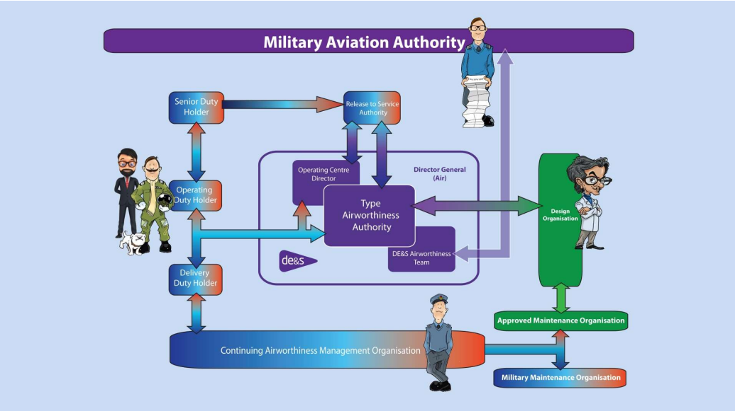
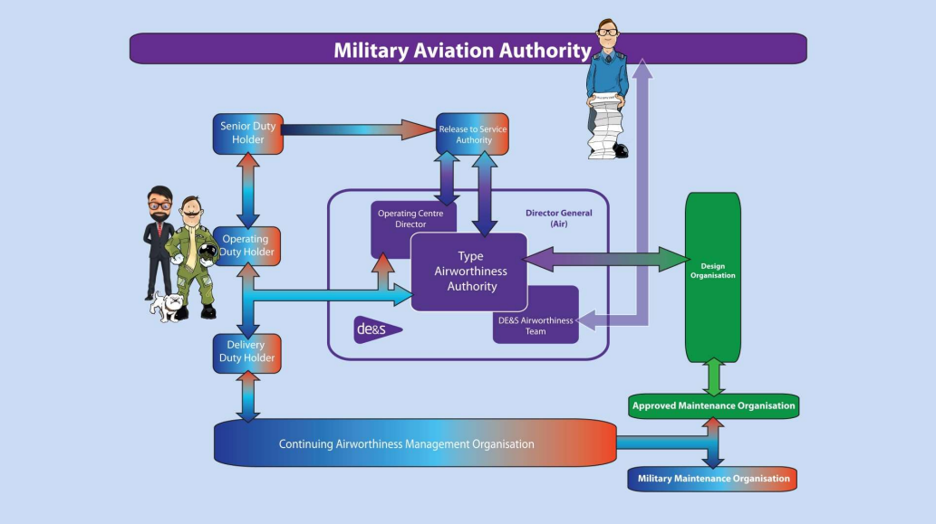
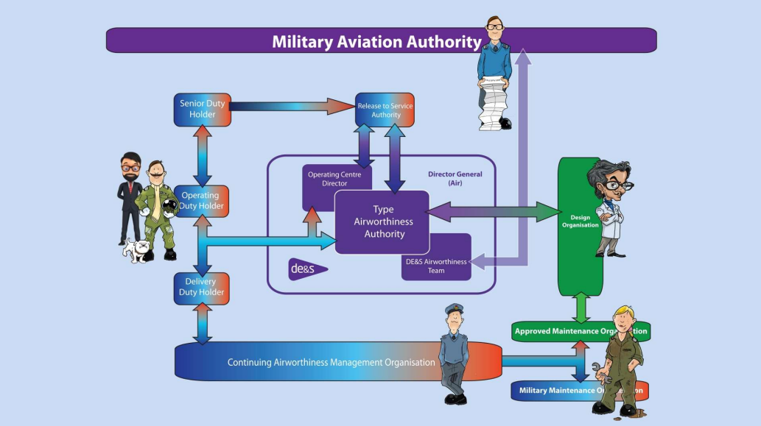
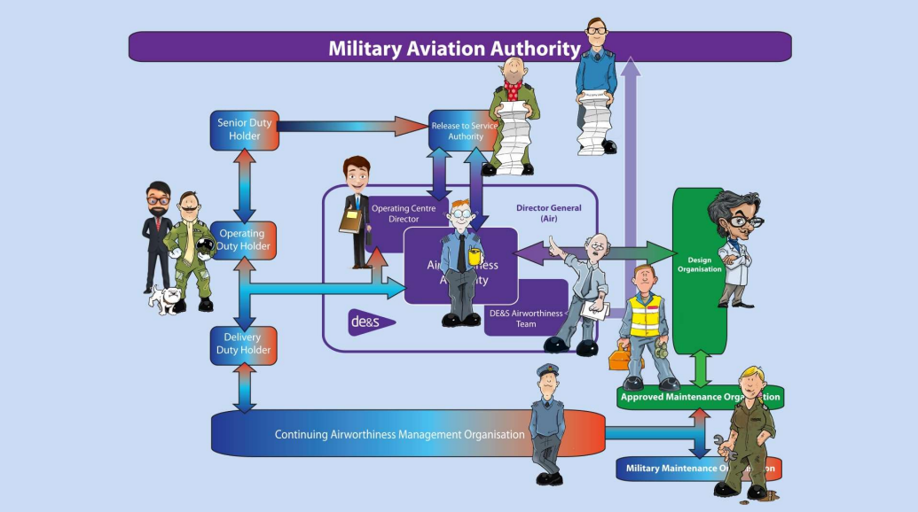
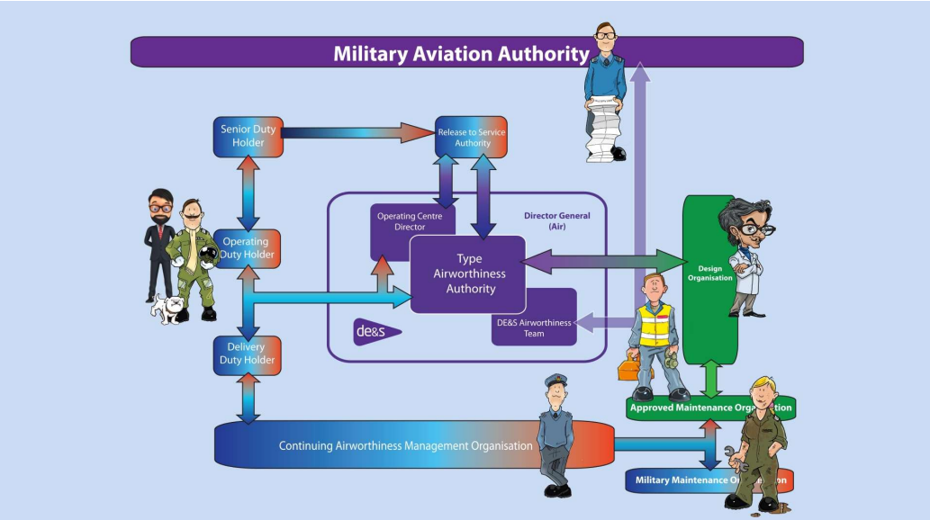
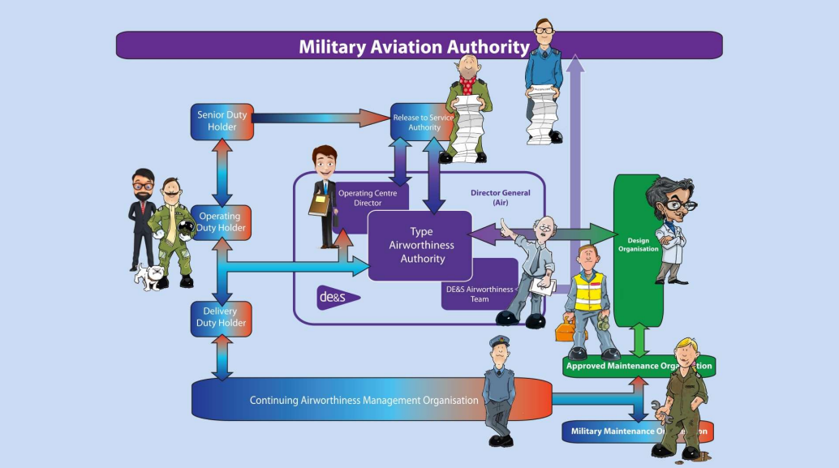
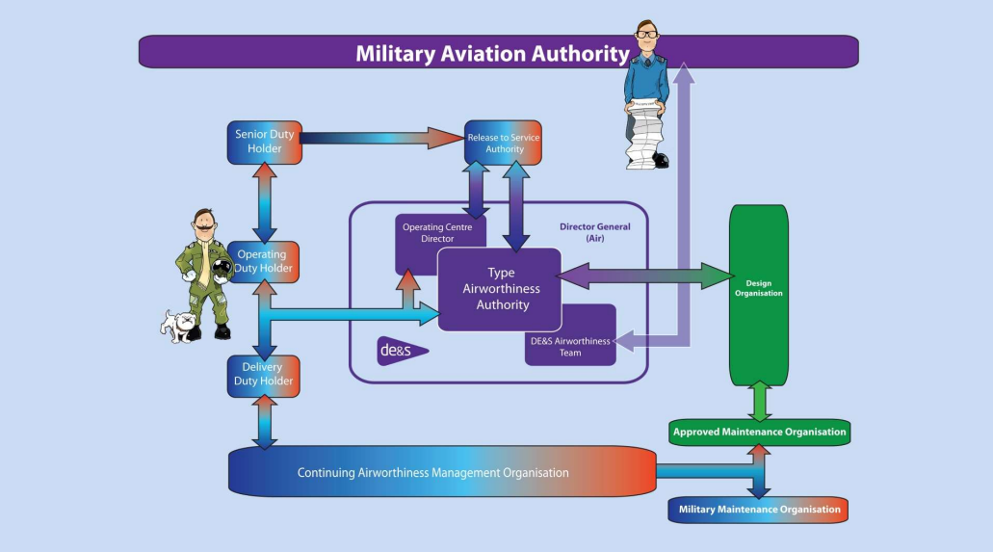
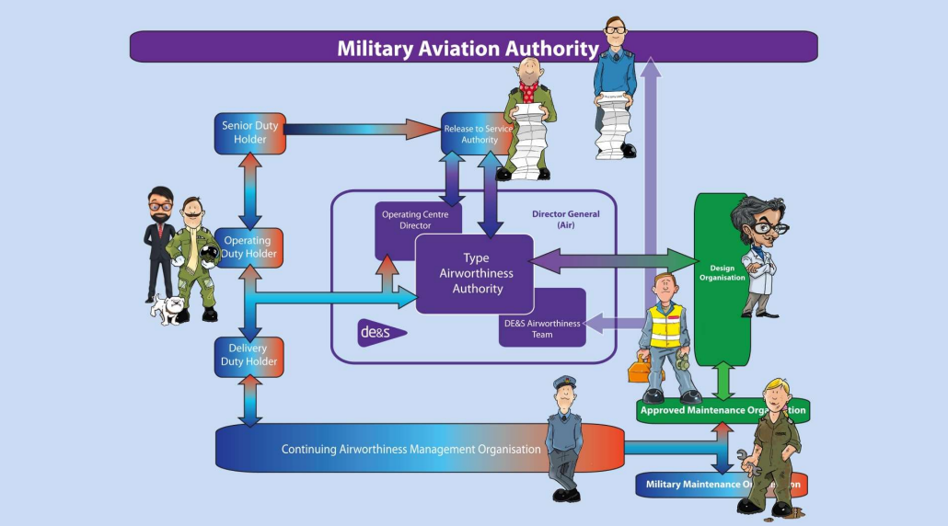
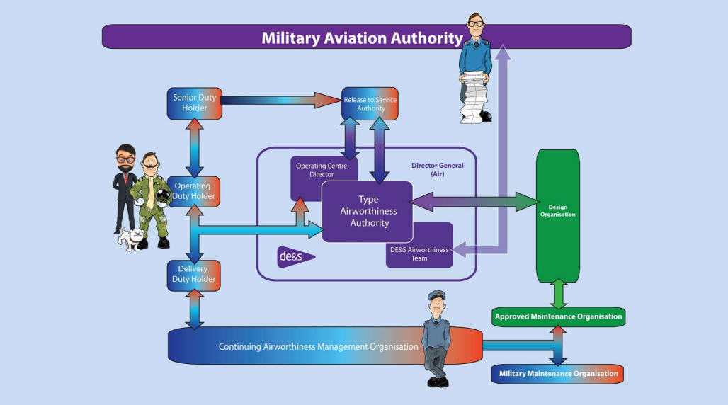
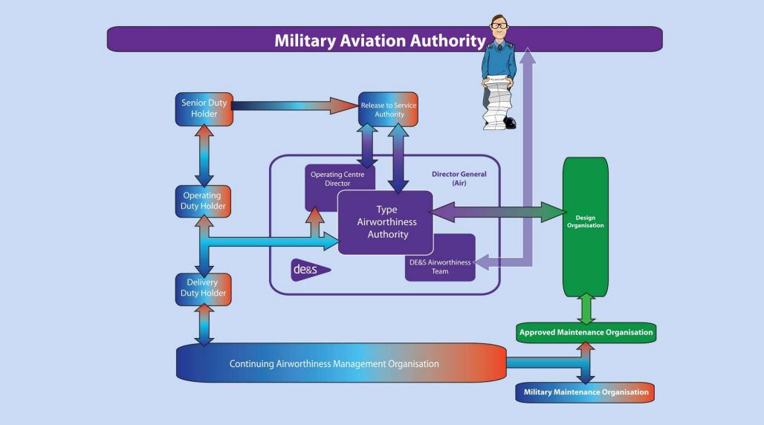

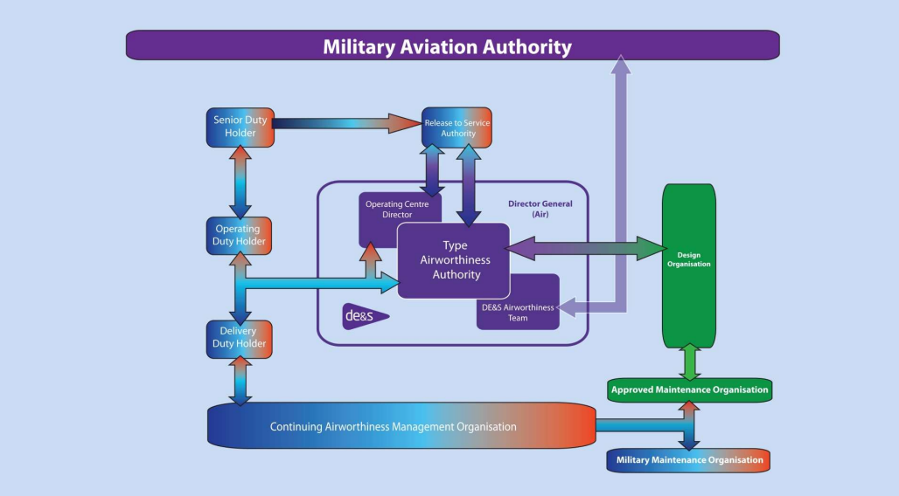
Dir Fixed Wing
Dir Rotary Wing &
UAS (RA1013)
Director Engineering
and Safety (RA 1012 Responsibilities
HEA
Notes:
In order of appearance
MAA
Duty Holder
Accountable Manager (Military Flying)
MilCAM
DO/CDO
Military Maintenance Organisation (MMO)
Approved Maintenance Organisation
RTSA
Core Directors
As was DAT - now called HEA (Air)
TAA

Slide 19
Dir Fixed Wing
Dir Rotary Wing &
UAS (RA1013)
Director Engineering
and Safety (RA 1012 Responsibilities
HEA
Notes:
TAA being the centre character of the Defence Air Environment structure.
What about the HEA?

Slide 20
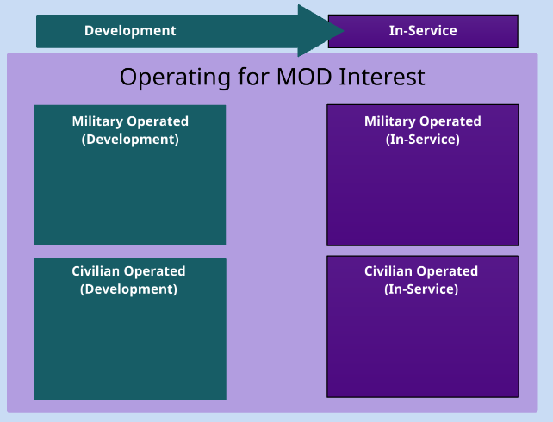

Defence Air Environment Operating Framework - RA1160
Notes:
To provide Defence with the required flexibility over how capabilities are both procured and employed, Air Systems that qualify for military registration may be Military or Civilian-Owned and may be operated under an Aviation Duty Holder (ADH) / Accountable Manager (Military Flying) (AM(MF)). Additionally, an Air System that is not being operated in MOD Interest, but has the wider interest of the UK Government, may be granted UK military registration. Without a clear understanding of the correct governance framework, there is a Risk that key responsibilities may be diluted or neglected entirely, with the result that the Risks associated with operation of the Air System are not adequately managed.
RA 1160 introduces a coherent and consistent operating framework which ensures that similar aviation activities within the Defence Air Environment (DAE) that result in a similar level of Risk exposure, attract the same level of Assurance and scrutiny, regardless of who owns or operates the Air System.
So what is development? – Pertains to a UK military registered air system where the air system or any role equipment or ENBAS that is being trialled, tested etc. This could be with a system in development, experimentation, in support to certification or flight clearance etc.
What about in service then? – Pertains to a UK military registered air system where the Air system and all role equipment and or ENBAS are being used to deliver the capability for which is it intended including training, post maintenance etc.
We then have DAE Operating Categories that sit within both these areas.
Military Operated (Development) – UK Mil Registered Development Systems operated under an ADH
Military Operated (In Service) – UK Mil Registered In Service Air Systems operated under an ADH undertaking front line or training activities
Civilian Operated (Development) – UK MIL Registered Development System operated under an AM(MF) in MOD Interest. Usually associated with air systems that are in production or development for the MOD by industry or tx to industry for modification
Civilian Operated (In Service) – All uk military registered in service operated under an AM(MF) in MOD Interest. This would include activities undertaken by CFAOS organisations including post maintenance test flying, provision of training for MOD aircrew or the transport of MOD personnel
You then have Special Case Flying – The are air systems operated under an AM(MF) which are not in MOD Interest but deemed to be in the interests of the wider UK Government. Can still encompass development and in service activity and can include activities to facilitate exports or being used to deliver a service to a 3rd party customer. - QATARI Hawk is the example

Slide 21
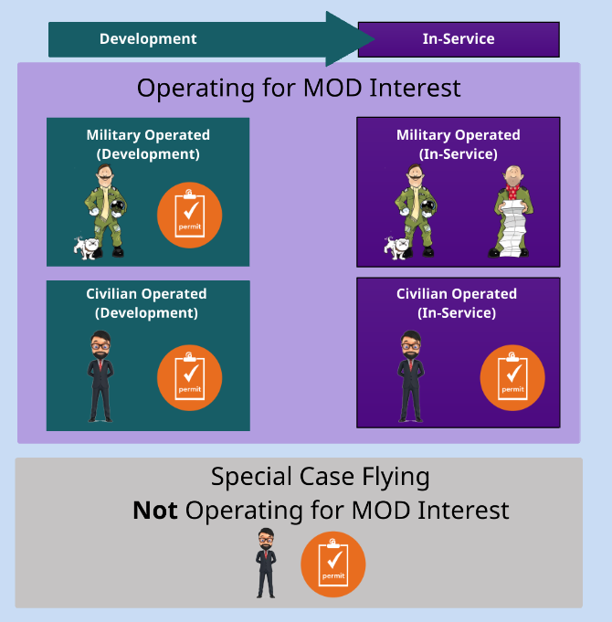
Defence Air Environment Operating Framework - RA1160
Notes:
ADH’s and sponsors of Civilian owned air systems or civilian operated air systems shall assign the air system within their area of responsibility to appropriate operating categories be that (read off the slide)
For all but the Military Operated (In Service) category a Military Permit to Fly is going to be required be it in service or development with the MPTF identifying how such flights are to be conducted.
The key responsibilities for the ensurance and assurance of these operating categories are summarised in the following slide

Slide 22
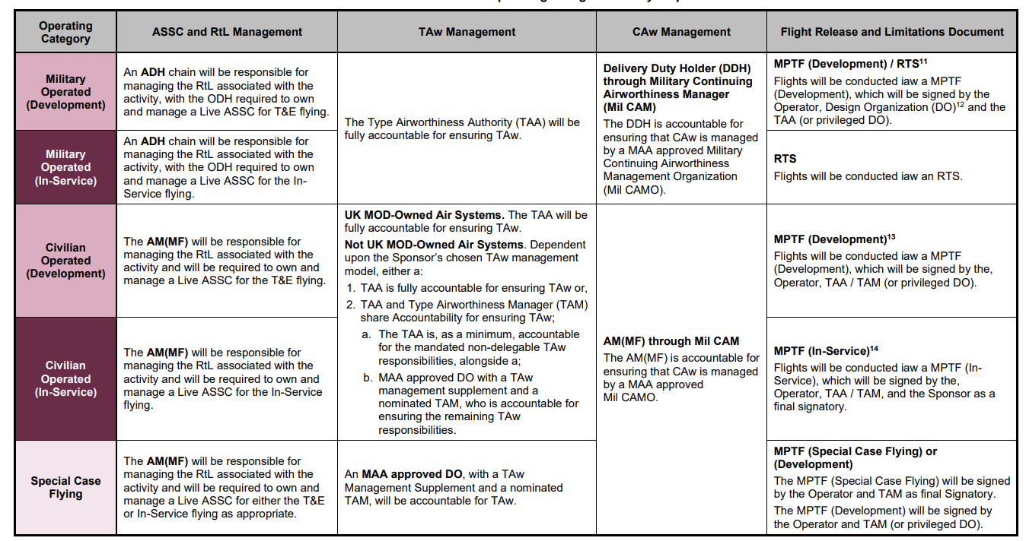
Defence Air Environment Operating Categories - RA1160
Notes:
Table provides an aide memoir for the regulatiry requirements for the x5 operating categories
Note: In a civil type airworthiness organisation the TAM (Type Airworthiness Manager) has authorisations similar to the TAA.
EG Export of Hawk – Special Case Flying (BAE Systems)
To note that the explicit responsibilities for
Civilian Operated Air Systems are detailed in RA1162
Special Case Flying are detailed in RA1163
Note that Civil operated sysems require a MOD Sponsor in the absence of an ADH. The Sponsor is there to ensure the appropriate air safety governance arrangements are in place and are a Level 2 or above crown servant holding appropriate LoD from DE&S CEO.

Slide 23
Air Engineers Toolkit
Why AET?
To address inconsistent approaches across 30+ Delivery Teams managing 70+ air systems and commodities.
Problems Identified:
  Divergent methodologies & tech solutions
  Lack of standardization
  Inconsistent regulation interpretation
  Inefficiency & non-compliance
Foundation:
AET is based on the MRP, but users must understand the MRP–AET relationship for correct application.
Scope:
Covers most MRP requirements relevant to DE&S Air Environment roles.
Tools & Processes:
Developed to standardize activities and ensure consistent, compliant delivery.
Notes:
The AET was stood up to address the problem of differing approaches being taken by over 30 DTs managing more than 70 air systems and commodities to meet the requirements of the MRP. Leading to divergence in methodologies and technology solutions, lack of standardisation, inconsistent interpretation of regulation, inefficiency, non compliance with wider requirements. The AET is based on the MRP but in order for it to be applied correctly users must understand the precise nature of the relationship between the MRP and the AET.

Slide 24
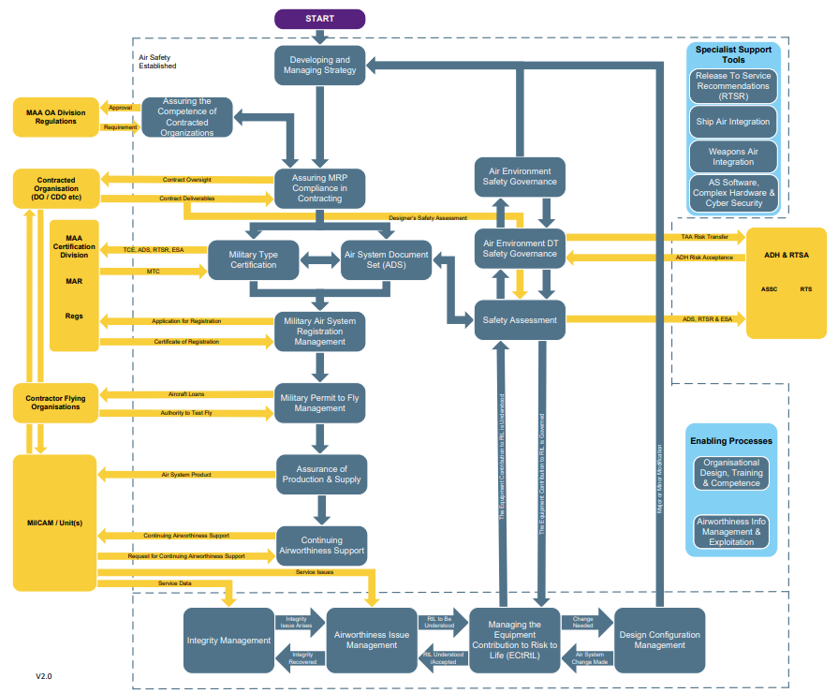
Air Engineers Toolkit
AET
Notes:
AET Processes and Procedures cover all requirements within the MRP that relate to key roles within the DE&S Air Environment. AET tools are developed in order to standardise activities. The map here identifies all the processes and how they relate to each other. On the AET Website most of these processes are web links that will take you to the associated AET Tool.
Image and Botton will take you to the AET if on MODNet. Once there navigate around the tool
Click on area provides:
Flow diagram
Contacts for differing processes
Process Overview
Tool Shadowboard (details of processes in area)
Related DGAPIs and DATINs
Click and discuss – aligns with remainder of course
Air Env Safety Governance (AET P5)
Safety Assessments (AET P16)
Equi Contribution to Risk to Life (AET P17)
MPTF (AET P6)
ADS (AET P11)
Continuing Airworthiness Support (AET P13)
Integrity Management (AET P18)
Design Config Management (AET P7)
Airworthiness Information Management (AET P19)

Slide 25
Any Questions?

