Slide 1
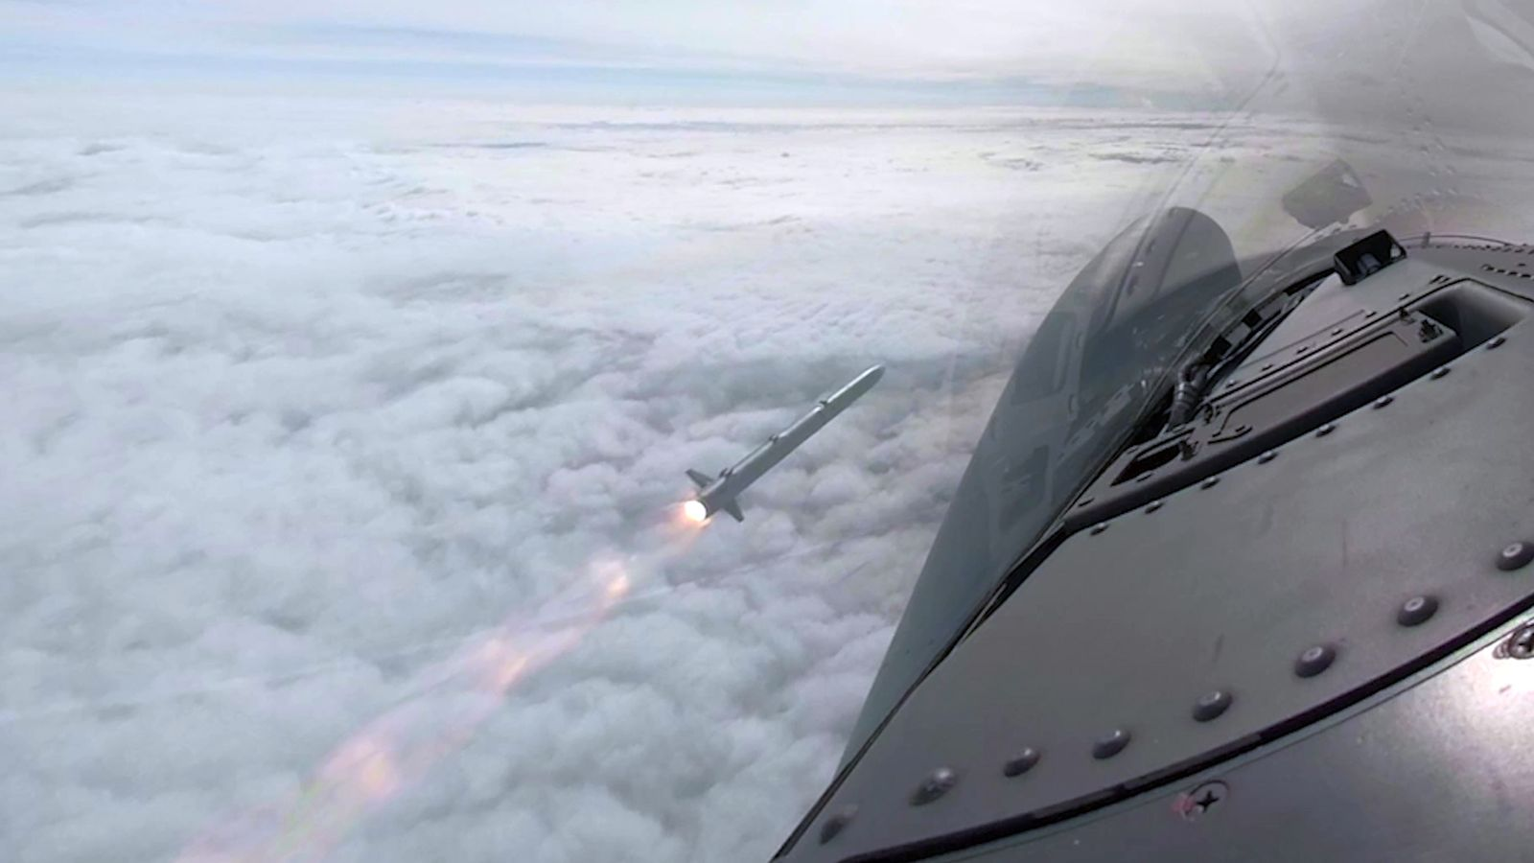
Ordnance, Munition and Explosives Integration
Type Airworthiness Desk Officers’ Foundation Course

Slide 2
OME Integration
Learning Outcome
To provide an understanding of:
Legislation, Policy and Regulations potentially applicable to OME Integration
Inherent Risks
Roles and responsibilities of the TAA related to OME Integration
Roles and responsibilities of the individual Lethality and Protect (L&P) (formerly Weapons Operating Centre (WOC)) Delivery Teams
The Manufacture to Target or Disposal Sequence (MTDS)
Functions, roles and responsibilities of key stakeholders in OME Integration
Sources of OME Integration Information
Outputs of the OME Integration Process
Notes:
READ OFF SLIDE

Slide 3
Definitions and Abbreviations
DSA 02.OME
OME | Ordnance, Munitions and Explosives
Ordnance | A weapon system with its associated munitions and auxiliary material needed to fire the munition.
Munitions | A complete device charged with explosives, propellants, pyrotechnics, initiating composition or chemical, biological, radiological, or nuclear material, for use in military operations, including demolitions.
Explosives | A substance or mixture of substances that, through chemical reaction, is capable of rapidly releasing energy.
OSRP | OME Safety Review Panel Assurance of inherent OME safety shall be through the independent peer review of documentary evidence undertaken by an OME Safety Review Panel (OSRP).
OAS | OSRP Assurance Statement
ALWRC | Air Launched Weapon Release Certificate

Slide 4
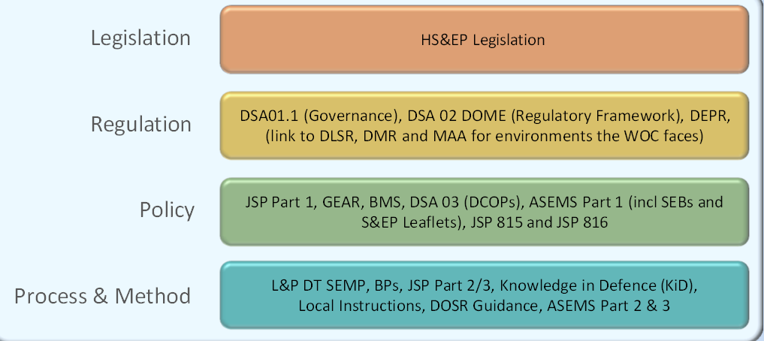
Sources of OME Integration Policy
Notes:
LS&EP – HEALTH, SAFETY AND ENVIRONMENTAL PROTECTION – DEFENCE SAFTEY OPERATING MODEL – FUNCTIONAL STARTEGY
Defence Safety Function Operating Model for the Defence Safety Function replaces the previous Health Safety and Environmental Protection (HS&EP) Function Operating Model for the HS&EP Function
DSA01.1
Dsa 02 DEFENCE ORDANCE, MUNITIONS AND EXPLOSIVES
Dsa 03 DCOP - Defence code of practice
Depr – DEFENCE ENVIRONEMTAL PROTECTION REGULATOR
Woc – WEAPONS OPERATING CENTRE
Jsp 815 – DEFENCE SAFETY MANAGEMENT SYSTEM – PROVIDES THE FRAMEWORK, DIRECTION, GUIDANCE TO DEVELOP AND IMPELEMENT A TAILORED SMS
Jsp 816 – AS PER jsp 815 BUT FOR environmental
LETHALITY AND PROTECTION DT
DOSR – DEFENCE ORDANCE SAFETY REGULATOR

Slide 5
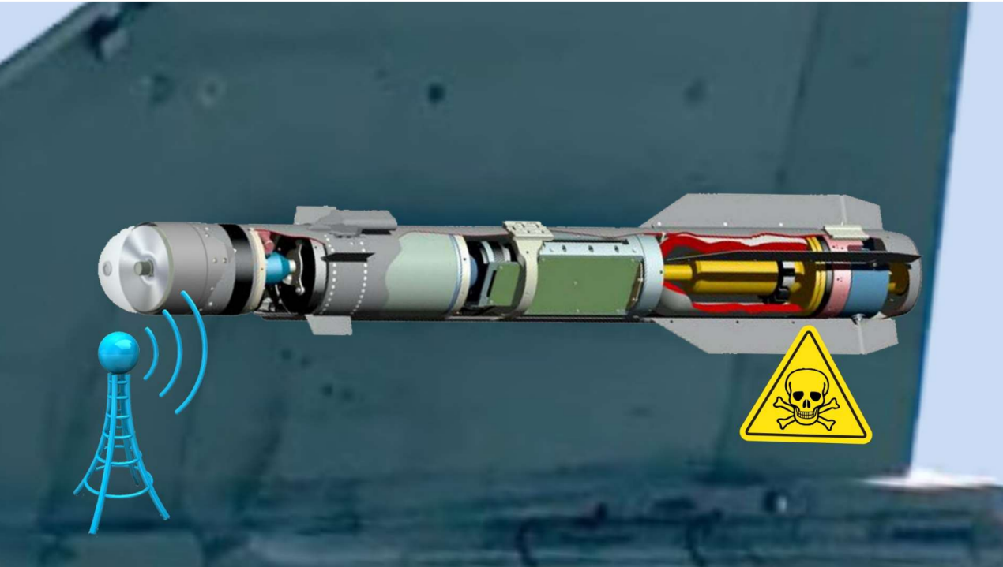
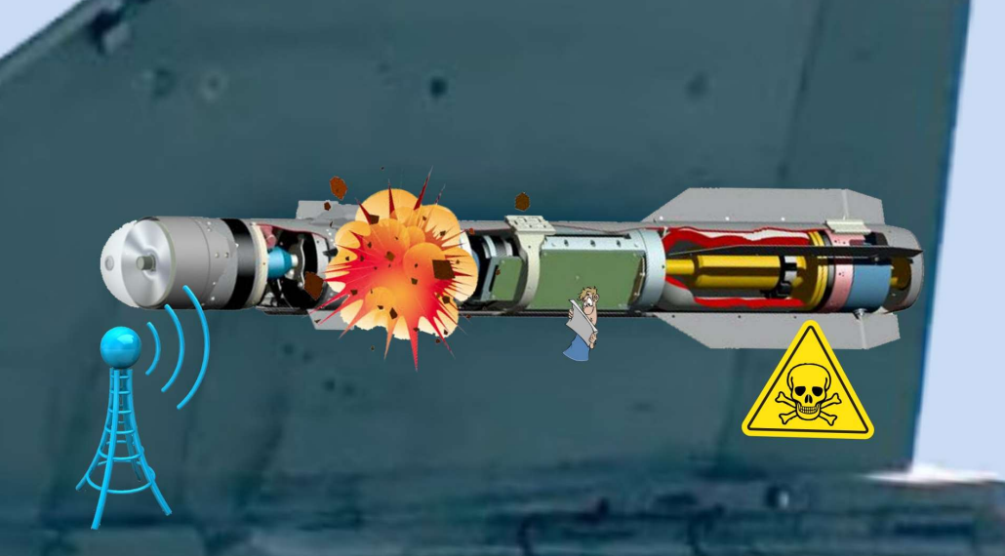
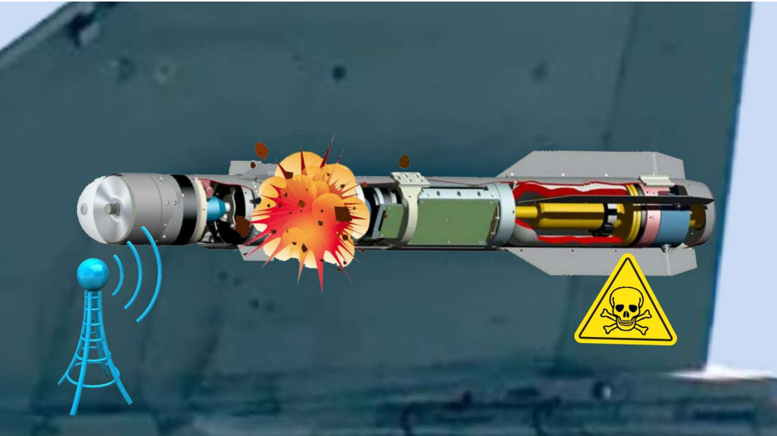
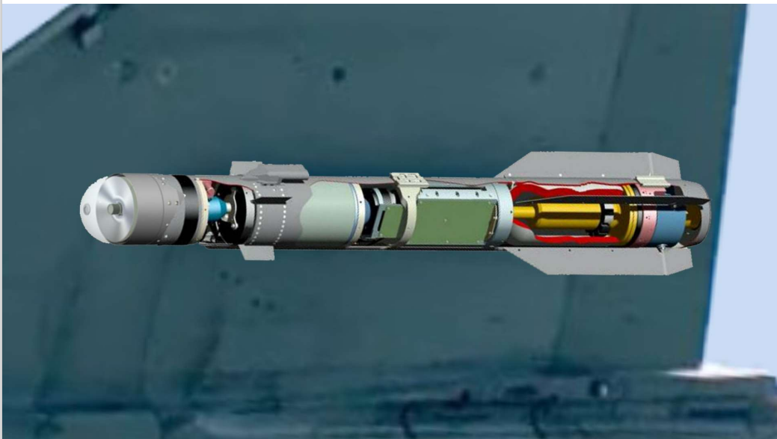
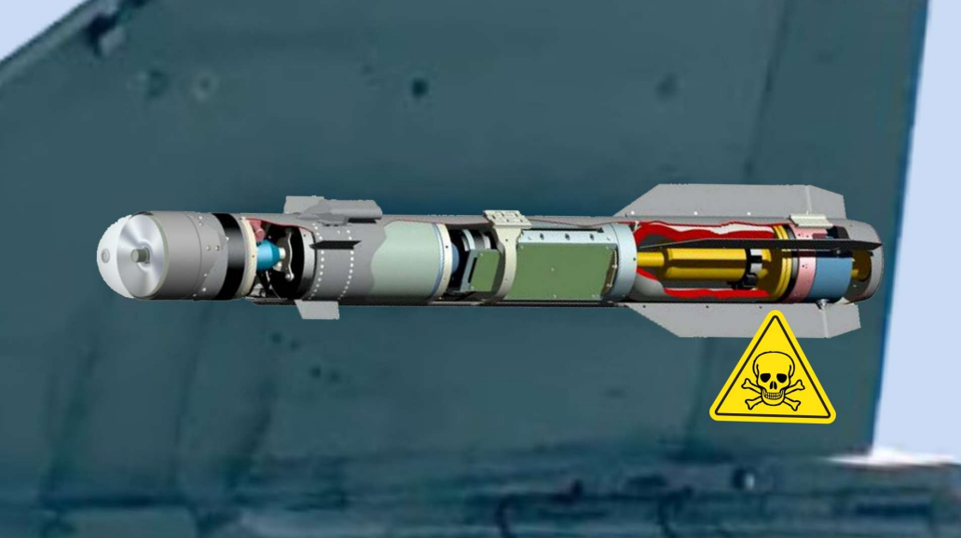
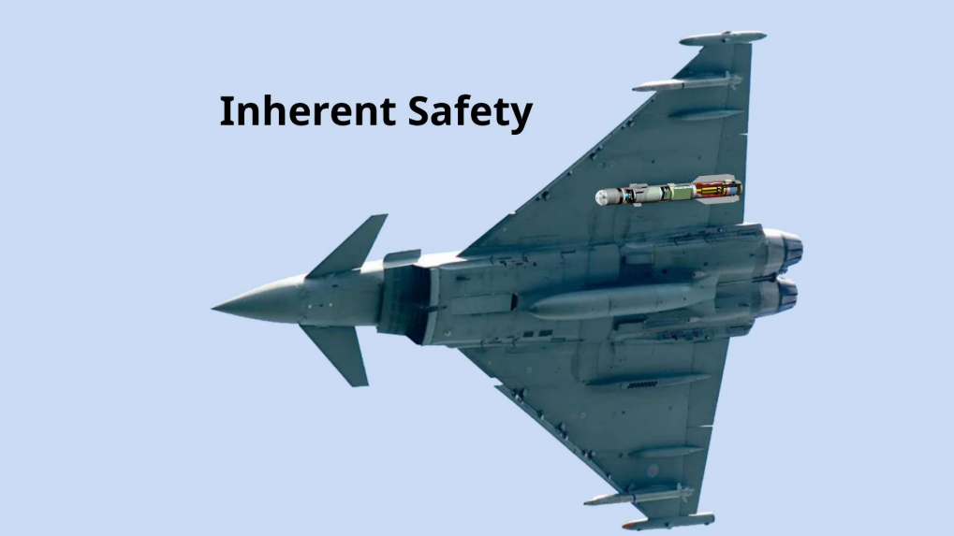
Inherent OME Risks
Notes:
Intrinsic hazards. Those hazards presented by the explosive material in its quiescent state, such as toxicity, composition breakdown, gas / heat generation, material incompatibility etc.
Gassing/extrusion of explosives – Glascoed deep storage
External and internal hazards. Which could initiate the explosive component or have an adverse effect on the firing chain, such as spurious fire commands, EMC / E3 (Electro Magnetic Compatibility / Environmental Electromagnetic Effects) emissions, temperature / drop / shock / vibration, firing chain failure, aerodynamic heating, fragment and bullet attack etc.
Need to eqalise static – RR weapons loading, touch a/c then store – Glascoed use of none sparking tooling and bonding – Flooding of air weapons mag with warshot stingray stored
Hazardous consequences of initiation. Including partial initiation (whether intentional or unintentional) of the explosive component, such as blast, fragment, noise, toxic efflux, heat etc.
Post launch and dynamic safety hazards. Such as loss of guidance control, unintended launch, ricochet, early burst, etc.
Excet firing (Minerva Leader class frigate) – toxic effluent around area of missiles post firing – potential for stingray warshot torpedo motor firing causing excessive heat external of torpedo
Firing of stingray from Lynx, picture torpedo launching out of sea after release and initiation, acquired contact with a/c?

Slide 6
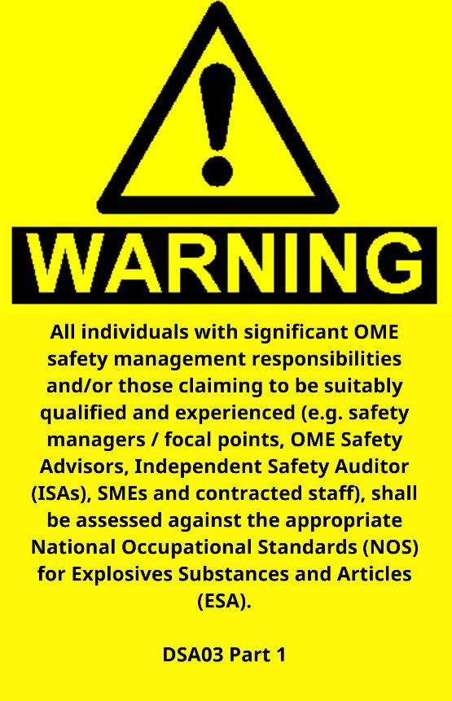
Notes:
Competency, read slide

Slide 7
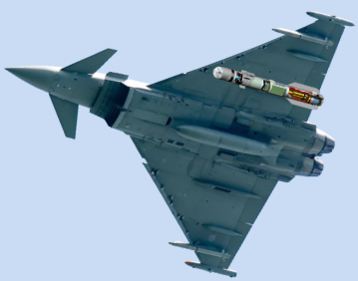
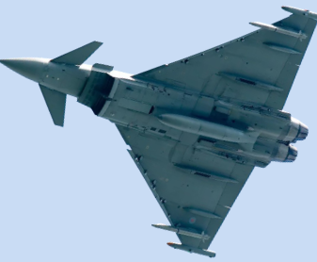
The TAA and OME Integration
DSA 02 & 03
The platform DTL is wholly responsible for the safety of the complete weapons system.
Responsibilities for safety issues that fall outside the definition of Inherent OME safety shall be managed in accordance with the policy requirements in [the MRP].
Where a Safety and Environmental Case covers entire Weapon Systems, a wider combat systems or platforms, the interfaces shall be assessed for requirements and risks that impact on the OME.
Notes:
Whilst the OME CE is responsible for all safety issues associated with the equipment, those hazards that are not included in (inherent OME Risks) are to be managed in accordance with the overarching, domain specific safety regulations applicable to the particular service operating environment. Wherever a safety and environmental case covers entire weapon systems, wider combat systems or platforms, the interfaces shall be assessed for requirements and risks that impact on the OME.

Slide 8
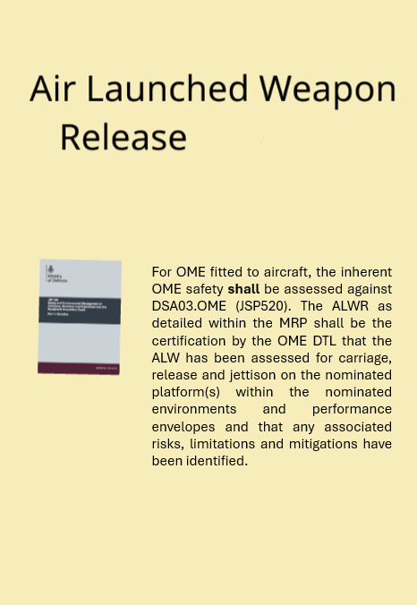
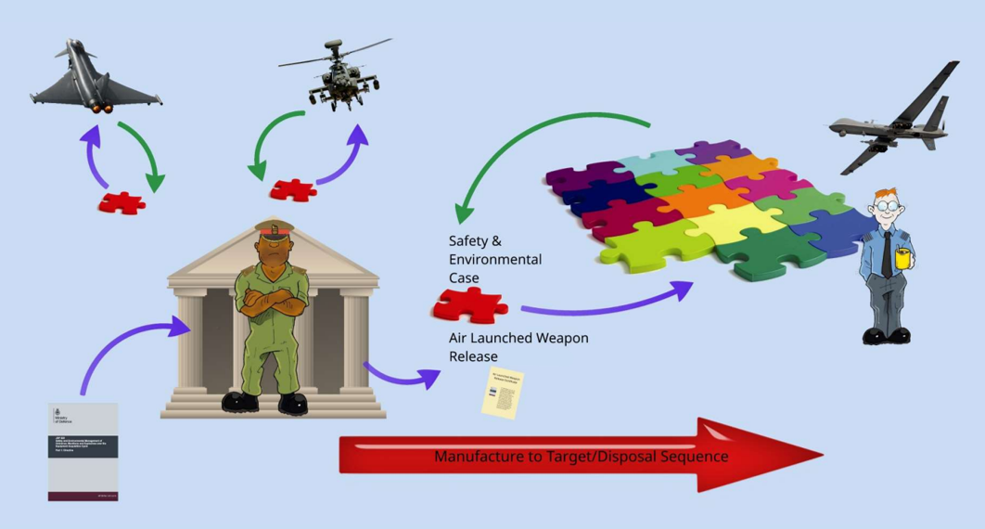
The OME Team Leader
Notes:
The OME CE is responsible for all safety issues associated with the equipment and it is the Duty Holder responsible for the Inherent safety of the OME; For managing inherent safety through all stages of the system lifecylce, in conjunctions with identified Duty Holders; Is responsible for the OME Safety and Environmental Management System integrally with other SEMS as part of the system of systems
ALWR – For OME fitted to aircraft the inherent OME safety shall be assessed against DSAA 03 OME. The ALWRC as detailed within the MRP shall be the certification by the OME DT that the ALW has been assessed for carriage, release and jettison on the nominated platform with the nominated environments and performance envelopes and that any associated risks limitations and mitigations have been identified.

Slide 9
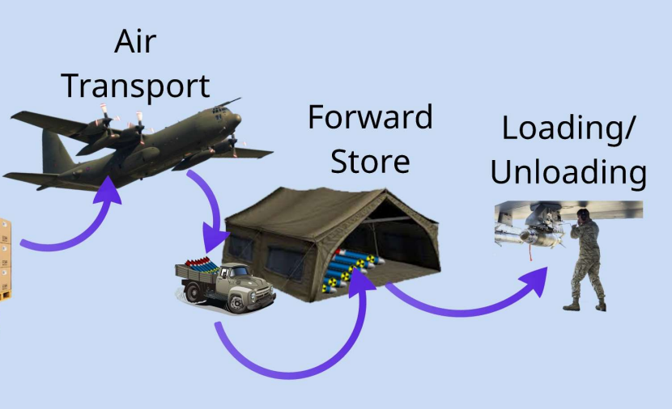
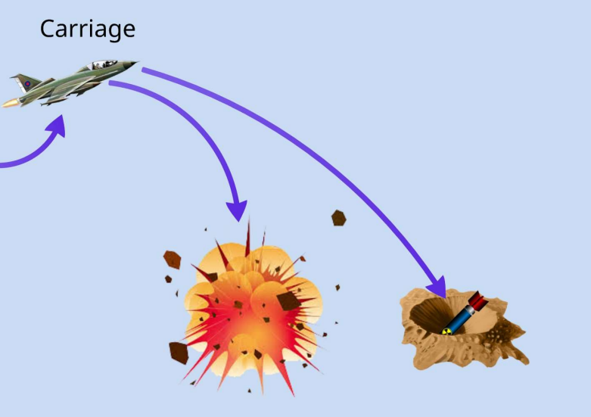
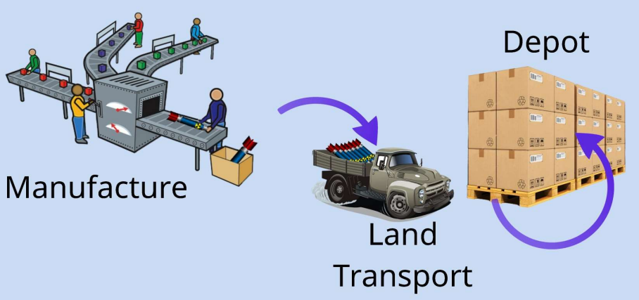
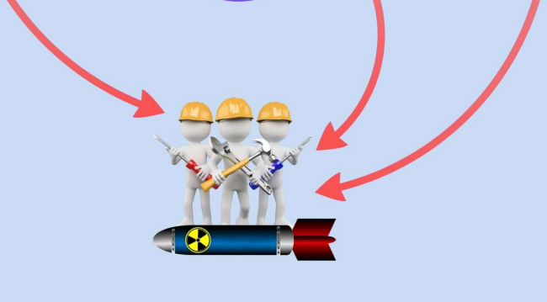
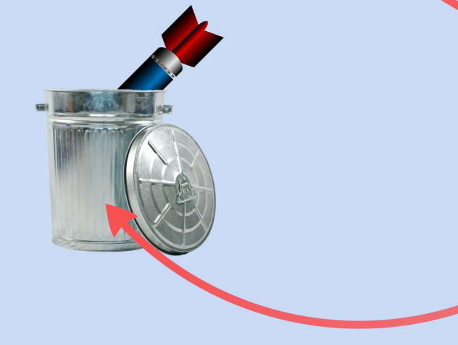
Manufacture to Target or Disposal Sequence
Notes:
THE EXPLOSIVE LIFE CYCLE CAN BE CONSIDERED EQUIVALENT TO THE PLATFORM CADMID CYCLE
Ra 1230(1) GM – RA SAFETY CRITERIA MUST INCLUDE SAFE CARRIAGE, RELEASE/DESPATCH AND JETTISON – FOLLOWING RELEASE OR JETTISON TRAJECTORY MUST BE DEFINED – TAA HAPPY THAT AIR LAUCH WEAPON SAFETY MEETS THE OVERALL OPERATING SAFETY REQUIREMENTS FOR COMPLETE WEAPONS SYSTEM – OWNERSHIP OF RISK OF SELF DAMAGE POST WEAPON ARMING / COLLATERAL DAMAGE IS THE RESPONSIBILITY OF THE ADH, AM(MF) AND COMMANDERS.
OME CE RETAINS RESPONSIBILITY FOR ENSURING PERFIMRMANCE AGAINST SAFETY REQUIREMENTS IS MAINTAINED

Slide 10
OME Integration Stakeholders
Secretary of State
MOD Permanent Secretary
DG Defence Safety Authority
DE&S CEO
Director MAA (Aviation Matters)
DOSR Team Leader (Non-Aviation Matters)
DG Land
DG Air
DG Ships
Director L&P (2*)
Notes:
Lethality and Protect (L&P)

Slide 11
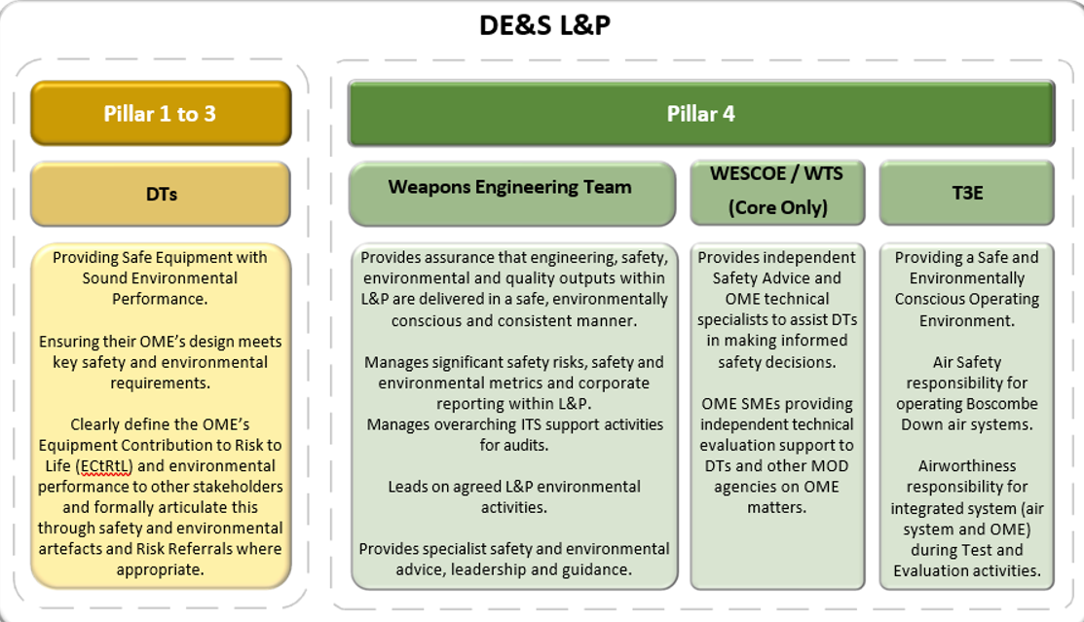
DE&S Lethality & Protect - Responsibilities
Notes:
Read slide
WESCOE – Weapons Engineering and Safety Centre of Excellence
WTS – WEAPONS THECNICAL SERVICES

Slide 12
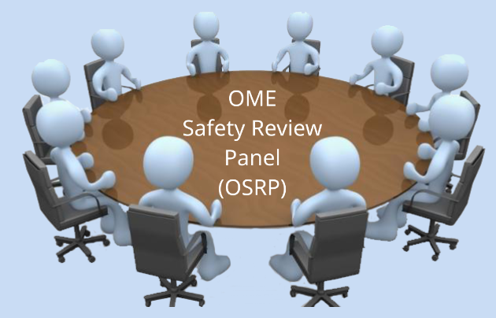

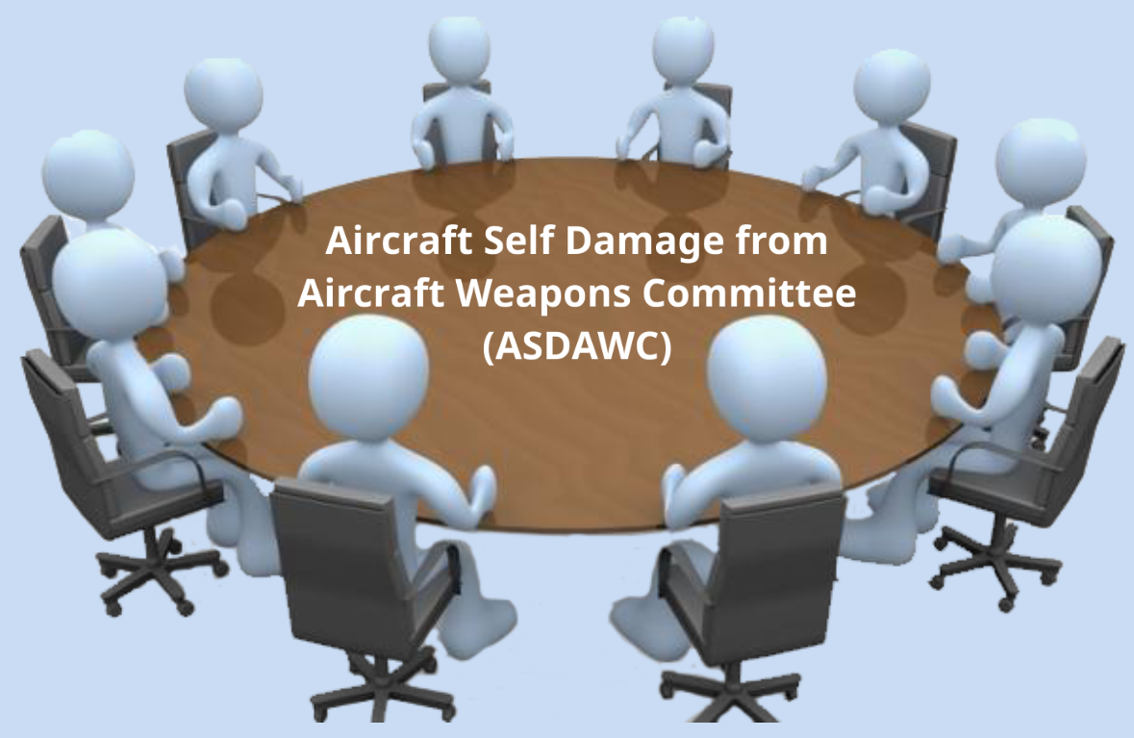

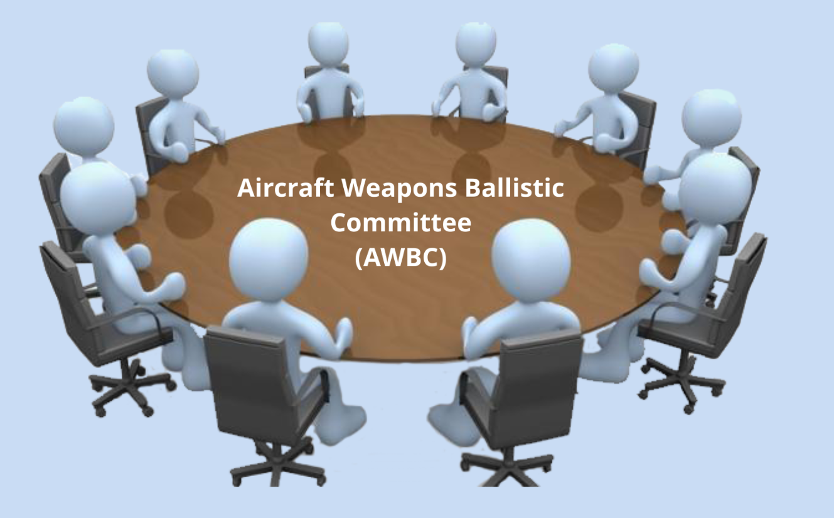
OME Integration Stakeholder
Head of Engineering
OME Safety Review Panel Assurance Statement (OSRP AS)
Notes:
ADVISORY COMMITTEES:
ASDAWC - AIRCRAFT SELF DAMAGE FROM AIRCRAFT WEAPONS COMMITTEE – APPROVES AIRCRAFT SELF DAMAGE (ASD) ASSESSMENTS FOR PUBLISH IN ASDS
TEACASE – THERMAL EFFECTS ON AIRBRONE CONVENTIONAL STORES AND EQUIPMENT COMMITTEE – ADI=VICE ON CARRIAGE LIMITATIONS OF WEAPONS AND EXPLOSIVE RELEASE EQUIPMENT FOR INC IN RTSTHROUGH THE ALWRC
AWBC – ADVISORY INFO FOR PRODUCTION OF BALLISTIC TABLES AND ALGORITHMS FOR AIRCRAFT WAEPONS AIMING.

Slide 13
Outputs
Delivery Team
OSRP
Platform Delivery Team
Whole Aircraft Safety Case
OME Safety Submission
Equipment Safety Assessment
OSRPAS
Air Launched Weapon Release Certificate
Operational Input
Operating Safety Assessment
Notes:
OME Safety Review Panel (OSRP)
OME Safety Review Panel Assurance Statement (OSRP AS)
PRIMARY OUTPUT FOR WEAPONS INTEGRATION PROCESS, ROBUST SAFETY ASSESSMENT FOR THE END USER PLATFORM (ASSC) – CONTRIBUTED TO BY THE OME SAFETY AND ENVIRONMENTAL CASE (SEC) – ENDORSED BY THE OME SAFETY REVIEW PANEL (OSPR).
OSRP OUTPUT IS A OSPR ASSURANCE STATEMENT (OSRP AS)
SEA AND OSRP AS INFORM AN ALWRC – STATEMENT AN ACCEPTABLE SAFETY ASSESSMENT HAS BEEN PREPARED FOR THE WEAPON
ALWRC – CERTIFCATION BY THE WEAPONS DT L (CE) THAT ALW HAS BEEN ASSESSED FOR CARRIAGE, RELEASE, AND JETTISONON NOMINATED PLAFORM(S)WITHIN E=NIRONMENATAL AND PERFORMANCE LIMITATIONS, RISKS LIMITATIONS AND MITIGATIONS HAVE BEEN IDENTIFIED
NOTE: ALWRC ONLY ISSUED FOR ALW AND CANNON AMMO (25mm OR LAGER) – PYROS AND SMALLER CAL AMMO – SIMILAR PROCESS FOLLOWED RESULTING IN ENGINEERING ADVICE LETTER RATHER THAN AN ALWRC.

Slide 14
Any Questions?

