Slide 1
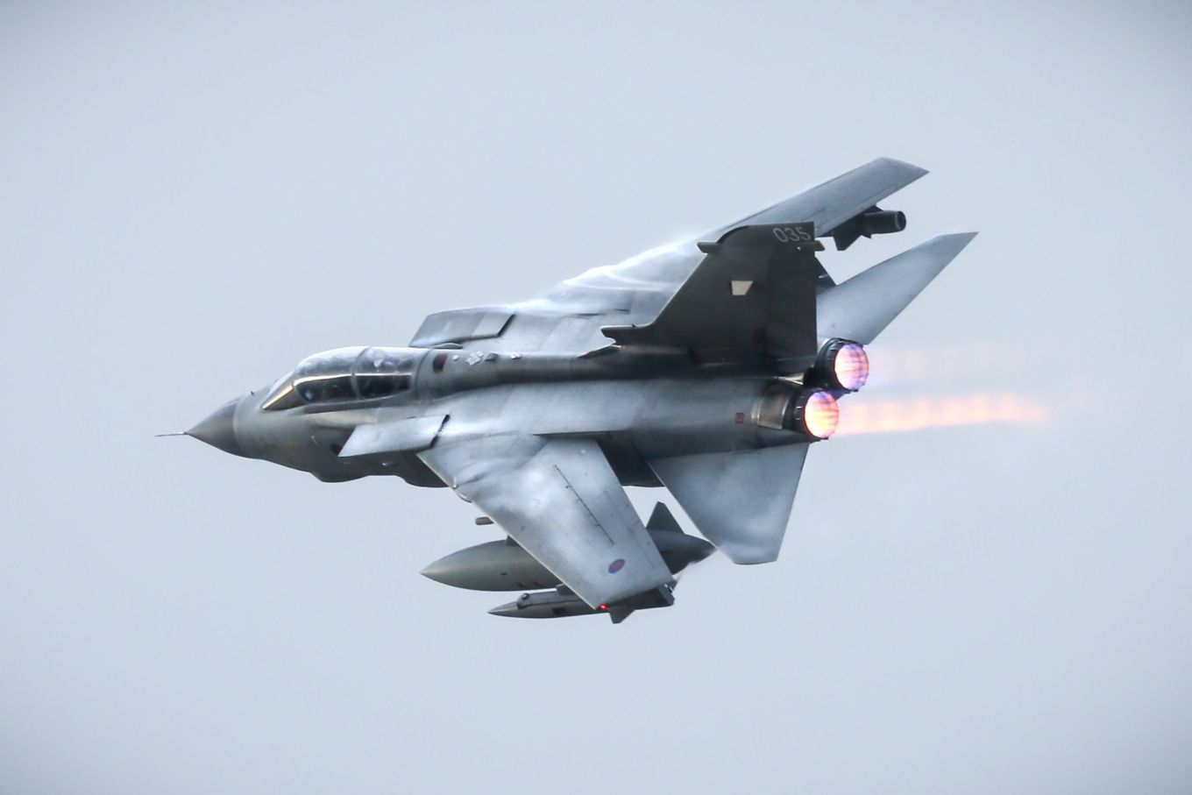
A Day In The Life Example of a Desk Officer (Fault Rep)
Type Airworthiness Desk Officers’ Foundation Course

Slide 2
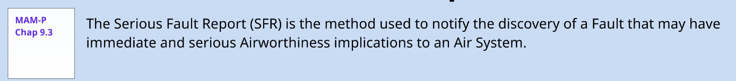
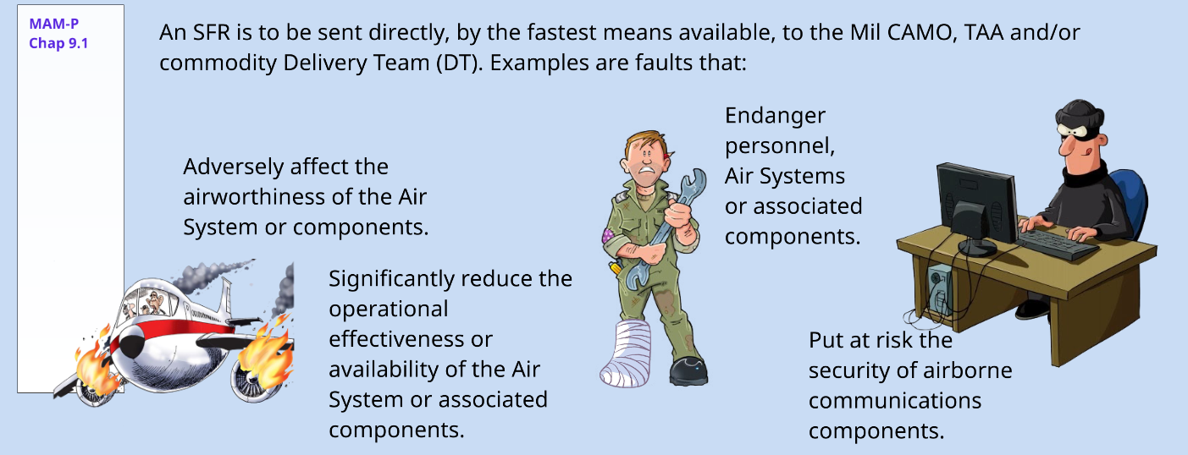
Serious Fault Report
Notes:
So we have had the DASORS and we have performed some safety assessment on the findings to see how it impacts on the ECtRtL and consider that this is a Serious Fault so we are going to have to raise a Serious Fault Report.
Note MOD Form 760 Narrative Fault Report is raised automatically in support to a SFR

Slide 3
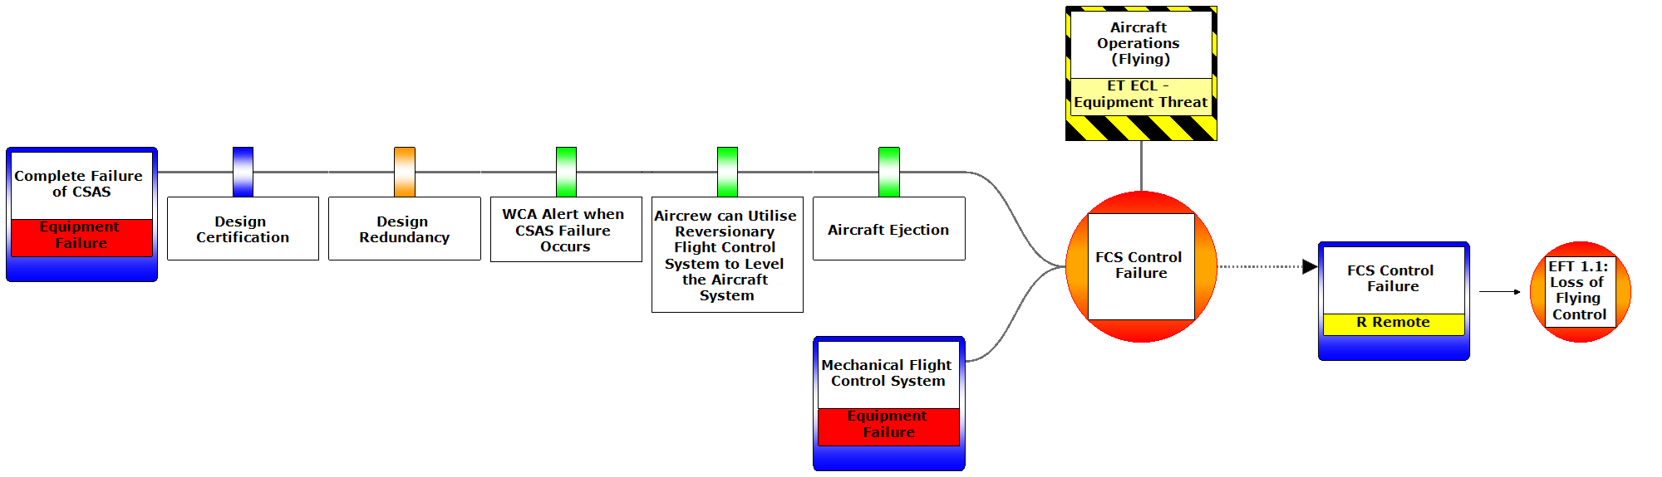

So we need to tell the Duty Holder
Notes:
There has been an increase in the ECtRtL so the Duty Holder has to be told
Informed throigh the ECID – Equipment Contribution Interface Document

Slide 4

Interface with the Duty Holder
Regulation 1032(1)
AA- Facing Organisations (internal) shall deliver and supply safe aviation-related services and/or resources to ADHs/ AM(MF)s.
AA-facing organisations should, […] formally communicate to the relevant ADH any decision, activity or change that has the potential to introduce new or increased RtL.

Slide 5
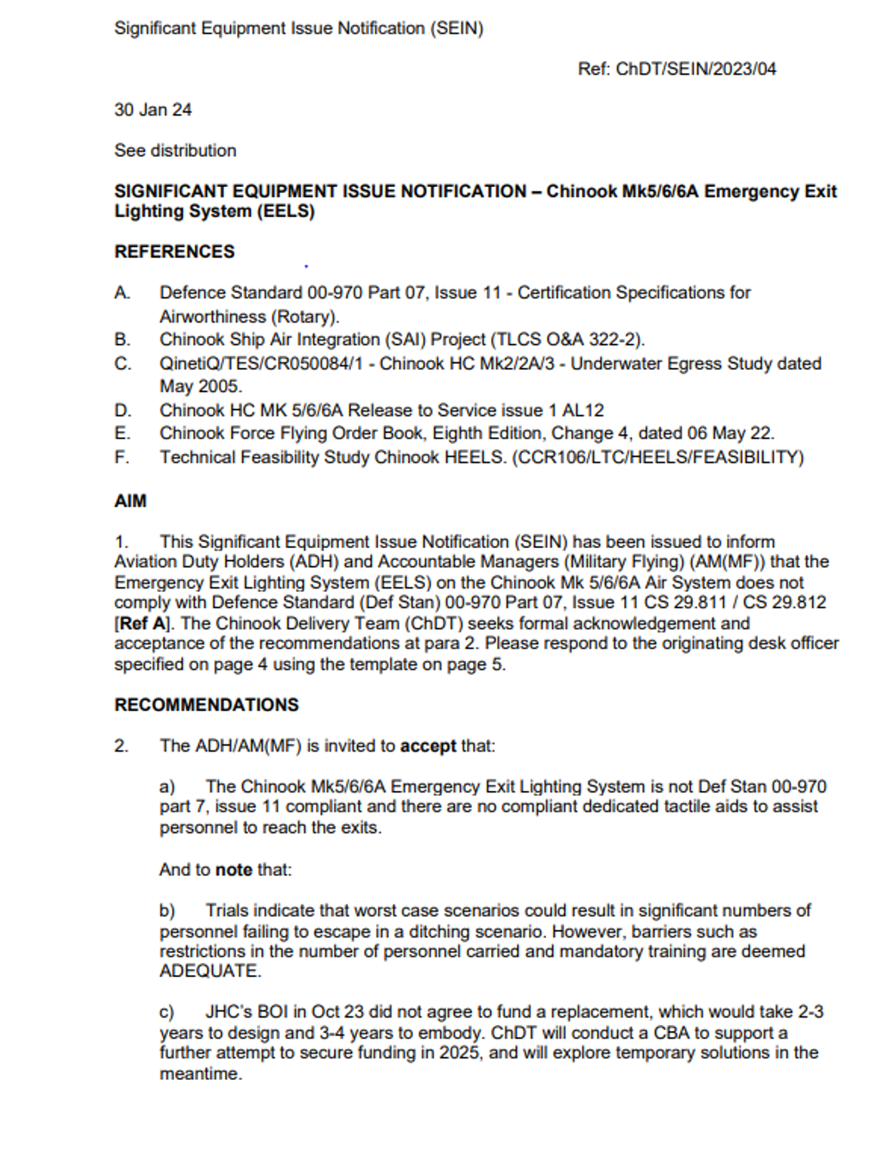
Significant Equipment Issue Notification (SEIN)
The purpose of a SEIN is for a TAA to bring to the attention of an ADH / AM(MF) an issue which significantly increases the ECtRtL. In this respect, there is a close relationship between AET Process 14 and AET Process 17.
In summary, Process 17 is to do with reporting ECtRtL, en masse, to the ADH / AM(MF) via the ECID and routine governance forums, whereas Process 14, and the SEIN, is to do with reporting a significant change to a specific ECtRtL in between governance forums and in an expeditious manner.
SEIN [PLACEHOLDER]
 | Process 14 - AIM | Process 17 - ECtRtL
When Applicable | Used to report Airworthiness Issue | Used to communicate ECtRtL
Single risk or en masse risk | Single | En masse
When raised | When there is a significant change to a specific ECtRtL | Routinely throughout the year
Vehicle | SEIN | ECID and governance forums
Notes:
Enclosure 7 provides the SEIN for the failure of the CSAS Reversion to Mechanical Mode provided to the Tornado DH Chain due to their being a potential increase in the Equipment Contribution to Risk to Life.
So the SEIN is the 1st formal means to inform the ADH of any issues that could impact the operating risk of the platform. The key here is to be clear and explicit in completing one of these but also it should be said that the ADH would in most cases like to have a verbal call to alert them to the incoming issue of the SEIN. A DDH once said to me ‘Ben, I don’t mind bad news, I just don’t like surprises….!!’ The point here is that if the DT are working a SEIN which is likely to introduce a limitation or a reduction in component life which will have a knock on to capability or availability, don’t let the SEIN be the first time that the Duty Holder chain is informed.
A SEIN is likely to take a couple of weeks to generate. Informing the Mil CAMO early that there is an emerging issue will enable the appropriate messaging up the Chain and allow contingency planning to take place!
So looking at the AET Process 14 F the SEIN in big handfuls provides information to the ADH on an identified issue supported by technical analysis and the impact the issue has on the ECtRtL. It will identify wider implications of the issue on DLODS and identify an action plan signing off with a TAA declaration.

Slide 6

THE TAA ASKS YOU TO DIG DEEPER!

Slide 7

Narrative Fault Report (MOD F760)
MAM-P
Chap 9.2
Some faults warrant a more detailed investigation. The MOD F760 Narrative Fault Report is used to provide the additional information needed.
A MOD F760 must be raised on the following occasions:
For any fault on Not In Use (NIU) equipment
When instructed to do so in an SI(T) MFRI, or any other instruction
Automatically in support of a serious fault report
When instructed to do so by a Service Inquiry
When it is considered that the fault may affect safety, equipment availability or performance
Where it is considered worthy of detailed investigation
On faults which are considered by local management to merit CAMO, TAA, or commodity DT attention
Notes:
Enclosure 8
Faults with Air Systems and associated equipment in the Defence Air Environment (DAE) are resolved by repair or replacement of components, accompanied by routine reporting procedures as described in RA 4814 and Chapter 9.1 of the MAM-P - Fault Reporting.
Some Faults, however, warrant a deeper, more detailed investigation to isolate the cause and/or explain an unexpected failure. In addition to routine Fault reporting, the MOD Form 760 Narrative Fault Report is used to provide the additional information needed to undertake this investigation.
Anyone raised one of these as yet? What was it for?
Anyone know what other 760 forms are available?
760- A – Fault Investigation Request
760- B – NFR Request for Mandatory Fault Reporting Instruction (MFRI) Action issued and managed by the TAA when 760s are needed on specific items of equipment restricted to monitoring, validating lifing policies, monitoring effectveness of mods or SI(T) or when further info info is required to supplement fault case histories.
760- C – Compilation Instructions of how to complete a form 760
760- E – Faulty Equipment Label – to be used pending receipt of disposal instructions on equipment subject to MOD Form 760 action
761 – Fault Investigation Report
So who is responsible for raising a 760? - the maintenance org holding the faulty system or equipment at the time the fault was discovered or the investigating officer of an air system accident or investigation.
A big issue with the NFR is where you need the involvement of the OEM - If the manufacturer does not get on board or agree with these then you are onto a failure straight away, as you will not have any feedback from them.
This is something that the TAA will need to focus on as part of their building and maintaining relationships between the different organisations involves and making sure the right contractual touch points exist that work to ensure the organisations will react in the necessary way to thinkgs such as 760s etc.

Slide 8
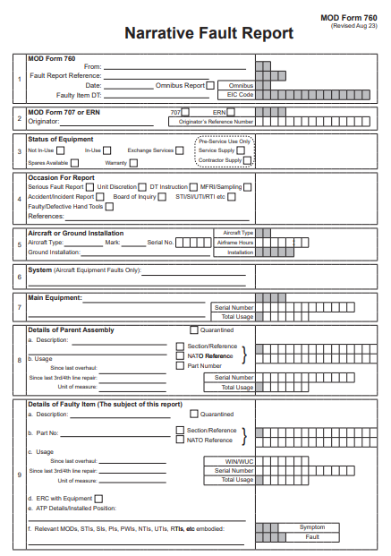
Narrative Fault Report (MODF760)
DGAPI 16 Governance Requirement
All Air Environment DTs shall establish and document their systems for equipment fault reporting and investigations.
Notes:
The Mil CAMO may request the raising of an F760 against a component due to either a high failure rate or an unexplained failure mode linked to a safety occurrence. In both cases, an unmitigated air safety risk exists—often reflected by an open DASOR pending resolution. The subsequent investigation, typically led by the Desk Officer, can take several months to complete. In my experience, Desk Officers have not always been sufficiently proactive in holding the DO accountable or driving timely closure of these investigations. While outcomes may include increased inspection regimes or reduced component lifing, the critical point is this: during the investigation period, the Air System remains exposed to elevated risk—risk that could be mitigated sooner through a more urgent and focused F760 investigation.

Slide 9
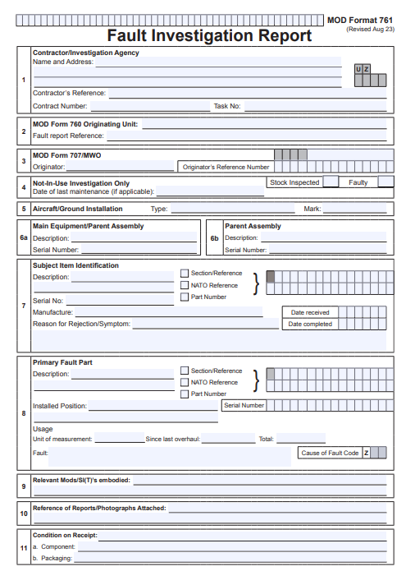
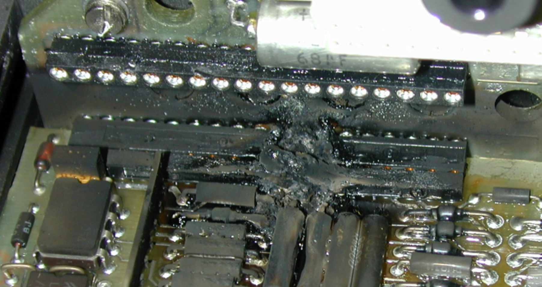
Investigation Report (MOD F761)
Notes:
Investigation identified that it was the power capacitors in the power supply that caused the fire however the box was never lifed. They had by the time of the failure done 20 years. In the wider investigation an attendee at some of the early design meetings stated that it had been discussed that the unit was supposed to be lifed along with several other items of equipment but there had been a conscious decision made to disregard all of them. The DT on finding the issue went back to the supplier and asked if they needed to be changed and was this known. They were told that the rest of the operators had indeed being changing theirs at the necessary time. The MOD chose not to understanding that they operated 250 or so aircraft – costs add up.

Slide 10
The Recommendations
Immediately check all CSAS computers for an excessive ripple voltage on each PSU. Test can be performed with computers in-situ using a locally-manufactured Breakout Box and oscilloscope (c2 hours per aircraft).
Return all CSAS computers to the Avionics Bay for a Standard Serviceability Test at regular intervals.
Campaign the replacement of the capacitors in the PSUs.
Notes:
The Capacitor failure found to have caused a 28V short to earth which burnt out the CSAS element. (See FTA)
Interestingly BAE had as part of a life extension programme stripped the modules and tested them with no restorative work performed. Nothing had been said about the lifed capacitors, no replacement etc.

Slide 11



Who should we tell?

Slide 12
Significant Equipment Safety Occurrence Report
AET Process 14G
TAAs and DTLs should ensure that significant equipment Air Safety issues identified by their DT, that may also require consideration by other air system DTs, are communicated using a SESOR.
A SESOR is a closed loop reporting format for communicating significant equipment safety/airworthiness issues between DTs in the DE&S Air Environment.
It provides assurance that equipment issues that may affect multiple air systems have been communicated successfully between DTs by presenting an audit trail of comments and actions.
ASIMS is the primary medium for staffing SESOR activity.
Notes:
SESOR ultimately used to raise the life item issue to the wider DE&S. Other Air Systems may find that they are affected and then they need to inform their Duty Hoder via DASOR or SEIN Etc.

Slide 13
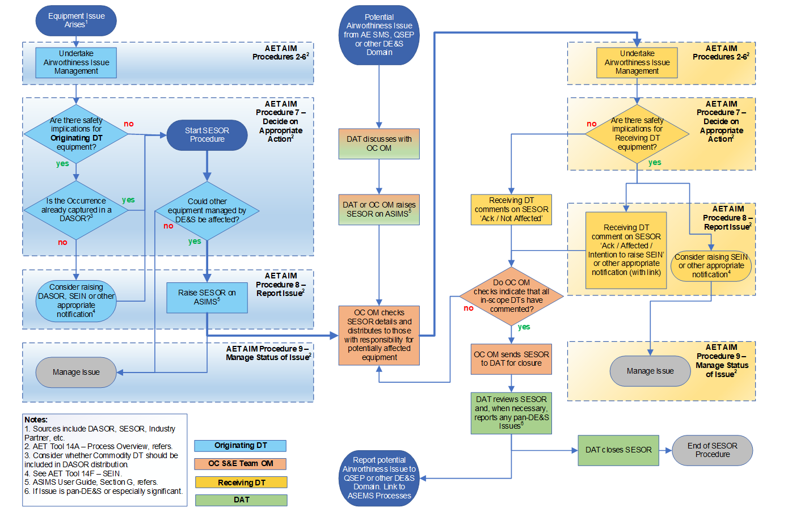
Notes:
Process of raising a SESOR
So in understanding whether there are any safety implications for the originating DT, if there are then the next question is whether it has been recorded in a DASOR. If not then do so along with perhaps a SEIN and start the SESOR procedure. The next question is whether there is an impact on other DE&S managed equipment. If not then there is no need for a SESOR and the originating DT handle it, is there is then a SESOR is raised on ASIMS. The Director as was OC checks the SESOR and distributes it to those with responsibilities for potentially affected equipment. Then on that affected side they then work the AIM process with outputs including SEINs that are then sent to the DAT for closure.
ASIMS is the primary medium for staffing the SESOR activity
So has anyone an example of a SESOR?
The one we have pertains to an issue reported around 2002, on a Jetstream T Mk2 where a clear fluid was observed leaking from a High Intensity Strobe Light – Power Supply Unit (HISL–PSU). The fluid was found to be the electrolyte from capacitors within the PSU and was subsequently identified as a dangerous engineering substance called dimethylformamide (DMF), which is toxic, harmful by inhalation and readily absorbed through the skin. The HISL-PSU was fitted to approximately 16 aircraft types, with multiple marks, across fast jets, transport, and rotary wing fleets. There were 2 fitted to each aircraft, so the total quantity including spares within the supply system ran into the thousands. As such a SESOR was raised to raise the issue to the wider fleet for action.
The recommendation of the SESOR was for Platform PTs (except Typhoon which didn’t have this equipment fitted) to ascertain whether their aircraft either flying or ground training have HISL - PSU, Part Number: 8ES003417-00; NSN: 6130-12-1879698 fitted and replace them with HISL PSU, Part Number: 8ES-003-417-00-2006A; NSN: 6130-99-3711549 at the earliest opportunity. Platform PTs update their Aircraft Documentation Sets to prevent inadvertent future fitment of HISL PSUs containing DMF.
Subsequent RTIs were raised by the different DTs however it was not a uniform approach with some DTs electing to replace all with others only electing to replace those that were seen as leaking....resulting in a loss of configuration control of the part across the fleet.
ACT instigated a capacitor replacement programme for all PSUs, and to regain configuration control changed the Part Number and NSN of the HISL PSUs to 8ES-003-417-00-2006A and 6130-99-3711549.

Slide 14
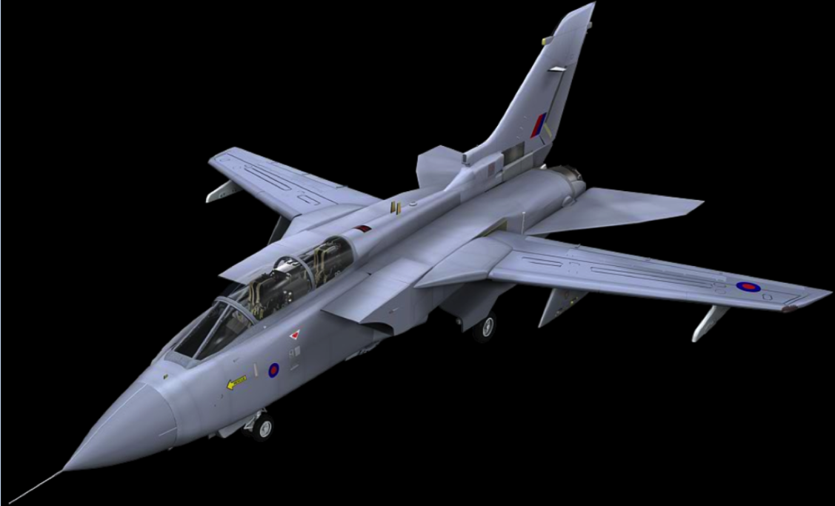
Back to the Tornado…

Slide 15
Action Plan
Immediately Check all PSUs (in-situ) for excessive ripple
Bay check all computers at regular intervals
Campaign the replacement of out-of-date capacitors
UTI
RTI
MOD
Manual of Airworthiness Maintenance - Processes
Special Instructions (Technical) (SI(T)) are instructions, issued by, or on behalf of, the Type Airworthiness Authority (TAA) or Commodity Delivery Team (DT), to undertake a work package to identify, monitor, repair or prevent the occurrence or re-occurrence of a potential Fault.
There are 2 main types of SI(T)s:
1. Urgent Technical Instructions (UTI) – Raised when an action is necessary within 14 days or 25 Flying Hours.
2. Routine Technical Instructions (RTI) – Raised for less urgent action. SI(T) are instructions to invoke rapid action and are not intended to circumvent more formal action, such as modification or Maintenance schedule amendment
Notes:
Special Instructions (Technical) (SI(T)) are instructions, issued by, or on behalf of, the Type Airworthiness Authority (TAA) or Commodity Delivery Team (DT), to undertake a work package to identify, monitor, repair or prevent the occurrence or re-occurrence of a potential Fault.
With UTIs it’s a good idea to discuss the UTI with the MilCAM to make sure all elements that are being considered are going to be able to be progressed and then as a Desk Officer monitor the activity once underway.
So, with this approach it is decided to
conduct a UTI that will investigate the failure state of the CSAS on the fleet. - Ripple Current Test
An RTI to bring each of the CSAS to the work bench, so removed from the aircraft to perform a routine activity to check the computers at regular intervals and then
a modification to replace the failed capacitors
Can you update your ECL with these barriers – where do we think they belong?

Slide 16
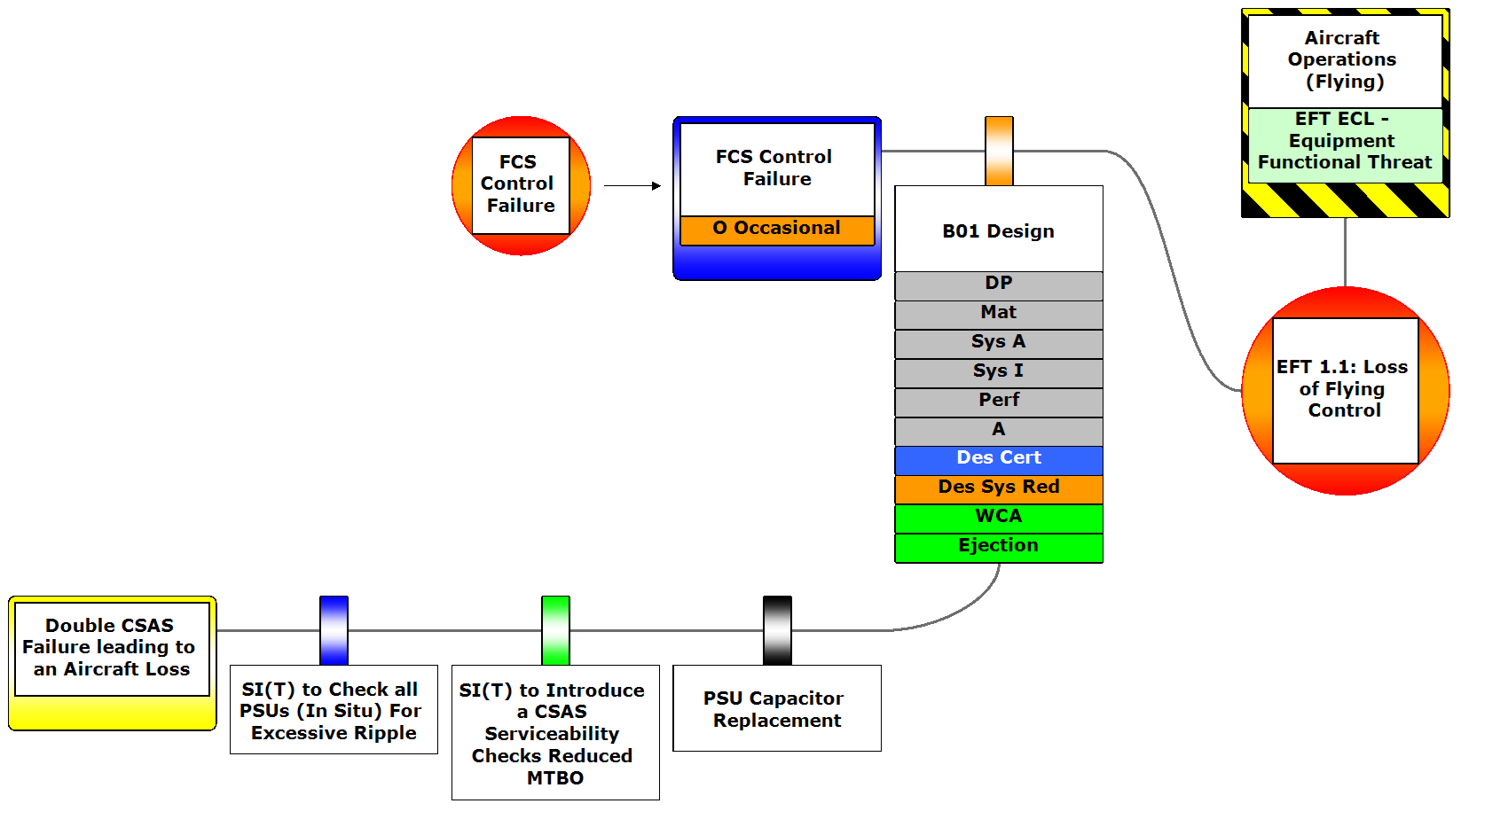
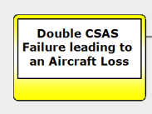
NDN
Notes:
So how does the Action Plan translate onto the ECL? Update you ECL with where you think it belongs
So, we have the UTI RTI, MOD and perhaps the capacitor replacement identified as barriers on the Escalation Factor and their strength assessed

Slide 17
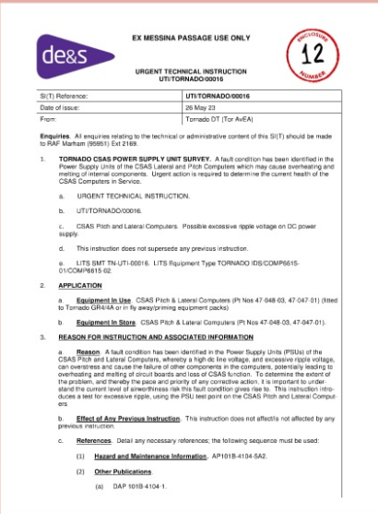
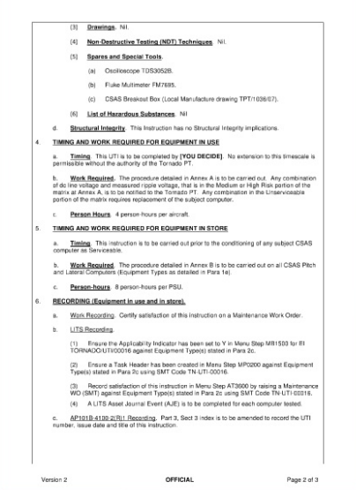
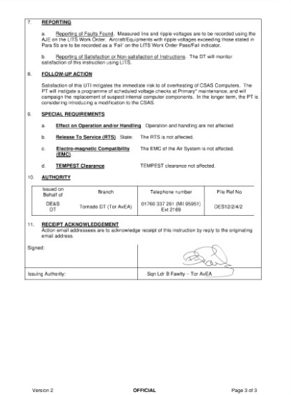
Urgent Technical Instruction
Guidance Material 5405(1)
The Urgent Technical Instructions (UTI) / Routine Technical Instructions (RTI) can be used to disseminate information of a technical administrative or policy nature.
Regulation 4966(1)
Local procedures developed to overcome the absence of appropriate TI shall be issued as Mil CAMO Instructions
Notes:
So what is a UTI? Check out the UTI at enclosure 12 of your pack
What can we say about these things?
The instruction provides information on the fault condition indicting why the instruction is identified.
In this particular case the application is identifying that we need to apply this instruction to both equipment in service as well as those in storage
It identifies any special tools and equipment needed and any hazardous materials that the person conducting the instruction needs to be aware of
It identifies when the Instruction is to be carried out, how it is to be carried out and how long it is expected to take
It calls for recording in this case via Lits and what is to be recorded as well as any follow up action
EXAMPLE OF A USE OF A UTI FLOWING INTO AN RTI AND THEN NEEDING A 765 – THE NEED FOR AN SI(T) in this case a UTI to be raised - Tail Rotor Blade (TRB) failure, A single TRB failure came into the Mechanical Desk, it was my job as an LoAA holder to deal with this situation. First thing was to ascertain what had happened, talk directly to the individuals that found it, not just read the report.
Write an Urgent Technical Instruction (UTI), this takes some thought as you need to know what has happened,
what is the potential cause,
could it happen again,
does the fleet require checking etc.
On this instance the Commander within the DT had the TRB removed and sent to 1710 Naval Air Squadron for examination, not the Design Organisation (DO) Westlands, was this right or wrong?
However, in the meantime the UTI was written to examine all TRBs in the fleet before next flight, that was Mk 3,4,5,6 and 7 at that time.
Once the reports came in from the UTI’s and the assessment of the failed TRB by 1710 Naval Air Squadron then a Routine Technical Inspection (RTI) was written to deal with the UTI’s and assessment of the failed TRB.
The assessment of the TRB had found that a repair had been completed near the front main spar and a tear had appeared from behind the front spar though the rear spar where the rear spar had completely failed, thus the TRB was nearly in two pieces however the front spar did its job. Therefore, the RTI had to be written to check the TRBs for an amount of repairs, as there were only to be a certain amount of repairs on a TRB according to the Vol 6 manual, where the repairs were situated and the weight of the TRBs. With all this information the TRBs were either allowed to continue to be in service or they were replaced and then scraped. Firstly though a stock check of serviceable blades had to be completed to ensure enough TRBs were available, thankfully they were in great supply for all Mks. This then led to MF765’s to be raised to update the Air Manuals for inspections and type of repairs carried out on the TRBs, thus completing the circle and once the Manuals were updated the RTI could be withdrawn.

Slide 18
Amending an SI(T)
During satisfaction of the RTI, it becomes apparent that one of the technical references is incorrect
How do we amend the instruction?
AL1
Notes:
AL1 – Amendment Leaflet
The references were identified to be incorrect in the RTI that had been created so an amendment activity was needed to update the RTI

Slide 19
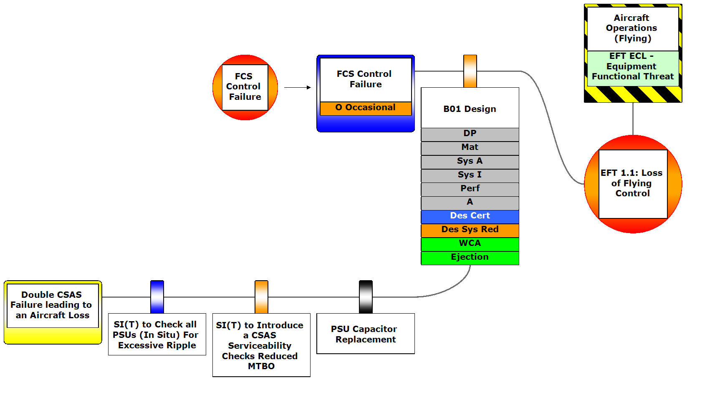
Notes:
Based on the issue the RTI strength has been downgraded

Slide 20
Amending an SI(T)
During satisfaction of the RTI, it becomes apparent that one of the technical references is incorrect
How do we amend the instruction?
AL1
Guidance Material 5405(1)
Amendments that do not require the SI(T) to be re-satisfied are identified by the addition of a suffix letter to the original number.
When the amendments require the instruction to be re-satisfied, a superseding instruction must be issued using a new number.

Slide 21
Notes:
RTI improved once correction rectified
Like with the UTI as a desk offier its good to agree with the MILCam what the activity is to be and then be kept aprised of the activity and its continued ability to realise the required output of the activity through its life.

Slide 22
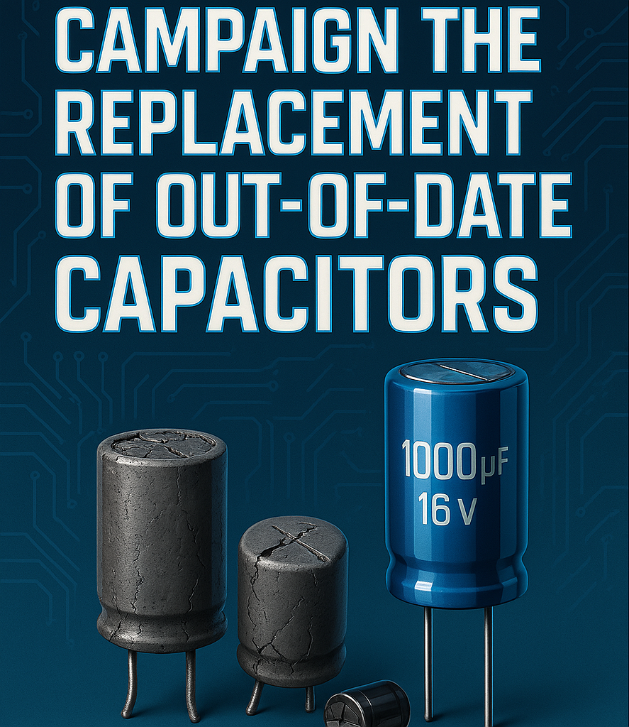
So what about the Modification?
Notes:
So, BAE proposed a £3mln contract to replace all the capacitors in the CSAS. The TAA considered this very expensive, so a local solution was identified where ex RAF servicemen set up an organisation to do the job for less money. They got the contract and started the update process which took around 2 years to complete.

Slide 23
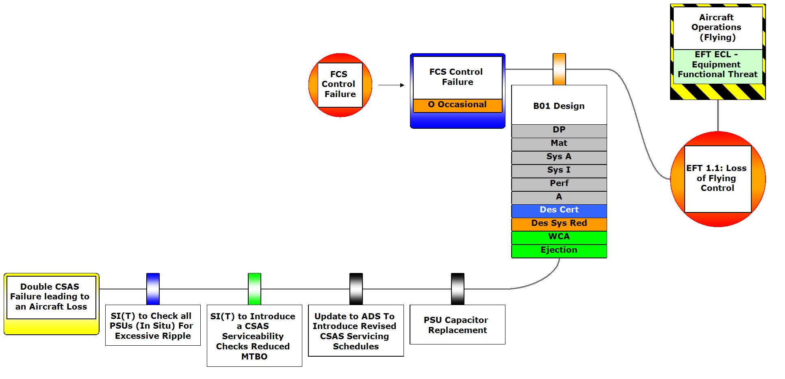
Notes:
So in this ECL we can see that the UTI is in place and considered an Effective (Blue) barrier, and the RTI for serviceability checks Adequate (green). In having the serviceability checks introduced there is a need to update the ADS and then we have the PSU Capacitor replacement activity yet to be competed so both classified as Not Present (Black).

