Slide 1
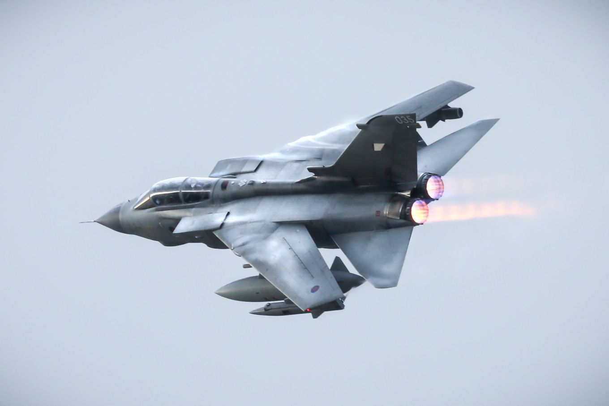
A Day In The Life Example of a Desk Officer (ADS, Maint & MODs)
Type Airworthiness Desk Officers’ Foundation Course

Slide 2
What about the Docs?…

Slide 3
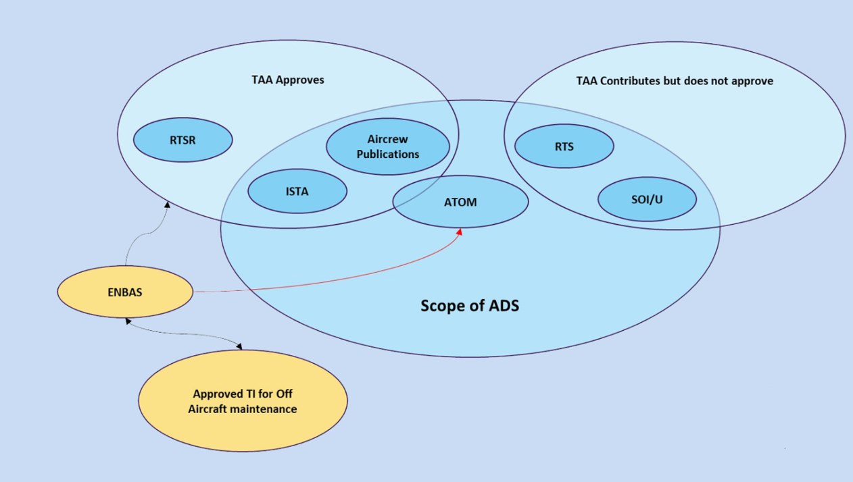
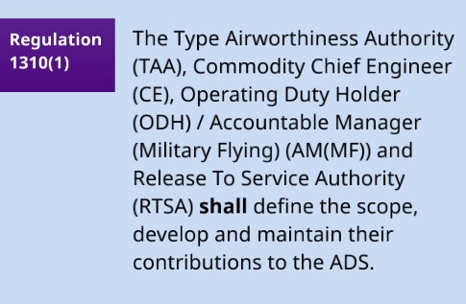

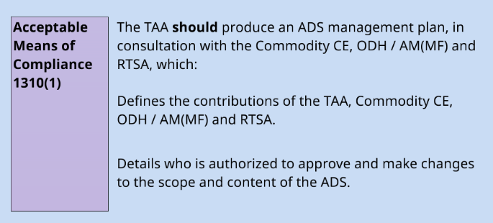
MAA-02
Air-system Document Set
The documentation considered as essential for sustaining the Type Airworthiness and maintaining the Continuing Airworthiness, and for ensuring the safe operation of an Air System.
Notes:
The documentation considered as essential for sustaining the Type Airworthiness, maintaining the Continuing Airworthiness, and for ensuring the safe operation of an Air System. The documentation is defined, developed, maintained and approved for use by one of the following: TAA, Commodity Chief Engineer, ODH / AM (MFl), or RTSA.
Air Systems can only be operated and maintained safely if there exists a set of instructions which describes operating procedures, operating limitations and Maintenance procedures. These publications are known collectively as the Air System Document Set (ADS). Deficiencies within the ADS may mean the Air System is no longer Safe to Operate, or being Operated Safely
AET Process 11A (Fig on slide) - The ADS is comprised of the Type Airworthiness Authority’s (TAA) contribution and wider stakeholder contributions (Aircrew Pubs and Instructions for Sustaining Type Airworthiness (ISTA)), Release to Service (RTS), Statement of Operating Intent / Usage (SOI/U) and the Air Transport Operation Manuals (ATOM), defined within a leaflet in the Orders and Instructions issued by the TAA (Topic 2(N/A/R)1)

Slide 4
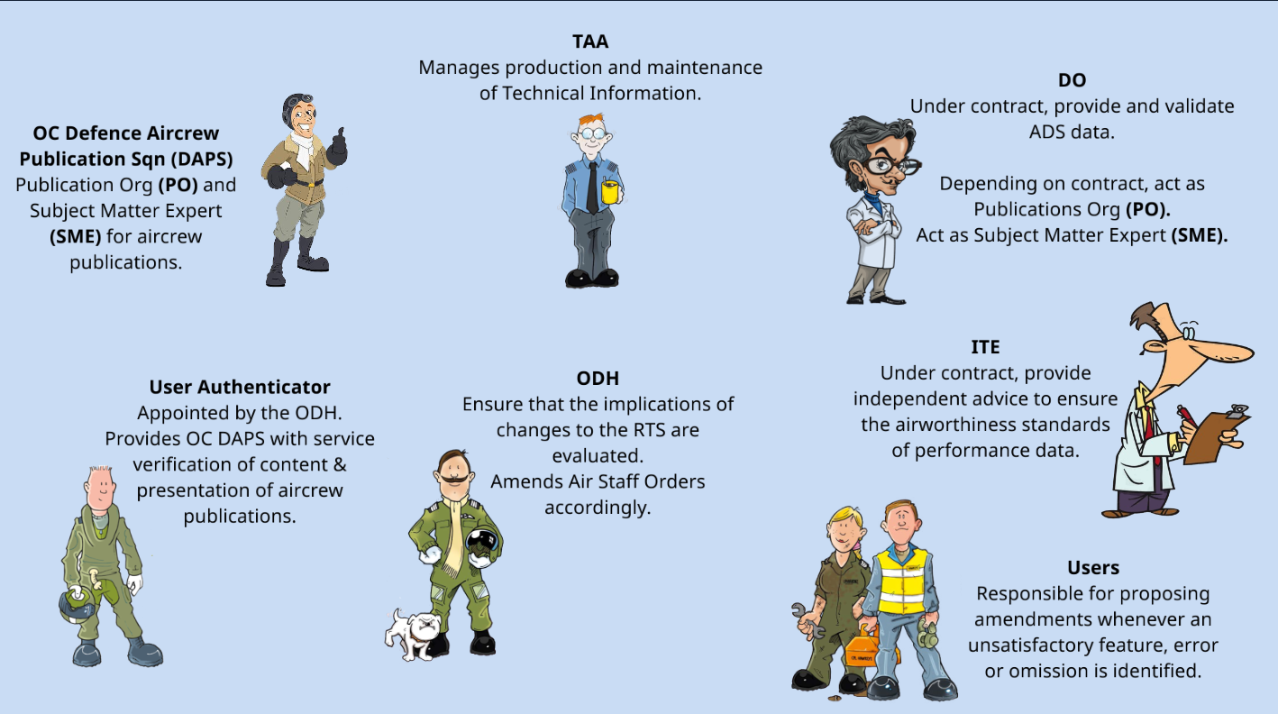
Notes:
Roles of each stakeholder

Slide 5
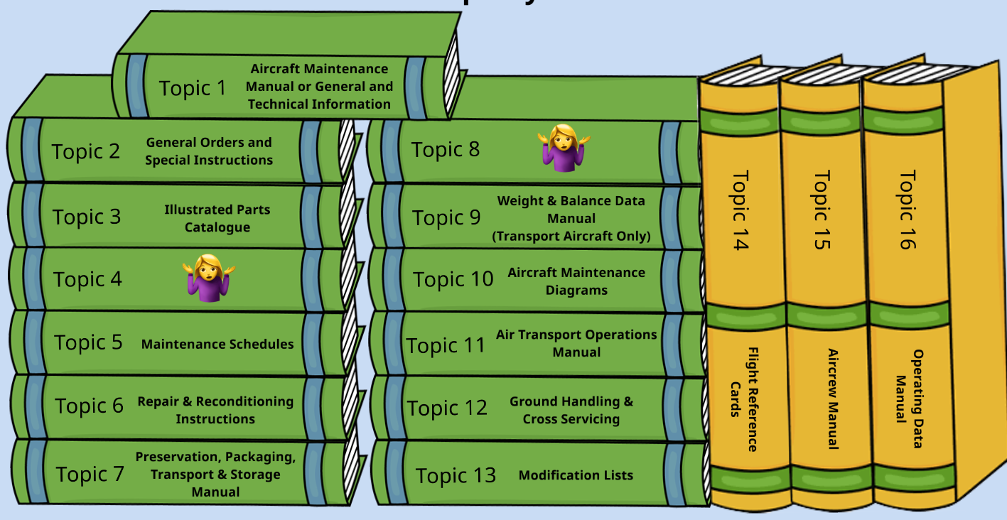
Notes:
So….the ADS.
What is shown here is the standard legacy construct that still resides in peoples minds, the term ‘Topic’ is still used and has familiarity.
People may be aware though that all the Topics shown here are now collected up together in the ISTA or Instructions to Sustain Type Airworthiness.
You will still see Topics referred to in the RAs also so this view will be useful to you.

Slide 6
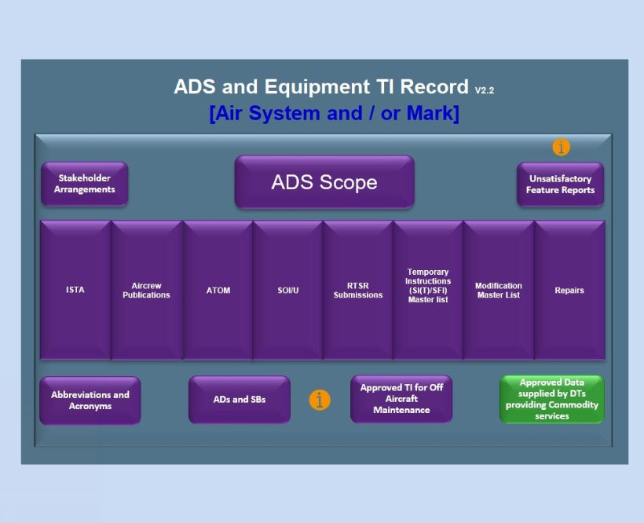
Topic 2(N/A/R)
Regulation 5815(1)
The TAA shall approve and provide a complete set of ISTA to the Operating Duty Holder / Accountable Manager (Military Flying). In doing so, the TAA shall ensure that:
a. ISTA is developed in accordance with the TCB
b. ISTA is amended through life incorporating change requests
c. The DO or Commodity Chief Engineer (CE) provides amendments to the ISTA
for an Air System or related Products, Parts and Appliances
Acceptable Means of Compliance 5815(1)
The following ISTA, as a minimum, should be provided:
….
Orders & Instructions issued by the TAA (Topic 2(N/A/R)).
…
Notes:
RA5815 provides instructions for sustaining type airworthiness or ISTA
These instructions are a subset of the ADS and include the combined suite of methods, inspections, processes, and procedures necessary to support the Maintenance and operation of an Air System and associated Products, Parts, Appliances, Airborne Equipment and Air Launched Weapons within its certified limits .
Failure to create and maintain ISTA will result in stakeholders being unable to ensure that the Air System is safe to operate.
To maintain safe operation, ISTA need to be provided and amended through life in a coherent and expedient manner so that they continue to reflect the Type Certification Basis (TCB).
RA5815(1) AMC - The following ISTA, as a minimum, should be provided which for the most part are managed in the ADS Equipment TI Record:
a. A Maintenance Manual containing all procedures required by Maintenance organizations to maintain the Air System or equipment in a serviceable condition and to diagnose typical Faults (Topic 1).
b. Modification Instructions (Topic 2).
c. Orders and Instructions issued by the TAA (Topic 2(N/A/R)1).
d. Illustrated Parts Catalogue (Topic 3).
e. Maintenance Schedules containing all necessary servicing procedures and detailing all Preventive Maintenance requirements through-life, including associated safety warnings and cautions necessary to minimize the Risk to Life for Maintenance personnel (Topic 5).
f. Repair Schemes (Topic 6).
g. Weapon Loading / off-loading Procedures (Topic 5A6), if appropriate.
h. Weight & Balance Data Manual (Topic 9), if appropriate.
i. Sub-system Diagrams required to support Maintenance, Fault diagnosis and Repairs (Topic 10).
j. Ground Handling Instructions (Topic 12A).
k. Electrical Wiring Interconnection Systems.
l. Airworthiness limitations (including where appropriate any Airworthiness Directive, Service Bulletin).
m. Emergency Rescue and Mishap Response Information.

Slide 7
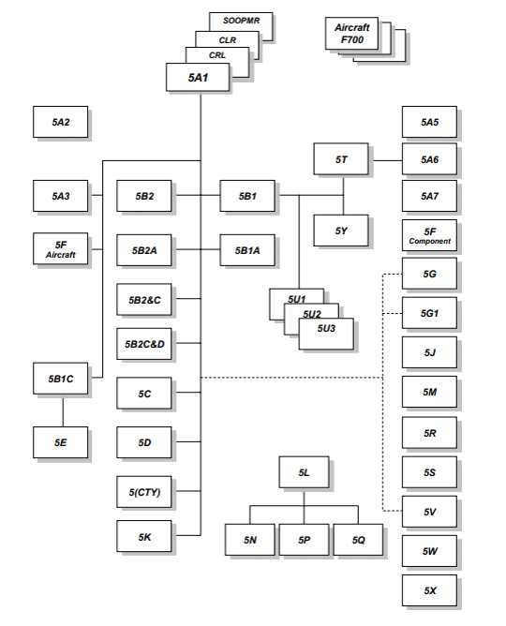
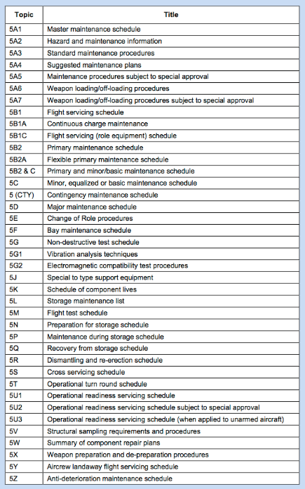
AP100C-20
Notes:
RA5815(1) AMC - Maintenance Schedules containing all necessary servicing procedures and detailing all Preventive Maintenance requirements through-life, including associated safety warnings and cautions necessary to minimize the Risk to Life for Maintenance personnel (Topic 5).

Slide 8
Air System Document Set Upkeep
Acceptable Means of Compliance 1310(1)
The TAA should ensure that amendments to the ADS are promulgated to relevant users in a timely manner.
Guidance Material 1310(1)
Amendments may be made by means of a MOD F765 UFR, MOD F765X Aircrew Publications Amendment Request, or equivalent
ASPIRE
Process 11
Air-system Document Set
The following prioritisation system and progression timescales should be encouraged for use for amendments to ISTA and Aircrew Publication UFRs:
 | TIMESCALES
UFR Priority | UFR Generation (Originator) | UFR Part 3 Completion (DT EA) | UFR Closure (from Part 3 Completion)
Routine | As Reqd | 3 Months | 1 Year
Rapid | As Reqd by DT EA | 28 Days | 3 Months
Immediate | 5 Days | 5 Days | 28 Days
Notes:
Unsatisfactory Feature Reports (UFR)
765 are used for capturing amendment requests for documents that make up the ADS
TO NOTE THAT ALL PERSONNEL WORKING IN THE DAE ARE REPONSIBLE FOR PROPOSING AMENDMENTS TO TECHNICAL INFORMATION WHENEVER AN UNSATISFACTORY FEATURE, ERROR OR OMISSION IS IDENTIFIED USING THE MOD FORM 765 AS ENDORSED BY THE TAA, TI SPONSOR AND OR PUBLICATION ORGANISATION.
ANYBODY USED A 765? - WHAT WAS THE ISSUE?
WHAT KID OF THINGS DOES ANYBODY THINK A 765 COULD BE RAISED FOR?
FACTUAL ERRORS, OMISSIONS, CONFLICTS, OBSCURITIES FOUND IN TI
WHERE THERE IS CONSIDERED A BETTER WAY OF DOING SOMETHING DESCRIBED
WHEN TI CONTENT OR DESIGN IS FOUND TO PRESENT PROBLEMS IN USE
It’s a faily straight forward form to use, MOD Format 765 asking the reporter to identify the unsatisfactory features of the document in question and how they think it could be improved. This is then reviewed by a SME who will give their view and id who it should go to in terms of Technical Info sponsor for any actions to be taken. The form is finalised by the publicaiton element who wil indicate what actions have been taken and whether the report has been updated., status of any activity, interim reports produced etc.
To note - the front line command will typically classify most UFRs as Priority One – Immediate, whether justified or not. However, it's not feasible to treat all of them as immediate in practice. Therefore, close coordination with the Mil CAMO to establish a prioritised list within the 'immediates' is essential. This approach helps ensure that the Delivery Team focuses its resources and efforts on the UFRs posing the greatest risk to Air Safety. Additionally, providing the Mil CAMO with regular updates on the progress of the most critical 'immediates' enables them to keep the Duty Chain accurately informed.

Slide 9
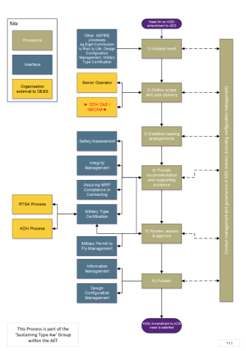
ADS and Equipment TI Record
Notes:
Flow chart (AET P11E) - Each of the steps illustrated in the flowchart is known in the AET as a ‘Procedure’ and each Procedure.
The Procedures are:
· Assess need.
· Define scope and plan delivery.
· Establish tasking arrangements.
· Provide recommendation and supporting evidence.
· Review, assure and approve.
· Publish.
· Conduct management and governance of ADS delivery (including configuration management).
Under AET Process 11B an ADS and Equipment Temporary Instruction (TI) (ST(T)) Record is provided – provides a repository to record details and status of various documents which constitute the ADS and Equipment TIs – stakeholder details – UFRs raised

Slide 10
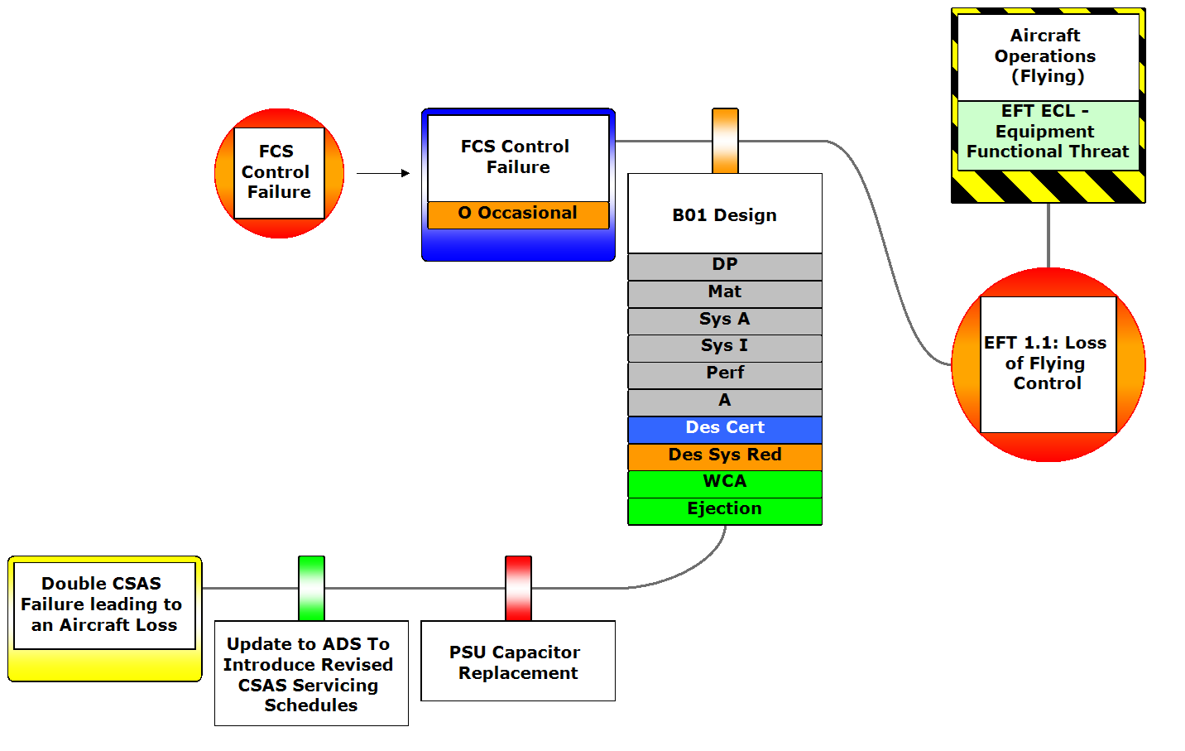
Notes:
Update to ADS has seen the removal of the UTI and RTI barriers, with ADS Update barrier considered Adequate (Green), PSU Capacitor Replacement barrier changed form Not Present (Black) to Unsatisfactory (Red) as modification programme not complete

Slide 11
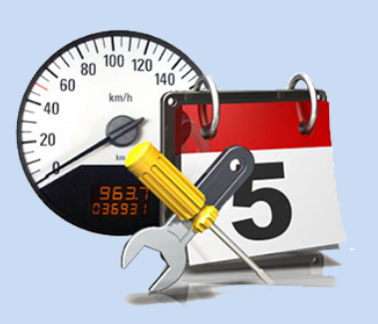

Preventative Maintenance
MAA-02
Preventive Maintenance:
Maintenance carried out at predetermined intervals, or according to prescribed criteria, and intended to reduce the probability of failure or the degradation of the functioning of an item.
Regulation 5230(1)
Each Air System Type Airworthiness Authority (TAA) shall ensure the protocols of an Air System Maintenance schedule are implemented throughout the life of the project.
Notes:
RA reference should read 5320(1)
The time needed to reach the decision to whether to replace the capacitors or indeed the whole CSAS was very time consuming so there was a need to enact a maintenance extension regarding the RTI
Air Systems and Role Equipment are to be maintained in accordance with the time limits detailed within the technical instruction.
However where operational needs dictate or where it is expedient to do otherwise (e.g. lack of resource) it may be necessary to authorise either a deferment or maintenance or apply for a concession.
Unless otherwise directed by the TAA or Mil CAM, an individual holding the right authority (MAMP-H802) may defer any Preventive Maintenance activity as prescribed by the TI (Note - not applicable to Survival Equipment (SE) Preventative Maintenance activity, may only be authorised by the appropriate individual holding authority level K)

Slide 12
Preventative Maintenance
Various tried and proven maintenance systems developed over the years
Flexible Maintenance
1
2
3
4
5
6
1
Grouped Maintenance
Primary
Primary*
Minor
Major
LF
LF
LF
LF
LF
LF
LF
LF
LF
LF
LF
LF
LF
MF
MF
MF
MF
MF
MF
MF
MF
MF
MF
MF
MF
MF
Equalised Maintenance
HF
HF
HF
HF
HF
HF
HF
HF
HF
HF
HF
HF
HF
Notes:
So there are a number of proven maintenance systems that have been tried and tested over the year to meet differing requirements. However not all maintenance task intervals readily align themselves to a chosen method of task packaging and the associated tasks are therefore detailed separately as independent activities. This would be identified as out of phase maintenance.

Slide 13

Maintenance Extensions
MAM-P Ch 4.8
There are occasions when it is not possible to complete a Maintenance task before an Air System is required for flight.
Alternatively, it is sometimes more efficient to carry out a Maintenance task at the same time as other work, such as when other Preventive Maintenance is undertaken.
Maintenance can be deferred by permitting further flights with a specified limitation on operation or handling (MOD Form 703 series) or
By declaring the fault/damage acceptable for further flights without limitation and raising an entry in the Acceptable Deferred Faults (ADF) Log (MOD Form 704 series).
Notes:
Sometimes we need to extent the time between maintenance actions i.e. when it is not possible to complete a Maintenance task due to operational needs or lack of resource etc.
Maintenance scheduling is planned considering safety, reliability, operation tempo and analysis like Reliability Centred Maintenance is required by the MAA to be performed in order to reach an optimum schedule of activity.
Sometimes it is more efficient to carry out a Maintenance task at the same time as other work, such as when other Preventive Maintenance is undertaken. So in terms of our RTI for our Tornado we perhaps have to move the procedure around to meet the tempo of operations.
To meet engineering requirements or flying commitments, Maintenance (Preventive and Corrective) may be deferred. Where Preventive Maintenance latitudes are permitted by applicable TI or Corrective Maintenance latitudes are applied by the Maintenance organization, the Military Continuing Airworthiness Management Organization (Mil CAMO) will have detailed the process for assessing the Airworthiness impact and the recording of any applied latitude.
Maintenance can be deferred by permitting further flights with a specified limitation on operation or handling or by declaring the fault/damage acceptable for further flights without limitation.
A lot of extensions are around the lack of spares, therefore, components would be extended by a percentage 1- 10% depending on the type of component and its availability. Air System extensions could be down to the maintenance facility's ability to get aircraft in and service them, air test and then get the vehicle out onto the squadrons for acceptance. As the aircraft was aging aircraft problems came in and the AS would be in longer than anticipated, therefore the next one due in would be extended by a percentage to allow further flying to take place.
Maintenance extensions, may be driven by an Operational imperative. From a Desk Officer perspective, if the TAA (through the DO) rejects a maintenance extension it is highly beneficial to establish clear communication with the Mil CAMO to explain the technical rationale behind the decision. This dialogue enables the Mil CAM/DCAM to effectively articulate the associated technical risks to the DDH.

Slide 14
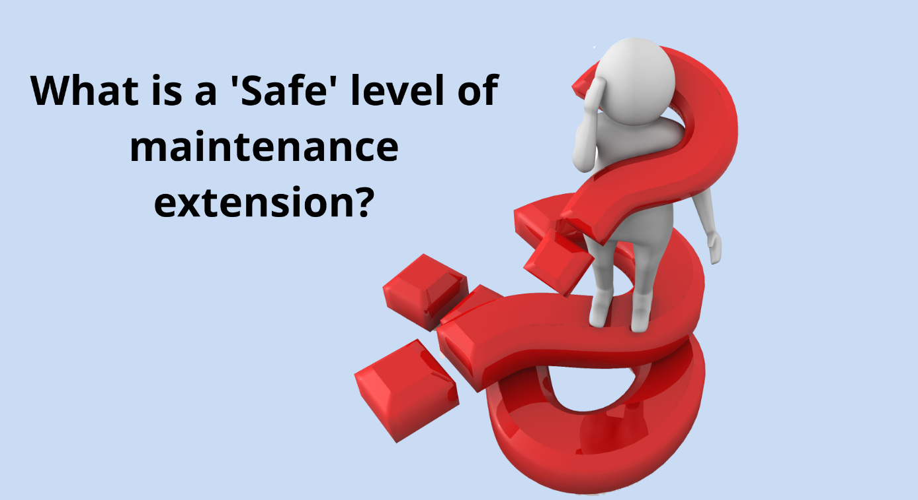
Deferments of Preventative Maintenance (MAM-P Chapter 4.8)
PM Deferments – Unless otherwise directed by TAA or Mil CAM Authorisation MAMP-H802 is needed for an individual who has to consider such deferment
PM Deferment Constraints:
PM Activity is one that the authoriser is ultimately responsible for, if not authority level K, TAA and/or MilCAM authorisation needed.
Upper usage hour or calendar limits for deferment are not exceeded.
Survival equipment and AEA PM may only be extended by people holding level K authority (MAMP-K1008 – Approve Local Manufacture of parts for Air System and Airborne Equipment)
Notes:
The period of deferment is to be kept to the minimum period possible.
Any deferment is to be for a specified period (eg calendar time, flying hours), or to a nominated Preventive Maintenance or review date, when the Maintenance is to be undertaken or the deferment reviewed. Ultimately the individual holding Authorization MAMP-G703 is to assess the associated Risks and consider all factors that will mitigate the Risk and document the mitigating factors.
As per RA4961 (2) - Where extensions to Preventive Maintenance are permitted by the applicable TI, the Mil CAM should detail the procedures for assessing the Airworthiness impact and recording the applied latitude.
This should include as a minimum:
Why the deferment applies.
Why the deferment does not compromise Airworthiness
When the Maintenance is to be conducted.
The Competent and authorized individual who approved the decision
Where Corrective Maintenance or Faults that exceed the limits laid down in TI are deferred, the Mil CAM should detail the procedures for assessing the Airworthiness impact and recording the applied latitude as described in paragraph
As per RA4947(1)f The Mil CAMO should plan and control all Maintenance activity, including the use of latitudes, deferments or Concessions as part of the fleet management task. 15. The Mil CAMO should inform the Aviation Duty Holder (ADH) or AM(MF) if there are any significant aspects of Maintenance that cannot be carried out and advise of the implications.

Slide 15
Deferments of Corrective Maintenance (MAM-P Chapter 4.8)
CM Deferments carry risk – Authorisation MAMP-G703 needed for individual who has to consider such deferment
Deferrable Corrective Maintenance include:
Faults and damage defined as acceptable within limits stated in the TI – Informed by the DO or TAA with defined limits published in the TI for which deferred rectification is authorised or not needed. Lowest risk.
Out of Limits Fault Damage – These are beyond DO or TAA defined limits and would usually require immediate rectification so carry an increased level of risk. May need to consider flight limitations to mitigate with the requirement to operate being clearly recognised as outweighing the additional airworthiness risk. Such cases will need to be referred to the TAA and Mil CAMO ASAP.
Faults and damage for which no limits are given – Faults and damage are not addressed in the TI so Risk Assessment will require more mitigation factors being considered (provided in the MAM-P) with a clear understanding that the requirement to operate outweighs the Airworthiness Risk before any deferment is granted. The authoriser informs the MiL CAMO as soon as practicable.
Maintenance activities that necessarily deviate from the TI – Due to resource or unworkable TI the activity should remain incomplete under normal circumstances. However where there is an operational imperative the maintenance activity may need to be carried out with the MiL CAMO managing the deviation from a Continuing Airworthiness perspective engaging with the TAA as required.
Notes:
The period of deferment is to be kept to the minimum period possible.
Any deferment is to be for a specified period (eg calendar time, flying hours), or to a nominated Preventive Maintenance or review date, when the Maintenance is to be undertaken or the deferment reviewed. Ultimately the individual holding Authorization MAMP-G703 is to assess the associated Risks and consider all factors that will mitigate the Risk and document the mitigating factors.
As per RA4961 (2) - Where extensions to Preventive Maintenance are permitted by the applicable TI, the Mil CAM should detail the procedures for assessing the Airworthiness impact and recording the applied latitude.
This should include as a minimum:
Why the deferment applies.
Why the deferment does not compromise Airworthiness
When the Maintenance is to be conducted.
The Competent and authorized individual who approved the decision
Where Corrective Maintenance or Faults that exceed the limits laid down in TI are deferred, the Mil CAM should detail the procedures for assessing the Airworthiness impact and recording the applied latitude as described in paragraph
As per RA4947(1)f The Mil CAMO should plan and control all Maintenance activity, including the use of latitudes, deferments or Concessions as part of the fleet management task. 15. The Mil CAMO should inform the Aviation Duty Holder (ADH) or AM(MF) if there are any significant aspects of Maintenance that cannot be carried out and advise of the implications.
Note Authorisation MAMP-G703 is – Defer Corrective Maintenance by Authorizing ADF and Limitations

Slide 16
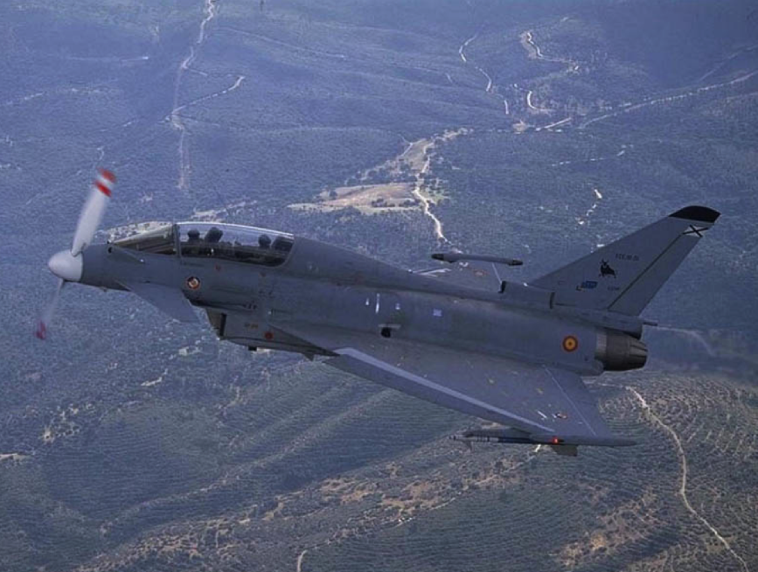
Good but it could be better

Slide 17
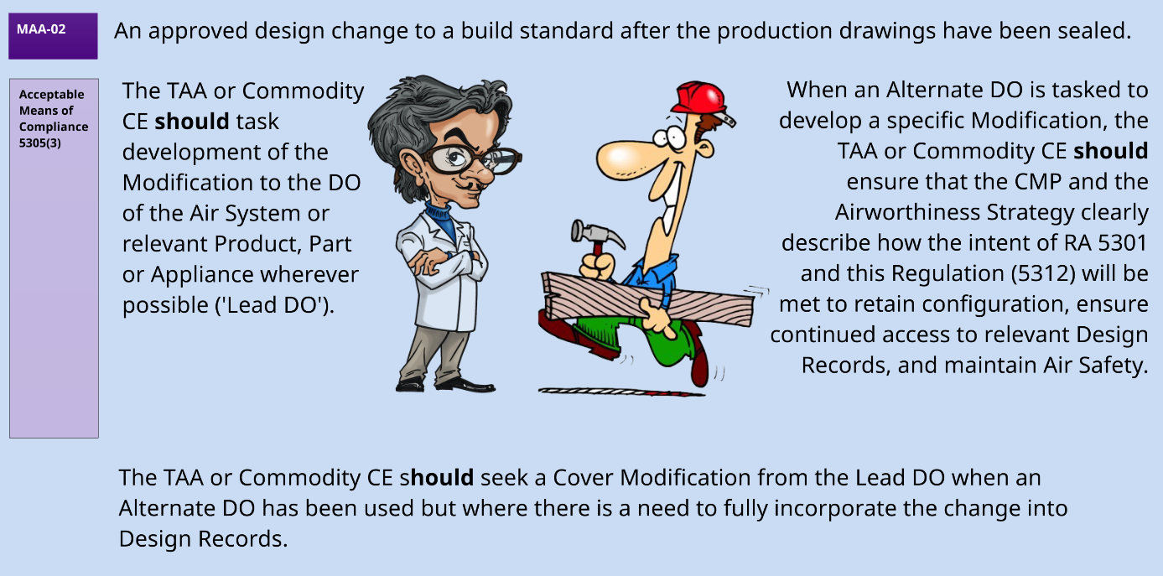
Changes to Design
Notes:
The request to implement the new capacitors were presented ultimately as a modification to the CSAS to determine whether the activity will be warranted, or if everyone is content with the RTI.
To note as a Desk Officer you should review the assessments provided by the DO and suppliers to make sure they make sense, are accurate and correct as some examples have been seen where assessments performed by the DO have been found lacking such as the clearin gof an installation of a GoPro camera into a Hawk T2 cockpit. During this process, the safety assessment was reviewed and noted that several risks had not been fully considered. This oversight stemmed largely from the fact that the assessment was developed entirely from the Bristol office, without conducting an on-site survey of the aircraft in Anglesey. There was also an example of supplier assessment of new cockpit display equipment for a large transport aircraft that had not evidence of development to DAL A with an incorrect argument raised about it not needing to be DAL A however they had not thought about Erroneous but Believable indications on the displays.

Slide 18



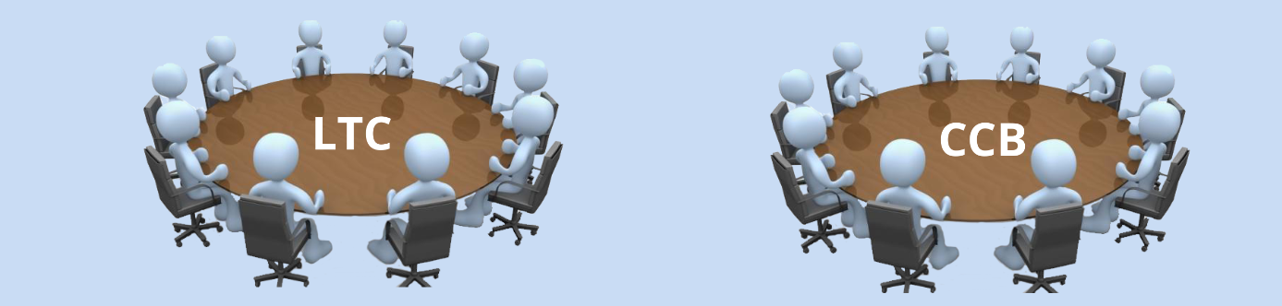
Design Change Forums
The Type Airworthiness Authority (TAA) shall manage the Configuration of their Air System (and related Products, Parts, Appliances), Airborne Equipment and ALW iaw an agreed Configuration Management Plan (CMP) under the oversight of an established design Configuration governance system.
Prior to the Design Records being brought Under Military Control (UMC), the TAA or Commodity CE should establish the Local Technical Committee (LTC), ensuring that Terms of Reference are agreed by the CCB and detailed in the CMP.
A governance system should be established comprising of Configuration Control Boards (CCB)3 and supporting committees as required to review and make decisions on changes to design and to ensure the effective delivery of the agreed change programme.

Slide 19
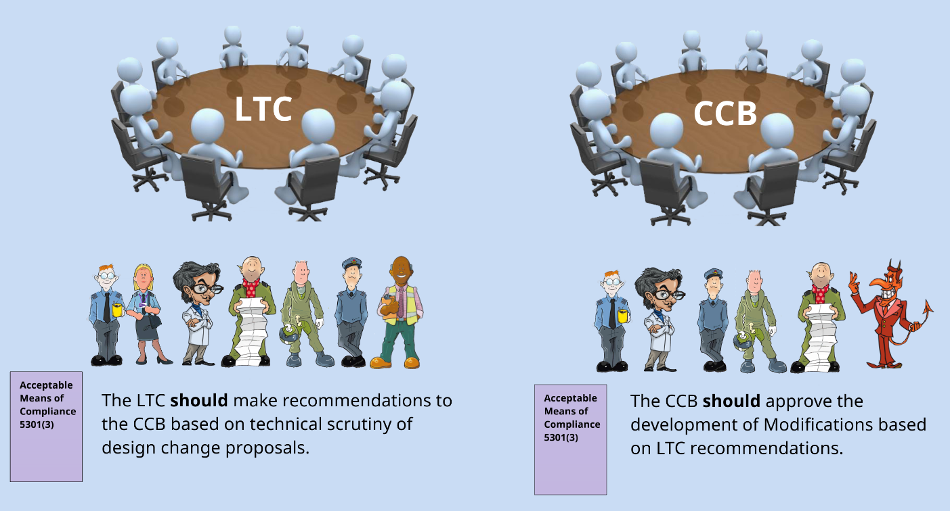

Slide 20
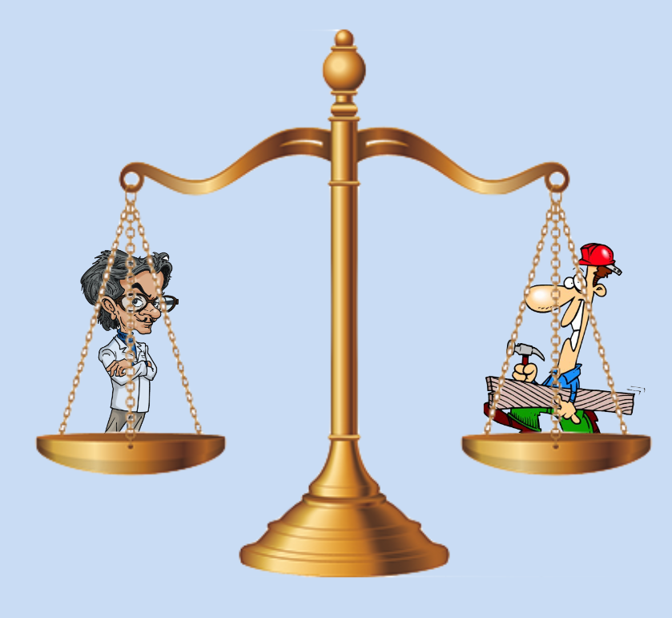
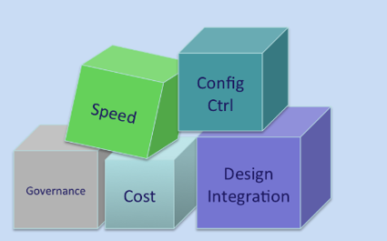
Regulation 1005(2)
For the procurement of Air Systems (including their Products, Parts and Appliances), Airborne Equipment (AE) 8, Air Launched Weapons (ALW), Aircrew Equipment Assemblies (AEA) 8 and Survival Equipment (SE), TAw management and Post-Design Services (PDS), the contracting organization shall only contract with a Competent Design Organization (DO)
Notes:
Note that this does not mean to say to be Competent an organisation has to be DAOS Approved. Some companies creating UAVs are not DAOS along with other companies supplying parts and appliances that do not contribute to the airworthiness of an air system

Slide 21
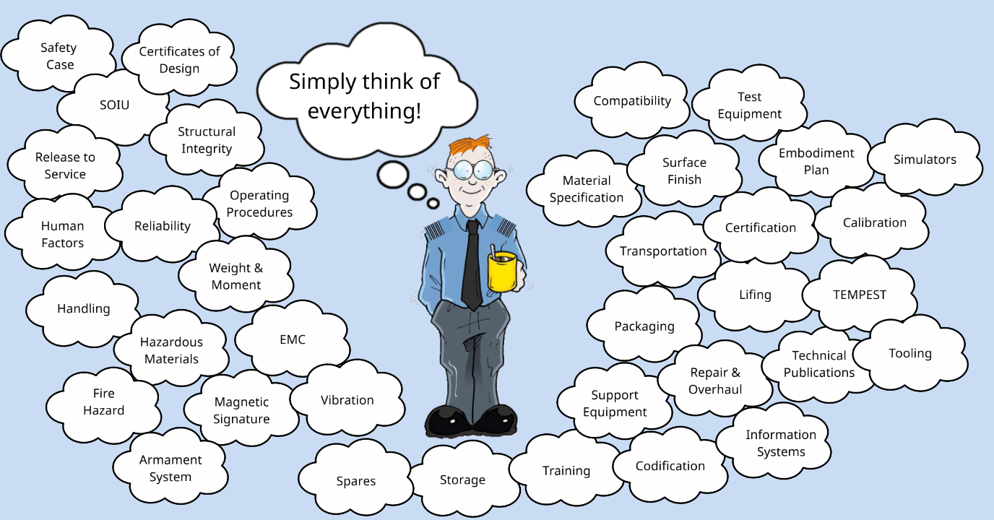

Slide 22
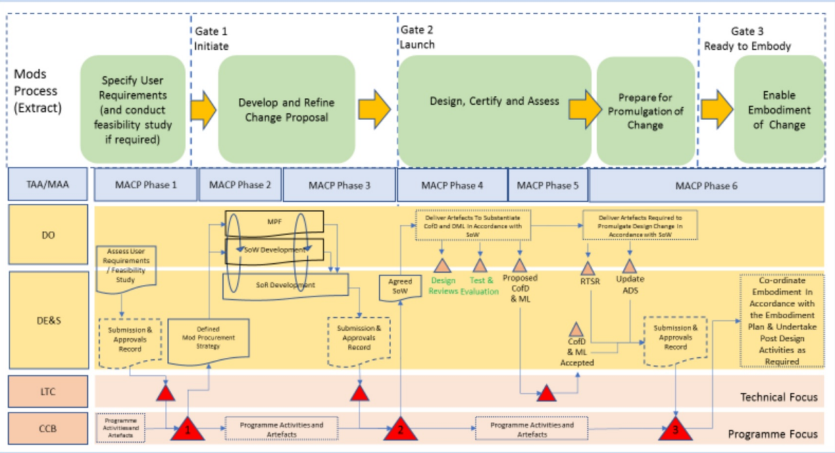
AET – Design Configuration Management
Notes:
AET P7 (Design Configuration Management)
AET P7A (Design Change Process – figure)
The application of the simplified three-gated construct in relation to other key procurement and safety activities is shown
Figure shows the high-level artefacts, decision points, milestones, broad alignment with the Military Aircraft Certification Process (MACP), organizations responsible, and how they relate to the three gates.
The process has been designed to cater for complex modifications (i.e. one that requires an update to the RTS) up to the threshold of ‘Major’. For illustration purposes it assumes the use of formal governance construct (i.e. convening of LTC and CCB) and modifications that have been developed from scratch.

Slide 23
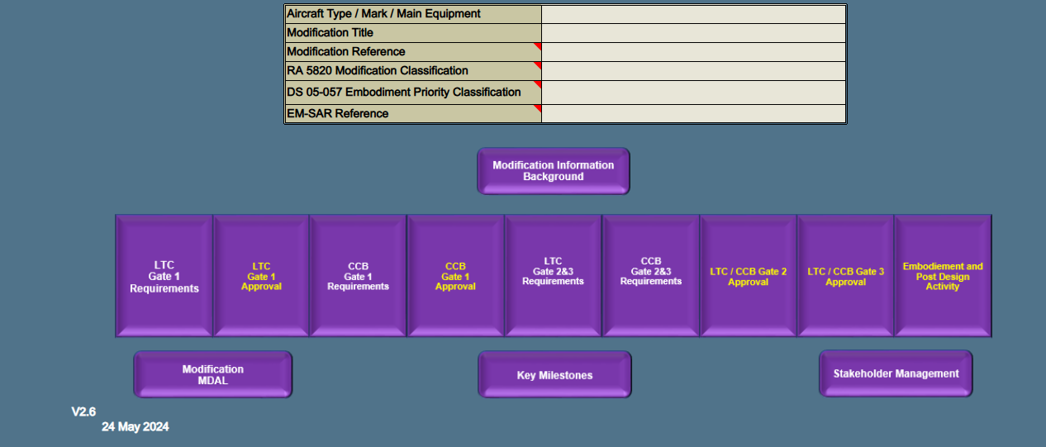
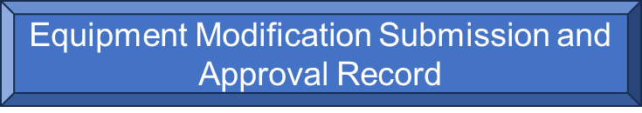
Notes:
AET P7B - Equipment Modification Submissions and Approval Record (EM-SAR) - provides a repository for recording all details of a modification key milestones -

Slide 24
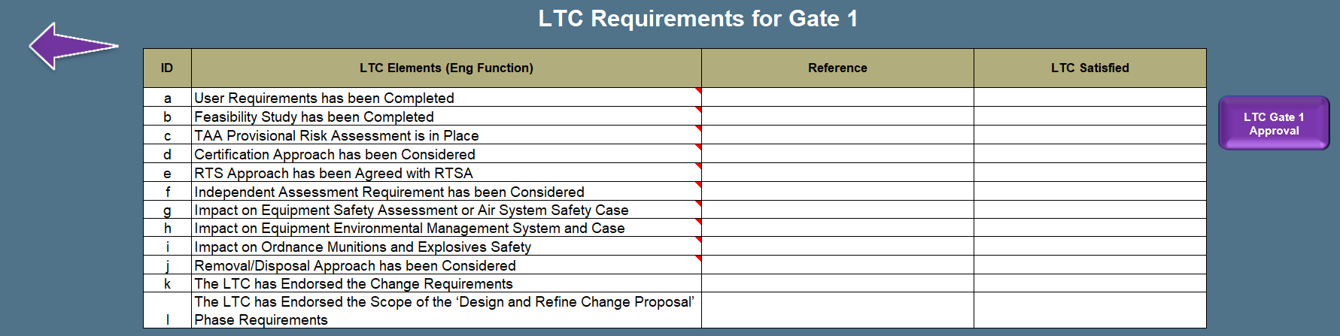
Notes:
Requirements for Gate 1 providing a check list for the local technical committee

Slide 25
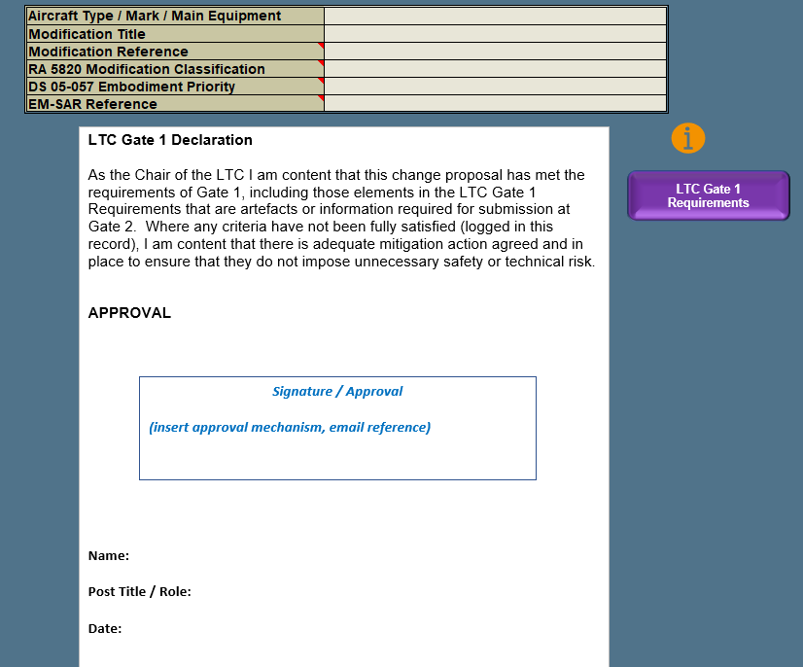
Notes:
Within this are the declaration made as the gates are passed

Slide 26
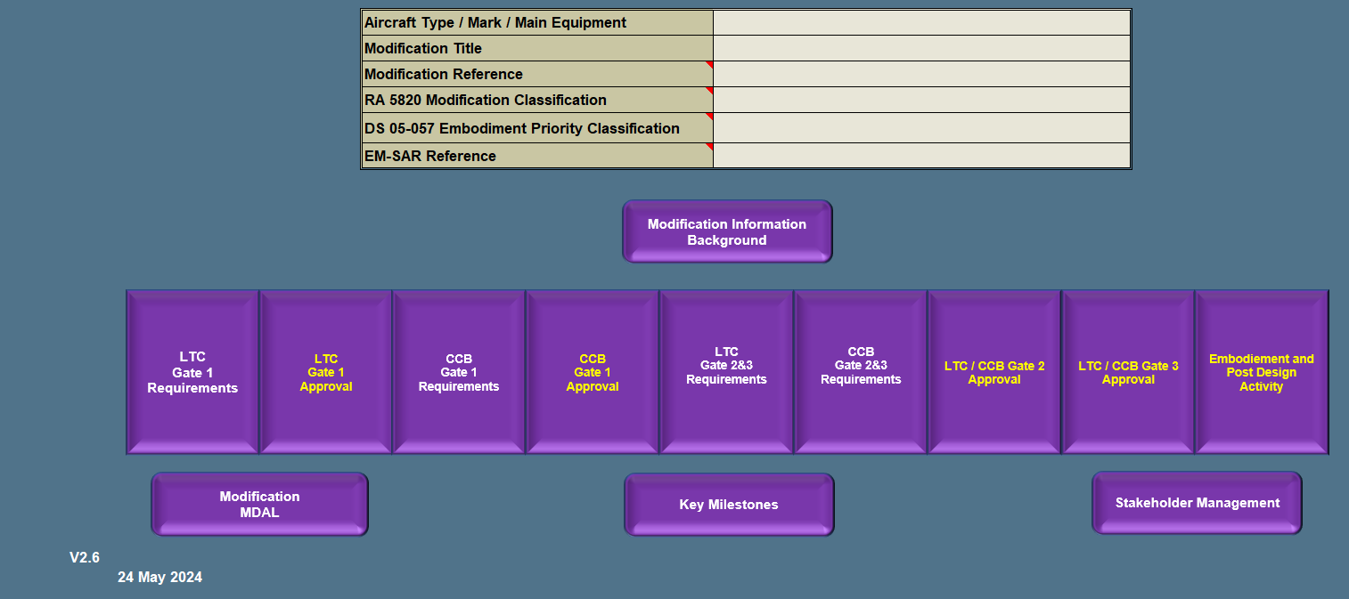

Slide 27
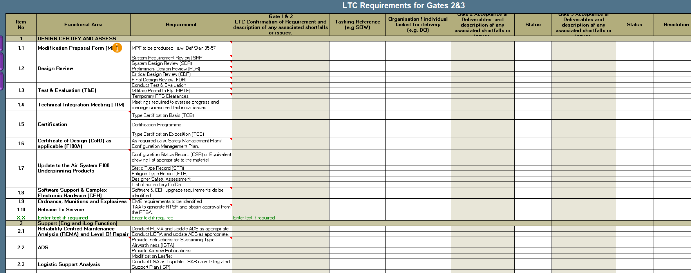
Notes:
Then this is a compliance matrix of all requirements across all involved functional areas showing status, references, responsibilities and acceptance at each gate review

