Slide 1
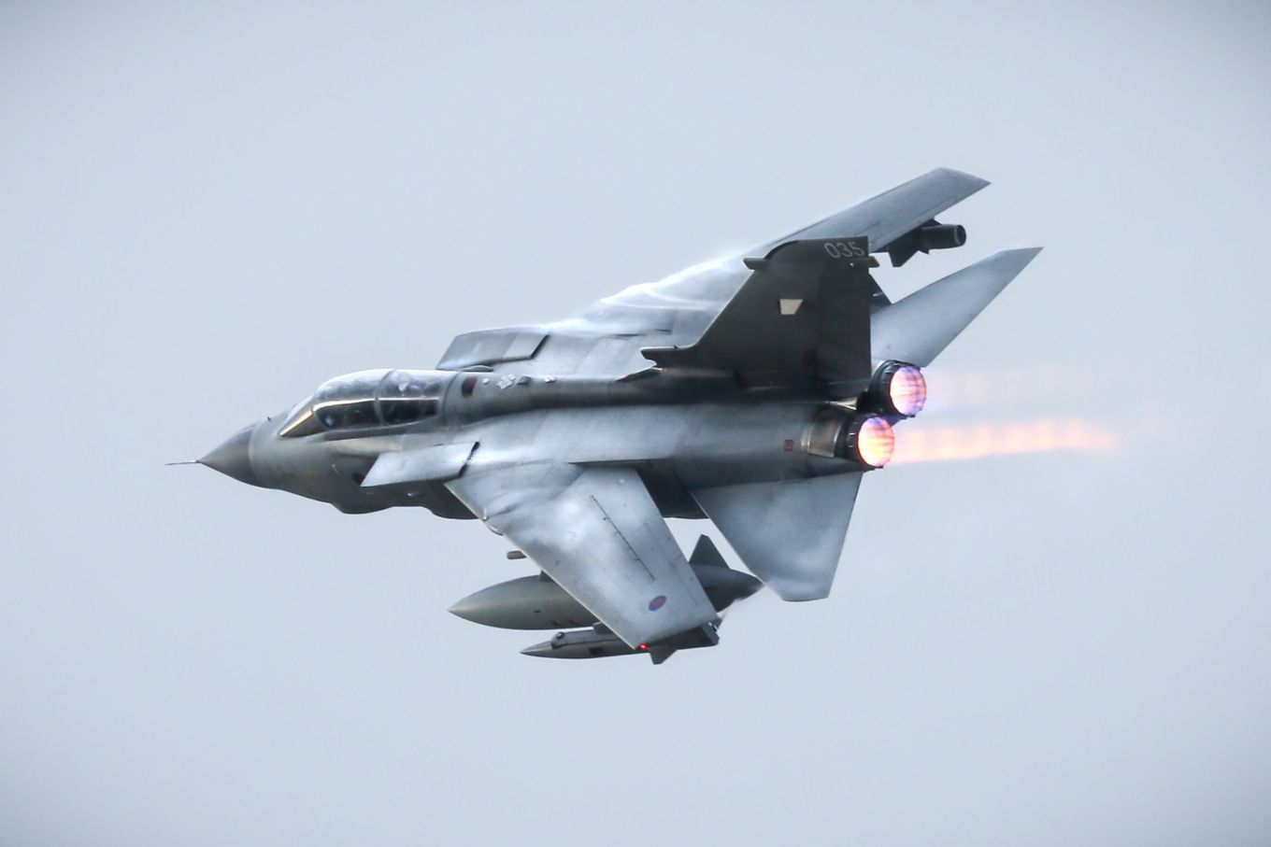
A Day In The Life Example of a Desk Officer (HF & RTSR)
Type Airworthiness Desk Officers’ Foundation Course

Slide 2
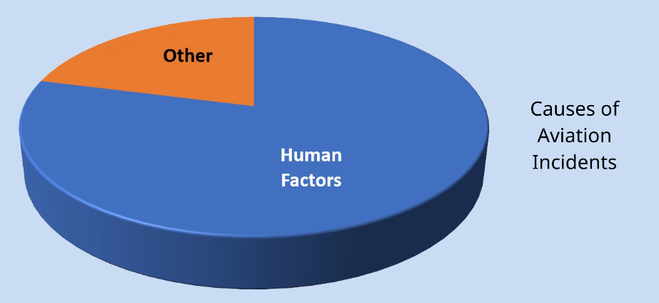
Human Factors Integration
JSP912
Part 1
Human Factors (HF) is a scientific and engineering discipline that is concerned with the study of human capabilities and limitations, human interactions with technologies and environments and the application of this knowledge to produces, processes and environments.
It is MOD Policy that Human Factor Integration shall be applied to all defence acquisition activities.
JSP912
Part 1

Slide 3
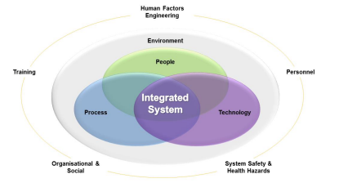
Human Factors Integration
JSP912
Part 1
The Delivery Team Leader (DT Leader) shall have prime responsibility for ensuring that HFI is successfully managed in a project, and that satisfactory HFI outcomes are achieved.
The DT Leader shall ensure that MOD Staff who undertake HFI management activities are provided with sufficient and suitable information and training to enable them to undertake their responsibilities.
JSP912
Part 2
Notes:
There are 5 domains to Human Factors – People, System Safety & Health Hazards, Organisational and Social, Training & Human Factors Engineering as identified in JSP912

Slide 4
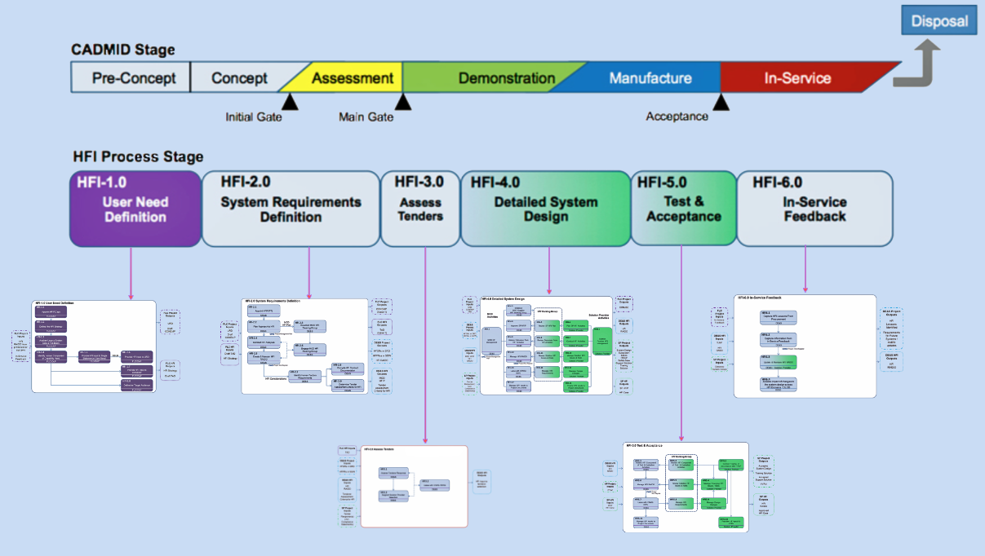
JSP912
Part 2
Notes:
Mapped against the CADMID cycle this process chart provides the steps in managing human factors

Slide 5

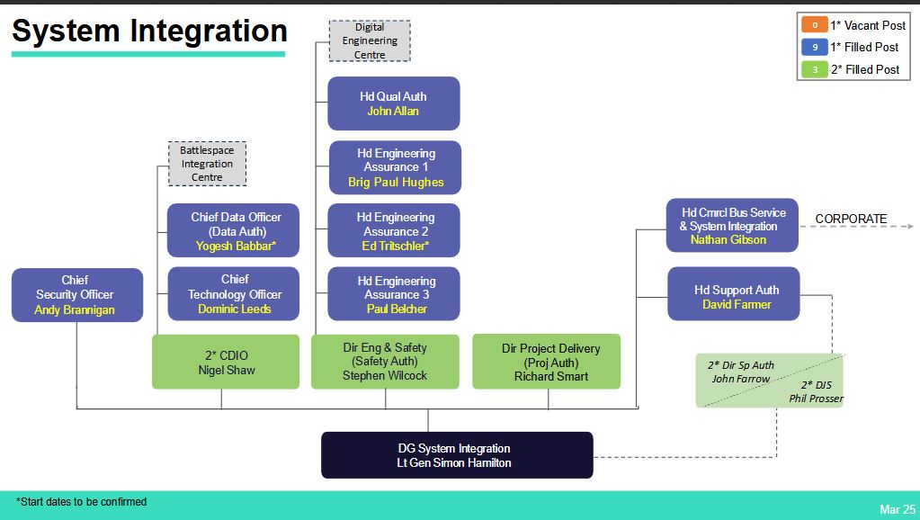
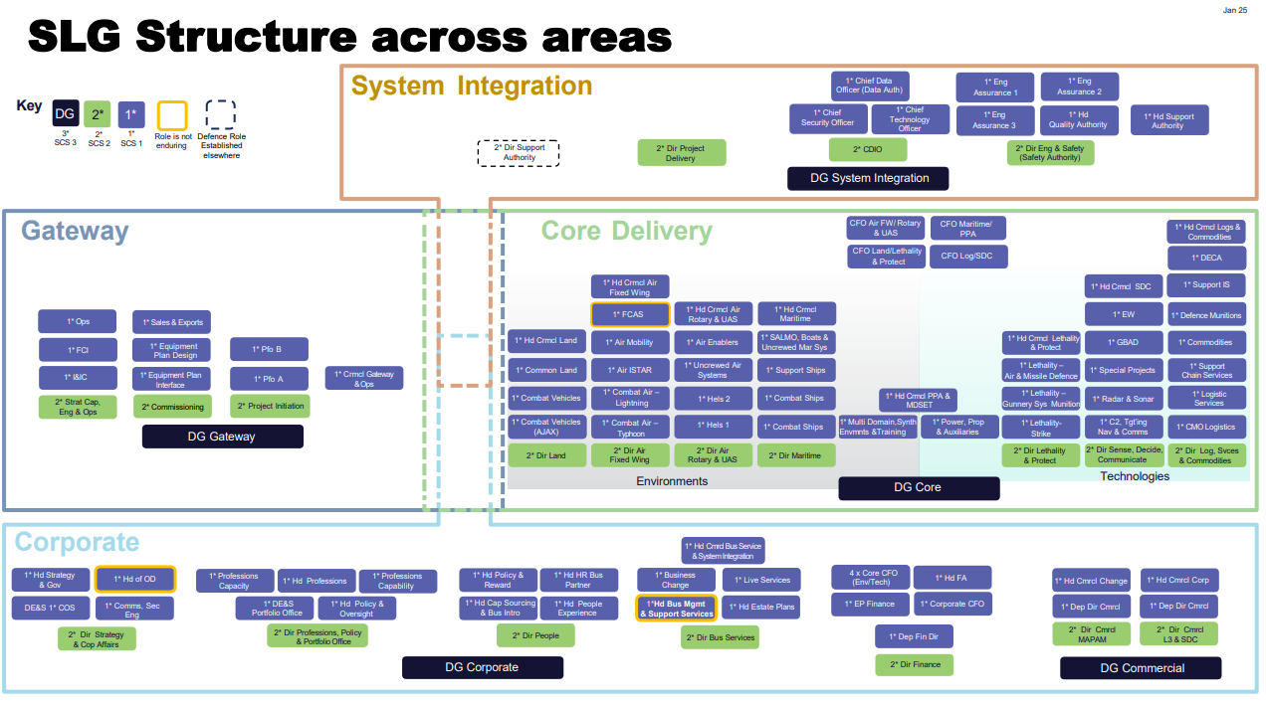
Human Factors
Notes:
Places to seen help and advice for HFE

Slide 6


"They're the wrong Capacitors Grommit!"
Notes:
So, the modification was decided to be commenced with a small team operating out of a hangar to remove and replacement the capacitors in each of the CSAS computers. Quite later in the activity, it was suddenly recognized that the part numbers and the capacitance rating was not accurate. So, 2 bags of capacitors had been supplied for the replacement activity. The team had not understood this in their daily activity to remove and replace the old capacitors until they had probably got through 2 thirds of the replacement activity and nearly 2 years into the activity. They had to raise the issue with the DT and discuss the repercussions with the TAA. In the ECL the barrier would have been flagged as red and another action plan started

Slide 7
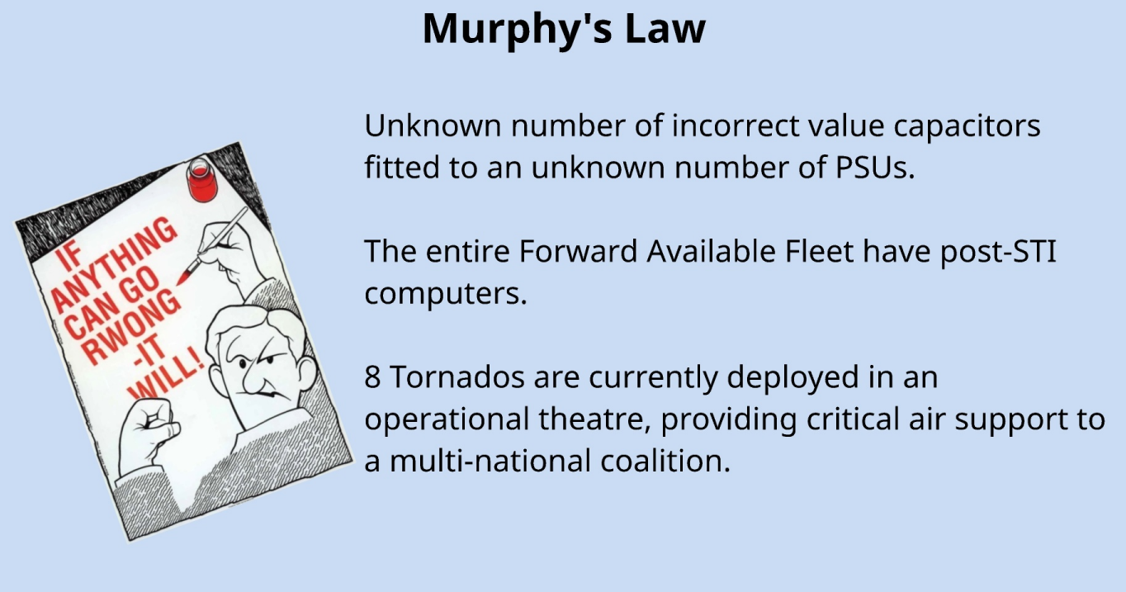
Notes:
How does this impact on your ECL?

Slide 8
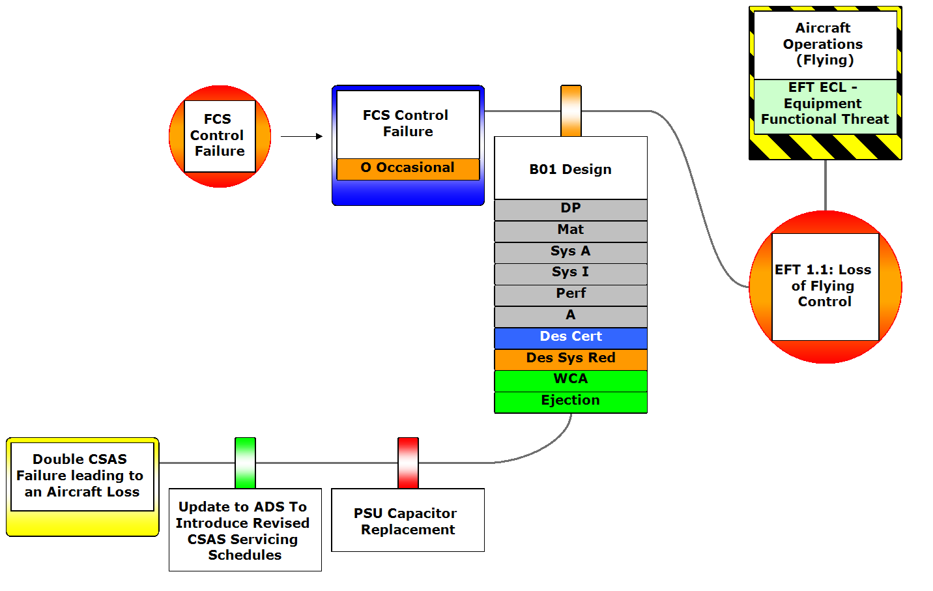
Notes:
So in view of the Capacitor issue we can see this barrier is red

Slide 9

DO Advice
Notes:
BAE approached to ask about the capacitor issue to which the response was that both capacitors could be used with no issue!

Slide 10
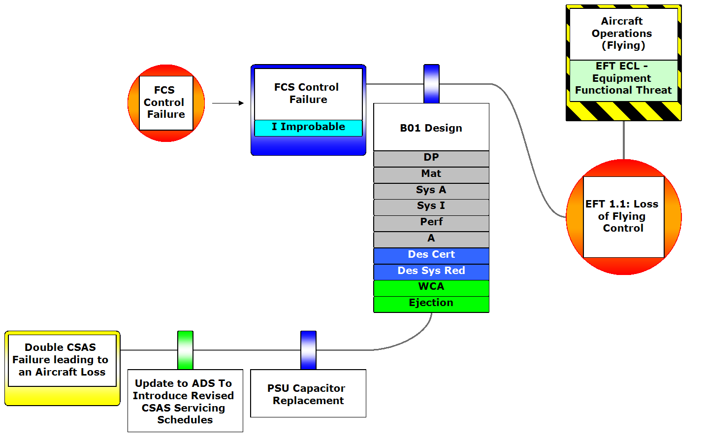
Notes:
Making the barrier blue on completion of the activity

Slide 11
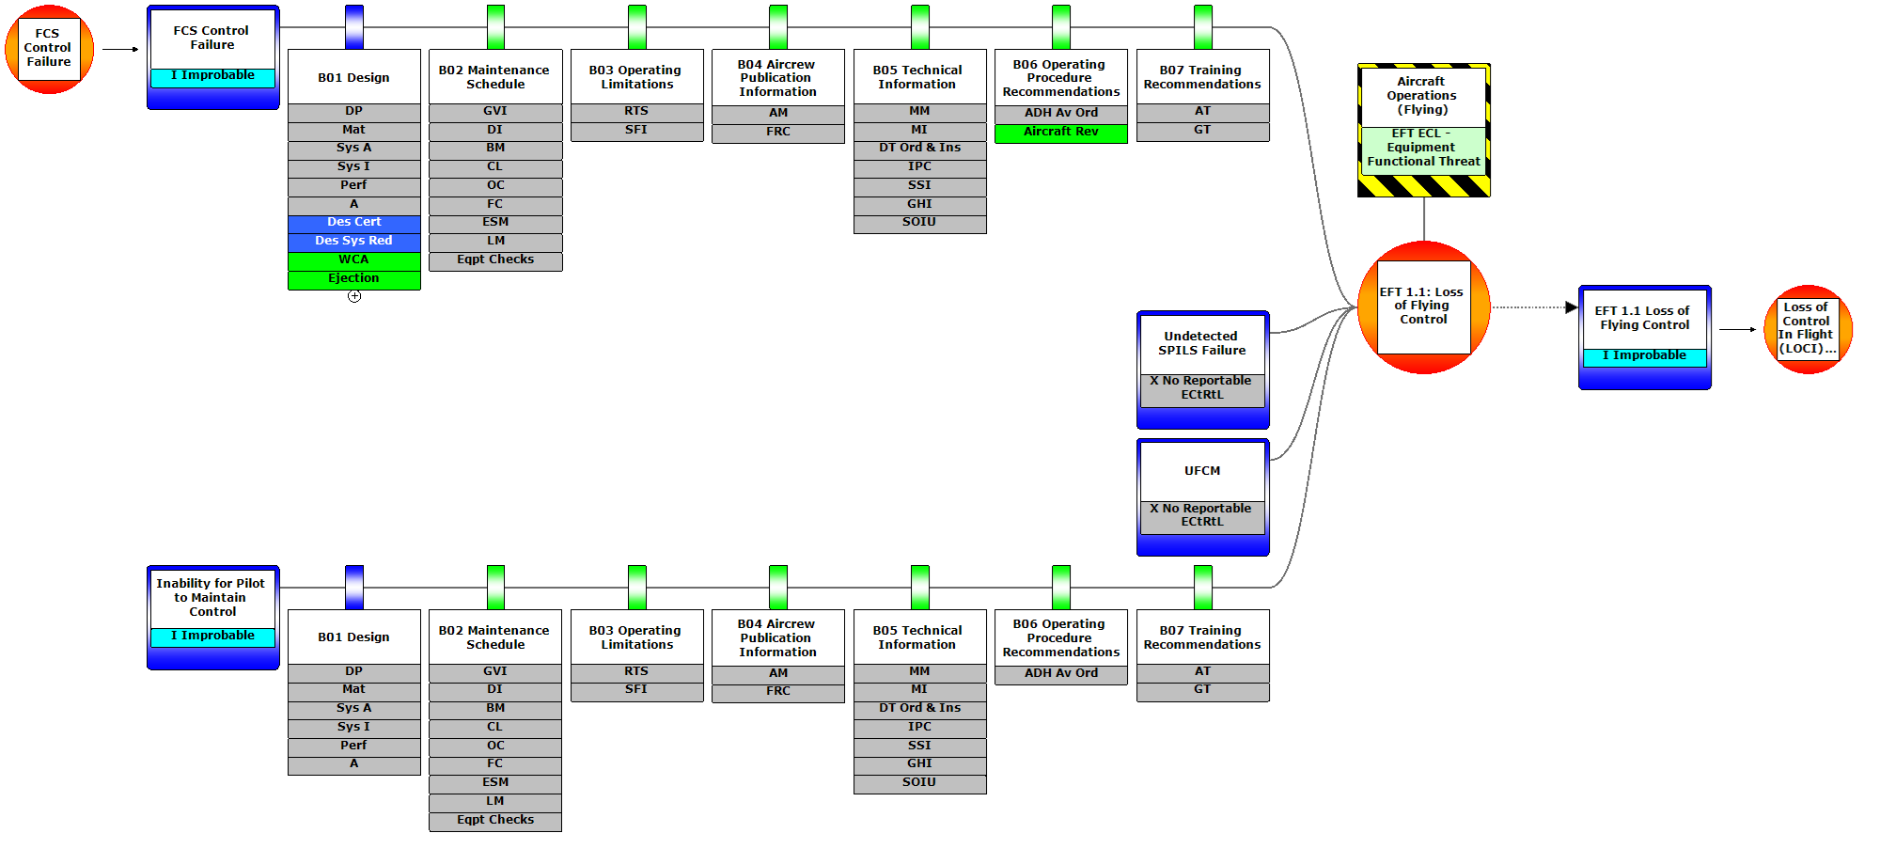

Slide 12
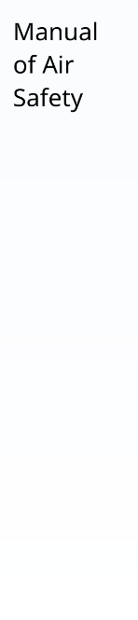
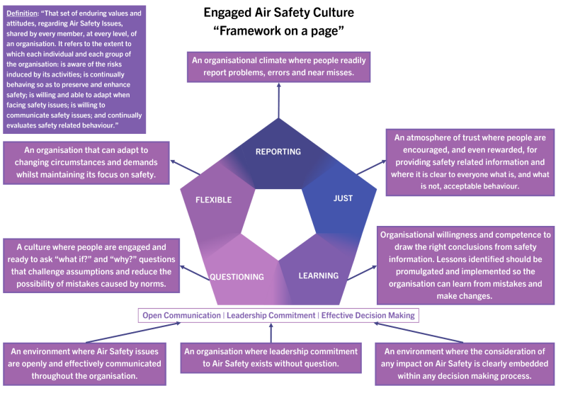
Safety Culture

Slide 13
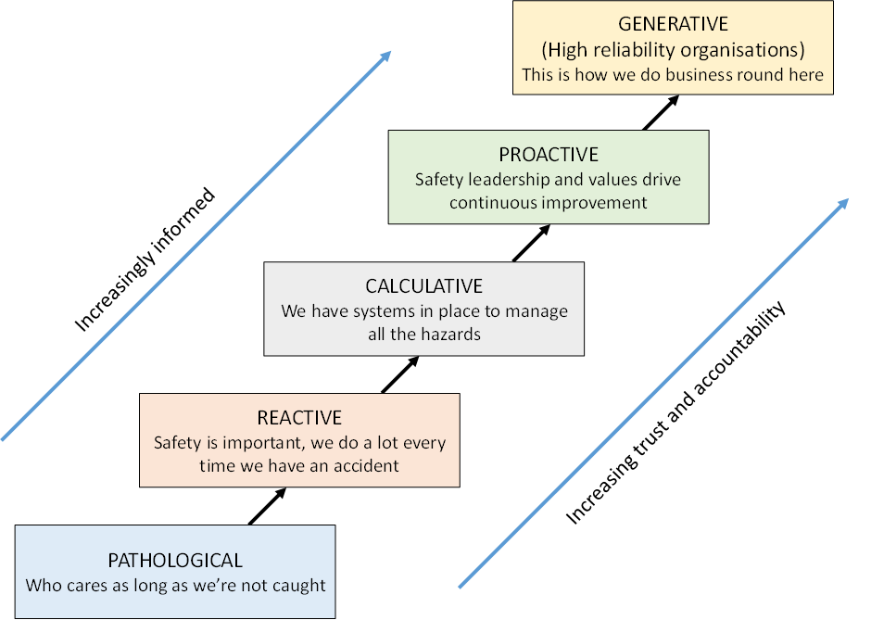
Different Types of Safety Culture
Five distinct climates are used to define the stage of an organisation’s Safety & Environmental Culture
Notes:
At what level do you think your part of the business operates on this path?

Slide 14
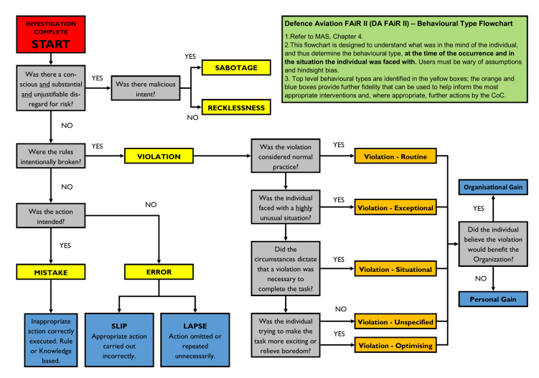
DA FAiR II Behavioural Type Flowchart
Notes:
So this model is built on James Reasons model for human factors which identifies slips, lapses, mistakes and violations
Investigation starts at the top and asks was there a conscious and substantial and unjustifiable di regard for risk yes no. If there was then your into malicious intent and its just whether the person was being reckless or was out to break or hurt someone
If no then were into whether rules were intentionally broken, If yes then is this considered normal practice, such as when you drive faster than the speed limit or without a seat belt for example
If no then was the action intended if yes then it was a mistake in applying the correct action but at the wrong time perhaps
If no then an error has ovccured with an appropriate action carried out incorrectly or something not done when required.
With violations we have a whole other tree where consideration is given to if it was normal practice to something knowingly wrong, what are the extenuating circumstances was this for organisational gain or personal gain, i.e. did the boss just want the aircraft out of the hanger or did the person want to get home for their tea…..

Slide 15
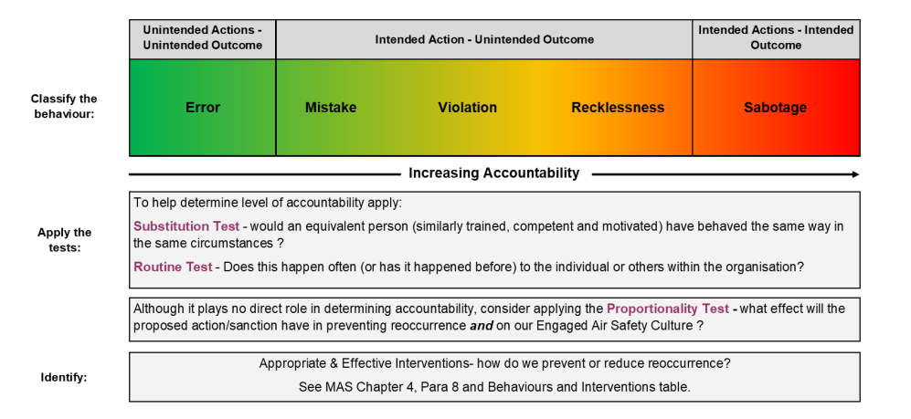
DA FAiR II Tests, Interventions and Accountabilities
Notes:
To help classify the behaviours

Slide 16
Notes:
So where have we ended up with out ECtRtL…..

Slide 17
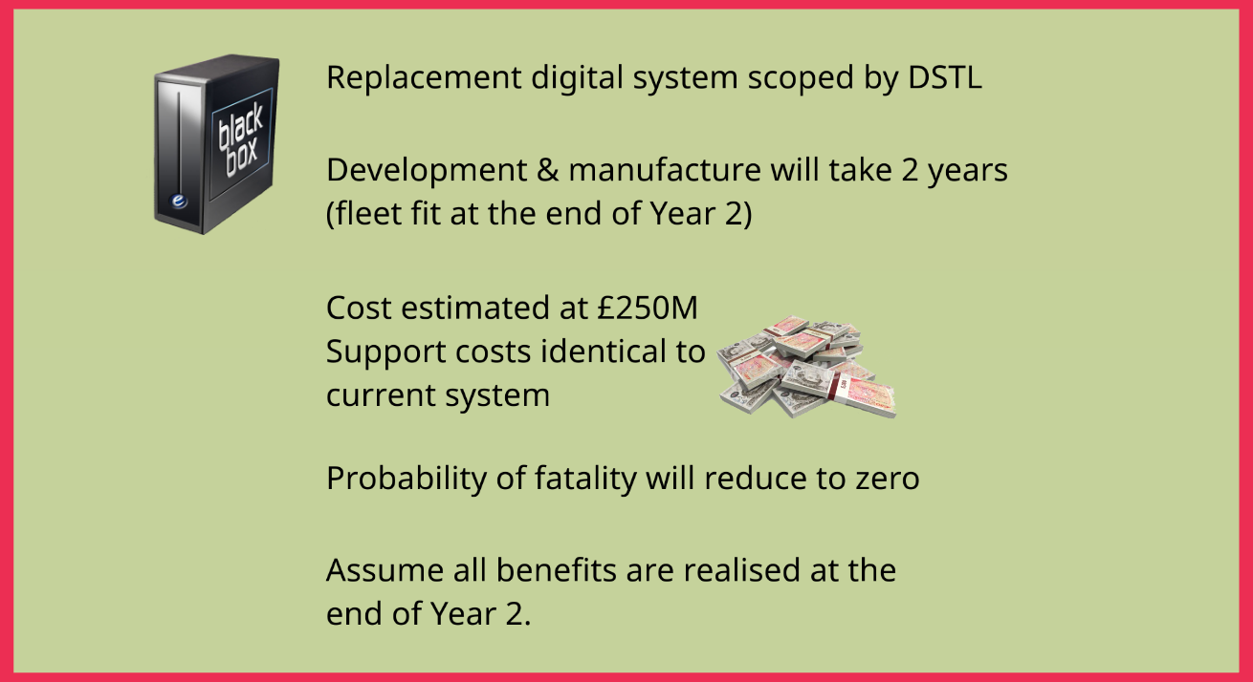
Have we done enough?
Notes:
Can anything else be done?

Slide 18

Quantitative Assessment (CBA)
OPY = Occurrences per Year
VPH = Value of Preventable Harm
L = Length of time used by the analysis
GDF = Gross Disproportion Factor
Cost of No Reduction
OPY x L x VPH x GDF
Cost of Reduction
£250M
Substituting in values for OPY, L, VPH, GDF given that the probability is currently deemed to be improbable (1E-7) the benefit of option is calculated to be grossly disproportionate to the benefit gained.
Notes:
We can perform Cost Benefit Analysis to quantify the cost of implementing an option vs the benefit gained by its introduction. CBA measure is monetary considering the cost of an impact such as a loss of life or injury over the lifetime of the system vs how much it would cost to reduce or remove that possibility in the 1st place. The equation provided looks at the cost of doing nothing, or the detriment vs the cost of implementing the option. Substituting in the values as identified will give you a detriment that can then be compared against the cost of the modification.

Slide 19
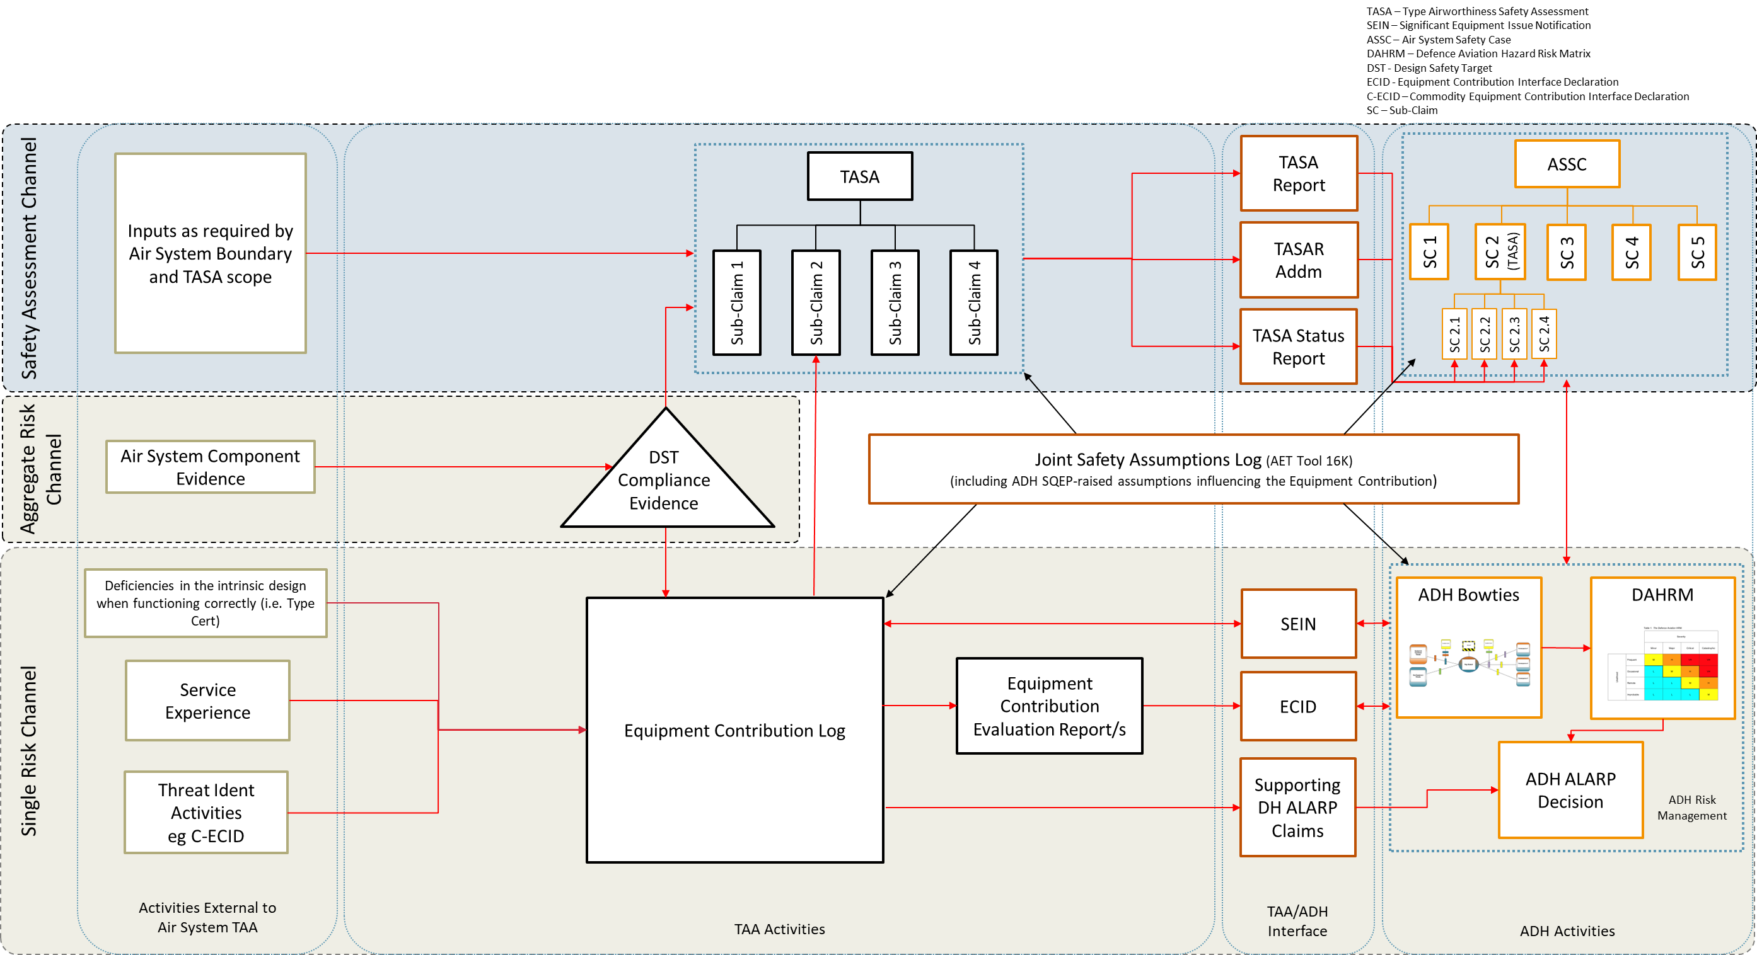
Recommendations to ADH
AET Tool 16.E
Notes:
Insights from this analysis will along with the ECtRtL assessment be provided to the ADH via the Equipment Contribution Interface Document to which the ADH is required to respond to agree or otherwise to the position reached by the TAA

Slide 20
Any Questions?

