Slide 1
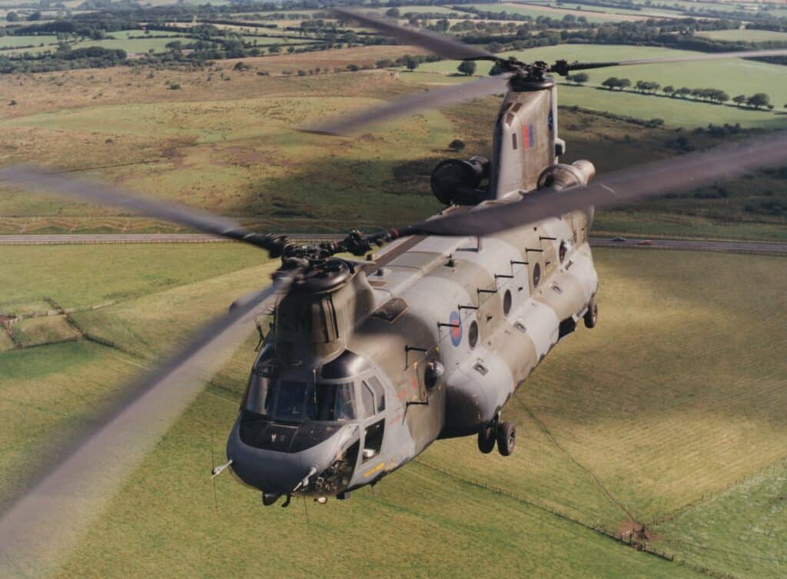
Type Airworthiness Authority
Type Airworthiness Desk Officers’ Foundation Course

Slide 2
Type Airworthiness Authority
Learning
Objective
To provide an understanding of:
The Role and Responsibilities of the TAA
The purpose of Letter of Airworthiness Authority (LOAA)
The purpose of the Letter of Airworthiness Notification (LOAN)
The purpose of the Letter of Endorsement (LOE)
The relationship between the TAA and the Aviation Duty Holder and their CAM
The role of the TAA in the Air Safety RtL Process
The relationship between the TAA and the non-platform PTs

Slide 3
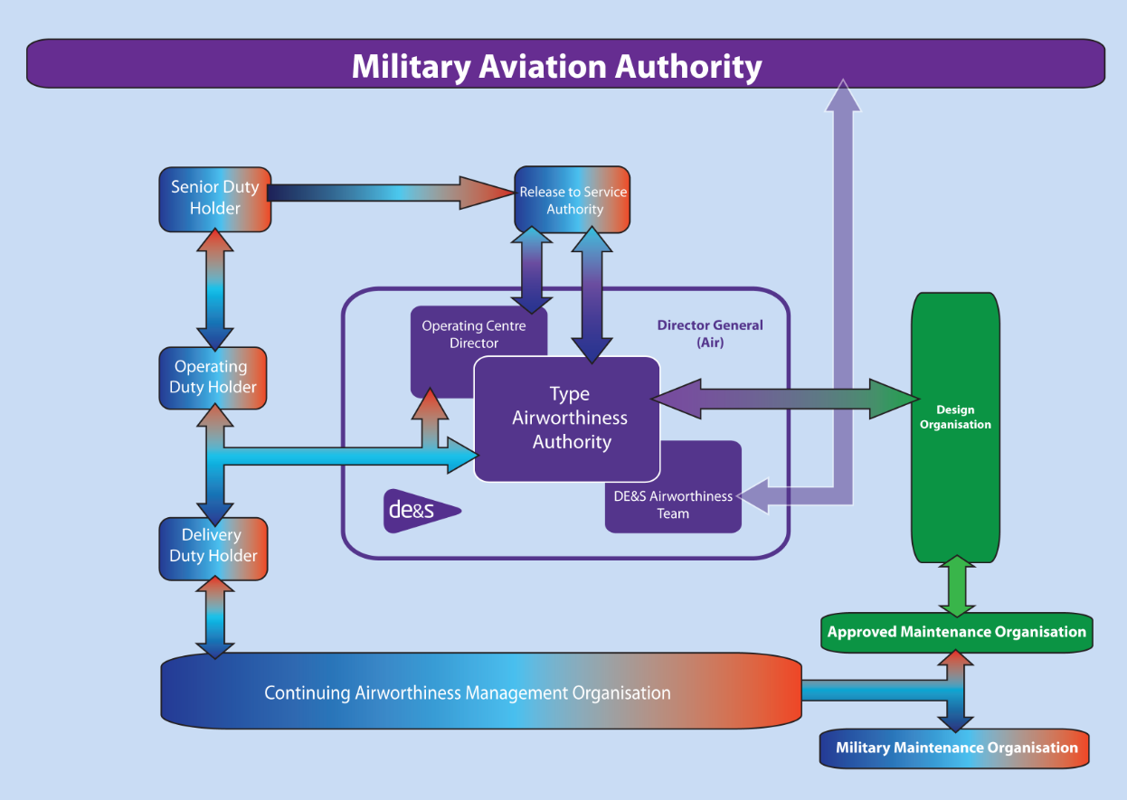
Dir Fixed Wing
Dir Rotary Wing & UAS (RA1013)
Director Engineering
and Safety (RA 1012 Responsibilities
(RA1015 Responsibilities)
Head of Eng Authority (Air)
Notes:
So you were introduced to this model in the overview were going to look specifically at the TAA element here in the middle
Click

Slide 4
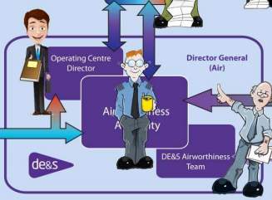
Dir Fixed Wing
Dir Rotary Wing &
UAS (RA1013)
Director Engineering
and Safety (RA 1012 Responsibilities
HEA

Slide 5

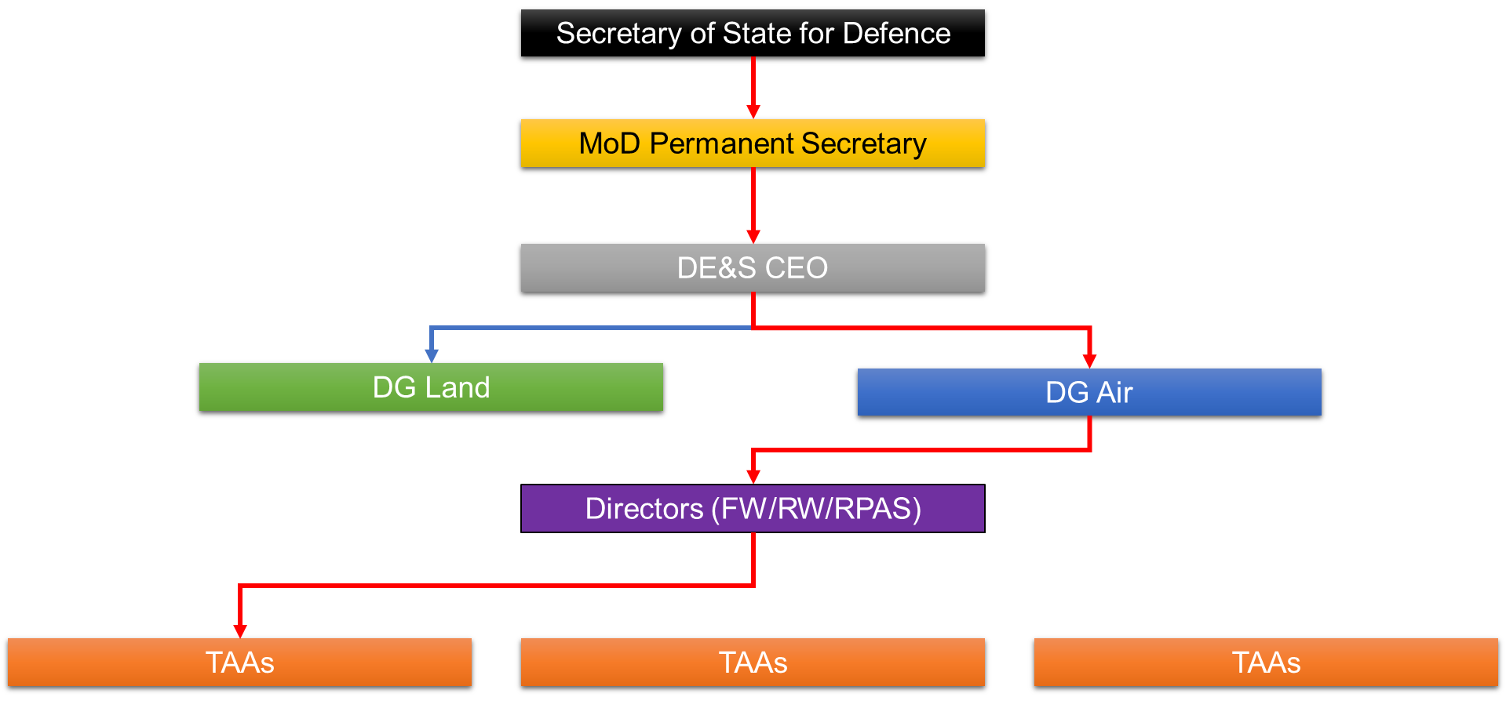

Who is the TAA (and what do they do)?
They should:
Acceptable Means of Compliance 1003(1) 1015(1)
Be a senior project engineer who is nominated for each aircraft type
Hold a Letter of Airworthiness Authority (LoAA)
?
Be should be at least OF5 (or equivalent) and can be OF4 for certain (S2) categories of RPAS
Have achieved Chartered Engineer status
Have previously held DT delegated responsibility
Regulation 1015(1)
[The TAA] shall be responsible for the Type Airworthiness of an air system throughout its life from development of disposal.
Notes:
So here are the things that pertain to the TAA as defined in RA1003 and RA1015
So anyone know what the RA1003 is focussed on? - Delegation of Airworthiness Authority and the Notification of Air Safety Responsibility
Does anyone know where the responsibility for Air Safety and Airworthiness of an Air System resides overall? Who owns that responsibility? -
CLICK!!!
The Secretary of Defence….does anyone know who that currently is? John Healey
CLICK!!
Here is is…..So John is overall responsible but he then delegates this authority to down through this chain to the Chief Executive Officer which then crosses over into DE&S for onward delegation management activities which eventually arrives at the appointment of people into the roles of a Type Airworthiness Authority for each Air platform currently in service with the MOD.
More on this delegation chain later on
So what about RA1015? Anyone know what this covers? Type Airworthiness Management – Roles and Responsibilities.
It effectively sets out the roles and responsibilities for personnel appointed to Principal Type Airworthiness Positions – the Management Positions
So the person needs to first and formally be a Senior Project engineer nominated as the TAA for a particular aircraft type or perhaps a group of air system types.
So to be nominated what does that person need to have achieved?
Anybody know without looking at your slides?
Got an LoAA from the Director
Is Chartered
Be at least an OF5 or equivalent so a Group Captain, or Captain in the RN or a Colonel in the Army
Be a crown servant
Have previously held a DT delegated position with airworthiness responsibility
Do with think there is anything like this in the Civil world? No there isn’t. Who manages Type Airworthiness in the Civil World? The OEMs (yes)
So lets dig into what the TAA role looks like….

Slide 6

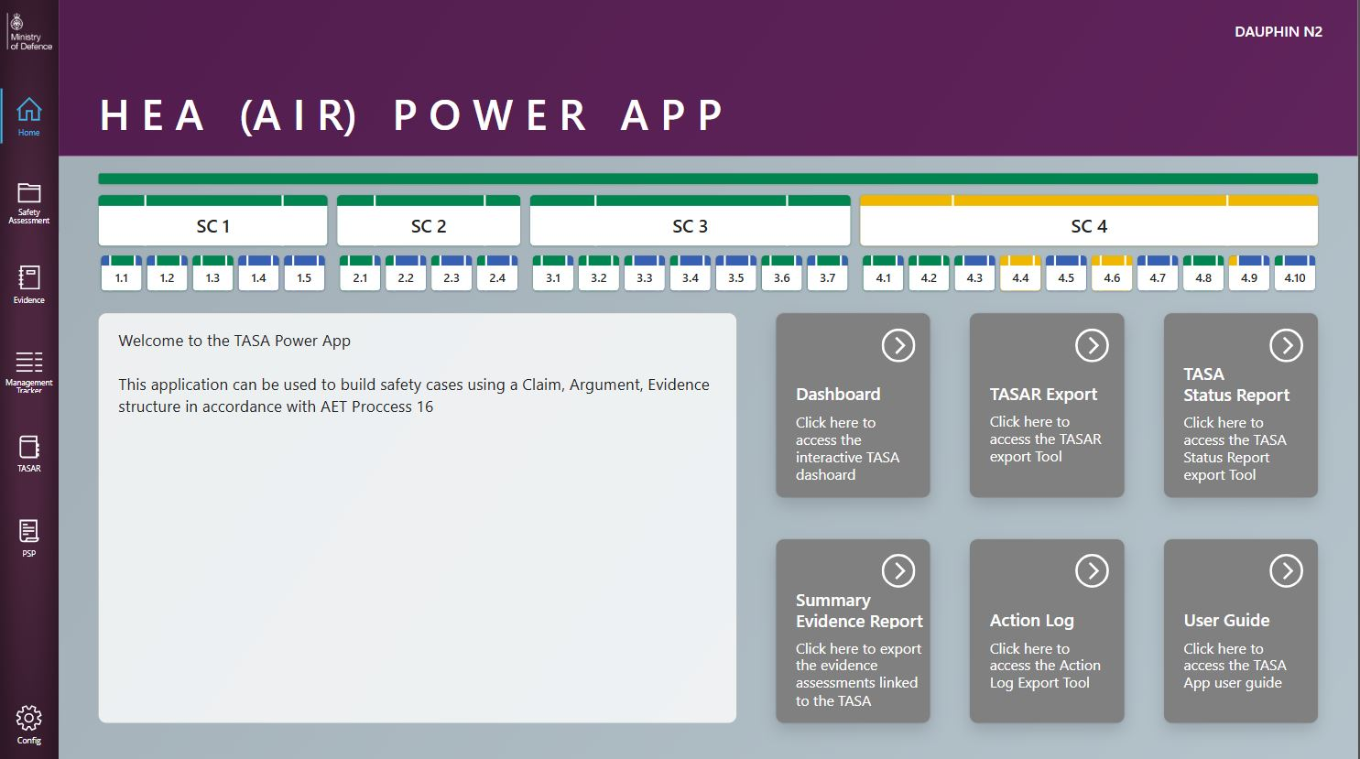
A day at the office!
Notes:
SO HERE IS THE TAA IN THEIR OFFICE – LETS LOOK AT WHAT THEY HAVE TO MANAGE AND WORK

Slide 7
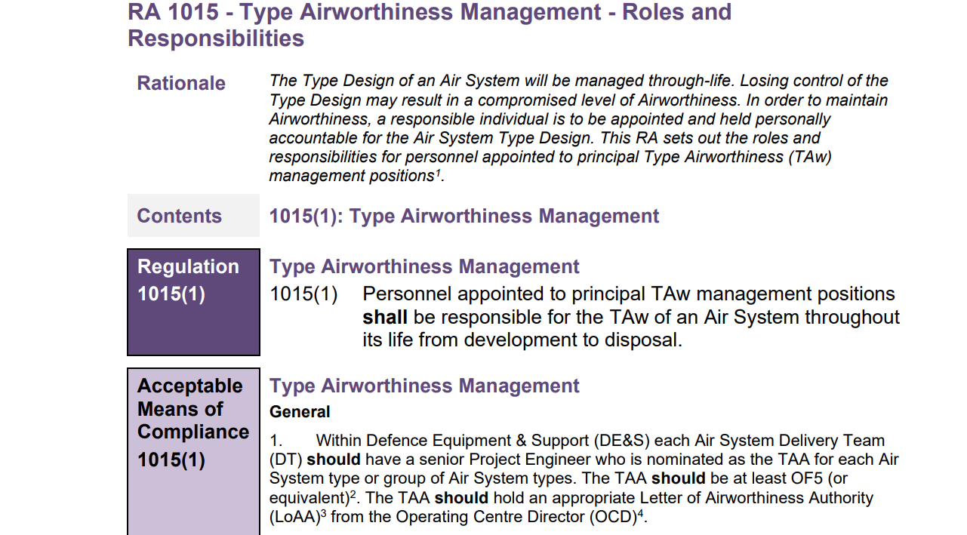
RA1015 – Type Airworthiness Management
7
Notes:
ON THEIR SCREEN IS THE RA1015 WHICH AS LOOKED AT A LITTLE ALREADY IS A PRIMARY ARTICLE THAT PROVIDES THE ROLES AND RESPONSIBILITIES FOR TAA'S. THE TAA IS THE INDIVIDUAL WHO IS APPOINTED AND HELD PERSONALLY ACCOUNTABLE FOR THE AIR SYSTEM. THROUGH ITS LIFE AND IN DISPOSAL
HOW DOES IT BREAK DOWN?

Slide 8

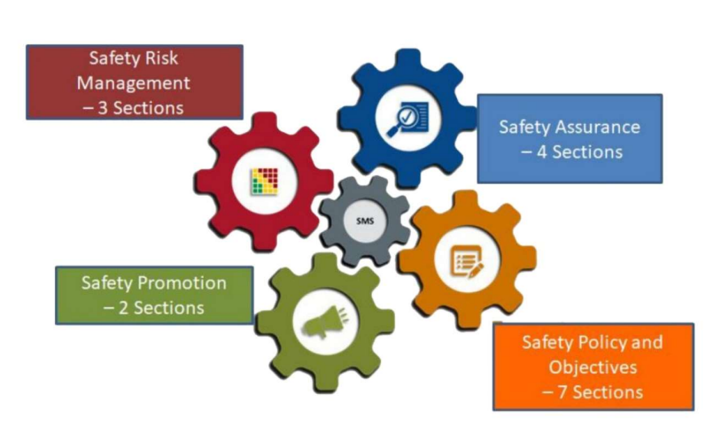
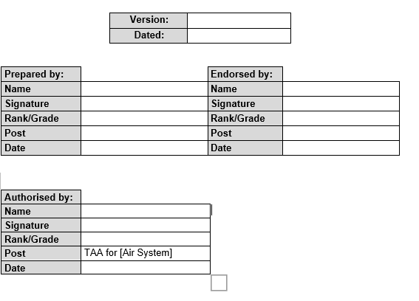
Produce a Type Airworthiness Strategy
Be responsible for the safety management of the project
Wedgetail Delivery Team Type Airworthiness
Strategy
Initiate and maintain the TASA
Notes:
So the TAA needs to develop and maintain through life, a Type Airworthiness Strategy for a given Air System that supports the Air System Safety Case. RA5010 captures the regulation and AMC with AET Process 0 providing a template for its production or capture, so help is at hand. More on the strategy later.
Similarly and linked to the Strategy is the need for the TAA to develop and maintain and improve over time a Safety Management System specific for the platform or platforms which complies with the Airworthiness Strategy.
Finally on this slide is the need for the TAA to initiate and maintain an up-to-date Type Airworthiness Safety Assessment (TASA) and ensure the TASA and Project SMS is subject to independent evaluation and audit .

Slide 9
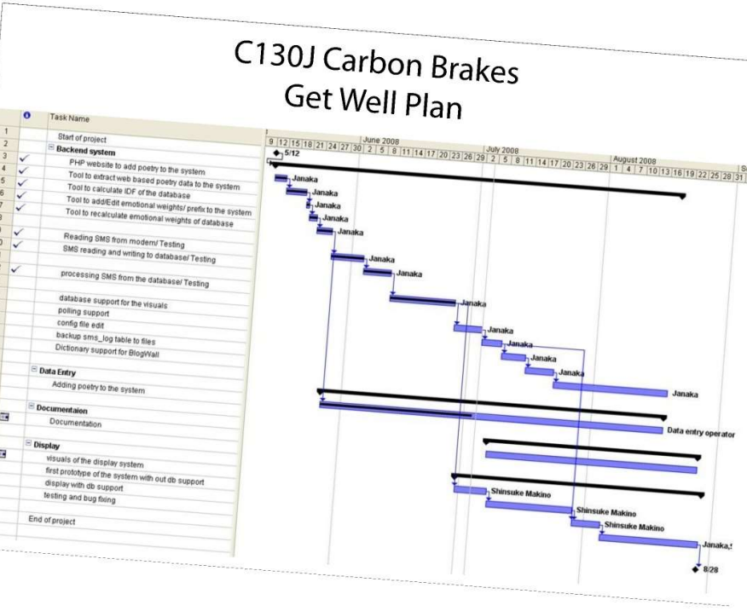
Take appropriate action in response to airworthiness issues
Notes:
The TAA needs to have systems in place that monitors and captures in service issues both from the operator and perhaps the DO or CDO and that will work to take appropriate action that may include the need for investigations, analysis, solutions and perhaps the need for design changes to be realised through modification activities where improvements have been shown to be needed.

Slide 10

Ensure technical data capture and analysis validates design assumptions
Notes:
The TAA needs to make arrangements for technical data to be captured in the 1st instance to support assessments and investigations and make sure the data is analysed and that any assumptions applicable remain validated in so doing. Data could be from the operator, the MIL Cam, health data from the aircraft, data from the commodities DT, weapons DT. Data could be captured through DASORS in ASIMS etc. which we’ll talk about later in the week

Slide 11

The TAA approves the ISTA, ensuring the completeness and accuracy of the Approved Data
Notes:
So the instructions for sustaining type airworthiness (ISTA) form the Air System Document Set and. This will include the Maintenance Manuals, Air Crew Manual, Flight Reference Cards, the RTS, all the documents that are needed to support the aircraft in service. The TAA needs to make sure this is a complete set, has been created by competent organisations such as the OEM/DO, is reviewed by appropriate sqep and endorsed, is kept up to date and provided in a way that makes it readily accessible to those who need to see the data.

Slide 12
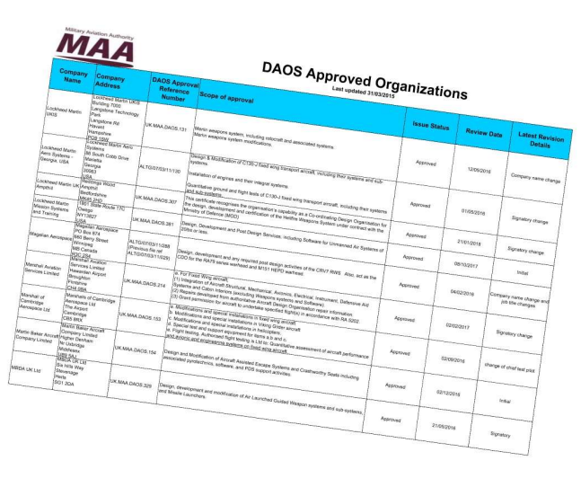
AET Process 03
Establish and maintain a direct contractual relationship with the Air System DO or Co-ordinating DO (CDO) throughout the life of the Air System type.
Notes:
The TAA needs to engage and then maintain a direct contractual relationship with those organisations who are responsible for the design of the aircraft and the engines i.e. the DO understanding that for some platforms this may be different organisations. Sometimes there is a Coordinating DO or CDO that manages the different organisations involved in the design aspects of the aircraft and is the poc for the TAA. Organisations providing design services generally need to be DAOS although for UAVs there seems to be some latitude on this.
The TAA activity is going to take the form of establishing formal contracts which will identify the various touch points between the organisations, what data is to be delivered and maintained and when, what meetings, roles and responsibilities etc. are to be involved.
AET Process 03 provides support to assuring the competence of contracted organisations

Slide 13


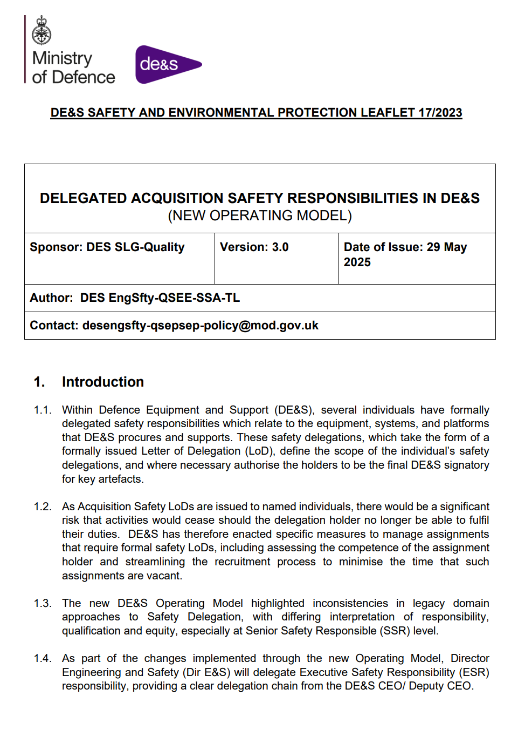
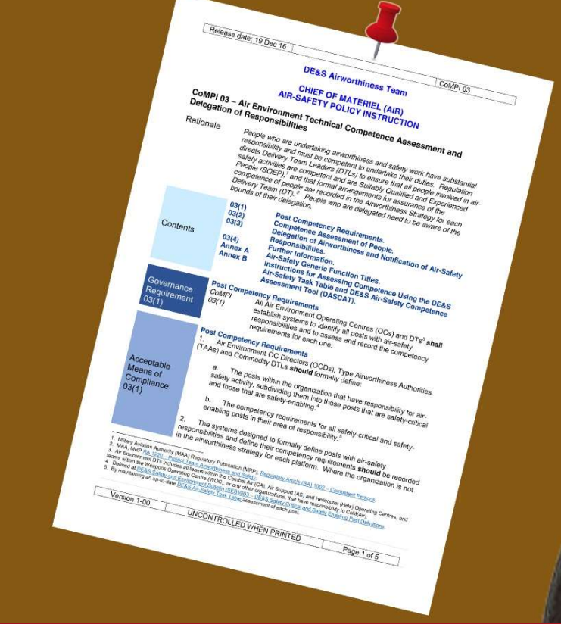


Delegate LoAAs to subordinate staff.
Notes:
The TAA cannot do all the work so they need to delegate responsibilities down to others through LoAAs and LoANs which involves identifying people already at level or those who are considered able to develop to level and work with those individuals to realise capability. So the TAA is going to actively identify and assess the competencies of resource and perhaps act as coach to support peoples development to level. It may be that the TAA is going to have to take a decision to put someone in post before they have an LoAA but then manage their completion of needs in post.
To note the approach to delegation is being aligned with ASEMS Leaflet 17 as part of the DE&S New Operating Model

Slide 14
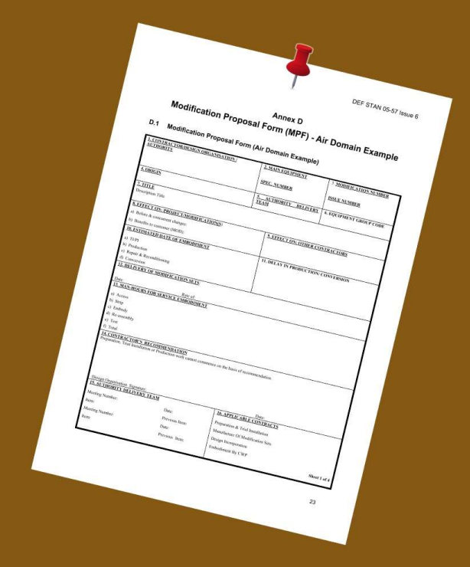
Remember to conduct assurance of the DT and Commodity DT and any other support teams and organisations
Approve each change to the Air System Type Design; except where privilege to approve minor changes has been conferred upon the DO
Notes:
The TAA needs to conduct assurance of non-Air Platform DTs, support teams and other organisations. So as per RA1200 this covers compliance monitoring and safety performance measurements with use of suitable safety performance indicators to measure performance against any defined Safety Objectives and targets whilst ensuring routine review.
And as it says here approve each change to the System Type Design unless privileging has been provided to the DO for minor changes. As part of this activity the TAA has to develop and maintain a configuration management plan and manage and authorise procedures for modifications.

Slide 15

Undertake Mil CAMO tasks sub-contracted to them
Notes:
RA4956 states that some MIL CAMO tasks can be sub contracted to other organisations including the DT and therefore the TAA but the responsibility remains with the MIL CAM.

Slide 17
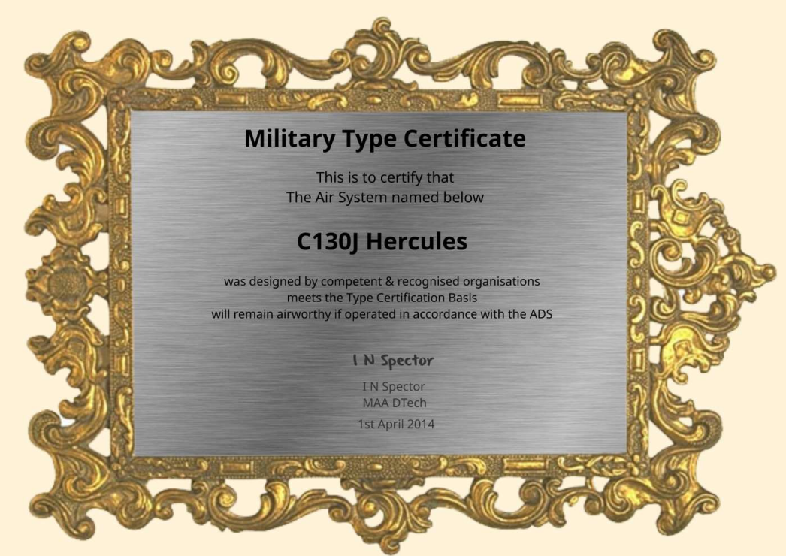
Notes:
The TAA is the Military Type Certificate holder for those air systems within their area of responsibility having to work with RA1015 to discharge their responsibilities. To note for those systems undergoing a major change in type design the TAA should be the holder of the Approved Design Change Certificate.

Slide 18


Ensure that the Air System Type Design meets all applicable Certification Airworthiness Regulatory requirements through life
Certification Standards
Notes:
The TAA should ensure that the Air System Type Design complies with all applicable Certification Airworthiness Regulatory requirements such as FAR 25, CS25, 27 etc. through life which includes applicable airworthiness directives and service bulletins etc.

Slide 19



Notes:
The TAA needs to build and maintain a good relationship with the duty holder chain where they can actively support them including informing them when there has been a change that could impact on the DHs assessment of risk. So informing on the status any issues regarding the ECtRtL assessments made by the DT. Indeed the TAA mush ensure that relationships are developed and maintained in all direction of involvements, from the OEM / DO/ CDO, with the MilCAM and then with the ADH and MAA ultimately. These relationships and touch points need to be captured in interfacing documents, contracts and business agreements.

Slide 20


Slide 21
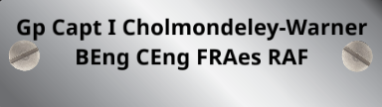



Notes:
So in summary....
To note that the Ops Delivery Manager is the Team Leader which is a change from the TAA holding this role previously.

Slide 22

Airworthiness Strategy
Regulation 5010(1)
The TAw Authority (TAA) or TAw Manager (TAM) shall establish and maintain a through life TAw Strategy for an Air System that supports the Air System Safety Case (ASSC)
Acceptable Means of Compliance 5010(1)
Content Should Include:
  Context, Scope, roles, intended use, ISD and OSD
  Delegation Responsibilities
  Approach to establishing an ASMS [RA1200 & 5011]
  Approach to establishing TD and In Service Change [RA5810, 5820, 5305]
  Approach to ensuring competent people and organisations [RA1002, 1005]
  Approach to QA, Audits, ITE, configuration management [KID]
  Approach to Integrity, hazard, and fault management [RA5726, 5828, 5011]
  Approach to Integration of equipment and systems that are in the TASA managed by the TAw organisations [RA5011, 5012, 5013]
  Approach to Configuration Management and ADS Management [5301, 1310, 5815]
  Approach to Airworthiness Information Management and Data Exploitation [RA1223, 1207]
  Approach to Production Acceptance, concessions, waivers [RA5835]
  Approach to Human and Capital Resource planning
Notes:
A TAw Strategy is required for each Air Systems type to set down the intended approach to Type related Air Safety and the demonstration and sustainment to TAw through life.
The TAA as stated earlier shall establish and maintain a strategy through out the air systems life as per RA5010.
What it should include is listed here and will need to be approved by the DE&S associated Director be it for fixed or rotary wing and UAV.
It has to relate to the DH ASSC requirements for their RTS or MPTF where applicable and reviewed in line with that ASSC.
From the RA 5010 AMC 5010(1)
- A clearly defined context, scope and boundary, including a declaration of the In-Service Date, Out of Service Date, and the intended military use of the Air System
The delegation of Responsibilities between the TAA and TAM, if applicable.
The approach to establishing and sustaining an effective Air Safety Management System (ASMS) with appropriate interfaces.
Detail on the approach to establishing the Type Design and managing in-Service design changes
The approach for ensuring the use of Airworthiness competent organizations and persons
The approach to assurance and review of TAw management activities, including Quality Management Systems, Independent Technical Evaluation, Independent Safety Auditing and independent review of publications.
Detail on the approach to delivering and sustaining the Air System TAw through proactive Integrity Management, reactive Fault and Occurrence investigation and Hazard Management activity
Identification and approach to integration of equipment and systems that are included within the Type Airworthiness Safety Assessment (TASA) but are managed or supplied by other TAw organizations
The approach to Configuration Management and Air System Document Set management
The approach to Airworthiness Information Management and Data Exploitation
The approach to production acceptance, including an overview of oversight and how production concessions and Waivers will be managed
The approach for assessing and ensuring sufficient human and capital resource to conduct the required tasks

Slide 23
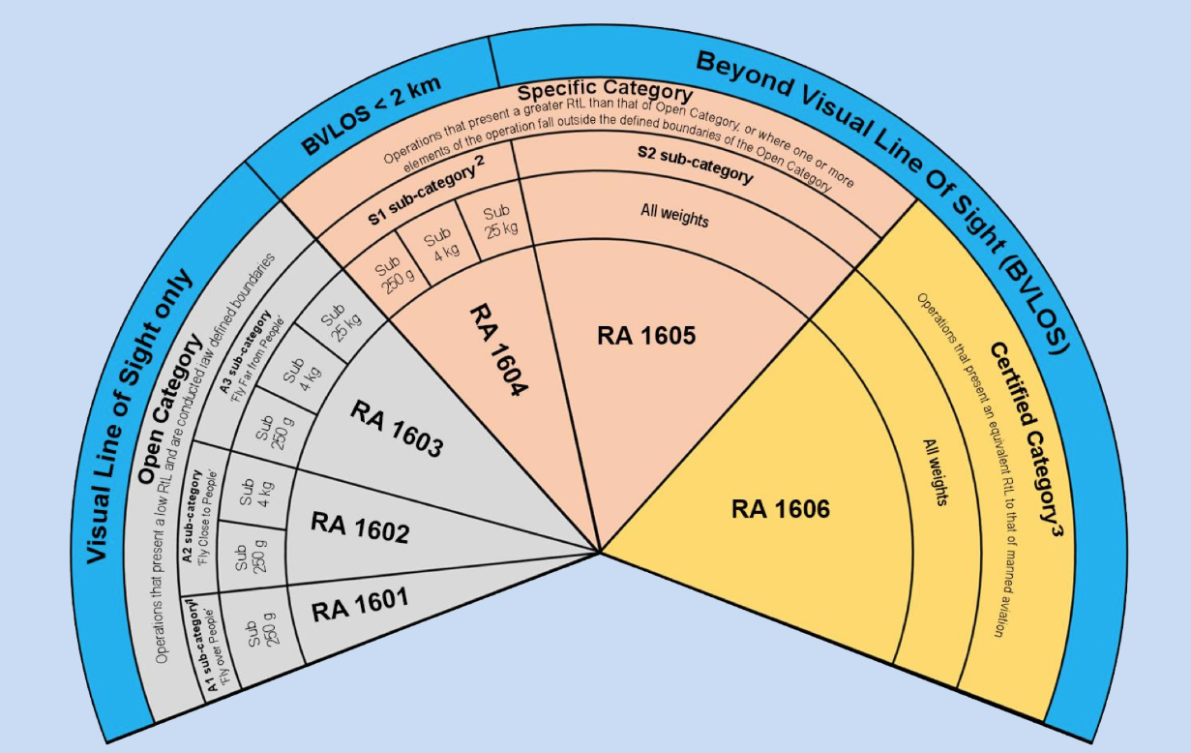
Remotely Piloted Aircraft Systems
Notes:
To note for RPAS Open Category and Specific S1 Sub category remotely piloted air systems do not require a TAw Strategy however Specific S2 sub categories and certified categories do.
Noting further that if the RPAS is swarming, armed or dropping anything it will always be an S2 category.
See RA 1600 for more information.

Slide 24
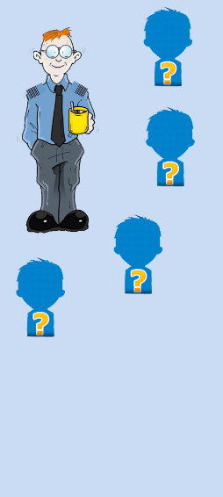
Delegation of Airworthiness Authority in DE&S
Regulation 1003(1)
Delegation of the Airworthiness Authority to approve changes to the ADS within DE&S shall be:
  By Suitably Qualified and Experienced Person (SQEP) Crown Servants, in nominated posts.
  Be in the form of a Letter of Airworthiness Authority (LoAA).
Notes:
The responsibility for the Air Safety and, consequently, the Airworthiness of Air Systems is vested in the Secretary of State (SoS) for Defence, who delegates authority in this matter to each Service Chief of Staff and Chief Executive Officer (CEO) for onward delegation to competent individuals

Slide 25


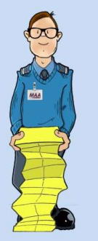

Secretary of State for Defence
Letter of Airworthiness Authority
MoD Permanent Secretary
Letter of Endorsement
DE&S CEO
Dir ES (Engineering & Safety
Directors (FW/RW/RPAS)
TAAs
TAAs
TAAs
Notes:
Just showing 2 of 4 strategic enablers here others being DG Ships and DG Strategic Enablers
The responsibility for the Air Safety and consequently the airworthiness of air systems is vested in the Secretary of state for defence who delegates authority in this matter to each service chief of staff and chief executive officer (CEO) for onward delegation.
CEO should issue a LoAA to Director General (Air) (DG(Air))containing, as a minimum, the Air Safety responsibilities and Airworthiness Authorities detailed in RA 10121 .
DG(Air) should issue LoAAs to those Directors with responsibilities for Air Systems and equipment, containing as a minimum, the relevant Air Safety responsibilities and Airworthiness Authorities detailed in RA 10132 .
The MAA issue Letters of Endorsement to the directors and the TAAs which then permit the issuing of LoAA to the directors and the TAAs.
The directors should issue LoAAs to subordinate TAAs, via intermediate line managers where necessary.
These LoAAs should contain, as a minimum, the Airworthiness Authorities detailed in RA 10153 .
Subordinate Delivery Team (DT) staff requiring LoAAs should receive such delegation directly from the respective TAA who should identify posts required to alter the ADS without reference to higher authority.

Slide 26
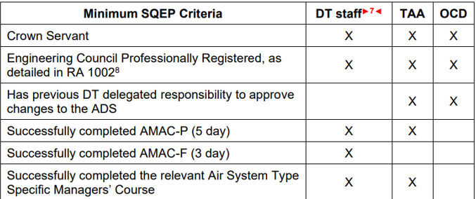
Letter of Airworthiness Authority (LoAA)
Acceptable Means of Compliance 1003(1)
The authority to approve changes to the ADS, granted to individuals through the issue of LoAAs, should be delegated to Type Airworthiness Authorities (TAAs).
A clear, unbroken chain of delegation from CEO to the respective TAA should exist, through the Directors and including intermediate line managers as necessary, with each receiving the appropriate level of delegation.
Dir ES
Notes:
The table here provides the minumum SQEP criteria for LoAA roles with the delegations reviewed by the issuer at least annually

Slide 27


LoANs
Secretary of State for Defence
MoD Permanent Secretary
DE&S CEO
Non-Air System DTL
Dir ES
Directors (FW/RW/RPAS
TAAs
TAAs
TAAs
27
Notes:
Letter of Air Safety Notification (LoAN): Formal Notification to an individual of their Air Environment Safety responsibilities. LoANs will be issued (by Dir ES) to individuals within DE&S who have responsibility for providing equipment (excluding Air Systems) and/or services in the Defence Air Environment.
LoANs have been issued by Dir ES to:
Director Lethality & Protection,
Director Sense, Decide & Communications
Director Logistic services and Commodities.
There is a requirement within the LoAN to cascade down the “Air” Requirements to their Delivery areas Chief Engineers.

Slide 28

Letter of Air Safety Notification
Regulation 1003(2)
Individuals within DE&S responsible for providing equipment (excluding Air System platforms) and/or service in the Defence Air Environment shall receive formal notification of their Air Safety responsibilities, promulgated through a system of formal letters.
Acceptable Means of Compliance 1003(2)
Directors should identify those Ship PAs or Commodity CEs within their operating centres who have formal responsibility for the Air Safety of the equipments and/or services they provide, but not Airworthiness Authority to approve changes to the ADS; such individuals should receive LoANs, issued through intermediate line managers if necessary.
LoAA and LoAN should issue LoANs, but LoAN holders should not issue LoAAs.
Notes:
LoAA and LoAN holders can issues LoANs but LoAN holders can not issue LoAAs
The purpose of a LoAN is to ensure that individuals are formally made aware of their responsibilities for air safety without airworthiness authority. There is no SQEP criteria identified however individuals will still need to be found to be competent to hold the responsibilities.

Slide 29
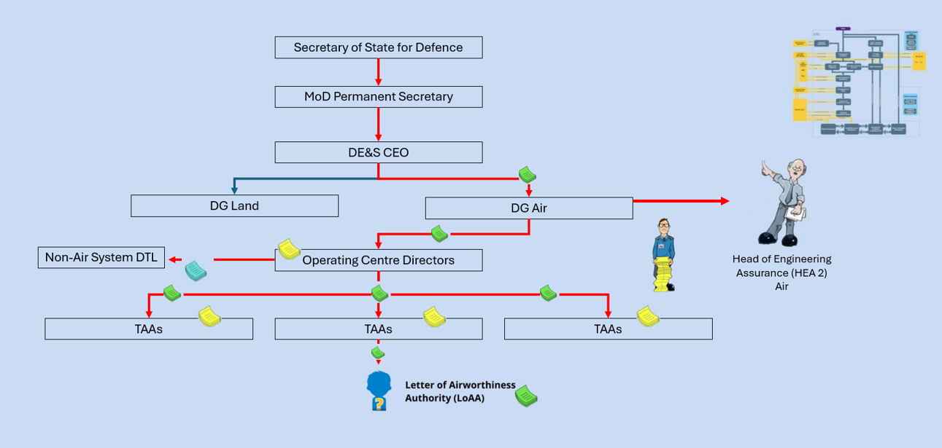
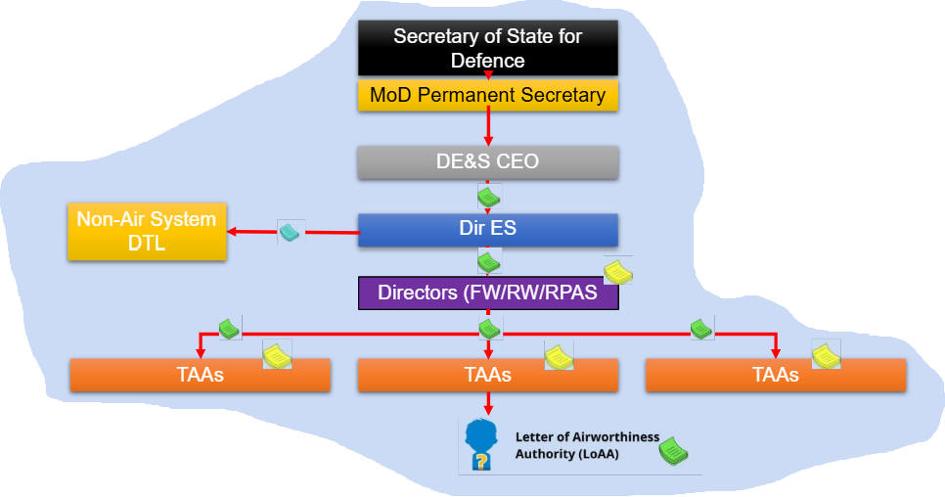
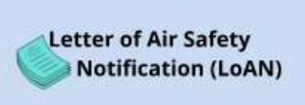

LoANs
Head of Engineering Authority Air (HEA Air)
Notes:
LoANs should be in the form of a letter personal to the individual receiving it and should not be transferable between individuals.
HEA as was DAT used here providing assurance to the DG Air

Slide 30
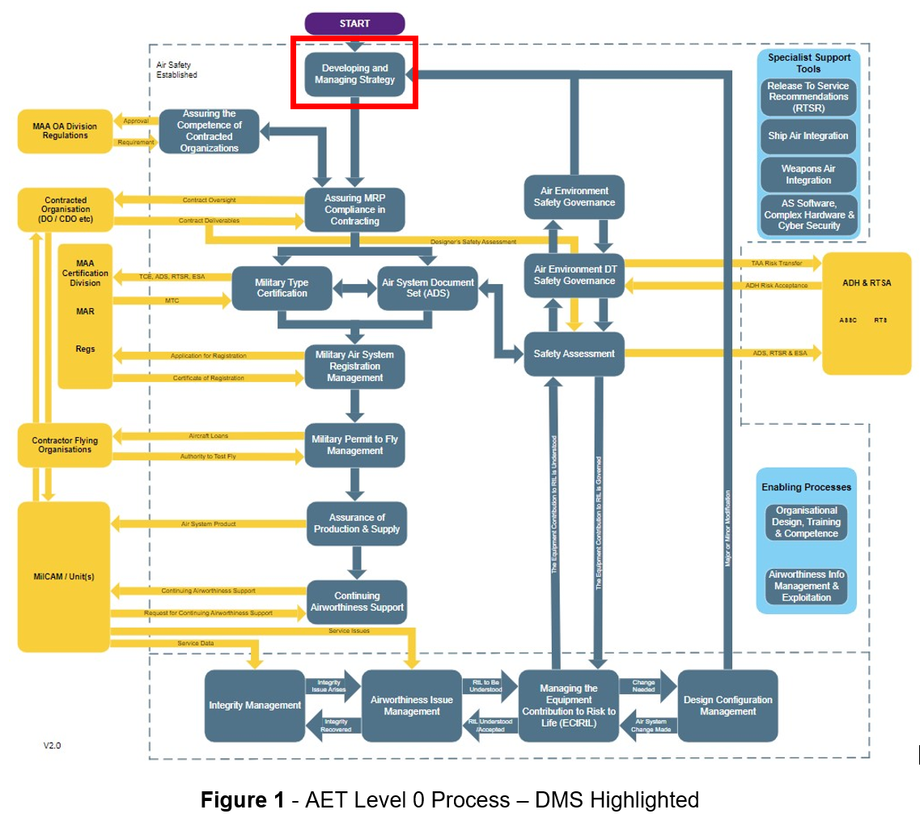
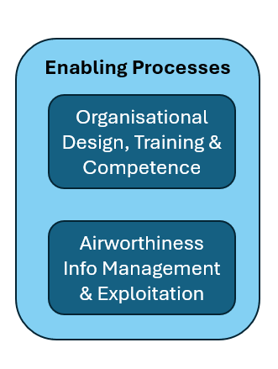
Notes:
The AET identifies enabling process that include competence as identified here

Slide 31
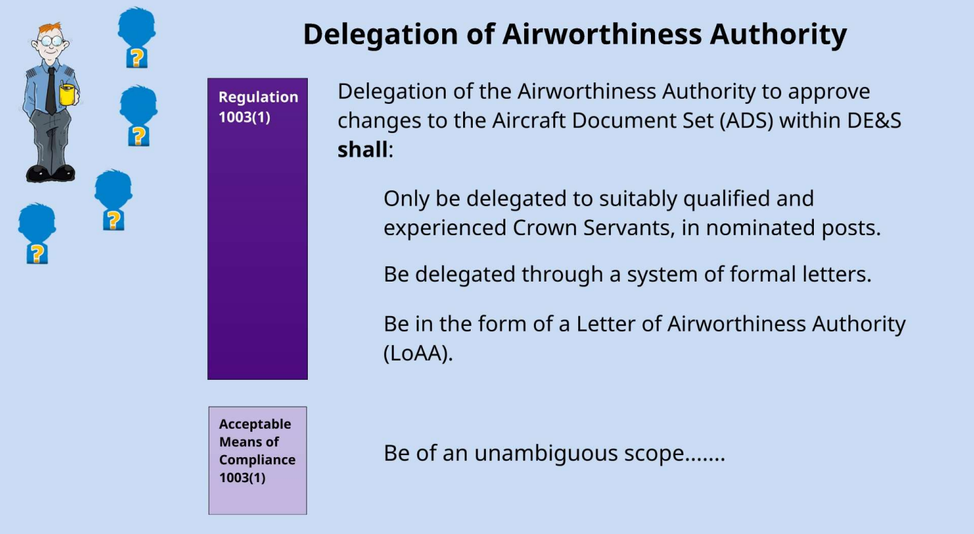
Delegation of Airworthiness Authority
Notes:
The authority to approve changes to the ADS granted to individuals through the issue of LoAA should be delegated to the TAA. As highlighted previously there is to be an unbroken chain of delegation from CEO to the TAA through the directors provided through formal letters and be of unambiguous scope and consistency with other delegations to prevent gaps or duplications

Slide 32
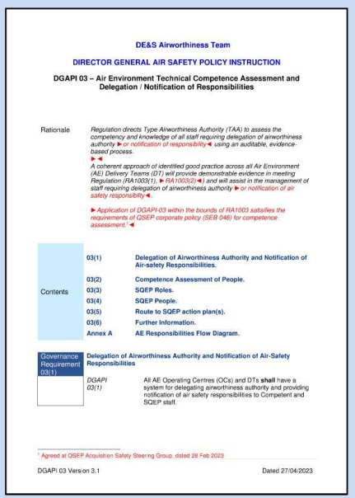
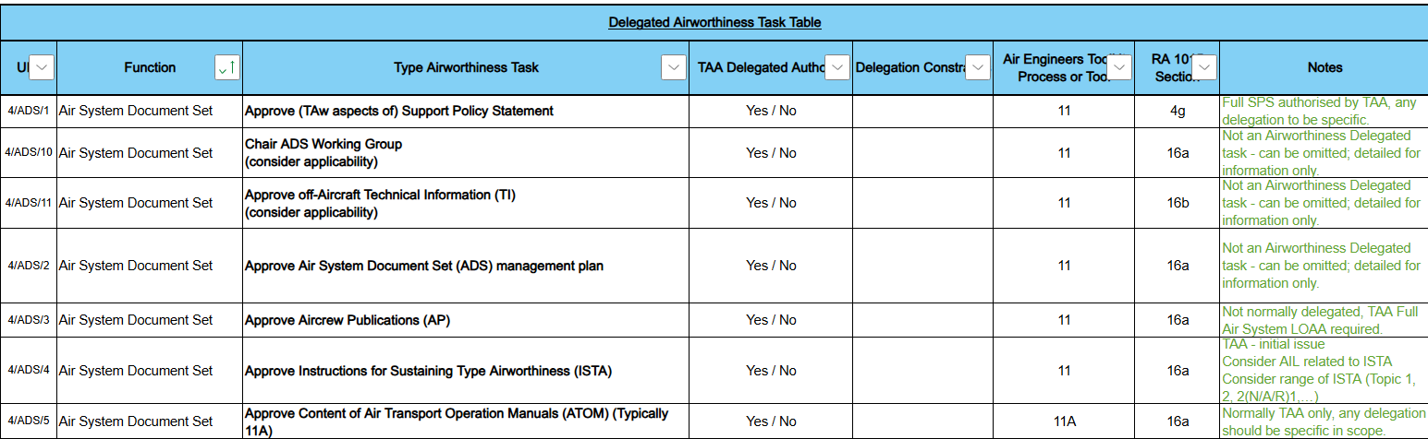
Air Engineer’s Toolkit Process 02
Airworthiness Task Table
Notes:
DGAPI 03 is provided to manage the competence assessment and delegation / notification of responsibilities. It provide a coherent approach based on good practices across all air environment delivery teams.
The AET Process 2 also provides a table of delegated airworthiness tasks.

Slide 33
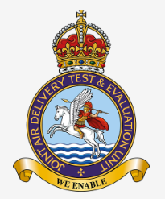
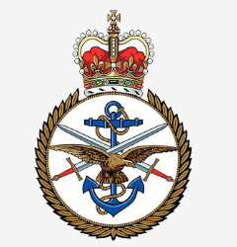


Interfaces with Non-Platform Teams
Acceptable Means of Compliance 1015(1)
To ensure the sustainment of Type Airworthiness activity, the TAA should ensure that signed formal agreements are in place with all organizations supporting Type Airworthiness activity.
Trials and Evaluation Units
Air Commodities FSaST
Other Air System DTs
Defence Aircrew Publications Sqn
Weapons Operating Centre
Notes:
So RA1015 – Type Airworthiness Roles and Responsibilities identifies the need for the TAA to ensure that signed formal agreements are in place with all organisations supporting the Taw activity.
Where an MAA Approved CDO is involved then the TAA needs to ensure that the CDO has arrangements in place with its sub contractors to support Taw activities.

Slide 34
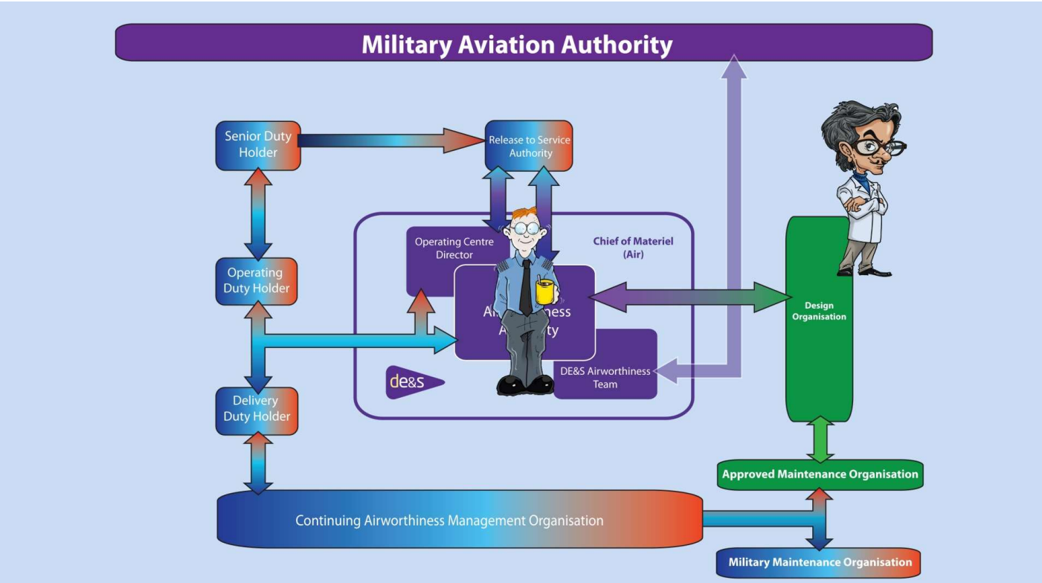
Dir Fixed Wing
Dir Rotary Wing & UAS (RA1013)
Director Engineering
and Safety
HEA

Slide 35
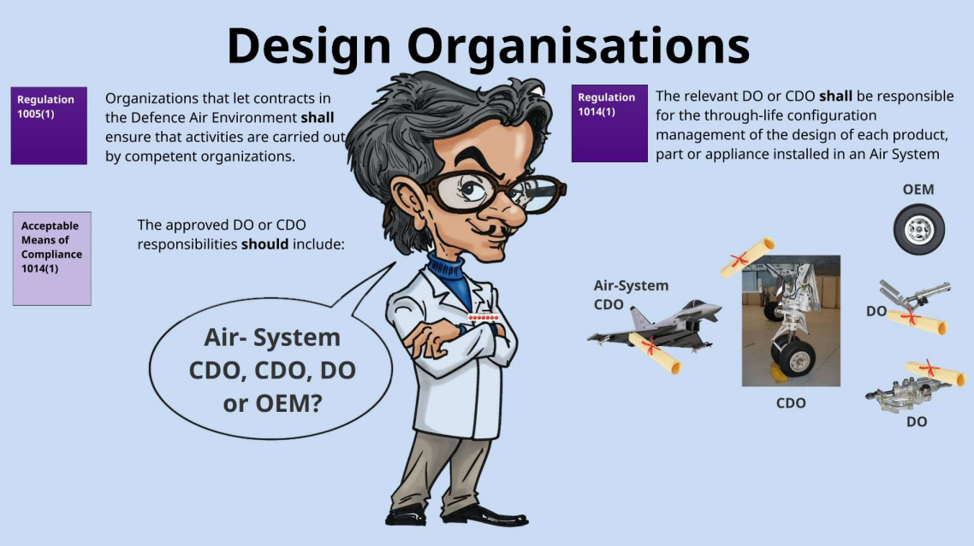
Notes:
For the procurement of Air Systems, Airborne Equipment, Air Launched Weapons, Aircrew Equipment Assemblies and Survival Equipment the contracting organisation shall only contract with a Competent Design Organisation with such organisations ideally being approved under the Design Approved Organisation Scheme.
DOs could be responsible for pieces of equipment, assemblies and even an overall air system. A CDO is going to be responsible for air systems in the main or complex assemblies where a number of OEM or DOs could be involved who individually do not own overall responsibility for the overall assembly or system of systems etc

Slide 36
DO or CDO Responsibilities
RA1014
AMC
1014(1)
DOs and CDOs should be approved through DAOS as detailed in RA5850 by the MAA
f. In agreement with the TAA the scheming, design, development and preparation of Modifications and Repairs to maintain TAw [...]
a. Demonstrating to the TAA or Commodity CE that the initial design is airworthy
b. The preparation and custody of specifications, drawings and instructions for maintaining the design
g. Contributing towards the equipment elements of the Air System Safety Case
c. The preparation and supply of information for the development and upkeep of the ADS
h. Ensuring that, where the organisation DAOS approval scope does not adequately cover a sub system, the relevant competent subcontracted organisation is consulted in respect of airworthiness
d. Reporting to the TAA or Commodity CE any failure, malfunction, defect etc resulted in or may result in an unsafe condition
i. Providing appropriate sub system and interface data in the form of specification and drawings for those aspects of the system or equipment that are designed by another DO
e. Ensuring any notified design related occurrence is investigated with provision of advice to the TAA or Commodity CE
j. Having arrangements in place with its subcontractors to support TAw activities
Notes:
DO or CDO responsibilities include

Slide 37
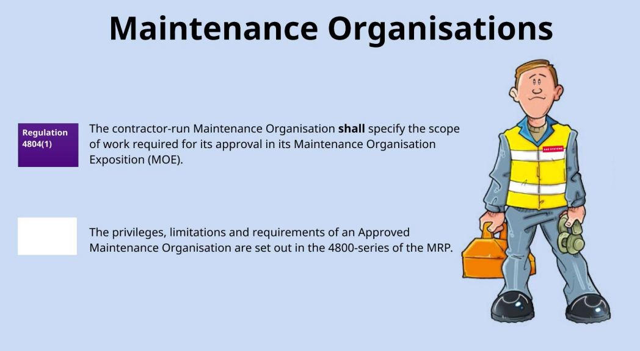
Notes:
Contractor run maintenance organisations are employed to undertake maintenance tasks for a defined scope of work. Activities are required to be undertaken in compliance with MRP Part 145 and as such maintenance organisations require MAA Approval. The approvals are managed through a class and rating system with class including the Air system, Engine and Components, and ratings looking at aircraft weight, helecotpers, RPAS, types of engine, and sub assemblies of an air platform like air conditioning, doors, electrical power etc.

Slide 38

Production Organisations
Rationale
5835
… the MAA does not currently require the specific approval of Production Organisations (PO)
Regulation 5835 (1)
The Type Airworthiness Authority (TAA) or Commodity Chief Engineer (CE) shall ensure that ‘prime’ PO hold a Part 21 Subpart G Approval that is accepted by the MAA or have a nationally accredited Quality Management System (QMS) with an appropriate scope for Production.
Notes:
The MAA does not currently require approval of PO’s however does consider it essential that there is an engineering process linking design and production activities together.
The TAA or Commodities TCE will ensure that POs hold a Part 21 SubPart G Approval that is accepted by the MAA or have a nationally accredited QMS within an appropriate scope for production.
A Part 21 SP G Approval would be accepted from EASA, FAA or CAA in the main. If not then you would be looking for AS/EN 9100 Certification and comply with Allied Quality Assurance Publications 2310

Slide 39
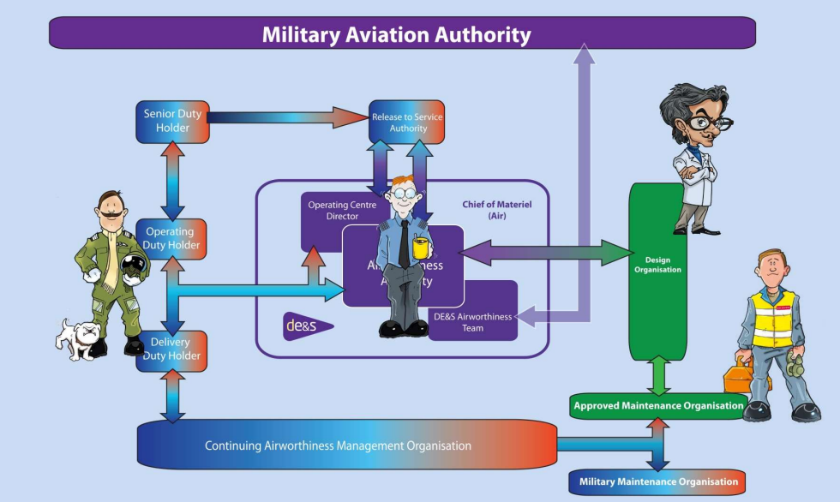
Dir Fixed Wing
Dir Rotary Wing & UAS (RA1013)
Director Engineering
and Safety
HEA

Slide 40
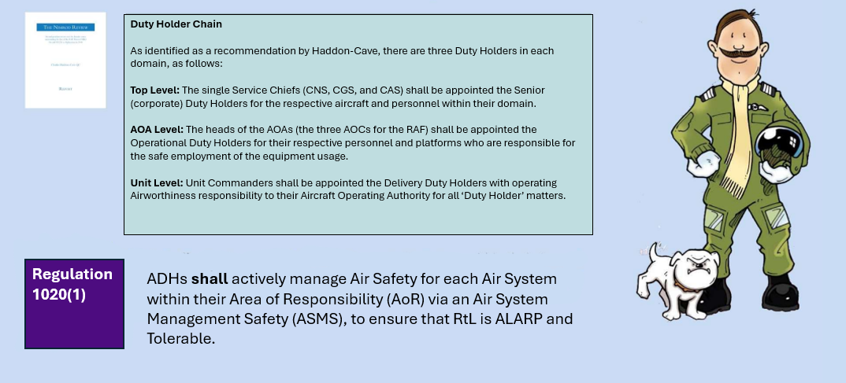
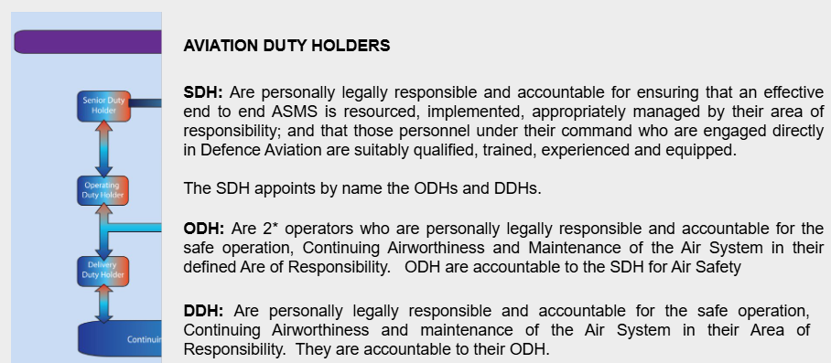
Aviation Duty Holders
Notes:
HC identified as a recommendation the need for 3 duty holders in each domain broadly identified as Top Level , Aircraft Operating Authority (AOA) level and unit level and as identified in the overview presentation provided earlier.
The ADH chain consists of three key roles:
Senior Duty Holder (SDH)
Typically a senior commander (e.g., 2-star level).
Holds ultimate accountability for air safety within their command.
Responsible for ensuring that Risk to Life (RtL) is As Low As Reasonably Practicable (ALARP) and Tolerable across all aviation activities in their Area of Responsibility (AoR).
Operating Duty Holder (ODH)
Usually a 1-star commander or equivalent.
Owns and manages the Air System Safety Case (ASSC) for each air system.
Ensures safe operation and maintenance of systems.
Chairs the Air Safety Steering Group (ASSG) and Air System Safety Working Group (ASSWG).
Delivery Duty Holder (DDH)
Often a senior officer or civilian responsible for delivering aviation capability (e.g., equipment, platforms).
Accountable for ensuring that delivered systems are safe to operate and meet airworthiness standards.
These roles are personally accountable and must be formally nominated. They are supported by key personnel such as:
Chief Air Engineer (CAE)
Military Continuing Airworthiness Manager (Mil CAM)
Accountable Manager (Maintenance) (AM(M))
Senior Operator (SO)
Governing Principles
The ADH chain runs parallel to the command chain, not within it. This separation ensures that safety decisions are not compromised by operational pressures.
ADHs are legally accountable under UK law, including the Health and Safety at Work Act (1974).
ADHs must cease operations if risks are not demonstrably ALARP and Tolerable.
They are answerable to the Secretary of State for Defence, via their superior Duty Holder chain.gov+1

Slide 41
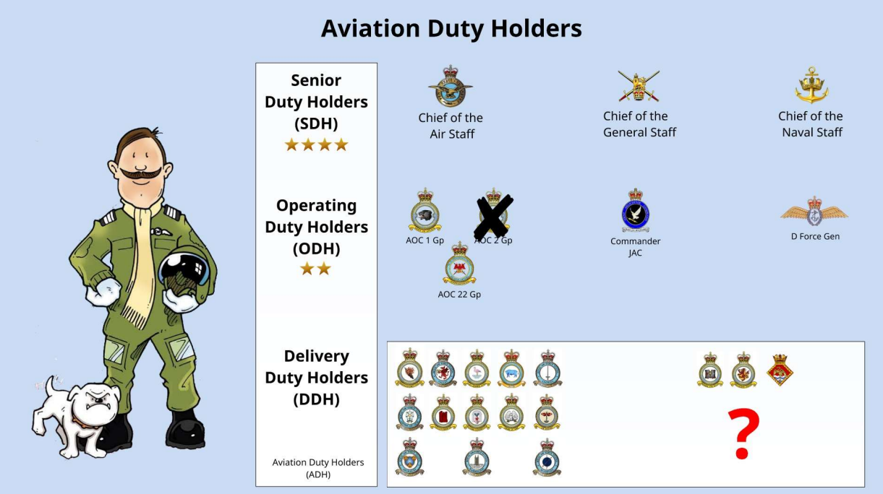

Aviation Duty Holders
Notes:
3 LEVELS OF DUTY HOLDER
SENIOR WHO ARE CHIEFS OF STAFF (CAS, CGS, CNS)
OPERATING DHs WHO ARE AOCs 1 GP and 22 GP, CDR JHC, DFORCE GEN or AM(MF)
DELIVERY DH – STATION or UNIT COMMANDERS

Slide 42
?
Notes:
SO HOW DOES THE INTERFACE WORK

Slide 43
Duty Holder Organisations
Senior Duty Holder
Acceptable Means of Compliance 1022(1)
Senior Operator
Acceptable Means of Compliance 1023(1)
Chief Air Engineer
Provide advice on operating RtL and Air Safety assurance
Provide specialist technical support in delivering their Air Safety responsibilities
Operating Duty Holder
Senior Operator
Chief Air Engineer
Delivery Duty Holder
Senior Operator
Chief Air Engineer
Continuing Airworthiness Manager
Notes:
SO WE HAVE OUR DUTY HOLDER CHAIN WITH RA 1022 STATING THAT EACH ADH SHALL BE SUPPORTED BY A SQEP CROWN SERVANT SENIOR OPERATOR
The SO will be issued with an Letter of Authority (LoA) detailing their responsibilities with the SO there to provide the SDH with advice on the operating Risk To Life and Air Safety Assurance.
Each ODH should select a suitably experience Aircraft as SO to provide them with specialist independent operator support in delivering air safety responsibilities
Each DDH will appoint a SQEP SO to provide them with independent specialist operator support in delivering Air Safety Responsibilities.
ADDITIONALLY RA 1023 STATES THAT THE ADH SHALL BE SUPORTED BY A SQEP CROWN SERVANT CHIEF ENGINEER aka the TAA
The CE will need to provide assurance that the Air Systems, Airborne Equipment, Airfield Support Equipment, Aircrew Equipment Assemblies and Survival Equipment across the appropriate Service are being maintained in accordance with (iaw) extant Regulations, procedures, orders, the Air System Document Set (ADS), Approved Data and higher level instructions
DH CAEs should provide their DH with the Technical advice on RtL and advice on technical issues associated with the Acquisition of new Air Systems or air capabilities.

Slide 44
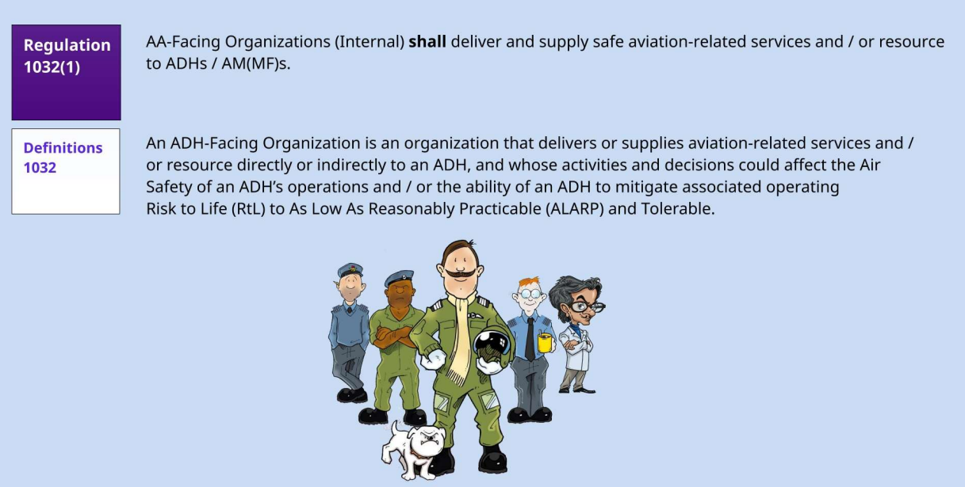
Duty Holder Facing Organizations (A-A Facing)
Notes:
Many organizations within and external to Defence Aviation (DA) and the Defence Air Environment (DAE) deliver and supply aviation-related services and / or resource to Aviation Duty Holders (ADH) and / or Accountable Managers (Military Flying) (AM(MF)) in order that ADHs / AM(MF)s can deliver operating output. Such ADH Facing Organizations and AM(MF)-Facing Organizations (AA-Facing Organizations) are responsible for delivering safe aviation services and actively supporting ADHs and / or AM(MF)s in their delivery of safe aviation and the management of Air Safety.
Therefore, appropriate Assurance is required such that ADHs / AM(MF)s have a complete understanding of the Risks that such organizations may bring to their operation

Slide 45
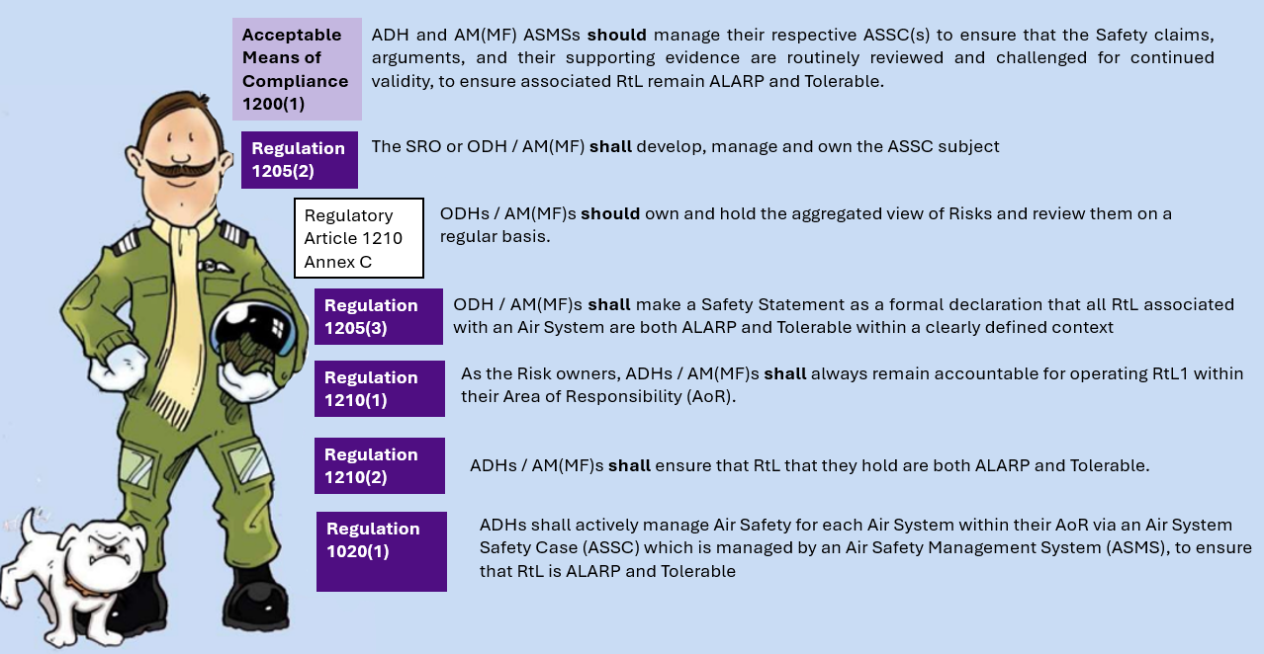
Notes:
So this is what the dh chain need to manage and ensure

Slide 46
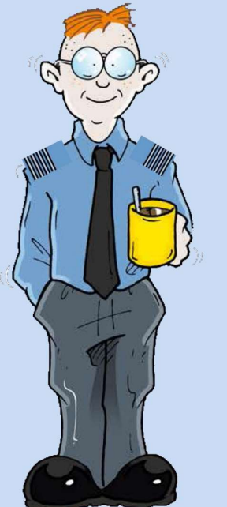
Acceptable Means of Compliance 1032 (1)
Heads of AA-Facing Organizations (Internal) should, actively support ADHs / AM(MF)s in their delivery of safe aviation and management of Air Safety
Acceptable Means of Compliance 1032 (1)
Ensuring that they identify and formally communicate to relevant ADHs / AM(MF)s any decision, activity or change in the AA-Facing Organization’s operating context that has the potential to introduce new or increased RtL into the ADH’s / AM(MF)’s operations, or which could affect the ADH’s / AM(MF)’s achievement of mitigating the operating RtL to ALARP and Tolerable
Acceptable Means of Compliance 1032 (1)
Establishing and maintaining an Air Safety Management System (ASMS) that: (1) Interfaces appropriately with the ASMS(s) and Air System Safety Case(s) (ASSC) of the ADHs / AM(MF)s being supported and; (2) Provides appropriate Assurance of the aviation-related services and / or resource delivered to supported ADHs / AM(MF)s
Acceptable Means of Compliance 1200(1)
The ASMS of ADH-Facing Organizations, AMs and HoEs supporting Defence Aviation should enable those organizations to actively support ADH and AM(MF) in their management of Air Safety and respective ASSC(s)
Regulation 1051(1)
Personnel appointed to principal TAw management positions, in line with their delegation, should actively support the ADH / AM(MF), who is responsible for Air Safety within their defined Area of Responsibility (AoR), by managing the TAw of the Air System
Notes:
On the taa side

Slide 47
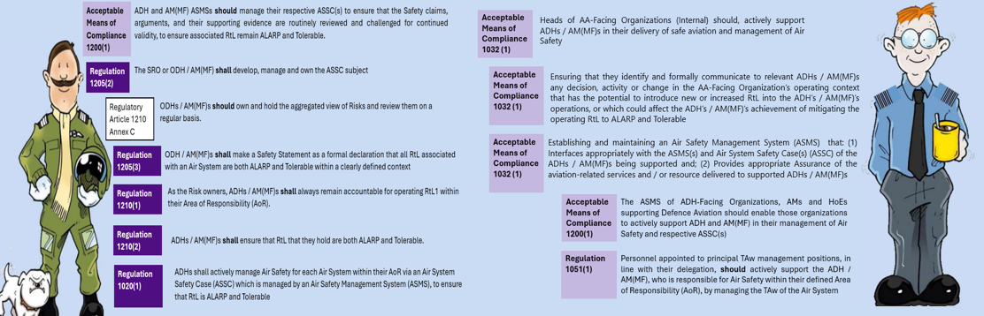
The Role of the TAA in the RtL Process
Guidance Material 1032(1)
Heads of AA-Facing Organizations (Internal) are not ultimately responsible for ensuring that Air Safety RtL are ALARP and Tolerable; however, they are individually accountable to the ADH / AM(MF) for the requirements placed upon them as set out in this RA (and any other applicable RAs and / or Regulations).
Equipment Contribution to Risk to Life
Notes:
To note that instructions issued by the TAA to the duty holder do not need to be actioned / heeded. This makes the TAA advisors in reality as the the DH ultimately hold the risk, not the TAA.
The RAs provide support statement all around the DH having the final say with the TAA role stated as actively supporting the DH
The role of the TAA is therefore to basically understand issues and then inform the FH for further discussions to be made.

Slide 48
Any Questions?

