Slide 1

Integrity Management
Type Airworthiness Desk Officers’ Foundation Course
Notes:
READ OFF SLIDE

Slide 2
Integrity Management
Learning Outcome
To provide an understanding of:
The purpose of Aircraft Integrity Management
The Establish-Sustain-Validate-Recover-Exploit (ESVRE) management principles
The purpose of an Ageing Aircraft Audit (AAA)
The principles of Aircraft Life Extension Programme
Notes:
READ OFF SLIDE

Slide 3
Integrity Management
Manual of
Air System Integrity Management (MASIM)
Any failure within the Air System will compromise the Air System's Integrity. The MOD have prescribed a dedicated framework to manage risks associated with the through-life management of an Air System.
Regulation 5726(1)
The TAA shall be responsible for IM, for all Air System types within their area of responsibility, to maintain integrity.
Regulation 5726(2)
The TAA shall establish IM to demonstrate that the Air System is airworthy to operate through all conditions detailed in the Release To Service (RTS), Military Permit To Fly (MPTF) (In-Service) or MPTF (Special Case Flying) and reflect the usage set out in the Statement of Operating Intent (SOI)
AET Process 18 – Integrity Management
Notes:
READ OFF SLIDE
RA 5726 – Integrity Management
AET Process 18 – Integrity strategy – Integrity Management Plan – Integrity Working Groups Direction and Slide Template - SOIU Template and Guidance – Ageing Air System Audit -

Slide 4
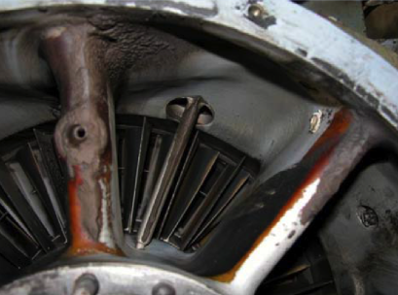

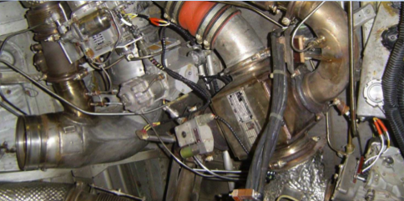
Types of Integrity Management
Structural Integrity
Propulsion Integrity
Systems Integrity
Notes:
What Types / categories of Integrity Management are there?
MAA 02 Definitions
Structural Integrity (SI) - The ability of an Air System Structure, designed, certified and maintained to defined standards, to retain its strength, function and shape within acceptable limits, without failure when subjected to the loads imposed during its Service Life through operation in accordance with the Air System Document Set.
Systems Integrity (SysI) - The ability of an Air System, designed, certified and maintained to defined standards, to retain, at an appropriate level of Safety, the function of its systems, within defined limits and without unacceptable levels of failure during its Service Life, through operation in accordance with the Air System Document Set.
Propulsion Integrity (PI) - The ability of a Propulsion System, designed, certified, operated and maintained to defined standards, to retain, at an appropriate level of Safety, its function, within defined limits and without failure or adverse effect on other systems during its Service Life through operation in accordance with the Air System Document Set.

Slide 5
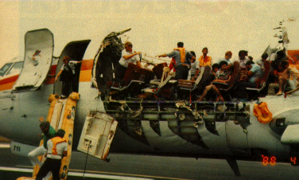
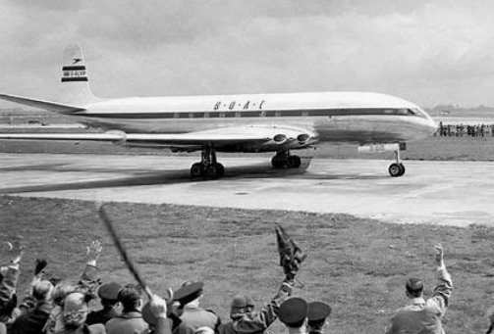
Structural Integrity
MAA-02
Definitions
Structural Integrity (SI) is the ability of an Air System structure, designed, certified and maintained to defined standards, to retain its strength, function and shape within acceptable limits, without failure when subjected to the loads imposed during its service life through operation iaw the ADS.
Air System Structure | Rotary Wing | Actuating Portions
All load-carrying members | Rotor blades | Landing gear
Fixed provisions for systems and equipment | Rotor heads | Flight controls
Wings | Associated transmission systems | Doors (structure and system)
Fuselage
Empennage
Engine mountings
Landing Fear
Flight control surfaces and points of attachment
Control rods
Propellers and Propeller hubs
Notes:
Top Image -
Aloa Airlines Flight 243 – Boeing 737 operating scheduled services around the Hawaiian islands without warning lost just over 5 metres of its upper fuselage mid air at 24000ft which resulted in the loss of life of a cabin attendant and a very extraordinary remaining flight for the rest of the crew and passengers. The cabin attendant was the only fatality. 13 minutes later the aircraft landed in Maui.
The NTSB determined that the cause of the accident was a failure of the Aloha Airlines Maintenance Programme to detect the sever disbonding and fatigue damage which ultimately led to the structural failure. Instrument to this was further findings that the Airline management failed to supervise properly its maintenance force as well as failings on the FAA not to determine issues in the airlines inspection and quality control processes.
Findings included, in addition to the maintenance shortfall, certification testing of the fuselage that although 15000 cycles had been performed this did not reflect actual usage of the fleet which needed to better consider the possibilities of disbonding, corrosion and fatigue cracking.
Interestingly a passenger post accident stated they had observed a crack in the fuselage noticed between the door and the hood of the air bridge / jet bridge but had not told anyone about it.
The second picture here is the DH Comet which famously suffered a number of accidents where the aricraft was lost in flight and it wasn’t until a thorough investigation into the aircraft including repetitive presurisation cycles and structural fatigue analysis having been performed.
Main finders were of Metal fatigue around the square windows and other fuselage cut-outs that caused stress concentrations far higher than anticipated. These stress concentrations led to crack initiation and propagation, ultimately resulting in explosive decompression and structural failure of the pressure cabin.
A number of recommendations came about including
Redesign of Windows and Cut-outs:
Replace square windows with rounded ones to reduce stress concentrations.
Reinforce areas around windows and escape hatches with thicker skin material
.
Improved Fatigue Testing Protocols:
Implement full-scale fatigue testing of fuselage sections under realistic pressurization cycles.
Use fracture mechanics to estimate crack growth and predict fatigue life
.
Enhanced Certification Standards:
Revise airworthiness certification to include fatigue life estimation and proof testing beyond static loads.
Require pressurization cycle limits and periodic inspections for fatigue damage
.
Manufacturing Quality Control:
Address defects in rivet holes and chamfers that could act as crack initiation sites.
Improve inspection techniques during production to detect micro-defects
.
Industry-Wide Fatigue Awareness:
Promote research into fatigue behavior of aluminum alloys.
Encourage adoption of Paris Law (developed later in 1963) for crack growth analysis
.
Legacy and Impact
These recommendations led to the redesign of the Comet (e.g., Comet IV) and influenced the development of safer aircraft like the Boeing 707. The Comet disaster became a pivotal case in aviation safety, leading to the modern understanding of metal fatigue, stress analysis, and airframe lifecycle management
Read slide – table provides example of components that will be covered by Structural Integrity Management
Lynx TRGB mounting feet corrosion/cracking

Slide 6
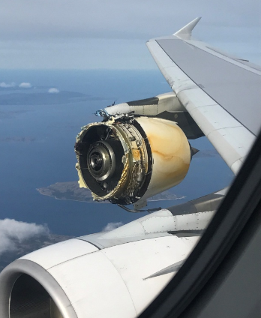

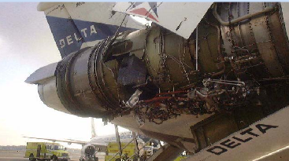
Propulsion Integrity
MAA-02
Definitions
Propulsion Integrity is the ability of Propulsion System, designed, certified, operated and maintained to defined standards, to retain, at an appropriate level of Safety, its function within defined limits and without failure or adverse effect on other systems during its service life through operation iaw the ADS.
Notes:
Read definition
Attendance at BAE146 Platform Integrity Day – discussed faults and hours completed on platform engines
Similar to structural integrity we have propulsion integrity
Key elements of propulsion integrity include
So what does anyone think is going to be involved in propulsion integrity, what are we going to be thinking about?
1. Structural Integrity
Ensuring that all components (e.g., fan blades, turbine discs, casings) can withstand mechanical loads, thermal stresses, and vibration.
Use of fatigue-resistant materials and stress analysis to prevent crack initiation and propagation.
2. Thermal Management
Managing extreme temperatures in combustion chambers and turbine sections.
Use of cooling technologies (e.g., air film cooling, thermal barrier coatings) to protect critical components.
3. Containment and Safety
Designing for blade containment: if a blade fails, the casing must prevent debris from escaping.
Fire suppression systems and isolation of fuel lines to prevent secondary damage.
4. Performance Reliability
Ensuring consistent thrust output across all operating conditions.
Monitoring fuel efficiency, emissions, and engine responsiveness.
5. Control System Integrity
Reliable operation of Full Authority Digital Engine Control (FADEC) systems.
Redundancy in sensors and actuators to prevent single-point failures.
6. Maintenance and Inspection
Scheduled inspections using borescope, ultrasonic, and other NDT methods.
Tracking component life and replacing parts before end-of-life thresholds.
7. Certification and Compliance
Meeting regulatory standards (e.g., FAA, EASA) for engine performance, safety, and emissions.
Passing rigorous testing including bird strike, ice ingestion, and flameout recovery.

Slide 7
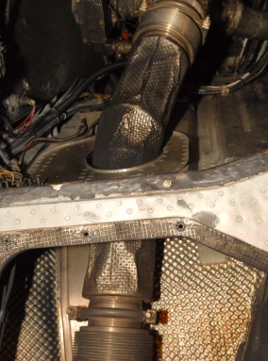

System Integrity
MAA-02 Definitions
Systems Integrity is the ability of an Air System, designed, certified and maintained to defined standards, to retain, at an appropriate level of Safety, the function of its systems, within defined limits and without unacceptable levels of failure during its service life, through operation iaw the ADS.
A system is defined as a set of devices and interconnected elements, encompassing hardware, firmware and software that, when functioning correctly, results in a desired outcome. This includes the actuating and dynamic components of hardware, such as landing gear and flight controls. However, it does exclude such elements as flight control attachment fittings, which are commonly treated as Structure.
Notes:
Read definition
C130 and BAE146 – Integrity meetings – discussed all aspects of system performance and ageing including EWIS
ISA attendance at C130 IWGs – issues with actuator control rods within flying controls
So then we have systems integrity.
What do we think is involved in System INtegrity?
System integrity refers to the overall reliability, safety, and correctness of a complex system—whether it's an aircraft, spacecraft, industrial process, or digital infrastructure. It ensures that all components and subsystems work together as intended, without unexpected failures or vulnerabilities.
1. Functional Integrity
Ensures the system performs its intended functions under all expected conditions.
Includes redundancy, fault tolerance, and graceful degradation in case of partial failures.
2. Structural Integrity
Physical robustness of the system, including materials, joints, and load-bearing components.
Resistance to fatigue, corrosion, vibration, and environmental stresses.
3. Data and Control Integrity
Accurate and secure transmission of data between sensors, controllers, and actuators.
Protection against data corruption, cyber threats, and software bugs.
4. Safety and Risk Management
Identification and mitigation of hazards through safety analysis (e.g., FMEA, fault tree analysis).
Compliance with safety standards and regulations (e.g., DO-178C for avionics software).
5. Integration and Interoperability
Seamless interaction between subsystems (e.g., propulsion, avionics, hydraulics).
Ensuring compatibility across hardware, software, and communication protocols.
6. Lifecycle Integrity
Reliability and maintainability over the system’s operational life.
Includes maintenance planning, upgrades, and obsolescence management.

Slide 8
Threats to Aircraft Integrity
Overload
Fatigue, Fretting and Wear
Accidental Damage and Environmental Damage
Lack of Configuration Control
Procedural Error (Design, Manufacture, Maintenance, Supply)
Obsolescence
Legislation Change
Contamination
Human Factors
Change in Usage or Un-monitored Operation
Manual of Air System Integrity Management
Notes:
Read Slide

Slide 9
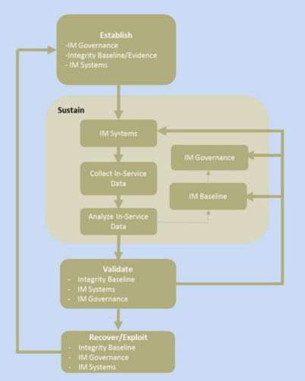
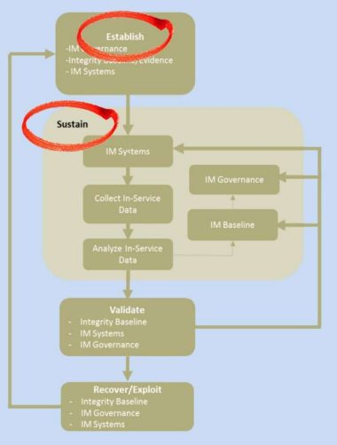
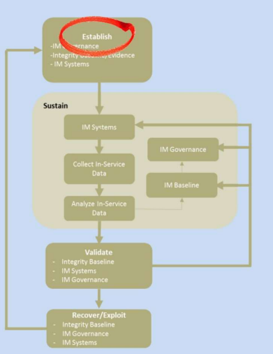
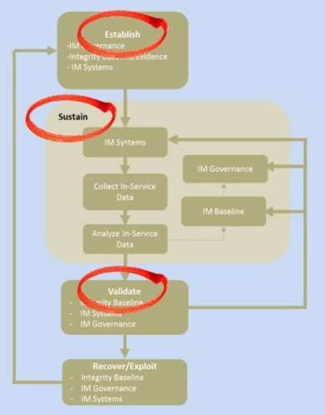
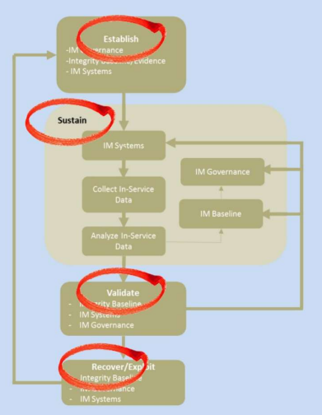
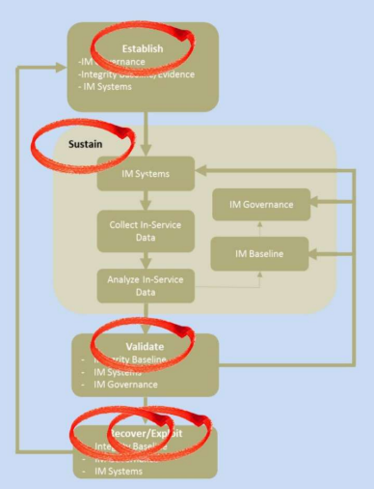
Establish-Sustain-Validate-Recover-Exploit (ESVRE)
Manual of Air System Integrity Management
Notes:
The chart shown on the slide comes from Figure 4 in MASIM - Manual of Air System Integrity Management
Establish - Establish an IM Strategy and document the Strategy in Air System Integrity Strategy Document (AISD).
- Establish an IM Plan and document the plan in Integrity Management Plan (IMP)
- Establish an Integrity Working Group (IWG) and identify appropriate stakeholders.
Sustain – Implement and review at IWG
Integrity Strategy per AISD
Implement IM per IMP
In-service data and report key issues
Validate - Revisit the Strategy and Plan as In-Service evidence becomes available.
- IWG to validate the In-Service data against the Integrity Baseline.
Recovery - Activities to re-establish Integrity Baseline
Treat any loss or potential compromise of Integrity as an Airworthiness issue.
IWG to identify and assess unmitigated or unquantified Airworthiness risks and to recommend recovery action.
Exploit - IWG to review, assess and subsequently recommend if applicable, any exploiting activities including relaxing the requirements, temporary extension beyond lifing or inspection requirements
Integrity Baseline - The Integrity Baseline is a group of artefacts that defines the characteristics of an Air System Type

Slide 10
Artefacts Within the IM Cycle (MASIM)
Notes:
Figure 1 from MASIM
Following slides will build the Artefacts within the IM Cycle

Slide 11
Integrity Evidence
Endorses/Changes
Forms & Validates
IM Systems
Integrity Baseline
Artefacts Within the IM Cycle (MASIM)
Integrity Governance
Set Requirements For
Informs
Notes:
Figure 1 from MASIM
Following slides will build the Artefacts within the IM Cycle

Slide 12
Integrity Evidence
DO Analyses
DO Test Data
DO Intended Usage
Notes:
DO/OEM analysis – test data – intended usage and assumption
Integrity Evidence is produced during the Design and Certification phase.
The TAA demonstrate compliance against the Air System’s Type Certification Basis (TCB), and assessment against Def Stan 00-970.
Given that qualification testing required to achieve full clearances, the Integrity Evidence is revised subsequent to the completion of such qualification testing.
Used by the DO or Original Equipment Manufacturer (OEM) to support the Air System Type characteristics as documented in the ADS, forming the Integrity Baseline.
Once the Air System is In-Service, the Integrity Evidence is updated continuously by assessing In-Service data and, if available, worldwide fleet data. It is captured in an Integrity Evidence Record.

Slide 13
Integrity Evidence
Endorses/Changes
DO Analyses
DO Test Data
Forms & Validates
DO Intended Usage
IM Systems
Integrity Baseline
Artefacts Within the IM Cycle (MASIM)
Integrity Governance
Set Requirements For
Informs

Slide 14
Integrity Baseline
DO Declared Life
DO Declared Operational Limits
Significant/Critical Items
Notes:
ADS Documents – DO/OEM declared life and operational limits – significant/critical items
The Integrity Baseline is a group of artefacts that defines the characteristics of an Air System Type.
Once the Air System is In-Service, the operating conditions, usage and configuration assumed by the DO during design development may change and may require recertification.
The implications of any changes are assessed, and the Integrity Baseline is updated accordingly throughout the life of the Air System Type.
Similarly, IM activity may result in a need to change component lives, thresholds or intervals.
Authorizing the life of Air System components is the responsibility of the TAA for the Air System on which the component is installed.
The IWG will need to be made aware of the extensions in place.

Slide 15
Integrity Evidence
Endorses/Changes
DO Analyses
DO Test Data
Forms & Validates
DO Intended Usage
IM Systems
Integrity Baseline
Artefacts Within the IM Cycle (MASIM)
DO Declared Life
DO Declared Operational Limits
Significant/Critical Items
Integrity Governance
Set Requirements For
Informs

Slide 16
Integrity Governance
Integrity Strategy
Integrity Working Group
Integrity Plan
Notes:
Integrity Governance – Strategy – plan - IWG
Integrity Governance is the strategic intent established by the TAA in the form of governing processes stated in the Air System Integrity Strategy Document (AISD) and the Integrity Management Plan (IMP), and is supported by an IWG to provide the fundamental governance of the through-life of the Air System Type.
The AISD and IMP form part of the document hierarchy.

Slide 17
Integrity Evidence
Endorses/Changes
DO Analyses
DO Test Data
Forms & Validates
DO Intended Usage
IM Systems
Integrity Baseline
Artefacts Within the IM Cycle (MASIM)
DO Declared Life
DO Declared Operational Limits
Significant/Critical Items
Integrity Governance
Integrity Strategy
Integrity Working Group
Set Requirements For
Informs
Integrity Plan

Slide 18
IM Systems
In-Service Data
Worldwide Fleet Data
Ageing Aircraft Audit
Examination and Sampling
Hazard Assessment
EDPC
Usage Monitoring
Configuration Management
Exceedance Monitoring
FRACAS
Notes:
IM Systems – In-Service data – world wide fleet data (C130 and BAE146 used worldwide fleet data in analysis)

Slide 19
Integrity Evidence
Endorses/Changes
DO Analyses
DO Test Data
Forms & Validates
DO Intended Usage
IM Systems
Integrity Baseline
In-Service Data
Worldwide Fleet Data
Artefacts Within the IM Cycle (MASIM)
DO Declared Life
DO Declared Operational Limits
EDPC
Hazard Assessment
FRACAS
Ageing Aircraft Audit
Examination and Sampling
Significant/Critical Items
Usage Monitoring
Configuration Management
Exceedance Monitoring
Integrity Governance
Integrity Strategy
Integrity Working Group
Set Requirements For
Informs
Integrity Plan

Slide 20
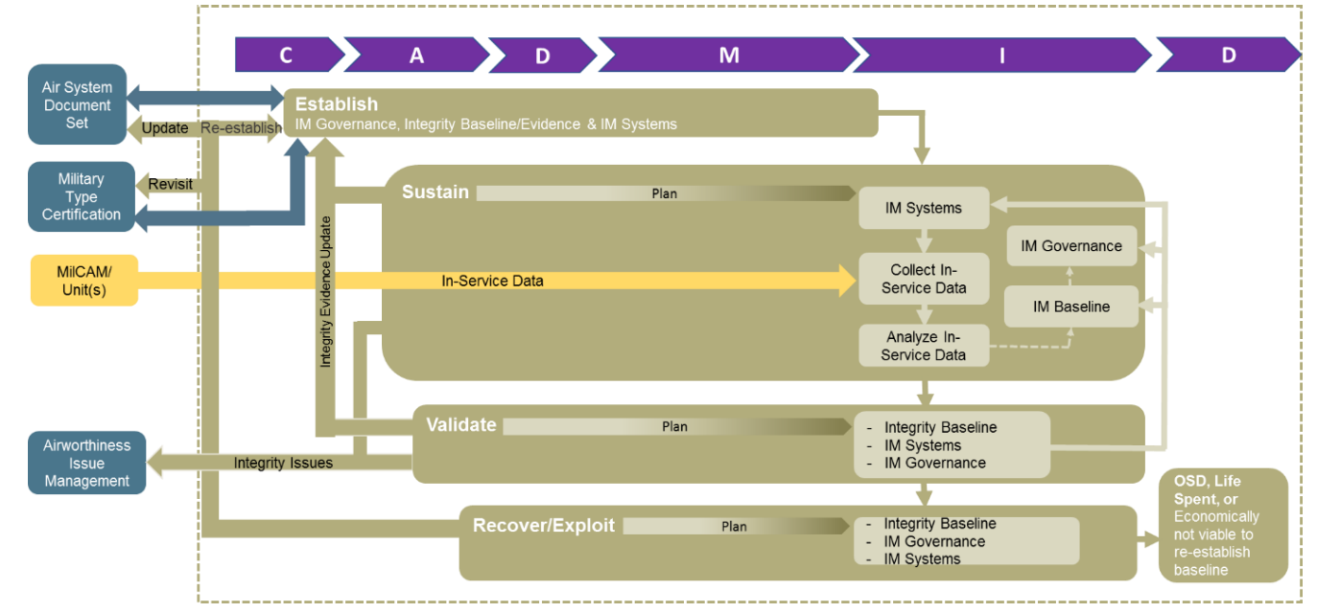
ESVRE Through Life Concept
Notes:
ESVRE Through Life Concept - Manual of Air System Integrity Management
Establish - Establish an IM Strategy and document the Strategy in Air System Integrity Strategy Document (AISD).
- Establish an IM Plan and document the plan in Integrity Management Plan (IMP)
- Establish an Integrity Working Group (IWG) and identify appropriate stakeholders.
Sustain – Implement and review at IWG
Integrity Strategy per AISD
Implement IM per IMP
In-service data and report key issues
Validate - Revisit the Strategy and Plan as In-Service evidence becomes available.
- IWG to validate the In-Service data against the Integrity Baseline.
Recovery - Activities to re-establish Integrity Baseline
Treat any loss or potential compromise of Integrity as an Airworthiness issue.
IWG to identify and assess unmitigated or unquantified Airworthiness risks and to recommend recovery action.
Exploit - IWG to review, assess and subsequently recommend if applicable, any exploiting activities including relaxing the requirements, temporary extension beyond lifing or inspection requirements
Note – Establish continues through the In-service phase of the CADMID cycle
Note that the framework is not chronological, and aspects of each phase may occur at various stages of an Air System’s CADMID life cycle

Slide 21
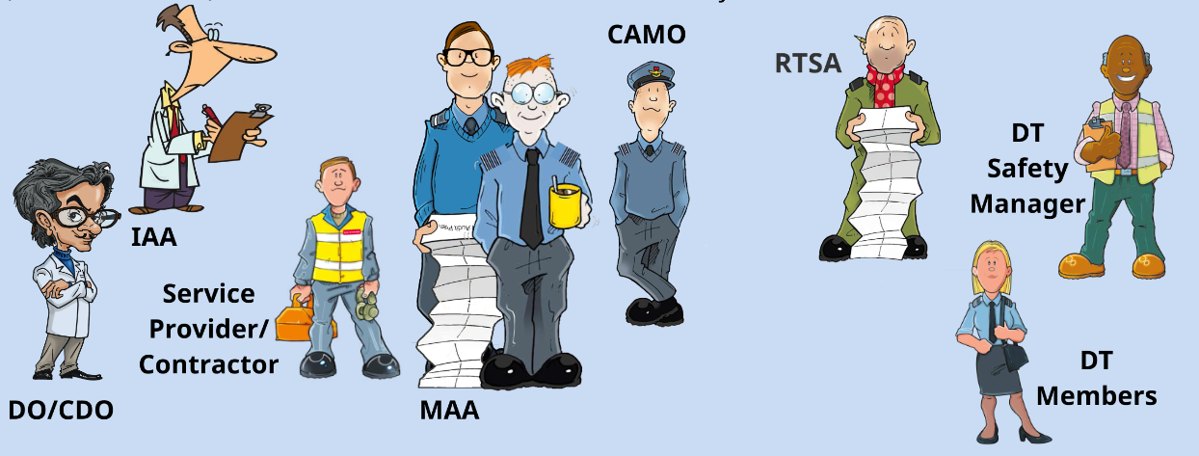
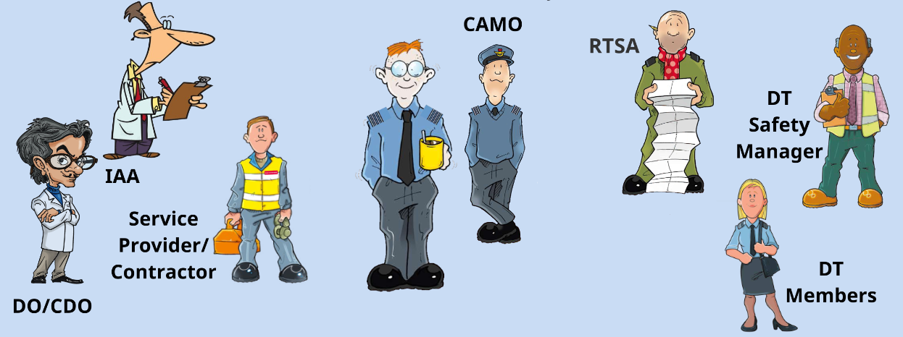
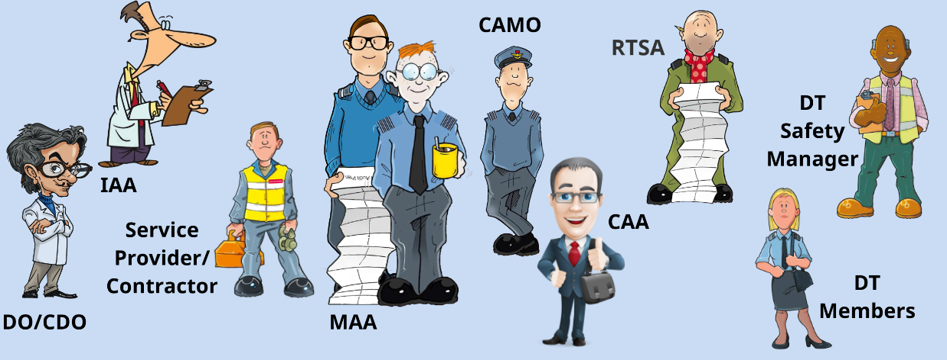
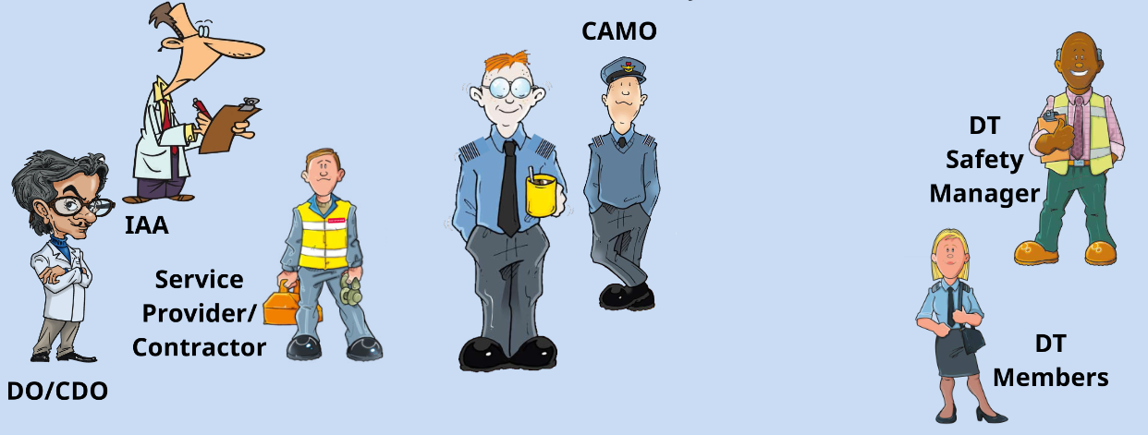
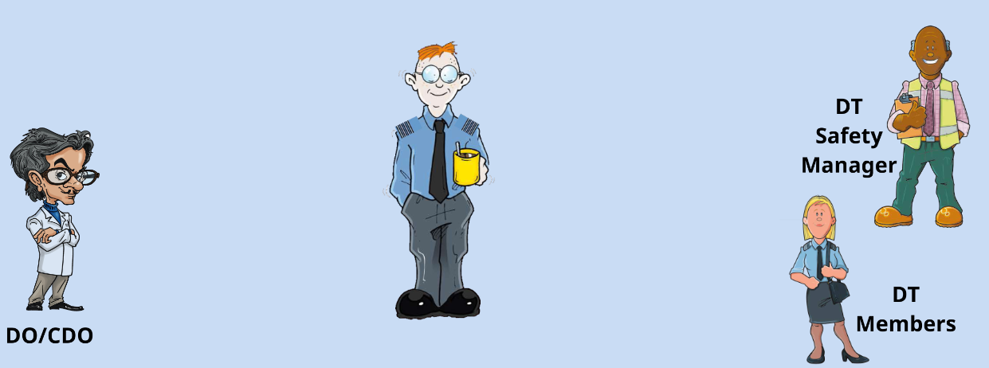
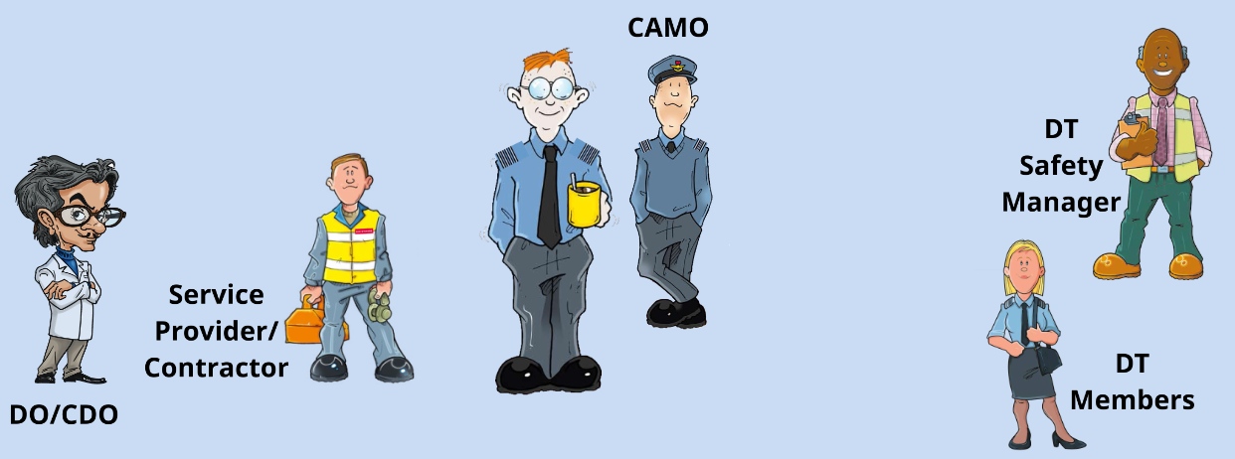
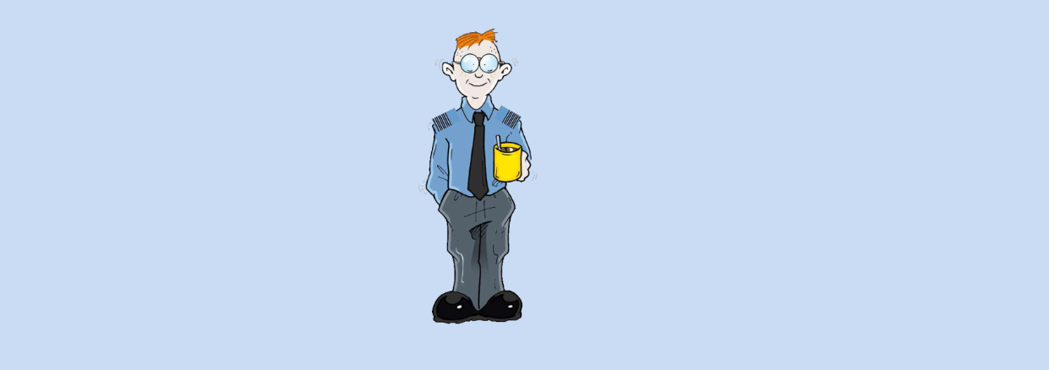
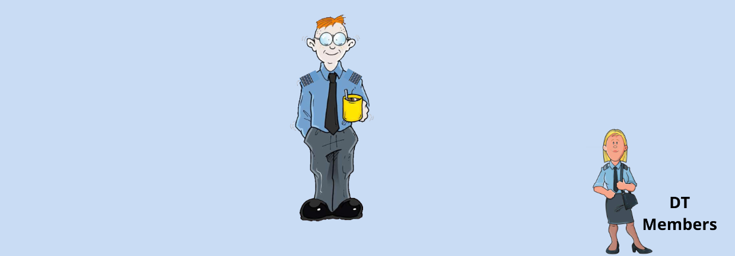
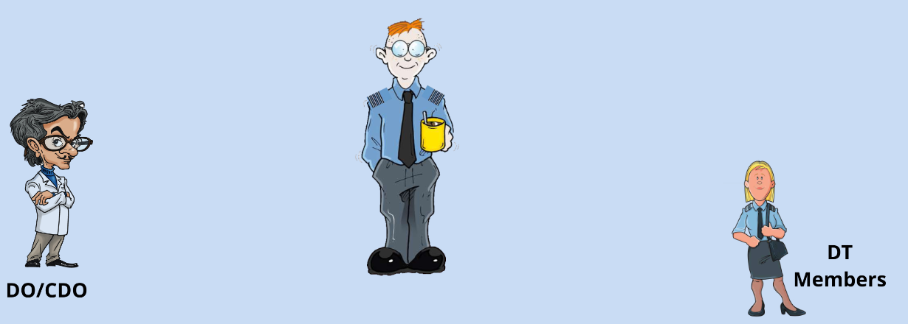
Governance – Integrity Working Groups
Acceptable Means of Compliance 5762(2)
The IWG should be chaired by the TAA or a holder of a delegated letter of Airworthiness Authority (LoAA) that refers specifically to the role of IWG Chair, who is at least OF4 (or equivalent).
The IWG Chair should ensure that the IWG comprises a quorum of SQEP stakeholders (identified below), and additional stakeholders, as necessary.
Notes:
Providing the Governance – 6 monthly intervals
Talk through slide
Identify stakeholders as they appear
Ref should be RA5726(2)

Slide 22

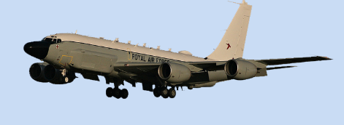
Ageing Air System Audit
Regulation 5723(1)
All UK military registered Air System types shall be subjected to an AAA, to provide an overall indication of the condition of the fleet and to give confidence that the Integrity of the Air System is being sustained as the fleet ages and regulatory requirements evolve.
Acceptable Means of Compliance 5723(1)
The TAA should initiate an AAA at an appropriate stage but no later than the earliest of:
15 years after a type’s declared In-Service Date (ISD). The mid-point between the declared ISD and the initial planned Out of Service Date (OSD). Where any member of a fleet, acquired under short-duration arrangements (i.e. a service provision contract), exceeds 50% of its cleared life (in any parameter).
Notes:
RA 5723 - Ageing Air System Audit
APROX 18 mths and 2 YEARs to complete – done every 10 years
A finding from Haddon Cave was that age does matter with a number of elements pertaining to Trend Monitoring, Husbandry, Attention to skills, corporate knowledge, forensic tear downs.
RA5723 (Rationale) - A rigorous periodic Audit is necessary to provide Assurance that the Airworthiness risks associated with Ageing of a fleet's Air System are being managed appropriately. An Ageing Air System Audit (AAA) covers both Air System physical condition and wider Assurance of continued applicability of Airworthiness procedures and management processes, providing a comprehensive review of the interrelated effects of Ageing on the fleet. The requirement for an AAA is supplementary to routine Integrity Management (IM).
RA5723 – Definitions
Ageing - The degradation of the system (equipment, knowledge or information) potentially leading to an increased Safety Risk
AAA initiation - The AAA is deemed to start at the point where the AAA initiation meeting is held with the organization responsible for conducting the independent aspects of the Audit.
AAA completion - The AAA is deemed to have been completed following the production of the final AAA Report, covering all Audits and detailing the closure plan for all resultant actions and recommendations.

Slide 23
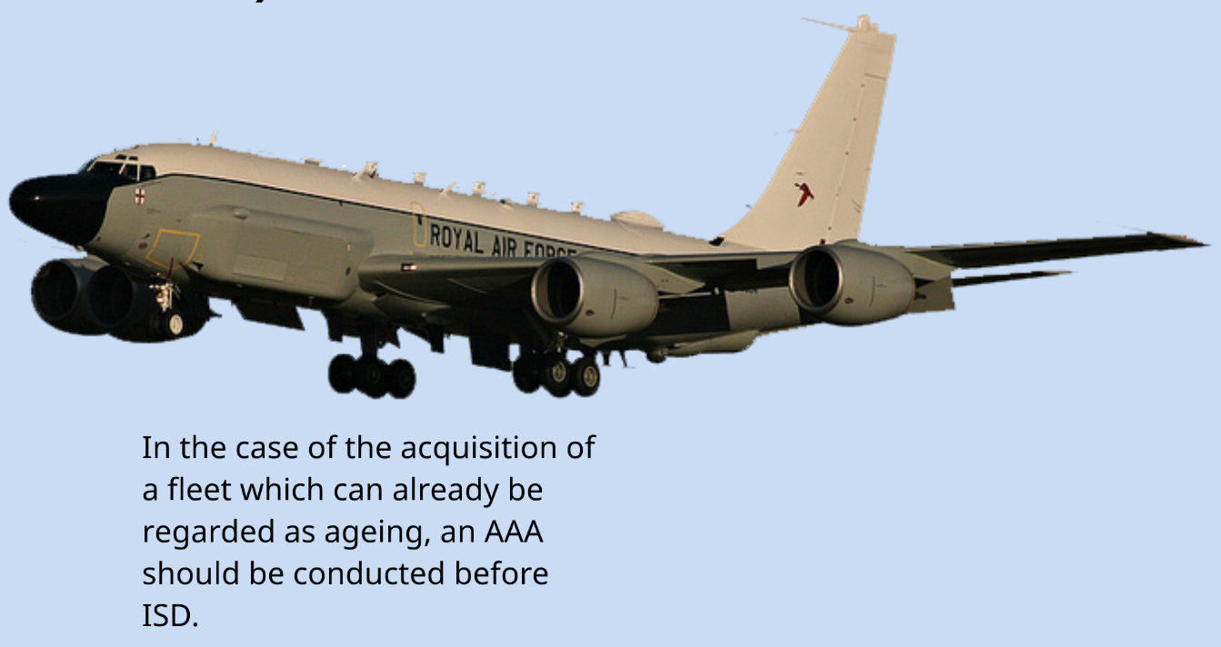
Ageing Air System Audit
Notes:
READ SLIDE

Slide 24
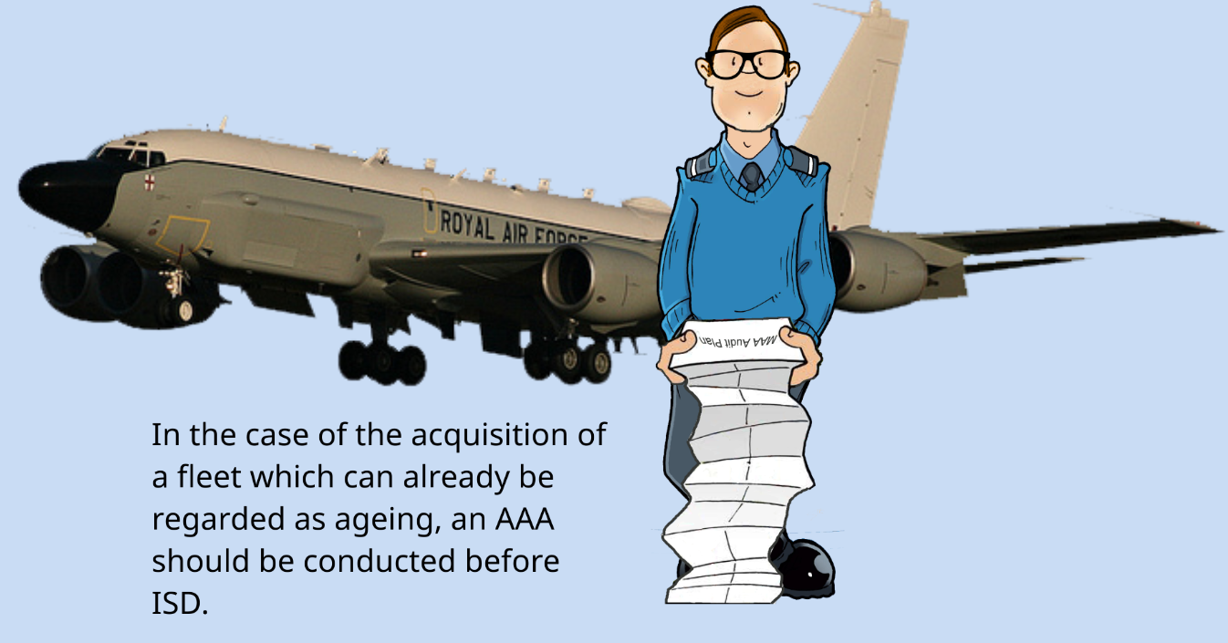

Slide 25
Manual of Air System Integrity Management (MASIM)
An AAA provides assurance that the Airworthiness management of an Air System type is effective and appropriately adapting from the perspective of ageing.
Aims of the AAA
Conduct a periodic, independent assessment of the Airworthiness management of the fleet, with consideration to ageing.
Consider individually and collectively the SI, SysI and PI activities, often carried out in isolation, to assess the effectiveness of the fleet’s IM.
Undertake an independent review of the continued applicability of procedures, management processes, assumptions and documentation that are in place to ensure Airworthiness, integrity and functionality.
Undertake a detailed, independent condition survey of representative Air System from the fleet, unless an equivalent examination is conducted routinely.
Identify patterns or trends that suggest future Airworthiness or integrity issues.
Identify significant risks to the Airworthiness or integrity of the Air System that would threaten the achievement of its planned OSD.
Notes:
Read slide
Independence - The key characteristic of the AAA is independence. The Air System condition survey, and the review of the Airworthiness procedures and processes, will be undertaken by organizations which are independent of those responsible for providing these Airworthiness aspects, unless the TAA can demonstrate that sufficient independence exists within that organization (ie ‘Chinese Walls’). This means that the use of personnel already involved in providing Independent advice or assurance to the TAA (such as the ISA, ITE and IAA) will not be suitable to undertake any activity as part of the AAA.
MASIM provides detail on the scope of the AAA.

Slide 26
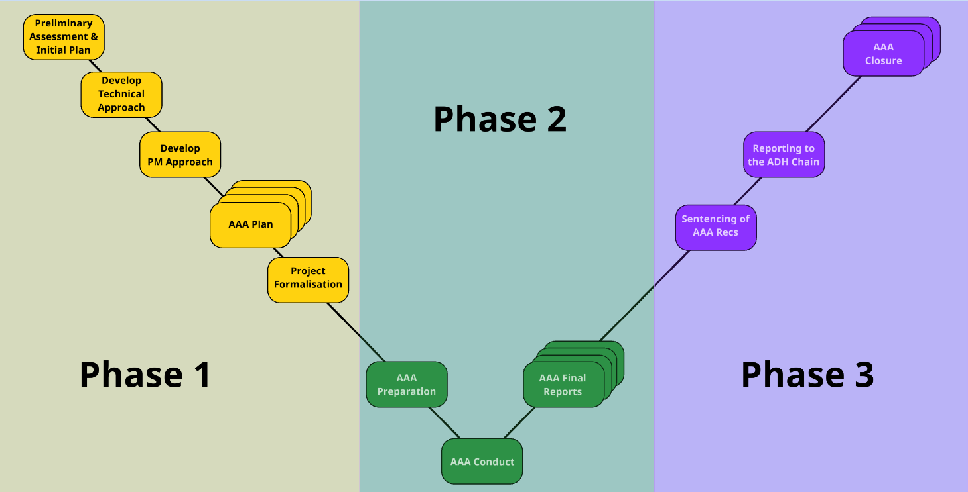
Ageing Aircraft System Audit
Notes:
AAA can be broken down into 3 phases
Plan - Preliminary phase – Plan, develop technical and PM approach, develop the AAA plan and project formalization
Do - AAA preparation and conduct and develop final reports
Act - Wash-up phase – sentencing of AAA recommendations, reporting AAA outcome to ADH chain and AAA closure

Slide 27
Scope of AAA
Manual of Air System Integrity Management
Review of the Hazard Log.
Significance, validity, quantity and potential interaction of deferred faults.
Effectiveness of the Maintenance programme.
Maintenance schedule reviews.
The existence of any other ageing Air System audits.
Review of assumptions.
Proximity to OSD
Issues revealed by any earlier AAAs.
Potential for collaboration with other users.
Effect of fleet size, roles and mini-fleets.
Availability and veracity of usage data.
Configuration control methods.
Known or perceived manufacture, repair or supply errors.
Sampling programmes (whether non-destructive or destructive).
Physical condition survey.

Slide 28

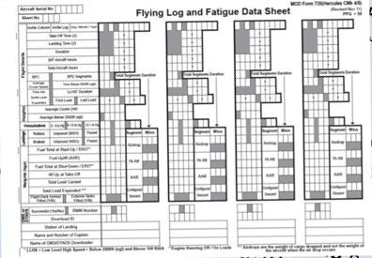
Life Extension Programme
Regulation 5724(2)
When required to extend the certified life of a UK military Air System type, in any parameter, the TAA shall develop and implement a LEP to underwrite the airworthiness of the aircraft type for its extended life.
Acceptable Means of Compliance 5724(1)
The TAA should undertake a LEP when it is identified that the operation of an Air System type needs to be extended beyond its current certified life (in terms of calendar time, flying hours, Fatigue Index, landings or pressure cycles).
The potential requirement for a life extension should be considered no later than 10 years before the original Out-of-Service Date (OSD) and should be reviewed annually thereafter.
Notes:
RA 5724 - Life Extension Programm
Read slide
RA5724 (Rationale) - Occasions may arise in which an Air System type is required to operate beyond its certified life. In such cases, Airworthiness Risks may increase if the Air System Products, Parts and Appliances exceed the life parameters against which they were tested and approved. A Life Extension Programme (LEP) can identify, mitigate and ultimately manage these Risks.

Slide 29
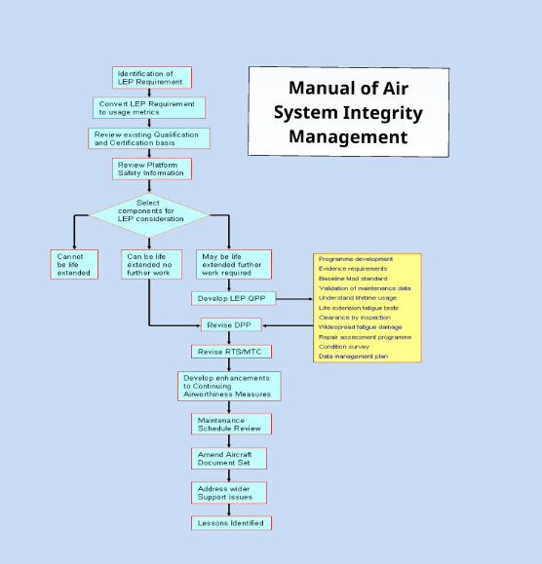

Notes:
RA5724(2) - LEP Scope
- The TAA should determine the scope of the LEP using a Risk-based approach: all Structure, Systems components and propulsion components whose failure could compromise Airworthiness should be identified and considered for inclusion within the LEP. The exclusion of any such components from the LEP should be identified and the rationale for their exclusion documented.
- The TAA should ensure that an analysis of all components to be included in the LEP is undertaken, using appropriate evidence and inputs from all relevant stakeholders (including the Delivery Team (DT) and relevant Design Organization(s) (DO), maintainers and operators), to categorise each as either:
a. ‘Non-extendable’, where the life cannot be extended to meet the new requirement. A Component Replacement Plan should be developed to address all such components.
b. ‘Extendable’, where the life can be extended without further work. Revised life limits, including any associated caveats such as Maintenance actions, should be determined and promulgated for all such components.
c. ‘Subject to LEP’, where the life can potentially be extended subject to further LEP work. Revised life limits, including any associated caveats such as Maintenance actions, should be determined and promulgated for all such components.

Slide 30
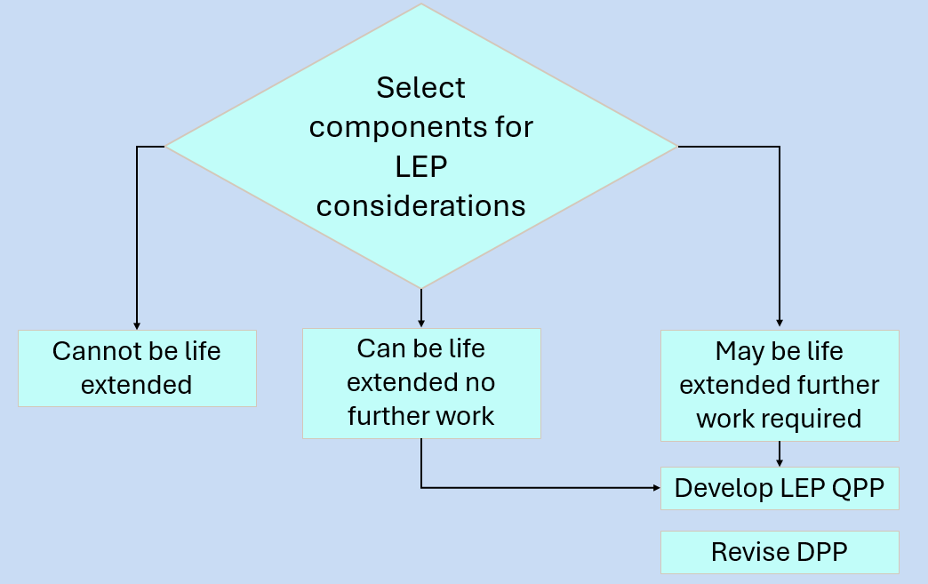
Notes:
The LEP Qualification Programme Plan (QPP) is the umbrella under which the various elements of the LEP component requalification evidence generation are conducted.

Slide 31
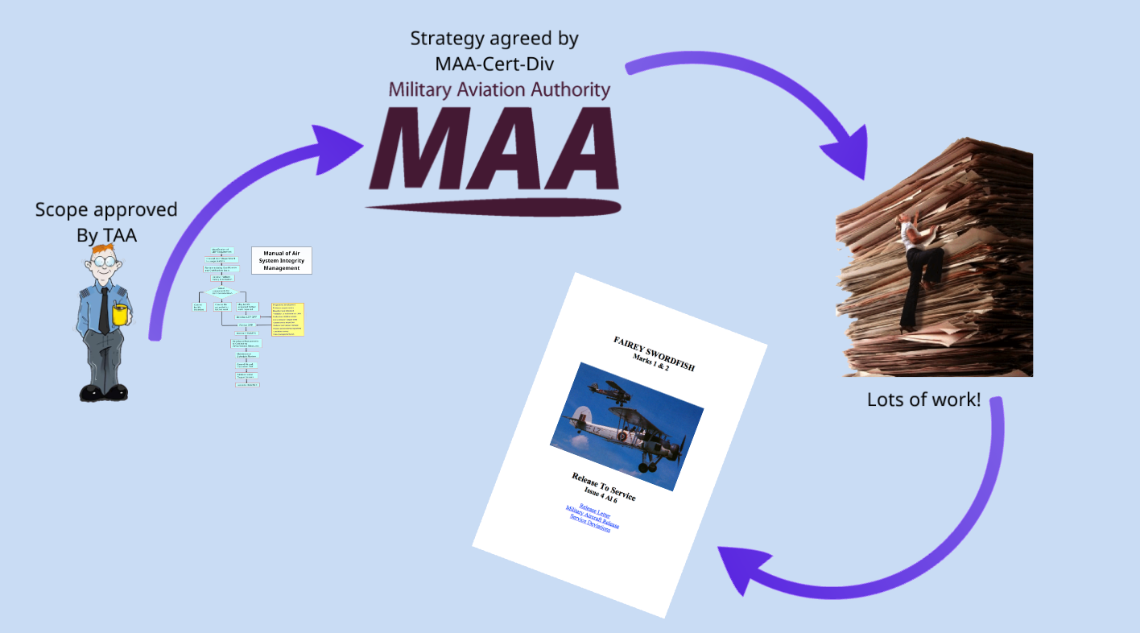

Slide 32
Out-of-Service Data Extension Programme
Regulation 5725(1)
When required to extend the Out of Service Date of a UK military air system type, the TAA shall develop and implement an OSDEP to underwrite the airworthiness of the Air System type for its extended service.
Acceptable Means of Compliance 5725(1)
An OSD should remain within the bounds of the certified Air System life. Where doubt exists as to the certified Air System life, and consequently whether a LEP is applicable, then guidance should be sought from the MAA.
Notes:
RA 5725 - Out of Service Date Extension Programme
Issue with cancellation of MOD due to OSD – move OSD and not done to mod – eg C130 Centre Wing
RA5725 (Rationale) - Occasions may arise which require an Air System to operate beyond the agreed Out of Service Date (OSD). Risks to Airworthiness of the fleet may increase with potentially unforeseen results. An Out of Service Date Extension Programme (OSDEP) can identify, mitigate and ultimately underwrite these Risks.

Slide 33
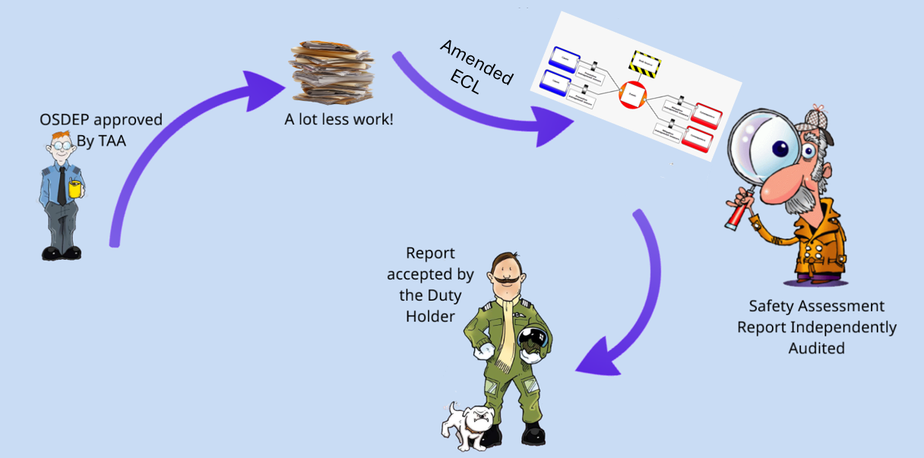
Notes:
Any change to the ECL supporting the ECtRtL will be reported and accepted by the Duty Holder (ECID)

Slide 34
Any Questions?

