Slide 1

Release to Service
Type Airworthiness Desk Officers’ Foundation Course (TADOF)

Slide 2
Release to Service
What this will do for you
To provide an understanding of:
The role of the Release to Service (RTS) and Release to Service Authority (RTSA)
The Aircraft Release to Service Documentation
The Release to Service Recommendations
The types of RTS Clearance
Notes:
READ OFF SLIDE

Slide 3
Purpose of the RTS
The Release To Service (RTS) authorizes Military Operated (In-Service) Defence Air Environment (DAE) Operating Category flying on behalf of the responsible Senior Duty Holder. It defines permitted as flown configurations and the permitted operating envelope. RTS limitations are the definitive limits for the Air System.
Rationale 1300
Regulation 1300(1)
An RTS shall be prepared for all Air Systems that are operated within the Military Operated (In-Service) DAE Operating Category, except for:
a) RPAS operating in the Open category,
b) RPAS operating in the Specific S1 sub-category, and
c) Air Systems with a Military Permit to Fly (MPTF).
Notes:
READ OFF SLIDE
RA 1300 - Release To Service
So what is the Release To Service's Purpose? Anyone?
So it’s a formal authorisation effectively issued by the MAA with its purpose being to ensure the platform is safe and fit for operational use within the limitations and configurations identified in the RTS.
The RTS defines the configuration of the aircraft and the permitted envelope within which it is cleared for flight and as part of that are the identified limitation such as not in lightning conditions for example which a number of aircraft have in fact as limitation, not over populated areas perhaps for some RPAS systems etc. To get an RTS you need to have completed the Military Air Sytem Cert Process (MACP), the TAA needs to have complete things like the Type Airworthiness Safety Assessment which in turn will have needed the ECtRtL to be completed along with all the other facets needed to support the TASA including the Design Safety Assessments, type certification, configuration is as expected, ADS in place along with arrangements for Continuing Airworthiness including reporting processes in place, and then have provided their RTS Recommendations.
Its noted on this slide that and RTS is not needed for the less impactful RPAS such as open category and S1 category that are your smaller drones as apposed to the S2 and Cert level drones that will require one, and any system being operated under a MPTF. Such platforms may eventually get an RTS but something like Wedgtail that is in development that is operating under an MPTF with an RTS expected next year as I understand it.

Slide 4
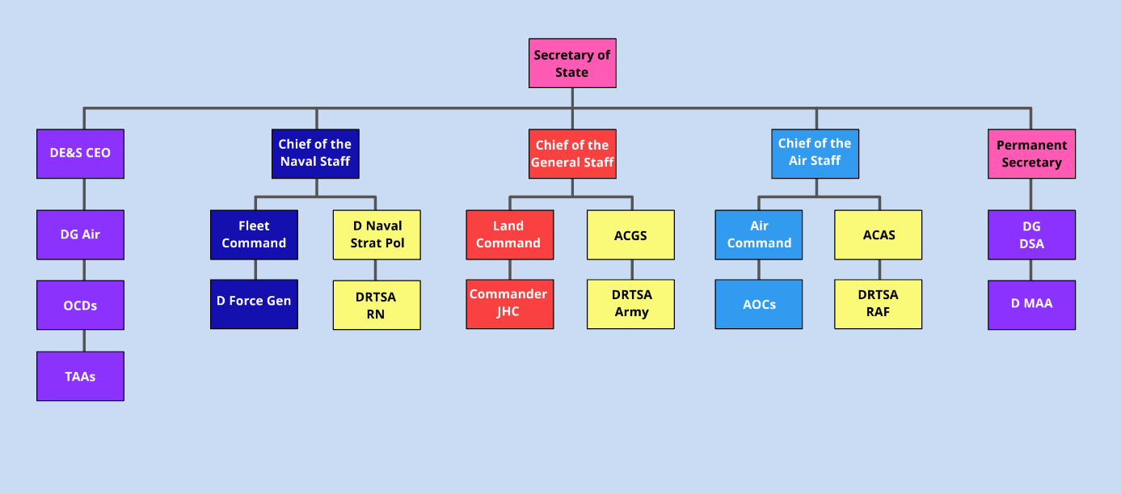





Role of the RTSA
Regulation 1021(1)
The RTSA shall authorise, issue, and maintain the integrity of the RTS through-life to provide Aviation Duty Holder (ADH) chain with independent Air Safety assurance of the Air Systems for which the SDH is responsible.
Notes:
So the RTSA plays a critical role in all of this noting that this role does not exist in the civil world mainly because in military aviation the activities air systems are needed to provide involve unique risks, classified systems and non standard configurations that need despoke management that is just not needed in the civil world where the CAA operated to oversee compliance of standardised systems to standardised requirements with no specialities for the most part.
The RTSA is part of the duty holder framework and provides independent assurance to the SDH that DLODs and the ASSC are sufficiently mature for the RTS to be issued and reaches this conclusion separately to anything that the TAA has or is providing as their input to the ASSC and the MAA and therefore provides their own assurance activities and inputs to the DH Chain.
As we can see here the RA 1021 - Release To Service Authorities - Roles and Responsibilities – directs the RTSA' activities
After issuing the RTS the RTSA is then responsible for ensuring it remains valid and accurate through life which would include being involved in design changes and operational updates with the RTS then being updated accordingly on the proposal that these become active on the air system
Runs interference with the ODH to make sure they understand any risk and that any associated mitigation is in place

Slide 5
Release to Service Authority (RTSA)
Notes:
To note that given the MOD operates air assets across, Air, Land and Maritime there are RTSAs deployed to each of these branches as can be seen in this structure here.
Here you can see a Delegated RTSA identified for each branch who DRTSAs who have been delegated by the RTSA then delegates responsibility down to the Delegated RTSA and then down to specific air system RTSAs.

Slide 6

RTS Documentation
RA1300 Annex A
The RTS is the primary document of the ADS and, where appropriate to provide supporting detail, it will contain cross-references to other documents within the ADS.
Part A - Airworthiness and Document Management
Part B - Aircraft Design and Handling Limitations
Part C - System Limitations and Constraints
Part D - Role Limitations and Constraints
Part E - Temporary information
Part F - Clearances with Limited Evidence /
Operational Emergency Clearances
Part G – RTS History
Notes:
So here are the elements expected to be found in the RTS
READ OFF SLIDE
So these are main headings and under each of these are sub sections which all need to exist in the RTS, even if they are NA. All sections have to be included even where its not applicable. If it is NA then you still need to include the section and state its non applicability. This is to make sure each RTS is consistent across all platforms, makes it clear for auditing, makes updates through life easier to be made as it prevent the need for restructuring, makes reviews easier etc
There are 5 principles needed when assessing what is appropriate for content.
Relevance – is the info relevant for the aim of the RTS
Completeness – no omissions
Target Audience – Is the info relevant to the target audience
Coherence – with other documents in the ADS. Part of making sure the whole ads is conherent and seamless as a source of safety info
Responsibility – Auditable trails needed where information has not been included with an overarching responsibility understood by the author for providing safety information
WHERE IS IT LAID DOWN WHAT APPROVED AEA (IE SOCKS) IS LAID DOWN, WHAT IF A PART NUMBER CHANGES?
Noting that the content of the RTS has to be auditable and traceable back to the source data and maintained throughout the life of the Air System by the RTSA with appropriate data retained.

Slide 7
Release to Service Recommendation (RTSR)
Regulation 1300(2)
The Type Airworthiness Authority (TAA) shall prepare the Release To Service Recommendation (RTSR) to the satisfaction of the Release To Service Authority (RTSA).
Acceptable Means of Compliance 1300(2)
Demonstration of change process completion through MTC or ADCC
RTSR to provide all clearances and limitations
RTSR for new Air systems and major changes should be approved by a 2* OCD
RSTA authorises and provided independent assurance
MAA provides independent assurance
RTSR to demonstrate an acceptably safe operating envelope
Notes:
RA 1300 - Release To Service
READ OFF SLIDE
MAA REVIEW OF RTSR AT MACP PHASE 5 (MAA REVIEW OF EVIDENCE)
Limitations could include Safety Limitations, Equipment Limitations
Could include restricted clearances to altitudes, preclude flight over water or in IMC etc, identify flight envelope boundaries
The TAA is required to maintain the RTSR over the life of the system with reviews and up issues occuring where changes are made to the platform with any changes being approved by the Director before being submitted to the RTSA and MAA

Slide 8
Other Types of RTS Clearance
RA1300 Annex A
Operational Emergency Clearance
Clearance with Limited Evidence
Temporary Clearance
Notes:
So you have your Standard RTS clearance when you all the necessary cert and safety documentation issues and available however there are other types of clearances as identified here.

Slide 9

Operational Emergency Clearance
Regulation 1300(4)
An Operational Emergency Clearance (OEC) shall be raised when there is likely to be an increased Risk to Life (RtL) associated with the Air System’s usage, compared to the risk identified within the Design Safety Target.
An OEC will only be used for flight under the following circumstances:
In conditions of actual or potential hostile enemy action, other life-threatening emergency situations, or associated training.
In the evaluation of options needed for contingency planning, including any Test and Evaluation trials.
Acceptable Means of Compliance 1300(4)
An OEC should be identified when the Air System Operates
outside of its Design Safety Target
An OEC should be authorised by the RTSA and only enabled at ODH level for a given activity and defined period.
OEC review periodicities should not exceed 12 months.
TAA should subject the OEC to a Safety Analysis and update the existing TASA as appropriate
Notes:
READ OFF SLIDE – UOR as was
You have the Operational Emergency Clearance which is provided when there is an urgent operational need to operate the platform outside of its standard RTS limitation, they are generally time sensitive and you are perhaps not able to get all the evidence you would have got under a standard clearance together in timer. Generally you would have to develop a risk based argument understanding that the TAA would be required to support with a version of the TASA that supported the OEC.

Slide 10
Clearance with Limited Evidence
Regulation 1300(5)
A Clearance with Limited Evidence (CLE) shall be raised when a fully substantiated TASA is not available to support a full RTS clearance but, on the balance of available evidence, the clearance is judged to remain within the required Design Safety Target
Guidance Material 1300(5)
There is an expectation that a CLE will be incorporated as a full RTS clearance within 5 years.
Notes:
You then have a CLE which allows operation where some evidence is incomplete or pending but you consider what you have as sufficient to permit a limited use. So it could be that you have enough for operations where you can make a diversion or have limitation not to fly where you cannot visually determine your location etc. Perhaps VMC etc.
CLEs should be used when a fully substantiated TASA is not available to support an RTS clearance
A CLR review periodicity should not exceed 12 months
Have a life of no more than 5 years
Where involved changes to TD then the MACP requirements should be met.

Slide 11
Temporary Clearance
RA 1300 Annex A
Temporary Information is to be of a genuinely transitory nature: e.g. the clearance of a Service Modification for a short duration trial, after which it will be removed; or included through operational necessity as a temporary amendment, pending its inclusion in the appropriate part at the next formal amendment of the RTS and/or the Air System Document Set.
Notes:
Finally you have a temporary clearance can be used as part of a staged RTS or issued to support urgent needs. Main difference with a CLE is that this is only in place for short term where a CLE could be permitted for up to 5 years. The Temporary may be just be focussed on specific aspects of an air system so could be something urgently needed that has not had all evidence asserted as yet.
Would be included in the Part E of the RTS which is reserved for the management of temporary information. Each element within the Part E needs to have been derived from a supplementary safety assessment and provides information or limitations on one or more aspects of the air system operation.
RA1300 Annex A - Temporary Clearances with a fully substantiated and evidenced Safety Assessment would be included in Part E of the RTS as stand-alone entries (not covered by an OEC or CLE);
- if the Safety Assessment is not fully substantiated or does not meet the Design Safety Target, the Temporary Clearance would also need to be covered by either an OEC or CLE and listed / cross-referenced in Part F (OEC / CLE) of the RTS

Slide 12
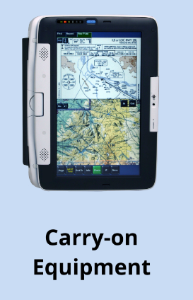
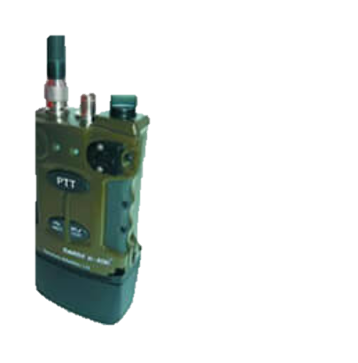
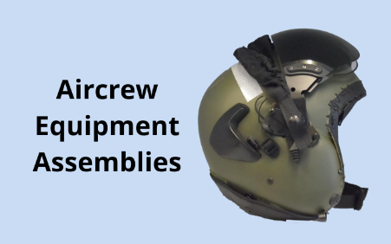
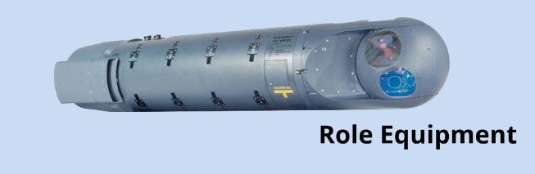
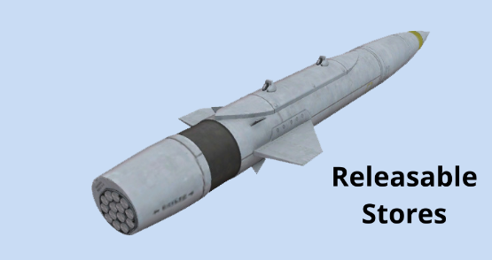
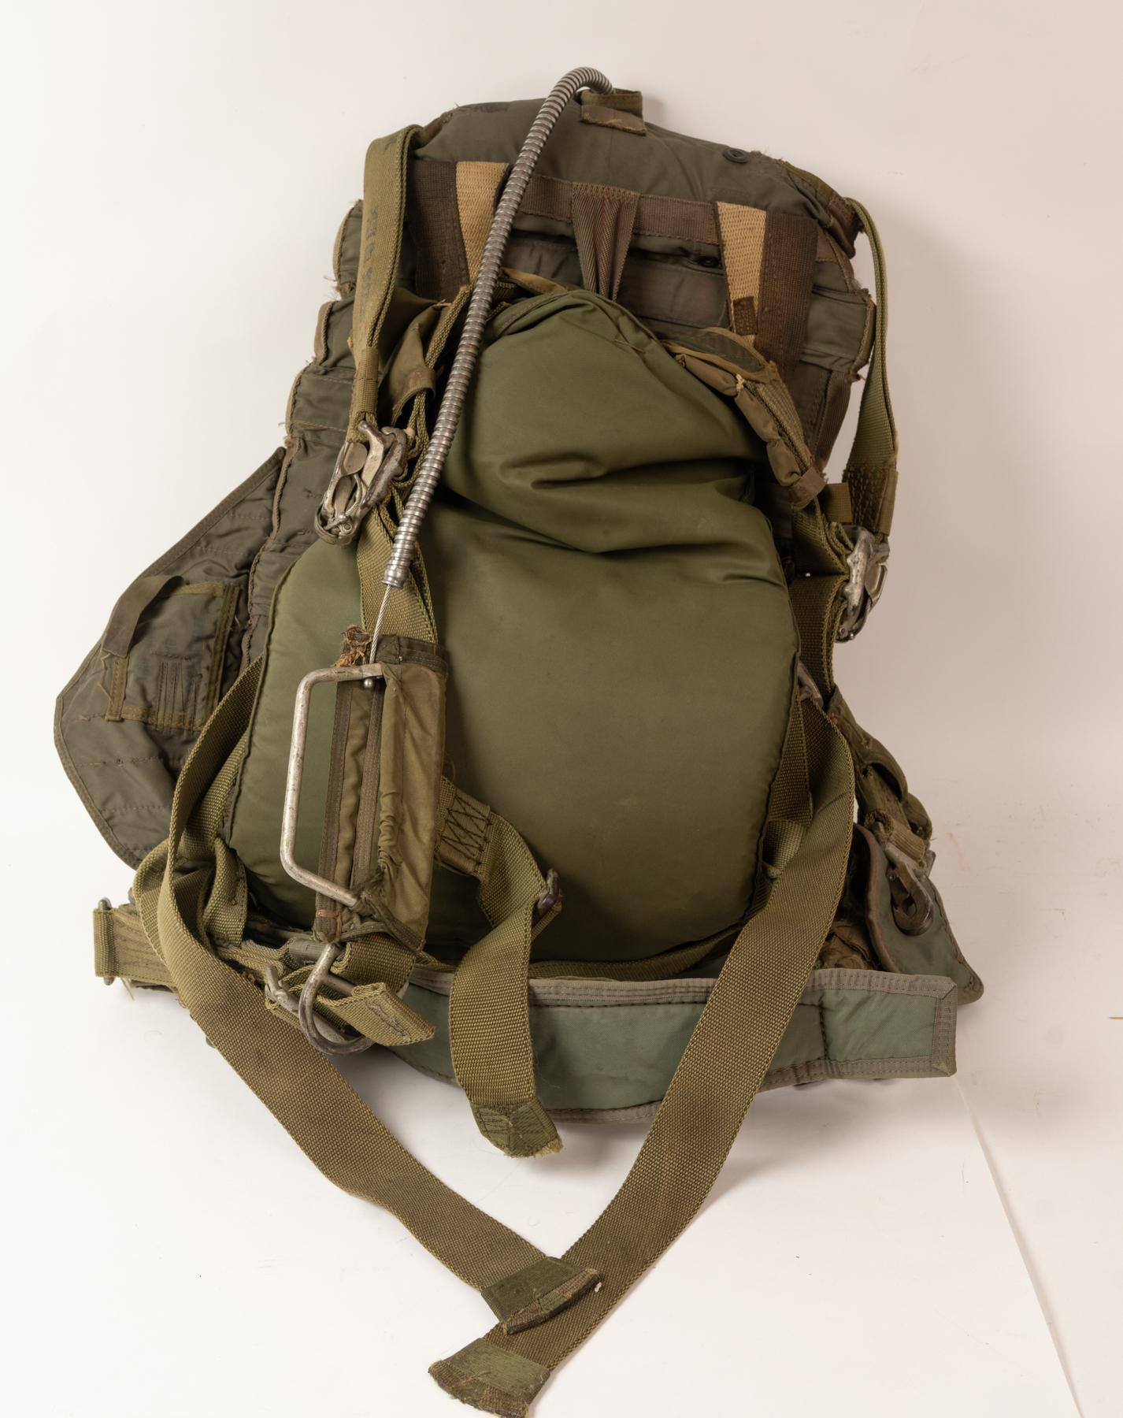
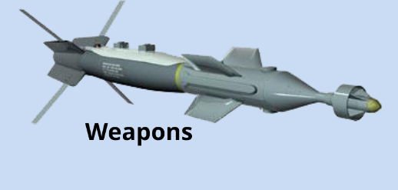
Equipment Not Basic to the Air System
Rationale 1340
Equipment Not Basic to the Air System (ENBAS) comprises items which are carried onboard / attached to the Air System to support delivery of the required capability but are not included within either the Air System design drawings or Certification of the Type Design
Such items generally include:
Other Items used in the Support of the Air System
The RA 1340 is not applicable to Air Launched weapons or role equipment that may affect handing and flight performance or any AEA that is identified as part of the TD or Airborne Equipment. Airborne Equipment and Air Launched Weapons require; Compendium of AE Release Certificates (CAERC) for AE and ALW Release (ALWR) respectively
AE
Notes:
So anybody know what ENBAS os?
So essentially its equipment that is not part of the aircraft type certification and that should not affect the core airworthinss of the platform. Such equipment is important to the RTS as the RTS has to provide specific authorisation based on evidence of the equipment have been assessed for safety in its own right and in relation to its installation on a given platform captured by the RTSA in the RTS.
The TASA needs to provide evidence of such assessments and the RTS identify the equipment and any assocaited limitations identified for its use.
Such equipment could be managed by a Commodities DT with the TAA working with the Commodities DT to ensure that the air system and ENBAS interfaces are appropriate to not undermine aspects of each safety assessment.
The specifics of the RA 1340 is not applicable to Aircrew Equipment Assemblies which are governed by separate regulations and safety assessments due them being directly impactful on human per, Air Launched Weapons which are mission critical payloads with dedicated interfaces and who release will have an effect on the airworthiness of the aircraft and therefore its safety requiring its own weapons release certificate awarded after the necessary assessments and trials have been performed. Similarly Role equipment that may affect handling or flight performance, may require permanent structural changes and therefore could affect the type design, an example of this could be the fitting of defensive aids.

Slide 13
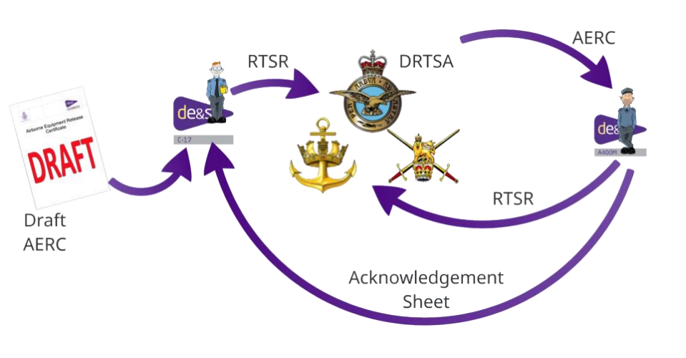
Airborne Equipment Release Certificate
Acceptable Means of Compliance 1701(2)
(1702(2))
MOD Approved AFE(ADE) should be included within the Compendium of Airborne Equipment Release Certificates (CAERC). It should be authorised for use on specific platforms through the relevant CAERC entry and despatch Air System RTS or MPTF.
The AE TAA should ensure that the MOD Approved AFE is safe to operate within the limitations of the CAERC, it has a valid CofD and inform the ADH of all ECtRtL identified.
Certified by
AE TAA
Authorised by
Passed to TAA of dispatching aircraft
Passed to
DRAFT
CAERC
Returned to AE TAA detailing
acceptance of the approved AE
Where UK forces are to operate with foreign military AFE the parachuting commander should manage RTL to ALARP and Tolerable
AMC 1703 (1)
Notes:
So for Airborne equipment as described on the earlier slide you need an Airborne Equipment Release Certificate (AERC) which is a formal document used within UK MOD military aviation to authorize the carriage, dispatch, or fitting of equipment to an air system that is not part of the certified type design. The process ensures that such equipment has been assessed for safety, compatibility, and operational suitability
Regulated through RA 1701 – MOD-Approved Airborne Forces Equipment
CAERC – Compendium of Airborne Equipment Release Certificates
AFE – Airborne Forces Equipment
ADE – Aerial Delivery Equipment
The CAERC is certified by the AE TAA along with the supporting evidence
This is passed to the DRTSA of the RAF or other DRTSA where applicable providing a recommendation to authorise use of the MOD approved. This will be authorised by the DRTSA and passed to the dispatching aircraft TAA
The TAA for the dispatching aircraft will provide recommendations to the DRTSA associated with the air system to authorise the use of the AFE/ADE within their aircraft RTS/MPTF.
Dispatching TAA will also return a complete acknowledgement sheet to the AE TAA detailing acceptance of the AE or stating reasons of non acceptance.

Slide 14
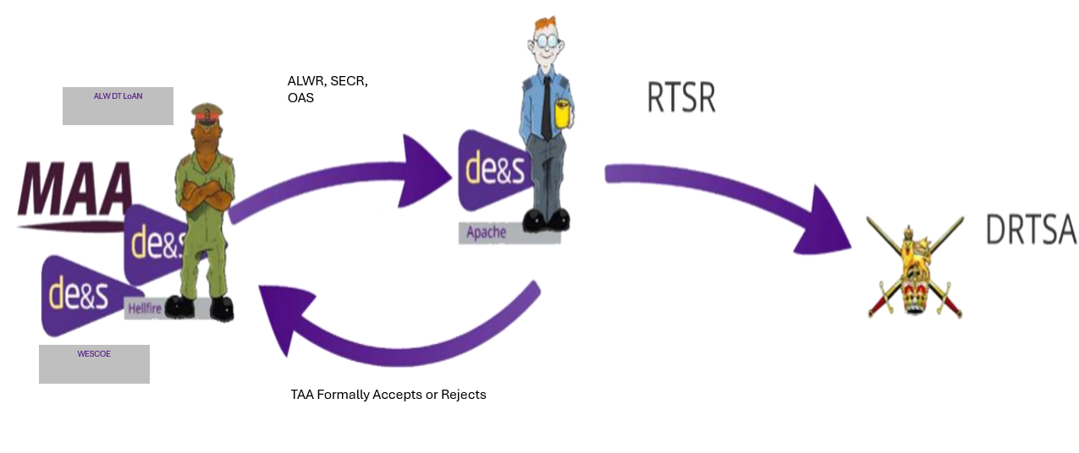
Air-launched Weapon Release
Regulation 1350(1)
The ALW Delivery Team (DT) Letter of Air Safety Notification (LoAN) holder shall authorize all ALWs for Aircraft CR&J for acceptance by the Air System Type Airworthiness Authority (TAA)
Acceptable Means of Compliance 1350(1)
The ALW Release (ALWR) should:
Be provided by the ALW DT LoAN holder and is the body of evidence that supports the SA in the MPTF (Dev) and/or TASA and ASSC. The ALWR should be tailored and proportionate to the complexity of the ALW and the associated hazards.
Encompass CR&J and refer directly to all limitations and clearances required by the SECR and OME Safety Review Panel Assurance Statements (OAS) for the ALW.
ALW DT LoAN ensures applicable ALWR, SECR and OAS is provided to the TAA, informs TAA, ADH/AM(MF) of all emergent hazards or changes, that the ALWR is reviewed at least annually.
TAA ensures SECR and OAS are robust, reflecting Air System operations, recorded and accepted, that the TASA addresses CR&J, ensures RTSR include ALW limitations and clearances.
General
Notes:
RA 1350 - Air Launched Weapon Release
ALW - Air Launched Weapon
CR&J - Carriage, Release & Jettison

Slide 15

Ship Air Release
Acceptable Means of Compliance 1395(1)
Where the requirement for a Ship and Air System to conduct embarked aviation exists, the combination should be authorized through a Ship Air Release (SA-Release)
Regulation 1395(2)
Regulation 1395(3)
The RN RTSA shall review pan-DLOD evidence and if satisfied authorise an SA-Release.
The Ship Platform Authority (PA) and TAA shall jointly prepare the SA-Release Recommendation for each Ship/Air System combination to the satisfaction of the RN RTSA.
Notes:
RA 1395 - Authorization to Permit Embarked Aviation in His Majesty’s / MOD Ships
Putting aircraft on ships and then operating them requires integration of the two complex, independent systems including the management of interactions between the Ship Duty Holder and the Aviation Duty Holder (or accountable person/manager). We need to make sure that the Risk to Life associated with the operating of air systems from ships is understood and everyone knows the boundaries and scope of such operations.
The Ship Air Release is the document that authorises the specific class of ship and air system to be able to conduct embarked operations.
The SAR is an integrated, limitations base document with all associated safety information, operating limits and constraints included and supported by evidence from all the DLoDs.
The SAR Recommendation is an evidence-based argument supporting the SAR prepared to the satisfaction of the RN RTSR and the Ship Air WG and should demonstrate that both the ship and the air system equipment are acceptably safe to conduct embarked aviation

Slide 16
Any Questions?

