Slide 1
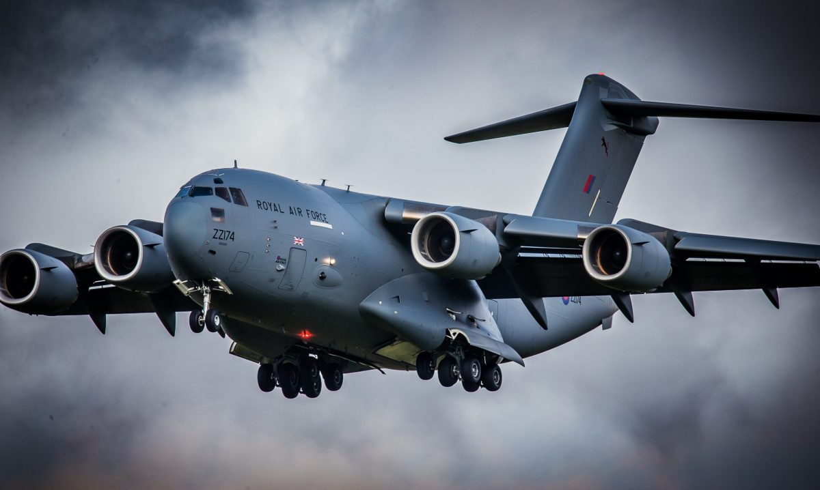
Continuing Airworthiness Management organization
Type Airworthiness Desk Officers’ Foundation Course (TADOF)
Notes:
Has anyone heard of the terms Continuing Airworthiness, CAw Management and CAMO?

Slide 2
Continuing Airworthiness Management organization (CAMO)
Learning Outcome
To provide an understanding of:
The role of the Ministry of Defence (MOD) CAMO
The appointment of an MOD Continuing Airworthiness Management (CAM)
The composition of the Continuing Airworthiness Management Exposition (CAME)
Which RAs are applicable to the management of aircraft maintenance
The responsibilities of a MOD CAMO
Notes:
READ OFF THE SLIDE

Slide 3
Continuing Airworthiness Management
Regulation 1016(2)
DDHs and AM(MF)s shall ensure that tasks associated with Continuing Airworthiness (CAw) of the military registered Air Systems in their AoR are managed by an approved Mil CAMO.
MAA-02
Continuing airworthiness is defined as all the processes ensuring that, at any time in its operating life, an air system complies with the airworthiness requirements in force and is in a condition for safe operation.
RA1016 – Military Continuing Airworthiness Management
MAA-02 – Military Aviation Authority (MAA) Master Glossary
Notes:
So this is all about the ongoing process of ensuring that an aircraft remains in a condition that has been accepted as a safe condition for its operation throughout the Air System service life. Its all about maintaining each aircraft in a state that matches the Type Airworthiness established when the aircraft achieved its MTC and then maintained as the TC develops over time in line with modifications etc.
The activity includes maintaining compliance with applicable airworthiness requirements and ensuring that all maintenance, inspections, and modifications are properly managed and documented.
Continuing Airworthiness Management is governed primarily by the Military Aviation Authority (MAA) and detailed in the Manual of Airworthiness Maintenance – Processes (MAM-P) and the Regulatory Articles (RA) 4000 Series with RA1016 establishing the need for an organisation being stood up to manage the Continuing Airworthiness tasks for military registered Air Systems with the output being to ensure safe operation and compliance with airworthiness standards. This organisation is referred to as the Mil CAMO or Military CAMO or to give its full title the Continuing Airworthiness Management Organisation (CAMO)
So in a little more detail RA1016 is requiring a MIL CAMO be stood up to manage the CAW tasks to ensure that the involved air systems remain in a condition that is safe to operate
What the MilCAMO does for a given platform is captured in the CAME or Continuing Airworthiness Management Exposition (CAME) which is a critical document required for the approval and operation of a Military Continuing Airworthiness Management Organisation (Mil CAMO).
Regulatory Article (RA) 4943, states that the CAME is: A formal document submitted by the Military Continuing Airworthiness Manager (Mil CAM) to the Military Aviation Authority (MAA), detailing the procedures, responsibilities, and scope of work that the Mil CAMO will follow to ensure compliance with the MAA Regulatory Publications (MRP).
We’ll take a look at the management of CAw, the organisation which is formed to undertake this task and the responsibilities paced upon that organisation.
For RPAS you would need to look at RA1600
-------
SO WE HAVE A COUPLE OF THINGS TO SAY HERE –
FROM RA1016 WE HAVE THIS REGULATION 'DDHs and AM(MF)s shall ensure that tasks associated with Continuing Airworthiness(CAw) of the military registered Air Systems in their AoR are managed by an approved Mil CAMO'. OVERALL THE RA IS COMING FROM THE POSITION THAT MAINTAINING THE AIRWORTHINESS OF AN AIR SYSTEM IS A COMPLEX UNDERTAKING THAT REQUIRES CLEAR PROCEDURES AND COMPETENT PERSONNEL TO ACCOMPLISH IT.
SO IF THIS IS CARRIED OUT IN A CORRECT AND APPROPRIATE WAY THE ACTIVITIES OR LACK THEREOF COULD INVALIDATE ALL THOSE ARRANGEMENTS BEEN ESTABLISHED BY THE OEM/DO AND THE DT CAPTURED IN THE AIR SYSTEM SAFETY CASE TO MANAGE THE RISK TO LIFE .
RA1016 OUTLINES THE REQUIREMENT FOR A MAA APPROVED MILITARY CONTINUING AIRWORTHINESS MANAGEMENT ORGANIZATION (MIL CAMO) REQUIRED TO MANAGE ALL CAW TASKS, IN ORDER TO ENSURE THAT MILITARY REGISTERED AIR SYSTEMS WITHIN THEIR AREA OF RESPONSIBILITY (AOR) ARE OPERATED SAFELY AND WITH A VALID MILITARY AIRWORTHINESS REVIEW CERTIFICATE (MARC).
TO NOTE THAT CAw REQUIREMENTS OF RPAS YOU NEED TO REFER TO RA1600
AOR INCLUDES ALL ACTIVE AIR SYSTEMS ON THE MAR IDENTIFIED IN THEIR CONTINUING AIRWORTHINESS MANAGEMENT EXPOSITION (CAME) INCLUSIVE OR AIRCRAFT IN STORAGE OR WITHIN SUSTAINMENT FLEETS

Slide 4
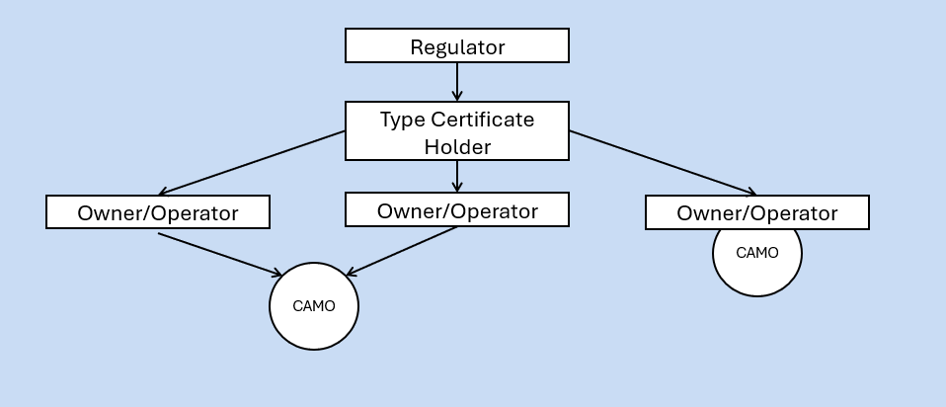
Origin and Role of a Mil Camo – The Civil Model
Notes:
So the need for a CAMO came from Haddon Cave who recommended that an organisation similar to the Civil Construct shown here in this diagram be created to manage the materiel state of the air system.
Prior to Haddon Cave making his recommendations – The IPTs (As was DTs essentially) acted as the CAM, the regulator, the EA and the airworthiness authority. If this was deemed unacceptable i.e. for one organisation to hold all these responsibilities in the civil aviation domain, why is it acceptable in the military?
So what is the Civil model?
SO HERE WE HAVE it, the CIVIL CONTINUING AIRWORTHINESS MANAGEMENT MODEL THAT IS USED ALL OVER THE WORLD.
WE HAVE THE REGULATOR - whos this going to be anyone? - (FAA, EASA ETC)
THEY ESTABLISH REGULATORY STANDARDS, CERTIFY DESIGN ORGANISATIONS THROUGH THE AWARD OF PART 21 A AND SIMILAR FOR MAINTENANCE, REPAIR AND OVERHAUL (MRO) ORGANISATIONS THROUGH THE AWARD OF PART 145,
THEY AWARD TYPE CERTIFICATION OF DESIGN FOLLOWING EXTENSIVE REVIEW OF EVIDENCE AGAINST THE REGULATORY STANDARDS SET,
THEY CONDUCT AUDITS AND INSPECTIONS OF DO'S AND MRO'S, RESPOND TO SAFETY INCIDENTS ETC.
YOU THEN HAVE THE TC HOLDER WHO MUST ENSURE THE DESIGN AND PRODUCTION OF AIRCRAFT AND ITS COMPONENTS MEET ALL APPLICABLE SAFETY AND PERFORMANCE REGULATIONS IN THE 1ST PLACE WHICH INCLUDES MAINTAINING COMPLIANCE THROUGH LIFE.
IN RESPECT TO CAw THE TC HOLDER IS RESPONSIBLE FOR THE CAw OF THE DESIGN WITH INCLUDES ADDRESSING MODIFICATIONS, REPAIRS AND ANY NECESSARY UPDATES TO THE REGULATORY COMPLIANCE AS REQUIRED BY THE AVIATION AUTHORITY.
YOU THEN HAVE THE OWNER OPERATORS WHO ARE PRIMARILY RESPONSIBLE FOR MAINTAINING THEIR AIRCRAFT IN AN AIRWORTHY CONDITION, NOW THEY MAY HAVE THEIR OWN CAMO TO DO THIS OR UTILISE A 3RD PARTY CAMO THAT DEALS WITH MANY DIFFERENT OWNER/OPERATORS OF VARIOUS AIRCRAFT TYPES
SO THERE YOU HAVE IT A TIERED STRUCTURE EMPLOYING DIFFERENT ORGANSATIONAL CONSTRUCTS TO MANAGE THE AIRFRAME TO ACHIEVE TC AND THEN THE MAINTENANCE OF THAT THROUGH LIFE. THIS STRUCTURE CREATES RESPONSIBILITIES AND ACCOUNTABILITIES POLICED BY THE REGULATOR THROUGH THEIR ACTIVITIES OF SETTING OF REQUIREMENTS AND CONDUCTING AUDITS TO ENSURE CONTINUED OPERATIONS TO EXPECTATIONS

Slide 5
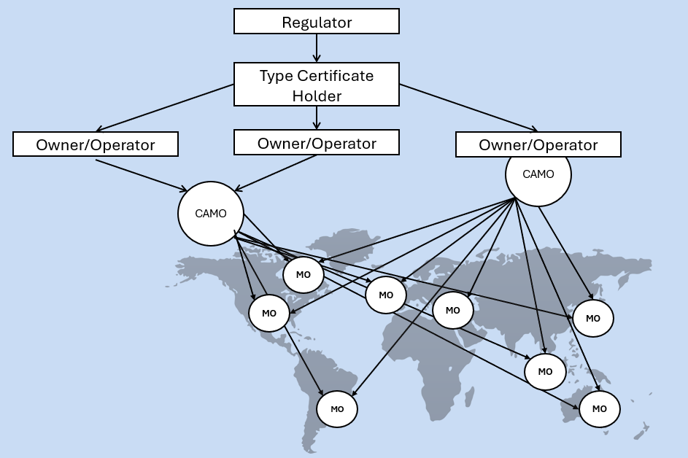
Origin and Role of a Mil Camo – The Civil Model
Notes:
SO WE HAVE THE CIVIL CONTINUING AIRWORTHINESS MANAGEMENT MODEL THAT IS USED ALL OVER THE WORLD. WE HAVE THE REGULATOR (FAA, EASA ETC) WHO ESTABLISH REGULATORY STANDARDS, CERTIFY DESIGN organizationS THROUGH THE AWARD OF PART 21 A AND SIMILAR FOR MAINTENANCE, REPAIR AND OVERHAUL (MRO) organizationS THROUGH THE AWARD OF PART 145, THEY AWARD TYPE CERTIFICATION OF DESIGN FOLLOWING EXTENSIVE REVIEW OF EVIDENCE AGAINST THE REGULATORY STANDARDS SET, THEY CONDUCT AUDITS AND INSPECTIONS OF DO'S AND MRO'S, REPOND TO SAFETY INCIDENTS ETC.
THE CAMO IS AN organization CERTIFIED (PART M) TO MANAGE AND ENSURE THE CAw OF AN AIRCRAFT WHICH INCLUDES OVERSEEING THEIR MAINTENANCE, COMPLIANCE WITH REGULATION AND THE MAANGEMENT OF AIRCRAFT RECORDS THROUGHOUT THEIR LIFE.
YOU THEN HAVE VARIOUS MRO'S THAT ARE FILLED WITH CERTIFIED AIRCRAFT ENGINEERS AND SUITABLE FACILITIES AND EQUIPMENT NECESSARY TO CARRY OUT THE CAMO INSTRUCTIONS.

Slide 6
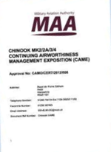
Purpose of the CAME
Regulation RA 4943
[The purpose of the CAME is to] set forth the procedures, means and methods which their Mil CAMO will follow
Regulation 4943(2)
The Mil CAMO shall seek approval for the CAME, and any significant amendments to its contents, from the MAA
RA4943 – Continuing Airworthiness Management Exposition
Notes:
SO WE INTRODUCED THE CAME EARLER. THIS IS THE PRIMARY MEANS BY WHICH THE DDH OR AM SETS FORTH THE PROCEDURES, MEANS AND METHODS WHICH THEIR MILCAMO WILL FOLLOW AND THEREFORE ESTABLISH COMPLIANCE WITH THE MAA REGULATORY PUBLICATIONS.
Q) WHAT DOES ANYBODY THINK THE REPERCUSSION COULD BE OF NOT HAVING A CAME? -
A) WITHOUT AN APPROVED CAME THERE IS A RISK THAT AIR SAFETY COULD BE UNDERMINED AND RISK TO LIFE INCREASED – INCORRECT MAINTENANCE PERFORMED OR NOT PERFORMED AT THE CORRECT TIME / INTERVALS, MANAGEMENT OF TECH INSTRUCTION NOT PERFORMED, MODIFCATIONS MISS MANAGED.
THE NEED FOR A CAME IS PUT INTO REGULSATION WITH RA4943 WHICH MANDATES THE CREATION OF ONE AND GOES ON TO ARTICULATE THE SCOPE OF ALL THE ACTIVITIES DEEMED TO BE WITHIN THE PERIMITER OF THE CAMO INCLUDING PROCESS AND PROCEDURES REQUIRED TO KEEP THE AIRCRAFT OPERATING AS INTENDED BY THE DO AND TAA / TC HOLDER
Interestingly DE&S pays for the maintenance so DS&S effectively controls it ultimately – CAMOs are historically under resourced with tasks normally underwritten by DE&S
SO THE CAME (Continuing Airworthiness Management Exposition ) is QUITE A a critical document required for the approval and operation of a Military Continuing Airworthiness Management Organisation (Mil CAMO).
IT’S A FORMAL DOCUMENT SUBMITTED TO THE MAA BY THE MILCAM AND AS STATED ABOVE DETAILS PROCEDURES, RESPONSIBILITIES, SCOPE OF WORK THAT THE MILCAMO WILL FOLLOW TO ENSURE COMPLIANCE WITH THE MRP. AS SUCH IT IS THE PRIMARY MEANS OF DEMONSTRATING COMPLIANCE TO THE MRP
Q) DO YOU THINK THE MAA NEEDS TO APPROVE THE CAME?
A) YES ALONG WITH ANY SIGNIFICANT AMENDMENTS
Q) WHAT ABOUT MINOR CHANGES?
A) THE MAA NEEDS TO BE NOTIFIED WITHIN 30 DAYS
The CAME must be kept up to date, and personnel must be familiar with the parts relevant to their duties.
Q) WHAT SORT OF SPECIFIC DETAIL DO YOU THINK WOULD BE INCLUDED?
A) Commitment BY THE DDH AM(MF), WHOS TO BE INVOLVED, WHAT SYSTEMS, TYPES, CONFIGURATIONS ARE IN SCOPE, PROCEDURES, LOCATION OF WHERE THE ACTIVITIES ARE TO TAKE PLACE
Scope of work, names and titles of key personnel (Mil CAM, deputies, Quality Manager), and an organizational chart.
Regulatory Article (RA) 4943, the CAME is:
A formal document submitted by the Military Continuing Airworthiness Manager (Mil CAM) to the Military Aviation Authority (MAA), detailing the procedures, responsibilities, and scope of work that the Mil CAMO will follow to ensure compliance with the MAA Regulatory Publications (MRP).service
It is the primary means of demonstrating compliance with the MRP and is mandatory for obtaining and maintaining Mil CAMO approval.

Slide 7
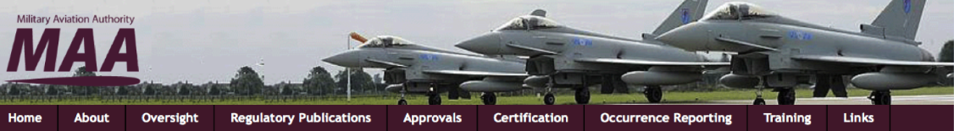
CAMO Specific Regulatory Articles
CAMO SPECIFIC
RA 1011 – Military Continuing Airworthiness Manager Responsibilities
RA 1016 – Military Continuing Airworthiness Management
RA 4900-4956 – Continuing Airworthiness Management organization Regulation
RA 4961-4966 – Continuing Airworthiness
RA 4970-4974 – Airworthiness Review Regulation
RA 1600 Series – Continuing Airworthiness Requirements for RPAS
Notes:
SO WHAT IS THE CAMO BUILT ON?
READ OFF THE SLIDE AND THEN...
SO RA1011 SETS OUT THE REQUIREMENT FOR AIR SYSTEMS TO BE MANAGED BY AN MAA APPROVED CAMO AND IN TURN THE CAMO TO BE MANAGED BY A MIL CAM AS PART OF THE ACTIVITY TO AVOID COMPROMISING THE AIRWORTHINESS OF AN AIRSYSTEM AND THEREFORE ITS AIR SAFETY. THE MIL CAM HAS THE RESPONSIBILITY FOR MANAGING ALL CAw ACTIVITEIS FOR THE MILITARY REGISTERED AIR SYSTEMS OPERATED WITHIN THEIR AOR.
RA1016 - DISCUSSED EARLIER BUT IS ABOUT THE REQUIREMENT TO ESTABLISH A MILCAMO NEEDED TO MANAGE CAw TASKS
RA4900 is a SERIES OF RAs THAT COVERS THE MANAGEMENT OF CONTINUING AIRWORTHINESS ACROSS DEFENCE AIR ALSO REFERRED TO AS THE MRP PART M REGULATION SET
THEN YOU HAVE THE RA1600 FOR PROVIDING REQUIREMENT ON RPAS

Slide 8
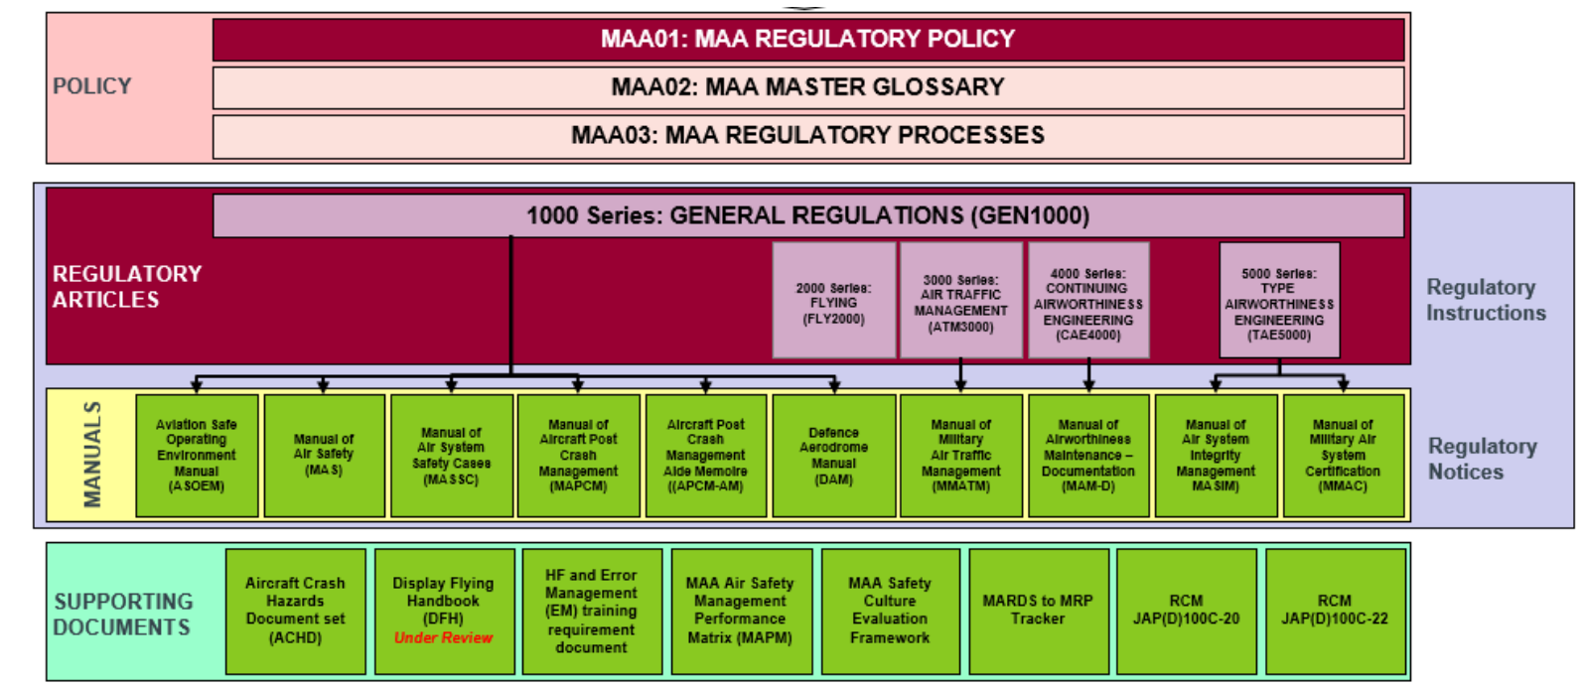
Notes:
SO WHERE DO THESE RA SIT IN THE OVERALL MRP?
SO WE INTRODUCED THIS IN THE MAA AND MRP PRESENTATION EARLIER.
SO WE HAVE THE RA1011 FOR REGULATIONS PERTAINING TO RESPONSIBILITIES OF THE CAM THE RESIDING IN THE GENERAL REGULATIONS HERE (POINT) ALONG WITH THE MANAGEMENT IDENTIFIED IN RA1016
THEN WE HAVE THE RA4900 SERIES HERE SUPPORTED SPECIFICALLY BY THE MAM-D OR MANUAL OF AIRWORTHINESS MAINTENANCE DOCUMENTATION
------
BACKGROUND IF NEEDED - MRP Construct:
SO HERE AT THE TOP WE HAVE THE OVERALL Policy documents
THE MAA01 – Regulatory Policy - THIS IS the capstone document of the UK MOD's Military Aviation Authority (MAA) regulatory framework. It sets out the Director MAA’s overarching policy and provides the foundational principles for how military aviation safety and environmental protection are regulated across Defence aviation activities.
Purpose and Scope of MAA01:
Defines the MAA’s role in regulating UK Defence aviation, assuring safety, and enforcing compliance.
Establishes the legal and policy framework under which the MAA operates.
Serves as the strategic guide for all MAA Regulatory Publications (MRP), including Regulatory Articles (RA) and manuals.
MAA02 – Master Glossary (definition of acronyms) - a foundational document within the UK MOD's Military Aviation Authority regulatory framework. It serves as the authoritative reference for terminology and abbreviations used across the MAA Regulatory Publications (MRP).
Purpose of MAA02 provides:
A single reference source for the definition of Air Safety terms and abbreviations used by the MAA.
A means to ensure consistency and clarity in terminology across all MRP documents, including Regulatory Articles (RA), manuals, and overarching policy documents.
MAA03 – Regulatory processes - the third of the three overarching documents within the UK MOD's Military Aviation Authority Regulatory Publications (MRP). It provides the procedural framework for how the regulated community interacts with the MAA.
Purpose of MAA03 - MAA03 outlines the processes for managing regulatory change, including:
Submitting and ratifying Alternative Acceptable Means of Compliance (AAMC)
Requesting Regulatory Waivers and Exemptions
Managing Requests for Change (RFCs) to the MRP
Applying for MAA Letters of Endorsement
Handling MAA Appeals
Conducting MAA Assurance activities
Regulatory Articles
The MAA Regulatory Articles (RA) are a core component of the UK Ministry of Defence's Military Aviation Authority Regulatory Publications (MRP). They define the mandatory requirements for ensuring safety, airworthiness, and environmental protection across Defence aviation activities.
Regulatory Instruction – 1000, 2000, 3000, 4000 & 5000 Series
Regulatory Notices – in the form of manuals: EG
Manual of Air Safety (MAS)
Manual of Air System Safety Cases (MASSC)
Manual of Air System Integrity Management (MASIM)
Manual of Military Air System Certification (MMAC)
Remote Piloted Air System Manual (RPASM)
Support Documents
Aircraft Crash Hazards Documentation Set (ACHD)
Display Flying Handbook (DFH)
HF and Error Managment training requirement document
MAA Air Safety Management Performance Matrix (MAPM)
MAA Safety Culture Evaluation Framework
Etc...

Slide 9
CAMO Responsibilities
Regulation 4947(1)
ASPIRE Process 13 CAM Support
For all aircraft within its control, the approved CAMO shall:
Develop and control Aircraft Maintenance Programme, support reliability programme, and propose amendments to TAA.
Manage Modifications and repairs.
Ensure Maintenance quality and compliance with Aircraft Maintenance Programme.
Apply all Special Instructions (Technical) (SI(T)).
Ensure MMOs or MRP Part 145 AMOs manage reported or discovered Faults.
Coordinate scheduled Maintenance, SI(T) application, and replacement of service life limited parts.
Manage and archive Continuing Airworthiness records and technical log.
Assure weight and moment statement reflects current Air System status.
Initiate and coordinate actions and follow-up from Occurrence reports.
Notes:
So if your in the CAMO Role these would be your responsibilities
To Develop and control an Aircraft Maintenance Programme, support any applicable reliability programme and propose amendments and additions to the Maintenance schedule to the Type Airworthiness Authority (TAA).
So for the Reliability programme DTs usually get the DO to perform some MSG or RCM analysis where they look at the failure rate data for equipment and work out when things are going to fail, liase with the safety team to understand repercussions and ultimately use this data to support the development of a maintenance schedule – ‘DIT’ about MERLIN….
To Manage the embodiment of Modifications and repairs.
To Ensure that all Maintenance is carried out to the required quality and in accordance with (iaw) the Aircraft Maintenance Programme and correctly released. This could involve DQAFF where necessary
To Ensure that all applicable Special Instructions (Technical) (SI(T)) are applied. – These are developed by the TAA including the necessary timeframes associated to the instructions
To Ensure that Military Maintenance Organizations (MMOs) or MRP Part 145 Approved Maintenance Organizations (AMOs) correctly manage Faults reported, or discovered during scheduled Maintenance. Which effectively is your quality activity again
To Co-ordinate scheduled Maintenance, the application of SI(T) and the replacement of service life limited parts.
To Manage and archive all Continuing Airworthiness records and the operator's technical log.
To Assure that the weight and moment statement reflects the current status of the Air System.
To Initiate and coordinate any necessary actions and follow-up activity highlighted by an Occurrence report.
Key Responsibilities of a Mil CAMO
Airworthiness Oversight:
Ensures all military air systems under its Area of Responsibility (AoR) have a valid Military Airworthiness Review Certificate (MARC) before flight.
Personnel and Competence:
Must appoint a Suitably Qualified and Experienced Person (SQEP) as the Military Continuing Airworthiness Manager (Mil CAM) to oversee CAw activities.
Subcontracting and Control:
While CAw tasks may be subcontracted (e.g., to MOD Delivery Teams or contractors), the Mil CAM retains full responsibility for ensuring these tasks are performed correctly and safely.
Documentation and Assurance:
Must maintain a Continuing Airworthiness Management Exposition (CAME) that outlines procedures, responsibilities, and agreements with other entities performing CAw tasks.
Regulatory Compliance:
Operates under the MRP Part M Subpart G regulations, which detail the structure, personnel requirements, and quality systems necessary for CAMO approval.
Support to Duty Holders:
Works in support of Delivery Duty Holders (DDH) and Accountable Managers (Military Flying) to ensure air systems are maintained in a condition for safe operation.

Slide 10
Sub-Contracting CAMO Responsibilities
Regulation 4956(1)
The Mil CAM shall retain responsibility for all CAw tasks carried out on behalf of the Mil CAMO by other parties.
Acceptable Means of Compliance 4956(1)
Oversight of Subcontracted Tasks
When tasks are performed by external parties on behalf of the Mil CAMO, the Mil CAM must ensure they meet Continuing Airworthiness (CAw) requirements, with appropriate assurance and control measures in place.
Internal Departmental Support (e.g., within MOD Delivery Teams)
Where another department within the same organization is performing tasks which the Mil CAMO is responsible, then the Mil CAM should establish a documented agreement with that department to demonstrate sufficient control of their responsibilities.
Notes:
SO THE MILCAM DOES NOT HAVE TO CARRY OUT THE ACTIVITIS THEMSLEVES DUE TO THE COMPLEXITY OF THE TASKS, CAW CAN BE CARRIED OUT BY OTHER PARTIES SUCH AS CONTRACTORS HOWEVER CONTINUED RESPONSIBILITY, IN FACT ACCOUNTABILITY, IS REQUIRED TO BE RETAINED BY THE MIL CAM REGARDLESS OF WHO PERFORMS THE WORK.
RA4956 IS ABOUT SUBCONTRACTING SUCH MIL CAM TASKS
THE MIL CAM STILL HAS TO ENSURE THE ACTIVITY BEING PERFORMED IS WHAT IS REQUIRED AND MAKE SURE ADEQUATE ASSURANCES AND CONTROL MEASURES ARE IN PLACE. SIMILARLY OTHER DEPARTMENTS SUCH AS THE DT CAN PERFORM TASKS THAT THE MIL CAM IS RESPONSIBLE FOR HOWEVER THE MIL CAM US REQUIRED TO ESTABLISH A DOCUMENTED AGREEMENT TO MAKE SURE ALL PARTIES KNOW WHAT THEY ARE DOING, WHERE THE BOUNDARIES ARE AND THAT THERE ARE CONTROL MEANS IN PLACE TO MANAGE THE RESPONSIBLITIES.
Subcontracting responsibilities within a Military Continuing Airworthiness Management Organisation (Mil CAMO) under the UK MOD is permitted but must be carefully controlled to maintain airworthiness and regulatory compliance.

Slide 11
Sub-Contracting CAMO Responsibilities
Acceptable Means of Compliance 4956(1)
Internal Departmental Support (e.g., within MOD Delivery Teams)
The agreement should :
name the department and the Mil CAMO;
define what responsibilities the department fulfils on behalf of the Mil CAMO and the post title of the person responsible for their deliver;
define the number of and competence of personnel committed;
define procedure by which change to the resourcing of tasks are communicated and agreed;
be referenced in the CAME, and
be endorsed by both parties.
Notes:
Key Principles FOR SUB CONTRACTING INTERNALLY
READ OFF THE SLIDE
1. Responsibility Retention - retains full responsibility for all Continuing Airworthiness (CAw) tasks, even if they are subcontracted.
Subcontracting does not transfer accountability; the Mil CAM must ensure tasks are performed correctly and safely.
2. Use of Mil CAMO Instructions - When subcontracting is necessary due to a lack of Technical Information (TI), Mil CAMO Instructions may be issued to authorize specific work packages.
These instructions must be:
Approved by the Mil CAM (or delegated authority).
Within the bounds of the Air System Safety Case (ASSC).
Shared with other organizations operating the same air system.
Not used to change Type Design or make unauthorized configuration changes.
3. Security Considerations - If subcontracting involves classified material, special procedures apply.
4. Documentation and Oversight - A register of Mil CAMO Instructions must be maintained.
Instructions must include:
Title, scope, safety precautions, compliance timelines.
Follow-up actions and closure mechanisms.
Validity periods must be controlled, and extensions should be minimized.

Slide 12
CAMO Quality
Regulation 4951(1)
The MilCAM shall ensure and independent Quality System and designate a Mil CAMO Quality Manager to monitor compliance with, and the adequacy of procedures required to ensure airworthy Air Systems
The QS shall monitor all Mil CAMO activities. It shall include the following functions, as a minimum:
a. Assurance of personnel Competence.
b. Assurance of all CAMO tasks, processes, orders and procedures.
c. Assurance of CAME compliance with Regulation.
d. Assurance of Alternative Acceptable Means of Compliance, Waivers and Exemption (AWE) submissions and subsequent AWE management.
e. Assurance of Maintenance activity conducted by Maintenance organizations is adequate for maintaining the Continuing Airworthiness of their Air Systems.
f. Assurance of all Contracted Maintenance carried out in accordance with (iaw) the Air System Document Set (ADS).
g. Assurance of continued compliance with the requirements of MAA Approval of the Mil CAMO.
h. Assurance of all Mil CAMO activities being performed iaw RA 4900 - 4974 (MRP Part M).
Regulation 4951(2)
Notes:
SO ACTIVE AS A VITAL ELEMENT OF THE MIL CAMO ACTIVITY IS THE NEED TO HAVE AND EFFECTIVE QUALITY SYSTEM THAT underpins the Continuing Airworthiness of all the Air Systems identified in the Continuing Airworthiness Management Exposition (CAME).
THIS QS HAS TO OPERATE Regardless of who or where Subcontracted Airworthiness tasks are being conducted WITH THE QS NEEDING TO encompass all activities and relevant supporting organizations to ensure the Airworthiness management of its Air Systems is at the required standard.
WHAT WE ARE WANTING TO AVOID IS Unmonitored or unassured activity THAT can lead to a loss of configuration CONTROL OF THE AIR SYSTEM, which could significantly increase the Risk to Life and hence reduce Air Safety.
SO YOU CAN SEE HERE THE ACTIVITIES THAT THE QS IS ESTABLISHED TO MONITOR
READ OFF THE SLIDE
The scope of the Mil CAMO QS will cover all Maintenance activity on Air Systems that the Mil CAMO is responsible for, both on and off platform, including Contracted Depth Maintenance
SO IN THE ESTABLISHING OF THE QS AND THE MANAGEMENT OF THE ASSOCIATED FUNCTIONS IDENTIFIED THE MILCAM SHOULD IDEALLY IDENTIFY A QUALITY MANAGER WHO SHOULD HAVE IN THEMSELVES SUCCESSFULLY COMPLETED ALL RELEVANT SAFETY TRAINING COURSES, HAVE A THOROUGH KNOWELDGE OF THE CAME, BE EXECTED TO INTERFACE WITH THE DDH OR AM(MF) AND MANAGE NON COMPLIANCES AS THEY ARE FOUND INCLUDING BEING RESPONSIBLE FOR THEIR CLOSURE

Slide 13
Airworthiness Review
MAR processes are detailed in Service-specific manuals:
RAF: Air Publication 100B-01
Army: Army Publication 7400
Navy: Book of Reference 767
Regulation 4971(1)
A Mil CAMO shall ensure that:
A Mil Airworthiness Review (Mil AR) of the Air System, together with its Continuing Airworthiness records, is carried out periodically by suitably approved and authorised Mil AR Surveyors.
Mil AR procedures are incorporated into the CAME.
Regulation 4971(2)
On completion of a satisfactory Mil AR, the Mil CAM shall issue a Military Airworthiness Review Certificate (MARC) on behalf of the DDH or AM(MF). Thereafter:
A MARC shall remain valid for a period of 1 year from date of issue but with the potential to be extended or revoked.
MARC validity may be extended for a period not exceeding 90 calendar days; any such extension shall be approved by the Mil CAM.
A Mil CAM shall revoke the MARC if there is reason to believe that the Air System is not airworthy.
Notes:
RA4971 - Military Airworthiness Review and Certification - MRP Part M Subpart I
This is a 10th responsibility for the CAMO
It is effectively an annual MOT of the physical attributes of the platform and the documentation
HADDON CAVE IDENTIFIED A Hole in the process around the assessment of serviceability of the platforms WHICH THE STANDING UP OF THE CAMO WAS A MAJOR PART OF AND AS AN ELEMENT OF THIS THE MILITARY AIRWORTHINESS REVIEW. The MAR was introduced to provide confirmation that the air systems are being adequately maintained in accordance with the ADS and CONFIRM the physical condition of each platform. Not THAT this did NOT used to happen pre HC periodically but was perhaps not as rigid as what is now required through this RA. – DIT……degreaser….!
SO THE Military Airworthiness Review (Mil AR) is a formal process mandated by the UK MOD's Military Aviation Authority (MAA) to ensure that military air systems remain airworthy and compliant with regulatory standards. It is governed primarily by Regulatory Article (RA) 4971 and supported by RA 4973 and RA 4972.
The Mil AR is conducted to:
Revalidate the configuration and airworthiness of air systems on the UK Military Aircraft Register.
Confirm that the air system has been maintained in a controlled environment.
Provide assurance that Continuing Airworthiness can be guaranteed.
Support the issuance of a Military Airworthiness Review Certificate (MARC), which is required for flight.
THE REVIEW Must be conducted at least annually WITH Additional reviews triggered by modifications, repairs, or lack of visibility into maintenance activities WHERE THE NEED ARRISES.
The Military Continuing Airworthiness Manager (Mil CAM) is responsible for ensuring Mil ARs are conducted WHICH FOR THE MOST PART IN THE RAF A SUB CONTRACTING ORGANISATION IS USED WHICH PROVIDE authorized Mil AR Surveyors. THESE ARE LICENCED ENGINEERS WHO ARE HAVE THE ASSOCIATED LICENCES FOR THE AIRCRAFT TO BE REVIEWED NOTING THAT Even when support arrangements are used, the Mil CAM retains full responsibility.
Reviews are recorded using MOD Form 7104 WITH Procedures detailed in the Continuing Airworthiness Management Exposition (CAME).
For aircraft with civil origins, “shadow” reviews may be accepted if they meet MRP Part M Subpart I requirements.
Certificate Validity:
The MARC is valid for 12 months.
Extensions (up to 90 days) may be granted by the Mil CAM but must be justified and documented.
The MARC must be revoked if airworthiness cannot be assured.

Slide 14
Any Questions?

