Slide 1
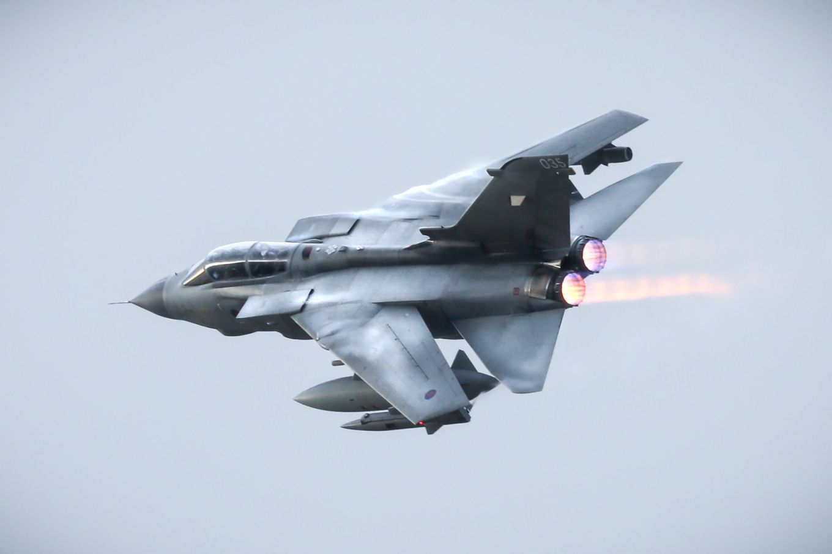
A Day In The Life Example of a Desk Officer (Occ Rep)
Type Airworthiness Desk Officers’ Foundation Course

Slide 2
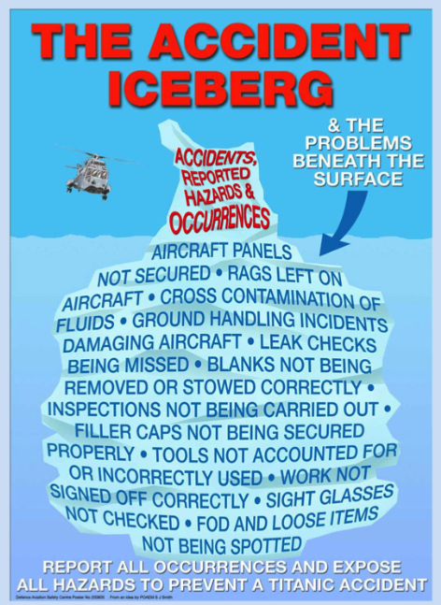
Occurrence Reporting
Occurrence Reporting
Guidance Material 4814(2)
Regulation 1410(1)
The aim of Occurrence report is to identify the factors contributing to incidents and to make the system resistant to similar errors. An Occurrence reporting system will therefore enable and encourage free and frank reporting of any (potentially) safety related Occurrence. This will be facilitated by the establishment of a ‘Just Culture’.
Aviation Duty Holders (ADH), Accountable Managers (Military Flying) (AM(MF)), Accountable Managers (AM), Heads of ADH-Facing Organizations and Heads of AM(MF)-Facing Organizations (AA-Facing Organizations) shall ensure that all Air Safety reportable Occurrences are reported, managed and appropriate action taken.
Notes:
So why do we perform occurrence reporting?
Primary reason? - To prevent accidents, incidents
How does occurrence reporting help this? - Gives us information on failures, interactions with the operators that have led to issues with the use of the equipment – could be linked to human factors, helps us seen any trends forming - example could be EGIs on the c130 that in reporting failures of the units resulting in a reset on the ground the DT could determine that there was a fundamental floor in the design of the unit in still air conditions.
Detail – THe C130 EGI operate on laser ring giro's and it was found in some of the units mainly on the ground doing hot turn arounds that one of the EGis would failure during taxi or standing due to no sensed motion. This rectified by a reset I needing to be performed on the ground. These occurrences were not being reported by each crew initially, masking the issue to the DT. It then happened in the air with both EGI's being lost which nearly resulted in a loss of aircraft.
There is a legal and regulatory obligation under the MAA RA 1410 and the activity promotes a just culture where personnel are encouraged to report safety concerns.
So what can we do with the information provided ? We can investigate the causes of occurrences and what can we do with that information? Modifications to equipment, processes, procedures, training etc.
So accurate and timely Occurrence reporting with effective investigation is fundamental to identifying Air Safety Risks and delivering effective mitigation. Without a simple, robust reporting and management system, that includes investigation and feedback, these events will re-occur, leading to increased Risk to personnel, equipment and the public.

Slide 3
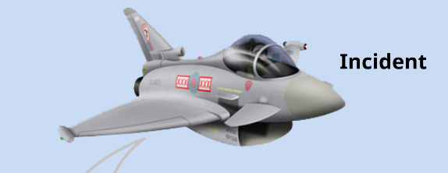

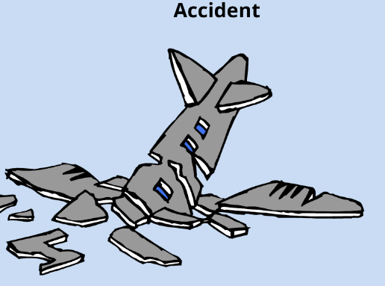
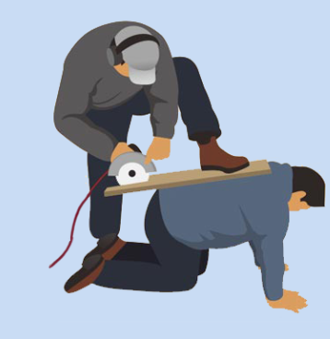
Types of Occurrences
Guidance Material 1410(1)
Hazard
Observation
Notes:
So Air Safety Occurrences fall into one of 3 types: Accidents, Incidents or Hazard Observations.
So what do we think falls into each of these?
Accidents? – simple enough – events causing injury, death or significant damage
Incidents? - Events that could effect safety but have not on this occasion resulted in what constituted an accident, perhaps through luck, effective post hazard controls / mitigations such as effective procedures etc So perhaps on landing there has been a brake fire of an aircraft that was recognised early, the fire team responded rapidly through good communication and training. The fire team were able to extinguish the fire on the effective landing gear with no significant damage beyond the level of the wheel and brake and no one was injured or killed.
Hazard Observations? These are risks that someone going about their normal work identify that have not as yet resulted in an incident or accident. Can anyone think of anything that they may have seen themselves? Most obvious ones are things like cables across the floor (do we have some here?),
To reduce the likelihood of re-Occurrence, all Air Safety Occurrences and failures of Safety controls (including those that originate in areas such as logistics, infrastructure and other support) need to be reported and investigated to a suitable depth in order that Causes are understood and lessons identified, promulgated and appropriate action taken

Slide 4
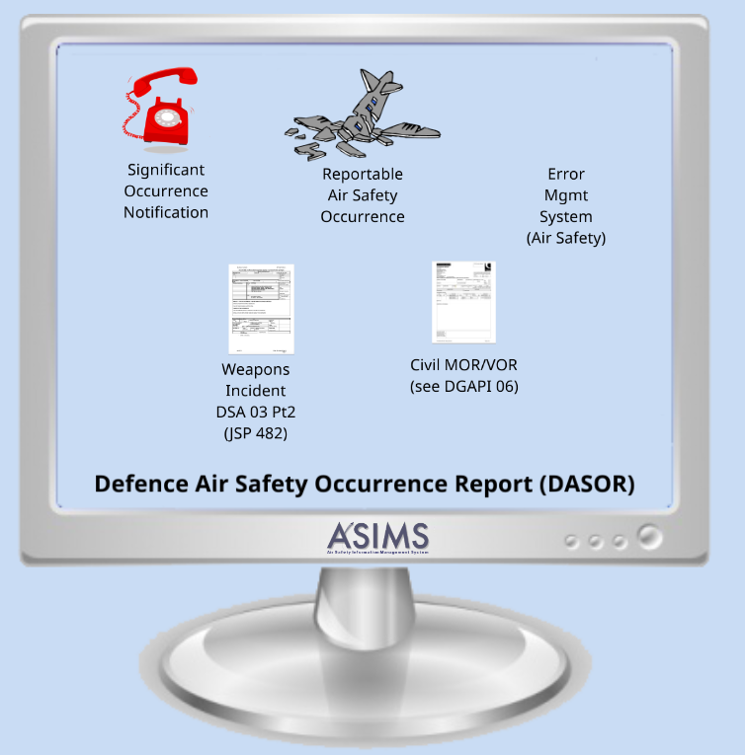
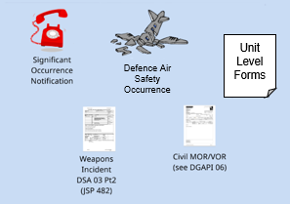
Reporting Types
Guidance Material 1410(1)
Error Management System
(Non Air Safety)
Unit Level Forms
Defence Air Safety Occurrence
Defence Confidential Occurrence Reporting Scheme
Notes:
Timely and accurate Occurrence reporting is required across Defence Aviation to:
a. Notify all relevant agencies of actual and potential Hazards.
b. Identify the Cause and causal factors.
c. Initiate further investigation where appropriate.
d. Highlight recommendations to address identified issue(s). e. Enable data capture and analysis.
Reporting Types.
There are three main Occurrence report types does anyone know what any of them are?
Defence Air Safety Occurrence Report – DASOR
Significant Occurrence Notification - SON
Unit Level Form
So what are these types?
a. Significant Occurrence Notification. - This is a notification that is raised for serious or sensitive incidents especially where senior leadership awareness is required. As such it is essential that a SON is submitted as soon as possible following any applicable reportable Occurrence, and updated as additional information becomes available, so that senior military leadership is notified as quickly and as accurately as possible. Units / Organizations submitting a SON need to ensure their Chain of Command and supporting organizations, such as ADH chain / AM(MF), TAAs etc, are appropriately informed independently of the SON. SONs need to be supported by a linked DASOR, where possible. The format for a SON and the report addressees are available in the SON template held on the MAA websites and accessible through the ASIMS homepage.
Example would be nice....
b. Defence Air Safety Occurrence Report. So this is the standard form used for capturing all occurrences. All Occurrences (including those described in a SON) need to be reported and distributed using a DASOR submitted via ASIMS. Other documents may be referenced where either classification or sensitivity markings mean they are inappropriate for transmission via ASIMS.
Anyone as yet raised on of these? What was it for?
c. Unit Level Forms. Alternative methods for the initial reporting of Hazard Observations may be in use at unit level such as InForms and the Flight Safety Log etc. Nevertheless, all Air Safety related observations need to be recorded via a DASOR.
Other types of reporting include
Civil Occurrence Reporting
Weapons Incident Reporting
Civil Occurrence Reporting. UK Reg (EU) No. 376/2014, is comprised of MORs and Voluntary Occurrence Reports (VOR). The MOD requires DASORs for a wider selection of Occurrences than the civilian MORs and VORs.
The Occurrence Manager needs to select the ASIMS MOR function for all appropriate DASORs (for both civilian MORs and civilian VORs), using the following breakdown:
a. MORs. Occurrences which may represent a significant Risk to aviation Safety, such as Occurrences related to: (1) The operation of the Air System. (2) Technical conditions, Maintenance and Repair of the Air System. (3) Air navigation services and facilities. (4) Aerodromes and ground services.
b. VORs. Occurrences which: (1) May not be captured as a MOR. (2) Are perceived by the reporter as an actual or potential Hazard to aviation Safety
Weapons Incident Reporting DSA 03 Pt 2 (JSP482) - TBD
Occurrence Reports are managed by the Air Safety Information Management System with ADHs, AM(MF)s, AMs, and Heads of ADH-Facing Organizations supporting an ASSC ensuring that:
a. All Air Safety Occurrences are reported, investigated, the results recorded, and any identified actions recorded and closed using the ASIMS as the primary management tool.
b. A Significant Occurrence Notification (SON) is raised following any Accident, or any serious or sensitive Incident utilizing the template held on the MAA websites and accessible through the ASIMS homepage.
c. An ASIMS Occurrence Reporting Structure is maintained and managed.
Defence Confidential Occurrence Report Scheme (DCORS). The DCORS aims to encourage the reporting of such Incidents directly to the appropriate Command Flight Safety Officer (CFSO) or MAA as per the DCORS form. If desired, the author’s anonymity is guaranteed, and names will only be released with appropriate consent. Originators of anonymous Reports will not receive feedback.
All Air Safety Occurrences are reported in the first instance to the MOD in the form of a PDF Defence Air Safety Occurrence Report (DASOR). Subsequent actions, including the following should be completed and uploaded to ASIMS.
Something needing to be said about Error Management System?

Slide 5
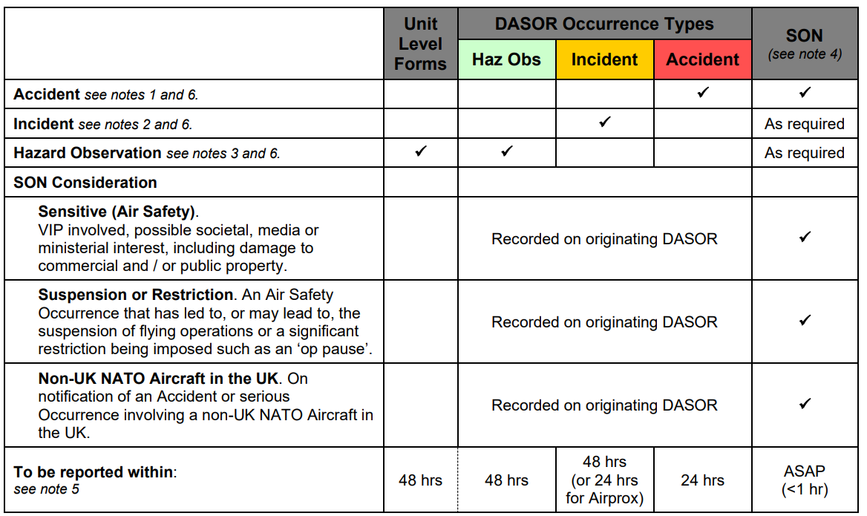
Occurrence Reporting
RA 1410(1)
Annex A
Notes:
So this is a Air Safety Occurrences Reporting Quick Reference Guide from the annex A in RA1410
It essentially helps you know how to report based on the occurrence that has happened.
So an accident is quite straight forward, you raise a DASOR and an SON
For an incident then a DASOR is needed and then a view taken on whether as SON is required. As stated previously if the occurrence has resulted in a serious or sensitive incidents especially where senior leadership awareness is required then you'll need to raise an SON. Something where serious escalation is needed. Any examples of that in the room? Lower down in the table there is further direction specific for the SONs to help you. (read a few elements)
Where a hazard observation is to be raised then a DASOR again needed along with a Unlt level Form which are part of the wider JSP 375.
At the bottom of the table there are the timelines for reporting required depending on the occurrence type. You can see for a SON it is immediate with the DASOR raised within 24hrs.
Notes:
1. Accident
a. A person being killed
b. A person suffering a specified Injury lasting over seven days
c. An Air System sustaining damage or structural failure which adversely affects the structural strength, performance, or flight characteristics of the Aircraft, and would normally require major Repair or replacement of the affected component.
e. An assessment of Air System Repair Category 4 or (including provisional) Category 5
2. Incident. An Air Safety related Occurrence which has not resulted in an Accident but has resulted in any or all of the following conditions:
a. A person receiving a specified Injury lasting seven days or less
b. An event which compromises Air Safety;
c. An assessment of Air System Repair Category 1, 2 or 3 damage.
3. Hazard Observation. A report used to provide information on a specific situation or set of circumstances which did not actually result in an Air Safety Incident but where the potential for an Air Safety Incident to occur in the future was identified.
4. Significant Occurrence Notification (SON). The format and contact details for a SON are detailed within the SON template held on the MAA websites and accessible through the ASIMS homepage.
5. DASOR Reporting Timeline. DASOR reporting timelines refer to the submission and initial distribution of the report by the Occurrence Manager.
6. Remotely Piloted Air System (RPAS). For RPAS investigations see also the appropriate RA in the RA 1600 series.
1. Accident. An Air Safety related Occurrence which has resulted in any or all the following conditions:
a. A person being killed; or,
b. A person suffering a specified Injury lasting over seven days, ►not applicable to injuries from parachuting activity unless they have been classified as Seriously Ill 25 , or Very Seriously Ill 25 .◄ In the event that an Injury severity is not known or confirmed (eg not immediately determinable, awaiting a medical examination, etc) when initially reported (as per the reporting quick reference guide above), then the Injury should be assumed to last for over seven days and be reported accordingly. When the Injury severity is confirmed, the report should be updated accordingly; or,
c. An Air System sustaining damage or structural failure which adversely affects the structural strength, performance, or flight characteristics of the Aircraft, and would normally require major Repair or replacement of the affected component. Except for: engine failure or damage, when the damage is limited to a single engine, (including its cowlings or accessories), to propellers, wing tips, antennas, probes, vanes, tires, brakes, wheels, fairings, panels, landing gear doors, windscreens, the Aircraft skin (such as small dents or puncture holes) or minor damages to main rotor blades, tail rotor blades, landing gear, and those resulting from hail or bird strike, (including holes in the Radome). Derived from International Civil Aviation Organization (ICAO) Annex 13; or,
d. ►◄
e. An assessment of Air System Repair Category 4 or (including provisional) Category 5.
2. Incident. An Air Safety related Occurrence which has not resulted in an Accident but has resulted in any or all of the following conditions:
a. A person receiving a specified Injury lasting seven days or less26 , ►not applicable to injuries from parachuting activity unless they have been classified as Seriously Ill25 , or Very Seriously Ill 25 ◄; or,
b. An event which compromises Air Safety; or,
c. An assessment of Air System Repair Category 1, 2 or 3 damage.
3. Hazard Observation. A report used to provide information on a specific situation or set of circumstances which did not actually result in an Air Safety Incident but where the potential for an Air Safety Incident to occur in the future was identified. Air Safety related Hazard Observations reported on Unit Level Forms need to be transferred to a DASOR.
4. SON. The format and contact details for a SON are detailed within the SON template held on the MAA websites and accessible through the ASIMS homepage.
5. DASOR Reporting Timeline. DASOR reporting timelines refer to the submission and initial distribution of the report by the Occurrence Manager.
6. Remotely Piloted Air System (RPAS). For RPAS investigations see also the appropriate RA in the RA 1600 series.

Slide 6
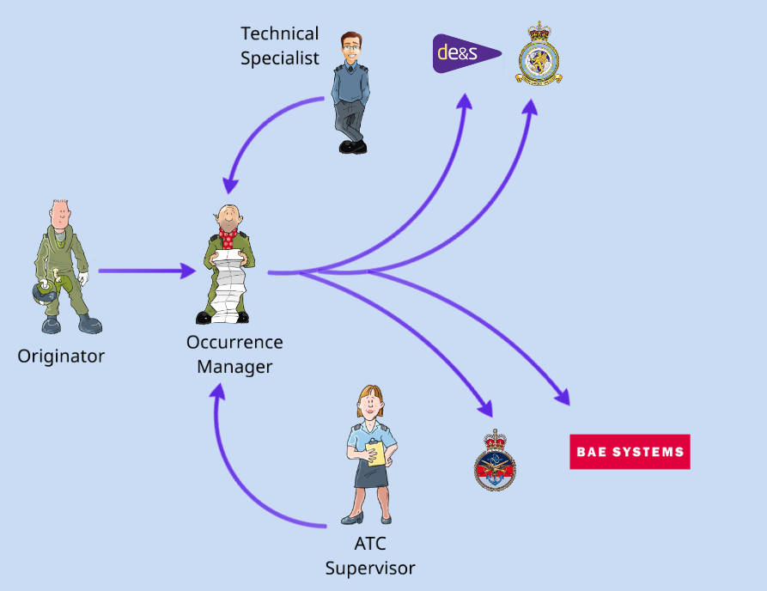
Occurrence Reporting
Notes:
So what is the flow process for reporting?
In terms of the process in reporting –
You have the originator who is reporting the occurrence to the RTSA.
The RTSA may ask for input from technical specialists and an ATC supervisor as required.
The outputs will be to the DT, DO, and the Directors.

Slide 7

DASOR Investigations
Guidance Material 1410(1)
All Air Safety Occurrences must be investigated. The aim of it is to determine what happened, why it happened and provide recommendations to prevent reoccurrence. There are three main types of investigation:
Local Occurrence Investigation
Service Inquiry
Occurrence Safety Investigation
Local Occurrence Investigation
For occurrences that do not require an SI or OSI investigation may be tailored by the local Occurrence Manager to suit the nature of the occurrence
Service Inquiry
Convened by DSA-DG When Mandated by law or policy, or when DSA-DG deems appropriate
Occurrence Safety Investigation
Non-statutory and flexible investigation providing a standard investigation formation within ASIMS
Notes:
An Air Safety Occurrence investigation aims to determine what happened, why it happened and provide formally recorded recommendations or mitigation to prevent recurrence.
There are three main types of investigation:
a. Service Inquiries (SI). When mandated by law or policy, or where DSA-DG deems appropriate, DSA-DG will convene a SI iaw The Armed Forces (Service Inquiry) Regulations 2008 and RA 1420. When DSA-DG deems that a SI is not required, the DSA-DG may direct that an NSI be conducted by the relevant authority (such as the ADH).
b. Occurrence Safety Investigation (OSI). An OSI is a non-statutory and flexible investigation that provides a standard Defence investigation format within ASIMS that can be used to record an investigation into any Air Safety Occurrence. An OSI also provides additional levels of scrutiny through the Occurrence Review Group (ORG).
c. Local Investigation (LI). For Occurrences that do not require a SI or OSI, the depth of the investigation may be tailored by the local Occurrence Manager to suit the nature of the Occurrence

Slide 8
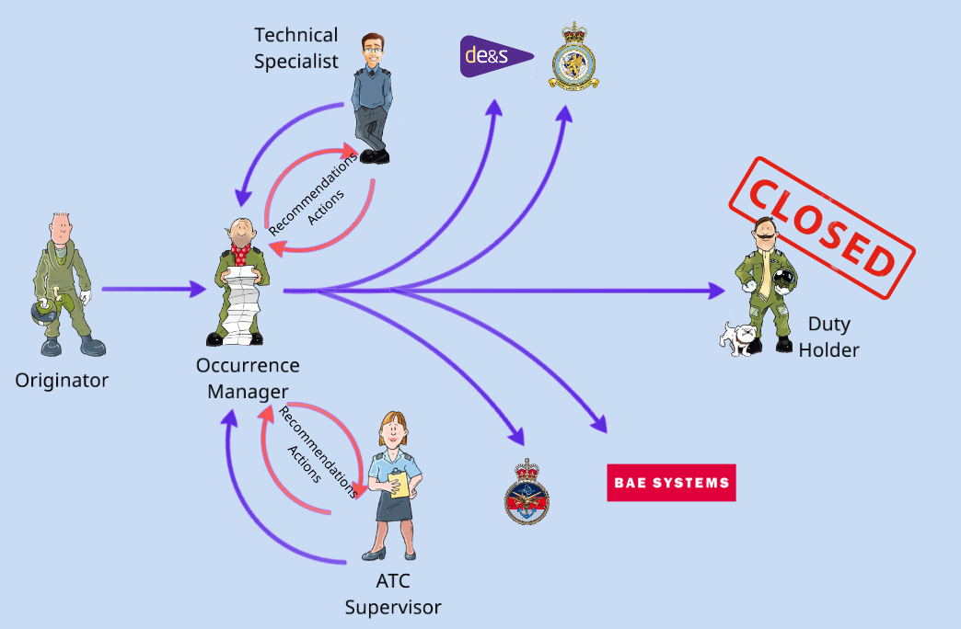
Notes:
As part of the follow on from the investigation, recommendations and actions are dealt with the interfaces by the RTSA (click) who keeps the DT updated with progress and discusses it (click) with the ADH for closure.

Slide 9
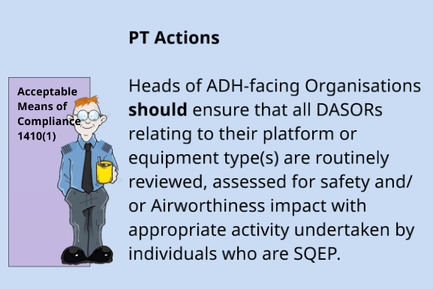
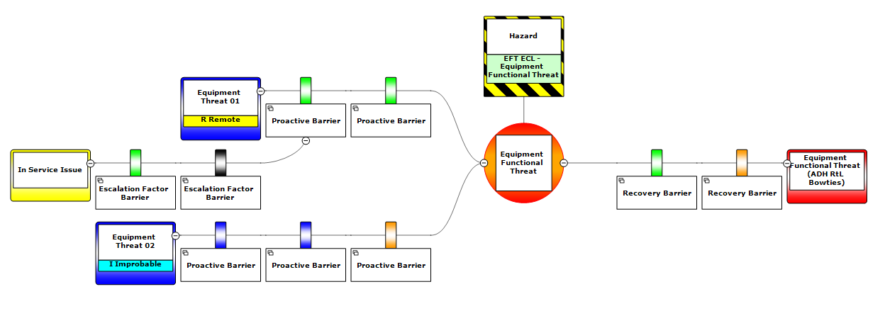
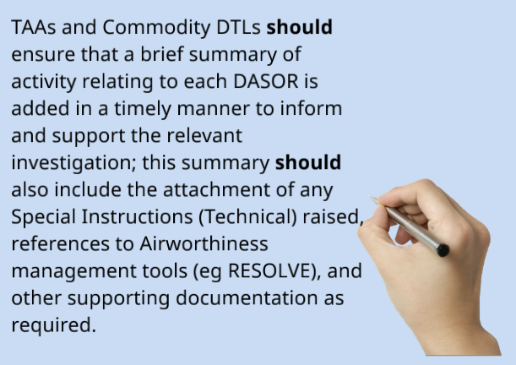
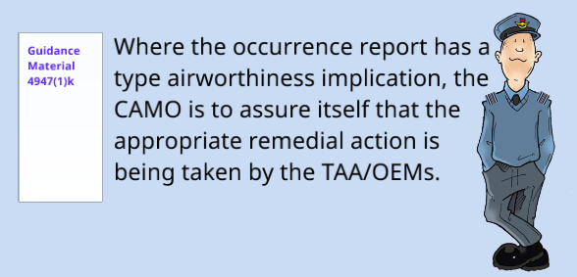
How does this involved the DT?
DT Actions
This activity could include, but is not limited to, actions against the Hazard Log / Equipment Contribution Risk to Life (ECtRtL) Log and Type Airworthiness Safety Assessment (TASA).
Acceptable Means of Compliance 1410(1)

