Slide 1
Equipment Contribution to Risk to Life (ECtRtL) Workshop

Slide 2
Workshop Objective
You are required to determine and communicate the Equipment Contribution to Risk to Life (ECtRtL) by applying ASPIRE Process 17 to the AAR Wing Pod. To help you achieve this:
Determine which EFTs apply to the AAR Wing Pod by considering the EFT taxonomy (see slide 3)
  To help you determine applicability, consider the outputs of the other workshop sessions – identified hazards, including design shortcomings, can be considered Equipment Threats
For each EFT, develop an EFT BowTie using the prepared template on Slide 4
  Identify the Equipment Threats
  Consider what measures are in place supporting each Barrier and stack them under the Barrier (Slide 5 provides examples from the Process 17 Barrier Taxonomy)
  Assign an effectiveness value to each Barrier (apply colour shading to the Barrier) based on your overall assessment of the Barrier in relation to the EFT (Slide 6 provides the Process 17 Barrier Effectiveness Criteria)
  Identify any Escalation Factors (e.g. design shortcomings), tag them to the relevant barrier and include any further barriers to the Escalation Factor (i.e. what is being done about the concern). Remember to assign Barrier effectiveness to these Barriers too.
  Determine the likelihood of each Equipment Threat based on the Barrier picture presented and using the RA120 Likelihood categories provided in Slide 7
  Similarly, assign the likelihood of the EFT based on the BowTie picture presented and using the RA120 Likelihood categories provided in Slide 7

Slide 3
ASPIRE - Equipment Functional Threat (EFT) Taxonomy
1. Flight Control
  1.1. Flying Control
  1.2. Flight indications
  1.3. CofG Control
2. Ground Steering
  2.1. Landing Gear Extension
  2.2. Ground Steering
3. Engine Control
  3.1. Engine Thrust/Power Control
  3.2. Sustained Engine Operation
4. Power (Torque) Distribution
  4.1. Power (Torque) Distribution
5. Ground Deceleration
  5.1. Ground Deceleration
6. Situational Awareness
  6.1. Altitude Indication
  6.2. Heading Indication
  6.3. Aircrew Visibility
  6.4. Location Information
7. Life Support
  7.1. Protection from High G Acceleration
  7.2. Cabin Conditioning
  7.3. Cockpit Environment free from Health & Safety Risks
  7.3. Cockpit Environment free from Substances Hazardous to Health
8. Retention and Release of Stores
  8.1. Safe Loading of Stores
  8.2. Safe Retention of Stores
  8.3. Safe Release of Stores
9. Damage Tolerance
  9.1. Withstand Flight and Ground Loads
  9.2. Retain Rotating Parts
  9.3. Prevent Sources of Ignition
10. Cargo and Handling
  8.1. Safe Loading of Cargo
  8.2. Safe Retention of Cargo
  8.3. Safe Release of Cargo
11. Launch / Recovery Systems
  11.1. Air System Launch System
  11.2. Air System Recovery System
Loss of
Failure of
Erroneous function of
AET Tool 17.C
Notes:
Need to add prefix of:
Loss of / Failure of
Malfunction / Erroneous

Slide 4

EFT: XXX
Hazard
Aircraft OPs
Control
ET
Add example
Design
Maint Schedule
Limitations
Air Crew Pubs
Tech Info
Control
Control
Probability
Control
Consequence
Link to ADH Bow Tie
EFT
Add example
Probability
ET
Add example
Design
Maint Schedule
Limitations
Air Crew Pubs
Tech Info
Probability
Escalation Factor
Notes:
As per slide. Due to time constraints, scope is limited but remember that this is purely a vessel to apply the learned techniques.

Slide 5
EFT: XXX
Hazard
Aircraft OPs
Control
ET
Add example
Design
Maint Schedule
Limitations
Air Crew Pubs
Tech Info
Control
Control
Probability
Control
Consequence
Link to ADH Bow Tie
EFT
Add example
Probability
ET
Add example
Design
Maint Schedule
Limitations
Air Crew Pubs
Tech Info
Probability
Escalation Factor
Notes:
As per slide. Due to time constraints, scope is limited but remember that this is purely a vessel to apply the learned techniques.

Slide 6
Example EFT BowTie

Slide 7
Example EFT: Loss of Sustained Engine Operation
Hazard
Aircraft OPs
ET
MCRI - No fuel flow sensor in Pod
Design
Maint Schedule
Limitations
Air Crew Pubs
Tech Info
Improbable
Isolation Valve
Regular Maintenance
RTS
Air System Doc Set (ADS)
Tech Manual
A/C Fuel Tank Indication
Limitation – only open fuel pod valve prior to and during refuelling
Note: Only an issue if leak present
Pre & Post Flight inspections
Fuel level monitoring
A/C Low Fuel Warning
Expected fuel burn rate
EFT
Loss of Sustained Engine Operation
Consequence
Link to ADH Bow Tie
Note: Fuel tank indication will indicate leak after substantial loss
Improbable
Leak Detection Sensor in Pod
Note: Limitation is the primary method of mitigating a continued fuel pod leak
Escalation Factor:
No means of detecting leak in Pod.
Notes:
As per slide. Due to time constraints, scope is limited but remember that this is purely a vessel to apply the learned techniques.

Slide 8
Barrier Effectiveness Criteria
Barrier | Description
Effective | Barrier is suitable to eliminate/prevent the threat or lessen likelihood/reduce severity of the consequence. Barrier has been tested and proven to work as expected. Barrier owner informed of responsibilities and has provided feedback/ assurance on the status of the barrier. Barrier is supported by documented evidence. There are sufficient resources available to maintain the effectiveness of the barrier.
Adequate | Barrier is suitable to eliminate/prevent the threat or lessen likelihood/reduce severity of the consequence. SME judgement suggests the barrier will work as expected, when needed but there might not be documentary evidence to support the assumption. Description of effectiveness rating in place through SQEP assessment. Barrier has an owner assigned through SQEP assessment. Procedural barriers should always be Adequate at best.
Weak | The barrier is in place and offers some level of control over the threat, but the adequacy and/or ability of the barrier is considered to be sub-optimal. Is the default assessment for purely HF related barriers (eg, “Behavioural” barrier Type) unless there is clear evidence to the contrary.
Inadequate | A mitigation that is in place but does not operate reliably or as expected. Applies especially to technical solutions that do not deliver the intended level of control.
Unknown | The barrier has been included in the BowTie but has not been assessed by a SQEP panel for effectiveness.
Not Present | Applies to any mitigation that is known to exist and is considered appropriate in the subject BowTie. Includes: Not present unfunded (purely aspirational) and Not Present funded (planed for future incorporation).

Slide 9
Likelihood Assessment Criteria
When communicating EFT’s into the ADH the use of the common likelihood assessments from RA1210, reproduced below, should be used. These assessment ratings are assigned to the ET and EFT by using the TE Release risk matrix defined within BowTieServer
Likelihood Assessment Category | Definition
Frequent | Likely to occur at least several times a year
Occasional | Likely to occur one or more times per year
Remote | Likely to occur one or more times in 10 years
Improbable | Unlikely to occur in 10 years

Slide 10
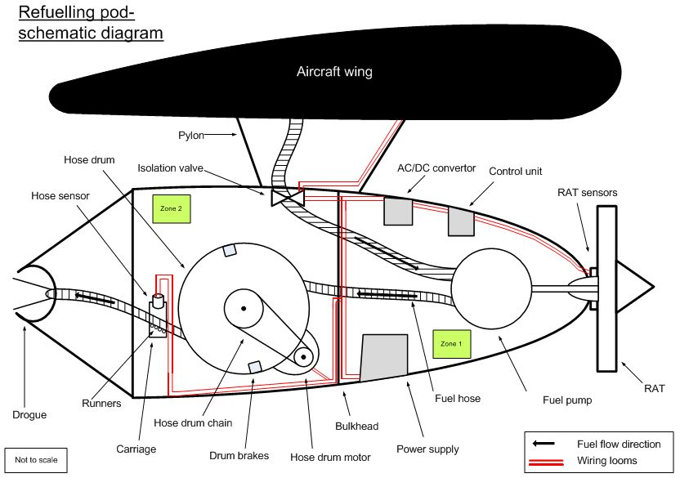
Notes:
Talk through the schematic, highlighting how the pod works:
Isolation valve,
RAT drives pump which draws fuel from the tanks and pumps it through the hose
Aerodynamic drag pulls hose and drogue out, brakes hold position.
Electric motor draws hose back in when finished.

Slide 11
EFT: BowTie Template
Hazard
Aircraft OPs
Control
ET
Add example
Design
Maint Schedule
Limitations
Air Crew Pubs
Tech Info
Control
Probability
Consequence
Link to ADH Bow Tie
Control
Top Event
Loss of situational awareness
Control
Probability
ET
Add example
Design
Maint Schedule
Limitations
Air Crew Pubs
Tech Info
Probability
Escalation Factor
Notes:
As per slide. Due to time constraints, scope is limited but remember that this is purely a vessel to apply the learned techniques.

