Slide 1
Fault Tree Analysis Workshop

Slide 2
Workshop Objective
Aircraft Refuelling Services is the supplier for the Wing Pods and Refuelling solution or the Voyager aircraft. As part of their contract they have been tasked with demonstrating compliance to a Failure Condition identified from the Aircraft Level FHA of ‘Failure to Return Wing Pod to Clean Configuration’.
Voyager has specified the event as HAZARDOUS and therefore in accordance with CS25.1309 it must meet a 1×10⁻⁷ requirement i.e. the design must demonstrate that its probability of occurrence is less than 1×10⁻⁷ pfh. It has been assessed by the aircraft manufacturer that a trailing hose could strike the aircraft (ailerons, flaps act) during landing or takeoff and will be able to severely affect the flying characteristics of the aircraft. Voyager has flowed this requirement onto the subsystem (Wing Pod) designer.
You are part of the ARS Safety Section. A Fault tree has been part developed by a colleague for the current design. Currently the only solution developed by ARS to return the Wing Pod to a Clean Configuration is the rewinding of the Hose back into the Pod.
You are tasked with reviewing the deliverable and identifying errors as well as completing the Fault Tree branches which are currently undeveloped.
Identify up to 4 concerns you would have with the attached initial fault tree of ‘Inability to Rewind Hose’. For each concern record the requested improvement or change you would make to the Fault Tree.
Develop the undeveloped branches of ‘Hose Drum Drive Failure’.
The hose Drum Design consists of; Hose Drum, Geared Motor to drive hose movement, Hose Drum Chain, Power Connection to the Motor, Various Sprockets and Pins.

Slide 3










Top Level Event
Inability to Rewind Hose
(A)
$$2.25×{10}^{−6}$$
Hose Drum Bearing Seizure (B)
Hose Drum Drive Failure
(C)
Hose Drum Brake Stuck On
(D)
Control Unit Failure – Hose unable to rewind
(E)
Power Supply Loom & Connector Failure (F)
Hose Drum Bearing Seize
$$1.85×{10}^{−6}$$
$$2.25×{10}^{−14}$$
Connector Failure
$$6×{10}^{−7}$$
Hose Drum A Brake Stuck
Hose Drum B Brake Stuck
Loss of Tanker a/c Power Supple
Wiring & Loom Failure
$$1.5×{10}^{−7}$$
$$1.5×{10}^{−7}$$
Connector Failure
Tanker Power
Wiring and Loom Fail
$$4.8×{10}^{−7}$$
$$7.3×{10}^{−8}$$
Notes:
As per slide. Due to time constraints, scope is limited but remember that this is purely a vessel to apply the learned techniques.

Slide 4









Top Level Event (A)
Inability to Rewind Hose
$$9.66×{10}^{−5}$$
Hose Drum Bearing Seizure (B)
Hose Drum Brake Stuck On
(D)
Control Unit Failure – Hose unable to rewind (E)
Power Supply Loom & Connector Failure (F)
Hose Drum Drive Failure (C)
Hose Drum Bearing Seize
$$9.0×{10}^{−5}$$
$$6×{10}^{−6}$$
$$6×{10}^{−7}$$
Connector Failure
Loom Failure
Hose Drum A Brake Stuck
Hose Drum B Brake Stuck
Loss of Tanker a/c Power Supple
Wiring Failure
$$1.5×{10}^{−7}$$
$$1.5×{10}^{−7}$$
Tanker Power
Connector Failure
Wiring Fail
Loom Fail
$$4.8×{10}^{−7}$$
$$8.9×{10}^{−5}$$
$$7.3×{10}^{−8}$$
$$8×{10}^{−8}$$
Notes:
As per slide. Due to time constraints, scope is limited but remember that this is purely a vessel to apply the learned techniques.

Slide 5
Hose Drum Drive Failure (C)
Hose Drum
Geared Motor
Hose Drum Chain
Power Connection
Sprockets and Pins
Basic Event
Notes:
As per slide. Due to time constraints, scope is limited but remember that this is purely a vessel to apply the learned techniques.

Slide 6
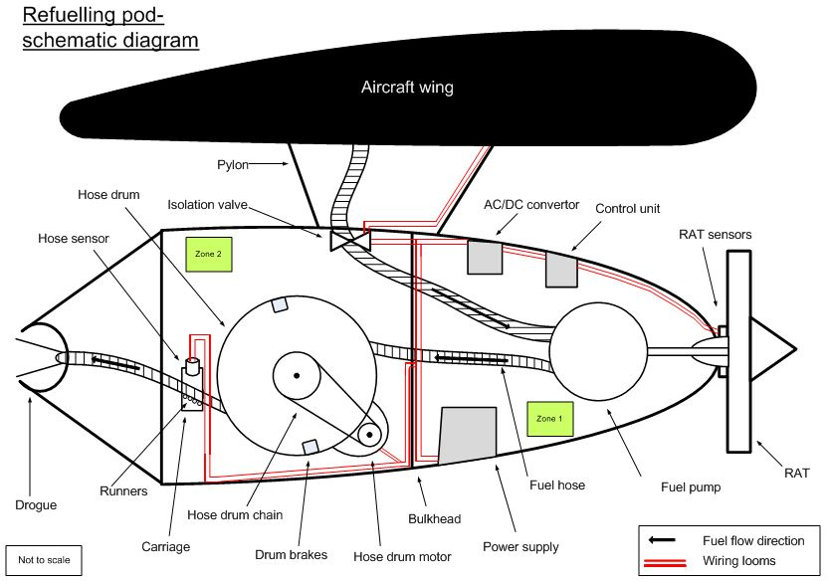
Notes:
Talk through the schematic, highlighting how the pod works:
Isolation valve,
RAT drives pump which draws fuel from the tanks and pumps it through the hose
Aerodynamic drag pulls hose and drogue out, brakes hold position.
Electric motor draws hose back in when finished.

