Slide 1
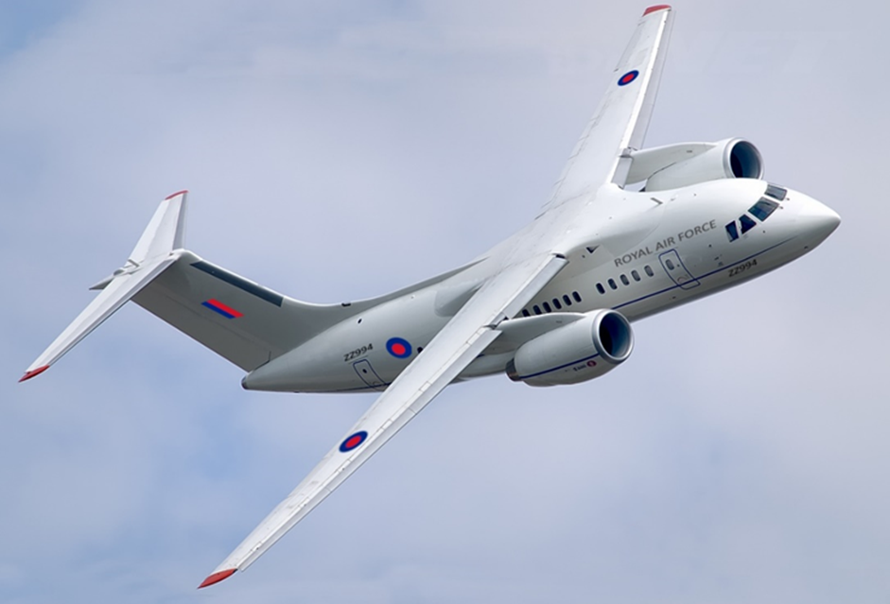
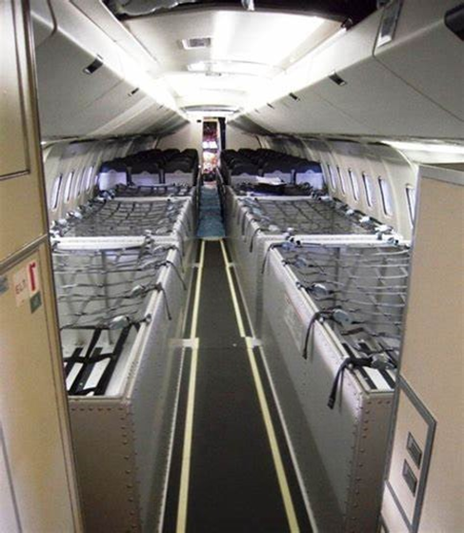
ELoS: C-18 Mk 5 TaK Fit – Brief
Enter your summary of the situation and ELoS argument here.
CS25.815 Width of Aisle
The passenger aisle width at any point between seats must equal or exceed the values in the following table:
Passenger Seating Capacity | Minimum passenger aisle width (cm (Inches))
 | Less than 64 cm (25 inches) from floor | 64cn(25 inches) and more from floor
10 or less | 30(12) | 38(15)
11 to 19 | 30(12) | 51(20)
20 or more | 38(15) | 51(20)
UK25.815a Width of Aisle
Minimum aisle widths shall be increased above the values of CS25.815 if required by the TAA to meet military specific requirements.
Compliance: Compliance should include passengers flying with bulky equipment while seated (eg body armour, weapons/kit etc.)

Slide 2
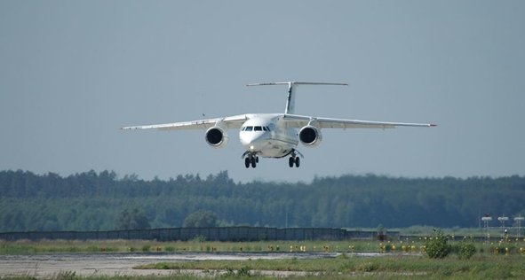
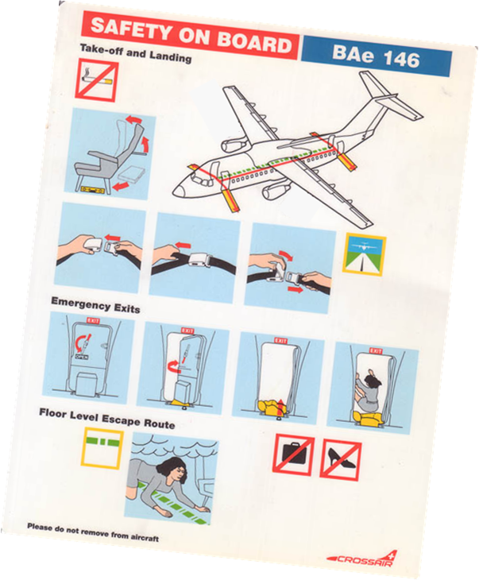
ELoS: C-18 Mk 5 Baggage Container – Assessment
Enter your ELoS Assessment here including a statement on whether you would agree an ESF

