Slide 1
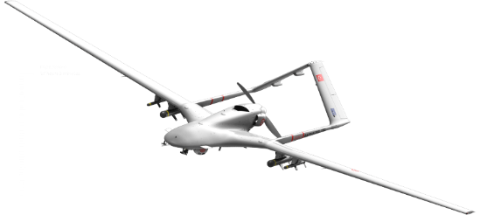
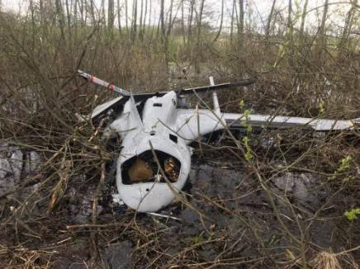
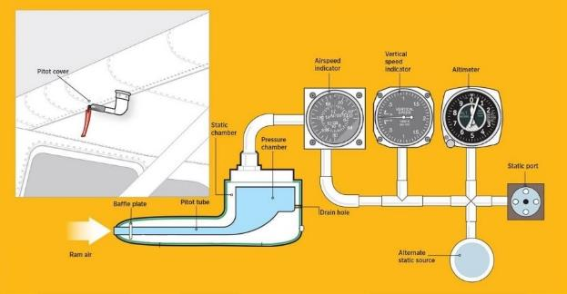
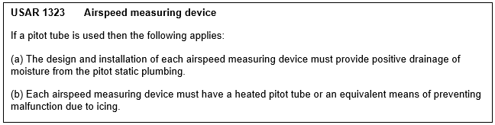
ELoS: Ghost RG Mk 1 RPAS - Brief
Enter your summary of the situation and ELoS argument here.

Slide 2
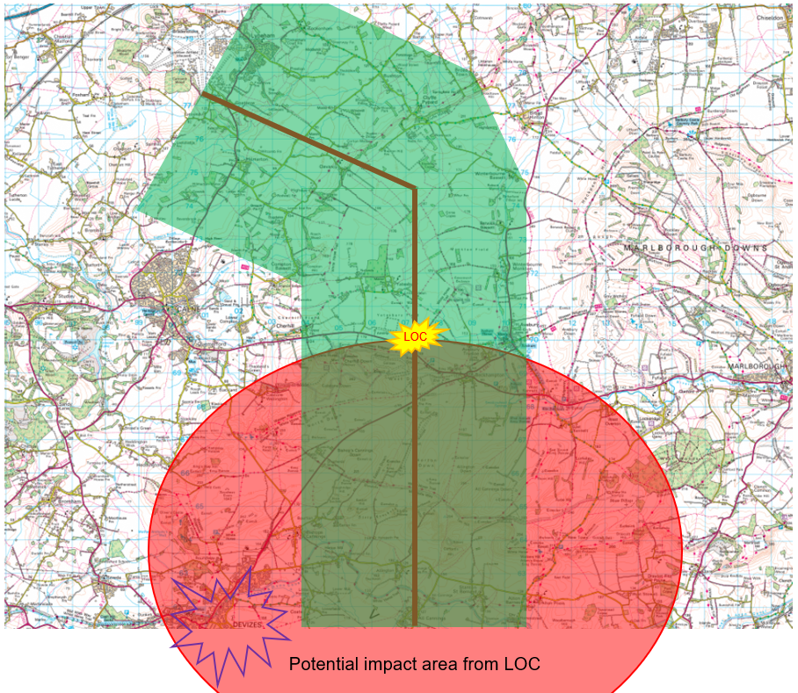
ELoS: Ghost RG Mk 1 RPAS - Assessment
Enter your ELoS Assessment here including a statement on whether you would agree an MSF

