Slide 1
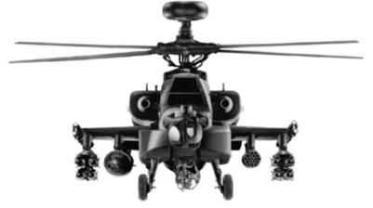
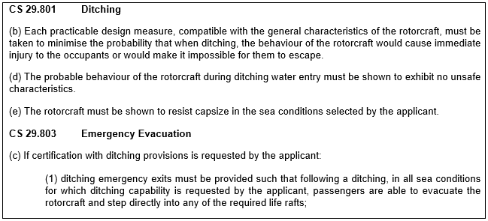


ELoS: AH Mk 2 Helicopter – Brief
Enter your summary of the situation and ELoS argument here.

Slide 2
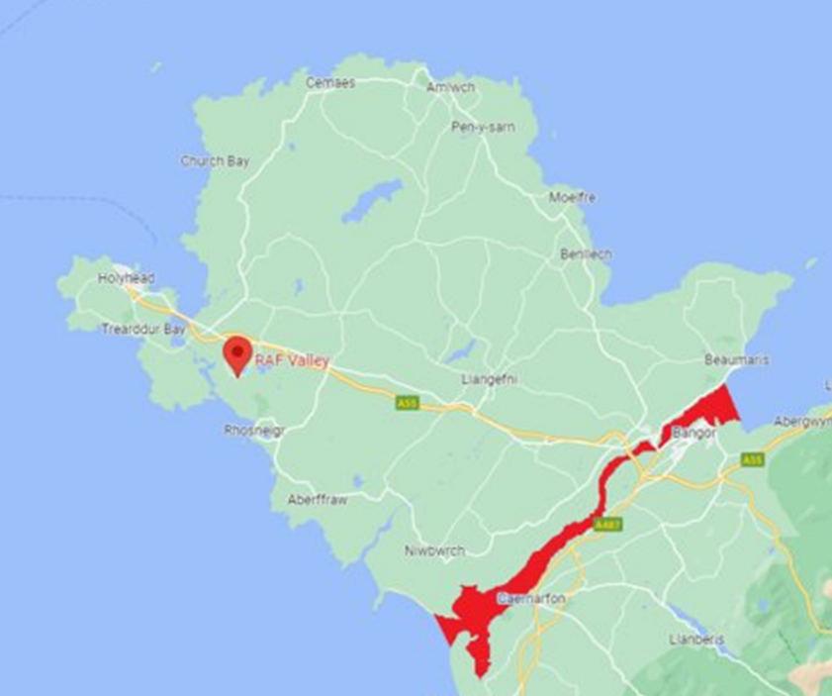
ELoS: AH Mk 2 Helicopter – Brief
Enter your ELoS Assessment here including a statement on whether you would agree an MSF

